Slide 1
Stress Relief “God Is”
Edward Christian Church
August 23, 2015
Genesis 1:1

Slide 2
Stress
Silent, Un-Silent
Still, Un-Still
Small, Un-Small
…Killer
It Kills Relationships:
Family
Work
Church
…it Kills YOU!

Slide 3
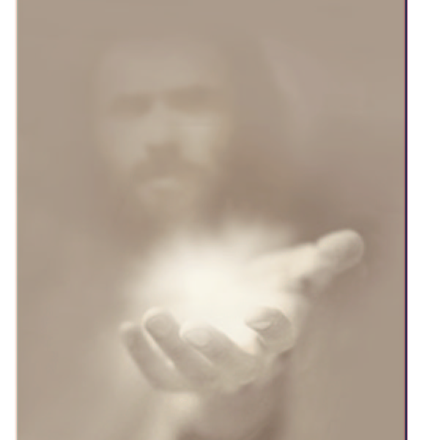
Stress
The World has Many Ways of Dealing with Stress…
But the Greatest is Not of this World!
Easy to Find –He’s Act looking for you
Easy to Incorporate –He wants to be involved
Easy to Implement –let Go! –turn it over to Him
You will find Him between the Covers of the Bible…
…God wastes no time…
Gen 1:1

Slide 4
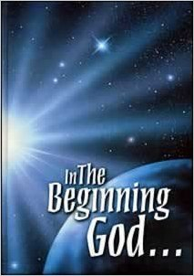
Our God Presented… …Recognize Him
In the Beginning, God
The Fact of God is Never Explained in the Bible.
The Existence of God is Never Argued in the Bible.
The Bible Does Not Try To Teach Against Atheism.
The Bible gives only One Half Of One Verse To Atheism,
"The fool hath said in his heart, There is no God."
God is Simply Presented.
God therefore Must Be Accepted by faith.

Slide 5
Our God Presented… …Recognize Him
The Finite Can Never Prove the Infinite
Job 33:4, "Where were you when I laid the foundation of the earth?”
Psalm 14:1, "The fool hath said in his heart there is no God."
Fool -Nabal= moral perversity. The fool says in his heart, No God.
It is not that he Cannot Believe, he Chooses Not To Believe.
God's Word Calls Them Fools
Romans 1:22, "Professing themselves to be wise, they became fools”
Romans 1:28, "And even as they did not like to retain God in their knowledge, God gave them over to a reprobate mind."

Slide 6
Stress Relief
#1- God Is
Ephesians 3:20 (NLT) ²⁰ Now all glory to God, who is able, through his mighty power at work within us, to accomplish infinitely more than we might ask or think.

Slide 7
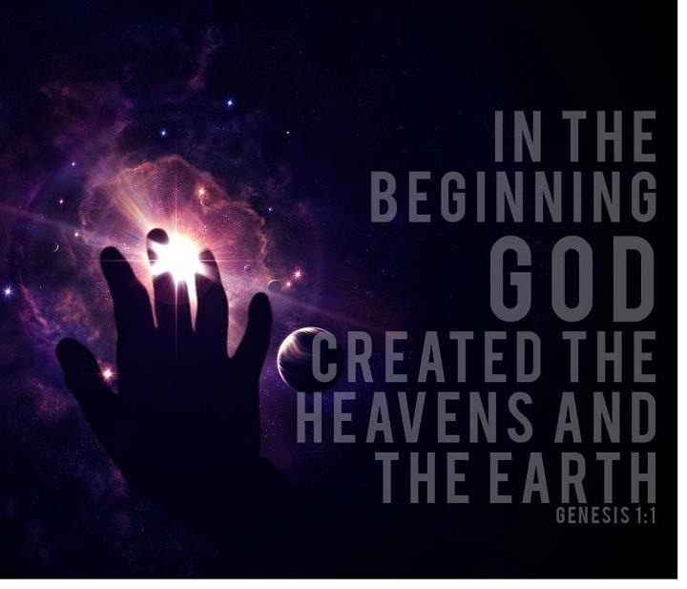
Our God Is Powerful… …Respect Him
"In the beginning God," did what? He created
Only God has Mighty creative power.
Create=bara, means making something out of nothing.
Men can take things that are in existence and rearrange them, but…
…only God can make something out of nothing.
Romans 4:17, "Even God, who quickeneth the dead," who quickeneth the dead—that means, who brings the dead to life—"and calleth those things which be not as though they were."
Plain English, God raises the dead and creates.
What an incredible power is demonstrated.
What a mighty God who created it all.
There are no laws of nature. They're the laws of God that nature must obey.

Slide 8
Isaiah 40:12 (HCSB) ¹² Who has measured the waters in the hollow of his hand or marked off the heavens with the span ⌊of his hand⌋? Who has gathered the dust of the earth in a measure or weighed the mountains in a balance and the hills in the scales?
Isaiah 40:12 (NLT) ¹² Who else has held the oceans in his hand? Who has measured off the heavens with his fingers? Who else knows the weight of the earth or has weighed the mountains and hills on a scale?

Slide 10
Stress Relief
#1- God Is
#2- God Is Able
Ephesians 3:20 (NLT) ²⁰ Now all glory to God, who is able, through his mighty power at work within us, to accomplish infinitely more than we might ask or think. 2 Cor 9:8 And God is able to bless you abundantly, so that in all things at all times, having all that you need, you will abound in every good work

Slide 11
Our God Is Purposeful… …Reverence Him
Why did God create the heavens and the earth? 3 Reasons.
#1- God did it for His Pleasure. Rev 4:11, "Thou art worthy, oh Lord, to receive glory and honor and power, for thou hast created all things and for thy pleasure they are and were created." God rejoiced in His creation
#2- He created it all for His Praise. Ro 11:36 says, "For of him and through him and to him are all things to whom be glory forever." All things have come from Him, all things operate through Him, all things are returning back to Him, then give Him glory, amen?
Ps 150:6, "Let everything that hath breath praise the Lord."
#3- God did it for His People.
man needed a home.
God is next going to create man and God wants man to have a place to dwell.
Ps 84:11, "For the Lord thy God is a sun and a shield." "The Lord will give grace and glory." I love this next part. "No good thing will he withhold from them that walk uprightly."

Slide 12
Stress Relief
#1- God Is
#2- God Is Able
#3- God Is More Than Enough
Ephesians 3:20 (NLT) ²⁰ Now all glory to God, who is able, through his mighty power at work within us, to accomplish infinitely more than we might ask or think

Slide 13
Our God Is Personal… …Receive Him
God is a…
Real Person. God is spirit, but He is a person….someone with emotion and, intelligence and will.
Revealed Person -"In the beginning God created the heavens and the earth,"
Elohim—El in the Hebrew, it's a compound name.
El= power, incredible power
Allah= to keep a covenant, to keep a promise, to keep one's word.
Elohim is a plural noun= Trinity
John 1:1, "In the beginning was the word and the word was with God and the word was God and all things were made by Him and without Him was not anything made that was made." He is the Elohim. Jesus is our mighty God

Slide 14
Our God Is Personal… …Receive Him
He is a…
Real Person
Revealed Person
Redeeming Person.
Genesis 1:1 tells of God's wonderful creation, but in
Genesis 3 Sin came and this first creation
He made His first creation, rested, but now He's gone back to work.
And Jesus said, "My heavenly Father works and I work and I must work the works of him that sent me.“
2 Corinthians 5:17, "Therefore, if any man be in Christ Jesus, He is a new creation,"

Slide 15
Stress Relief
#1- God Is
#2- God Is Able
#3- God Is More Than Enough
#4- God Is…
Here
Now
Waiting

Slide 17
Our God Is Powerful… …Respect Him
When you look at all that God has made, what you see is intelligent design and purpose. In a philosophy class there was only one answer on the page, one question, rather, in the class. A one-word question: Why? The students wrote furiously, but one man answered with one word. Because, because. But why? Why did God do it? Why did God create the heavens and the earth? I want to give you three reasons.
Number one, God did it for His pleasure. Revelation 4:11, "Thou art worthy, oh Lord, to receive glory and honor and power, for thou hast created all things and for thy pleasure they are and were created." God did it for His pleasure. That's one reason He did it. God rejoiced in His creation. He did it for His pleasure, we don't have to guess about it.
I'll tell you another reason that God did it. God did it—He created it all for His praise. When you look at the handiwork of God, then you want to praise God like you would praise anyone for his or her handiwork. Romans 11:36 says, "For of him and through him and to him are all things to whom be glory forever." All things have come from Him, all things operate through Him, all things are returning back to Him, then give Him glory, amen? To whom be glory. God did it for His praise. And that's the reason Psalm 150:6, says, "Let everything that hath breath praise the Lord." The trees lift their leafy branches and praise Him. The flowers unfold their petals and praise Him. The birds fly through the skies and praise Him and the stars nestle in the bosom of the heavens and praise Him and Niagara rolls and rolls and rolls and says, Praise God, praise God.
God did it for His pleasure, God did it for His praise, and God did it for His people. God made these things for us. You see, man needed a home. God is next going to create man and God wants man to have a place to dwell and so God made a good creation, and so after God created it all, God said, That is good. If you don't learn anything else about our mighty God, learn that God is good and you ought to be glad that He is. God is a good God and He's good all the time and don't you ever let the devil get you to thinking negatively about God, questioning God, and thinking perhaps that God is not a loving, kind, beneficent God.
Let me give you some verses. Psalm 37:4, "Delight thyself also in the Lord and he shall give thee the desires of thine heart." For example, Psalm 84:11, "For the Lord thy God is a sun and a shield." Ha ha, "The Lord will give grace and glory." I love this next part. "No good thing will he withhold from them that walk uprightly." And then 1 Timothy 6:17, "Charge them that are rich in this world that they be not high-minded nor trust in uncertain riches, but in the living God who giveth us richly all things to enjoy." Do you think God is a cosmic killjoy? No, why did God make it all? God made it for His pleasure, God made it for His praise, God made it for His people, who gives us richly all things to enjoy. Our God is strategically purposeful. Reverence Him.

Slide 18
Our God Is Personal… …Receive Him
Now, because of this, because of this, that God is a, is a real person, now watch, God is also a revealed person. You could not know God unless He revealed Himself to you. Put in your margin Romans 1:19, "Because that which may be known of God is manifest in them for God has shown it unto them, for the invisible things of him from the creation of the world are clearly seen, being understood by the things that are made, even His eternal power and God-head, so they are without excuse." Do you know what he's saying? Unbelief is inexcusable, inexcusable. I mean, what do you see in Genesis 1:1? God's eternal power and God-head, so that they are without excuse. God has revealed Himself. There are no natural-born atheists. No! If a person is an atheist, he has to learn to be an atheist, he has to be taught to be an atheist.

