Slide 2
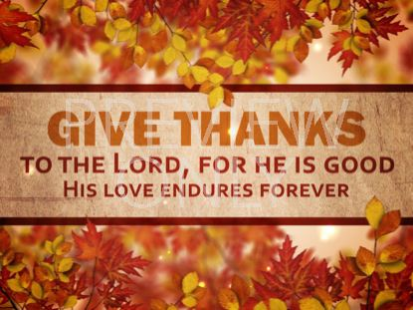
Thanksgiving Perspective
Acts 16:25
Edward Church
November 29, 2015

Slide 3
Today’s Challenges
Powerful / Unique
Without God We Are:
Overwhelmed / Overcome
With God We Are:
Not Overwhelmed but Overcomers…
Paul and Silas
Overwhelmed (cast down- bound)
Not Overcome (unshakeable)
They Knew the Powerful Force of
Thanks-Living!

Slide 4
Thanks-Living
There are Different Levels of Thanksgiving
Act (thanksgiving)
After Receipt
Momentary
Polite
Attitude (thanks-living)
Receipt Unnecessary- (Position)
Continual
Produces
Faith
Praise
Power

Slide 5
Thanks-Living is Attractive (25)
Praises(celebrate w/ praise / thanksgiving unto God)
To God – it Gets His Attention –God Heard
God is Always Listening
Does He Like What He Hears?
To the World –it Gets Their Attention
Prisoners Heard (to hear w- expectation/ joy)

Slide 6
Thanks-Living is Active (26-34)
It Moves the Heart of God…
…Then it Moves the Hand of God (Earthquake/ Chains)
Key to Miracles..
Seeking His Heart 1st
Then His Hand
10 Lepers

Slide 7
Thanks-Living is Active (26-34)
It Moves the Heart of Man…
…Moving the Hand of Man –started series of events
1st- Prisoners Stayed in Cells…
Witnessed Genuine Move of God
Expectation –what’s happening next?

Slide 8
Thanks-Living is Active (26-34)
It Moves the Heart of Man…
…Moving the Hand of Man –started series of events
2nd- Jailor Saved:
1st Phy Death- “Suicide”
2nd Spt Death- “Salvation”
3rd- Jailor Brought Them Out and Up…
…into His Home Ministered to Them
4th- Jailor’s Family Saved…
…Thanksgiving has a Ripple Effect

Slide 9
Thanks-Living is the Answer
Everything Else was Powerless to Deliver
Cast Down - Bound
Thanksgiving was Liberated and Liberating!
When You Have Nothing Else to Give…Give Thanks!
Can’t Bargain Way Out
Complain Way Out
Scheme Way Out
Offer Thanks-Living to the Lord…

Slide 10
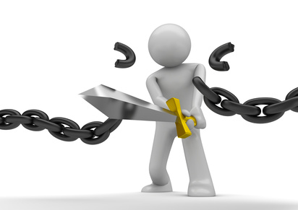
Thanks-Living is the Answer
Offer Thanks-Living to the Lord…
…Watch the Chains Fall

