Slide 3
Christmas Out of the BOX
Dealing with Loss at Christmas
II Samuel 12:22
Edward Church
Dec 20, 2015

Slide 4
Dealing with Loss at Christmas
But this Joyous Time of Year has become a Hurtful Time of Year for So Many …
Circumstances…Losses…
Seem To Have Overshadowed….
Crowded Out The Joy
Keeps You Out Of The Box
How Did David Deal With His Grief
…After His Loss?
He Did Three Things

Slide 5
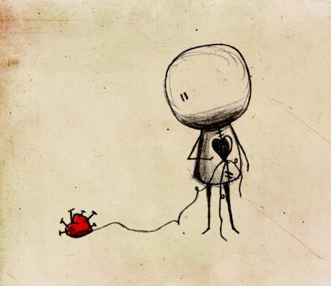
1st- He ACCEPTED What He Could Not Change
22 And he said, "While the child was alive, I fasted and wept; for I said, ’Who can tell whether the Lord will be gracious to me, that the child may live?’ 23 But now he is dead; why should I fast? Can I bring him back again? I shall go to him, but he shall not return to me." -2 Samuel 12:22-23 (NKJV)
Many are STUCK in Pain…
…Pull of Past
…Paralyzed by Present
Robs Your
Peace
Power
Amazing the Freedom…
…When We Accept This

Slide 6
2nd- He FOCUSED On What was Left Not What was Lost
Then David comforted Bathsheba his wife, and went in to her and lay with her. So she bore a son, and he called his name Solomon - 2 Samuel 12:24 (NKJV)
It’s OK to Look Back to Yesterday…
But Not Dwell “On It” or “In It”

Slide 7
2nd- He FOCUSED On What was Left Not What was Lost
Then David comforted Bathsheba his wife, and went in to her and lay with her. So she bore a son, and he called his name Solomon - 2 Samuel 12:24 (NKJV)
Mis-Directed Focus Brings…
Pain
Questions “Why…?”
Pull
Re-Directed Focus Brings…
Healing
Answers “Why Not…!”
Push

Slide 8
2nd- He FOCUSED On What was Left Not What was Lost
Then David comforted Bathsheba his wife, and went in to her and lay with her. So she bore a son, and he called his name Solomon - 2 Samuel 12:24 (NKJV)
It’s OK to Look Back to Yesterday…
But Not Dwell “On It” or “In It”
The Baby was Gone…
“He can’t come to me but I can Go to Him”
Bathsheba was Still There
Reality CHECK

Slide 9
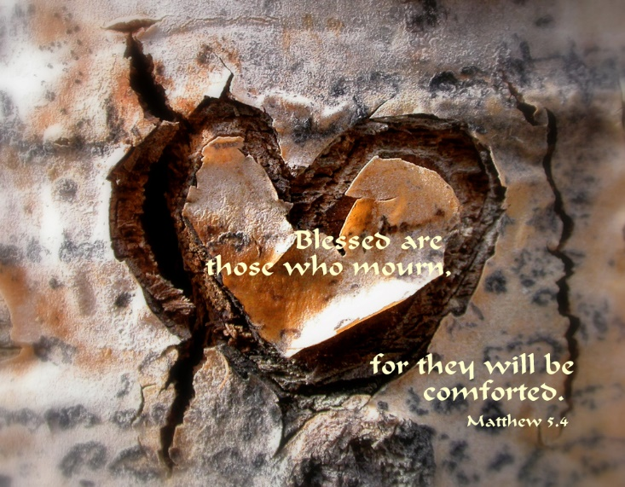
3rd- He TURNED to God
Then David arose from the earth, and washed, and anointed himself, and changed his apparel, and came into the house of the LORD, and worshipped: then he came to his own house; and when he required, they set bread before him, and he did eat. -II Sam 12:20
He Got Up -from where he was
He Cleansed Himself- physically and spiritually
He Put On Clean Clothes –changed his attitude
Then He Went to Church –went to hear from God Again
He Worshipped His God in whom he had learn to trust

Slide 10
Comforted (to console - to breathe strongly) 24
Comforted (to console - to breathe strongly)
David was a type of Christ - the Anointed One = HG Comfort
2 Cor 1:4-NLT - He comforts us in all our troubles so that we can comfort others. When they are troubled, we will be able to give them the same comfort God has given us.
Conceived - Solomon born
Solomon (shelo-mo -peaceful -fr. Shalom…
…peace, Safety, well, happy, prosper)
…..It Will Rain Again -
God Has Not Forgotten You!
He Is At Work Even Now!

Slide 11
Let this Year be a Year of…
Hope
Healing
Happiness
Isaiah 9:6 ⁶ For unto us a child is born, unto us a son is given:
and the government shall be upon his shoulder:
and his name shall be called Wonderful, Counsellor,
The mighty God, The everlasting Father,
The Prince of Peace.

Slide 13
In II Sam 12 we see king David was grieving like many of us today, because he lost someone he loved. He grieved, he cried, his heart was broken. He did what I suggest we all do today:
He got up -from where he was
He cleansed himself- physically and spiritually
He put on clean clothes –changed his attitude
Then he went to church –went to hear from God Again +Fellowship w- His People
He worshipped his God in whom he had learn to trust through out all his years. David said, "I know that my son can not come back to be with me here, But One day I will go to be with him." He knew that God, one day would work it all things

Slide 14
