Slide 2
10 Things Not to Worry About in 2016
10- The Bible will Still Have The Answers
9- Prayer will Still Work
8- The Holy Spirit will Still Move
7- God will Still Inhabit the Praises of His people
6- God’s Church will Not Cease
5- There will Still be Power in Praise
4- God will Still Pour Out Blessings Upon His People
3- There will Still be Room At The Cross
2- Jesus will Still Love You
1- Jesus will Still Save The Lost

Slide 3
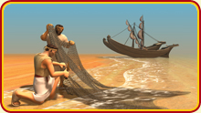
Nowhere Man
Luke 5
Edward Church
Jan 3, 2016

Slide 4
“Nowhere Man”
Luke 5:5 (KJV) “And Simon answering said unto him, Master, we have toiled all the night, and have taken nothing: nevertheless at thy word I will let down the net”
Possum Track Talk – “Got Nowhere”
Peter was a “Nowhere Man”

Slide 5
Custom
The Usual Way
Calm
At Night – little distractions
Calculated -Careful
Follow Shore Line
Consumed
Toiled All Night
Cleaning Nets
Nowhere

Slide 6
Nowhere Man Nowhere Plan
He was Preparing to Quit….
Process
Requires Stressful Effort
Careful Examination
Complete Cleaning
Constant Mending
Preparation
for Storage
Pause
No Plan of Fishing for a While
Necessary for Season of Restoration
Deadly If Done Too Long

Slide 7
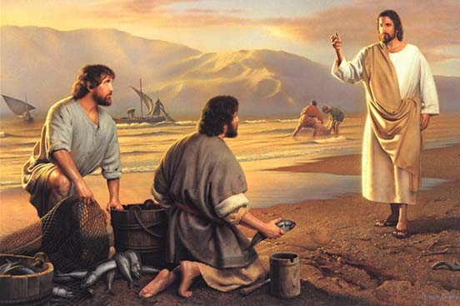
The Somewhere Man
The Chance
Not an Accident
Jesus Came to Him On…
Purpose
Time
Target

Slide 8
The Somewhere Man Somewhere Plan
The Challenge
Deep
Not Easy
Required Great Effort
Tremendous Risk Involved
At Day
Forced to Deal with Heat
Extreme Obstacles
Work with Others

Slide 9
The Somewhere Man Somewhere Plan
Get Beyond Natural (simple..easy)…
Avoid Shallow Spiritual Living
Psalm 42:7, “deep calleth unto deep..”
Instead of Backing Down…
…Time to Step Up

Slide 10
The Somewhere Man Somewhere Plan
Get Beyond Natural to Supernatural
Supernatural…
Challenge (5) -He followed God’s Word not his own
Catch (6) -once empty…now busting at seams
Co-Operation (7) -can’t do it alone
Change (8-11) -His Inlook, Uplook, Outlook
This was Only the Beginning…
…He’s Now a Some Where Man

Slide 12
The Somewhere Man Somewhere Plan
Luke 5:5- nevertheless at thy word I will let down the net. ⁶ And when they had this done, they inclosed a great multitude of fishes: and their net brake.⁷ And they beckoned unto their partners, which were in the other ship, that they should come and help them. And they came, and filled both the ships, so that they began to sink.⁸ When Simon Peter saw it, he fell down at Jesus' knees, saying, Depart from me; for I am a sinful man, O Lord. ⁹ For he was astonished, and all that were with him, at the draught of the fishes which they had taken: ¹⁰ And so was also James, and John, the sons of Zebedee, which were partners with Simon. And Jesus said unto Simon, Fear not; from henceforth thou shalt catch men. ¹¹ And when they had brought their ships to land, they forsook all, and followed him.

Slide 14
The Somewhere Man Somewhere Plan
The Comfort
Ezk 47:1-5,“….ankle.., knee.., loin, river to swim in”
Now Supported by River…
…Not Himself
Matt 11:28-30, “Come unto me, all ye that labour and are heavy laden, and I will give you rest. ²⁹ Take my yoke upon you, and learn of me; for I am meek and lowly in heart: and ye shall find rest unto your souls. ³⁰ For my yoke is easy, and my burden is light”
Isaiah 40:31, “But they that wait upon the LORD shall renew their strength; they shall mount up with wings as eagles; they shall run, and not be weary; and they shall walk, and not faint”

Slide 15
The Somewhere Man Somewhere Plan
Avoiding Shallow Spiritual Living
Psalm 42:7, “deep calleth unto deep..”
Risk –can be welcomed
Aids Spiritual Growth
Can’t grow without stretching
Assists Supernatural Discovery
start to see (miracles/ God’s Hand)
Aids Spiritual Health
live beyond stale

Slide 16
Peter Became a
Somewhere Man
1 Cor 15:58
Work is not in vain

Slide 17
God Uses Obedient People
One of the Greatest Faith Statements in the Bible
"Nevertheless at thy word I will let down the net"
Luke 5:5
If there is One Word you put in your Vocabulary
Nevertheless "in spite of doubt, discouragement, disillusionment, failures of others, personal setbacks, personal failure, I will let down the net"
Nevertheless= No Excuses

Slide 18
Depressing Experience
Fished all night; caught nothing
Peter
from Denial to Dynamic
Mark
from Desertion to Distinction
Discouragement
Discouraged is to have all courage drained
I Sam 30:6- Ziklag

Slide 19
The Hesitancy To Launch Out (5)
3- Dread of the Unknown
a- Abraham –explored land he knew not
4- Different Direction
a- Realize the Power of His Word
b- Not mind (think no fish)
c- Not experience (already tried)
d- Not body (tired; exhausted)

Slide 20
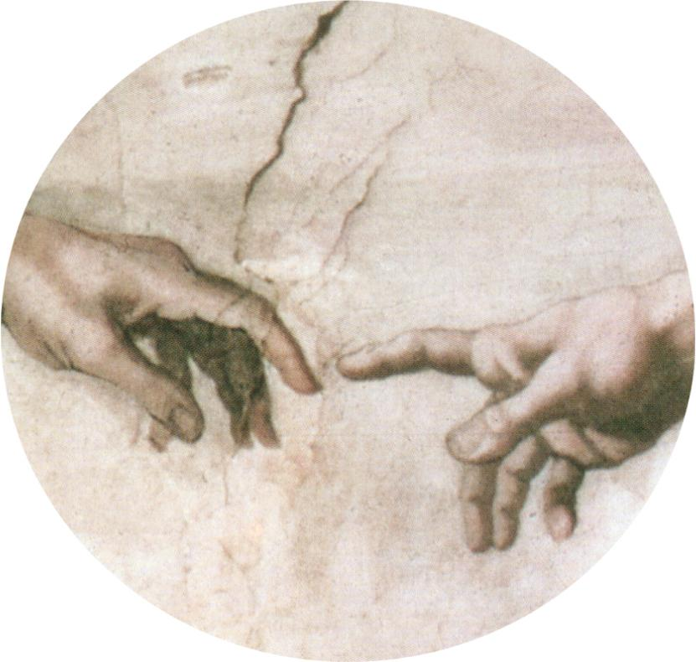
Washing Nets
1- Process
a- requires stressful effort
b- careful examination
c- complete cleaning
d- constant mending
2- Preparation
a- for storage
3- Pause
a- no plan of fishing for a while
b- necessary for season of restoration
c- deadly if done too long

Slide 21
I. The Challenge to Launch Out Into Deep (4)
2- The Challenge
a- Deep
Not Easy,
Required Great Effort,
Tremendous Risk Involved
b- At day
1) Forced to deal with heat,
2) Extreme obstacles,
3) Work with others

Slide 22
Healthy Spiritual Risk Taking Promotes…
1. Avoiding Shallow Living-
a- Psalm 42:7, “deep calleth unto deep..”
b- Risk –can be welcomed
2. Aids Spiritual Growth-
a- Can’t grow without stretching
3. Assists Supernatural Discovery-
a- start to see (miracles/ God’s Hand)
4. Aids Spiritual Health-
a- live beyond stale

Slide 23
II. The Hesitancy To Launch Out (5)
3- Dread of the Unknown
a- Abraham –explored land he knew not
4- Different Direction
a- Realize the Power of His Word
b- Not mind (think no fish)
c- Not experience (already tried)
d- Not body (tired; exhausted)

Slide 24
II. The Hesitancy To Launch Out (5)
1- Depressing Experience
Fished all night; caught nothing
a- Peter
-from Denial to Dynamic
b- Mark
-from Desertion to Distinction
2- Discouragement
Discouraged is to have all courage drained
a- I Sam 30:6- Ziklag

