Slide 2
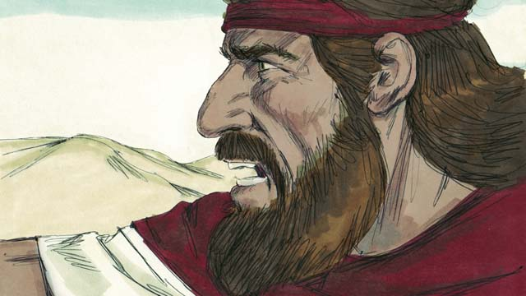
Elijah: A Man Like Us –
1 Kings 17:1
James 5:17-18
Edward Church
May 22, 2016

Slide 3
James 5:17-18 (KJV)
¹⁷ Elias was a man subject to like passions as we are/ he prayed earnestly that it might not rain: and it rained not on the earth by the space of three years and six months. ¹⁸ And he prayed again, and the heaven gave rain, and the earth brought forth her fruit.
James 5:17-18 (AMP)
¹⁷ Elijah was a human being with a nature such as we have [with feelings, affections, and a constitution like ours]; and he prayed earnestly for it not to rain, and no rain fell on the earth for three years and six months.
¹⁸ And [then] he prayed again and the heavens supplied rain and the land produced its crops [as usual].
1 Kings 17:1 (KJV)
¹ And Elijah the Tishbite, who was of the inhabitants of Gilead, said unto Ahab, As the LORD God of Israel liveth, before whom I stand, there shall not be dew nor rain these years, but according to my word.

Slide 4

We are Called to Make a Difference
Abraham Lincoln said,
"If you're not part of the solution, you're part of the problem"
Anyone Can Criticize
…But It Takes Commitment to Make an Impact
Anyone Can Analyze the Situation
…But It Takes Action to Change Things
Times of Crisis Call For Courageous and Committed Believers
  We Are the Salt of the Earth
  The Light of the World
  Ambassadors Of Christ
We Can Learn How to Make a Difference From Elijah

Slide 5
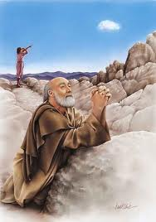
Elijah is Central in Scripture
Lived 850 Years Before Christ
Ministry Marked By Miracles Not Seen Since Moses
Last Old Test. Prophecy Is About Him…
…He Would Come Before The Messiah Appeared (Mal. 4:5-6)
Fulfilled in Ministry of John the Baptist (Matt. 11:11-15; 17:11-13)
John Came "in the spirit and power of Elijah" (Luke 1:17)
Elijah appeared to Jesus/ Moses at Transfiguration (Matt. 17:1-9)
At Passover a Chair is Left for Elijah at the Table/ the Door is Opened in Anticipation for Him
"Elijah was a man just like us" (James 5:17-18)

Slide 6

Israel was a Divided Kingdom
King Ahab was the Most Wicked King of the North to Date
He Married Jezebel, Her Father was King of Sidon / Priest Of Baal
Jezebel= "Where Is Baal?"
Jezebel Brought Baal Worship to Israel / Infiltrated Land w- False Prophets And Priests of this Pagan Cult
God Was About to Come On the Seen…
…In a Big Way
…To Bring A Nation Back To Him
…With the Least Likely Person – “Elijah”

Slide 7

What Does Elijah Teach Us About…
…Making a Difference?

Slide 8
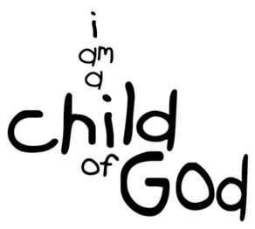
Define Yourself by Your Relationship to God
Elijah's Name is a Combination of Two Divine Names
Elohim and Yahweh = "Yahweh is my God"
Our Personal Identity is Derived From…
…Our Relationship to God as Our Creator
…and to Jesus as Lord of Our Lives.

Slide 9
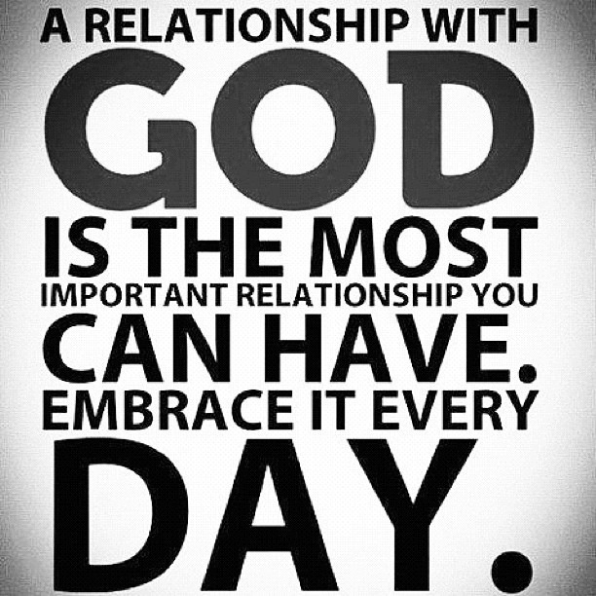
Define Yourself by Your Relationship to God
Your Pedigree Doesn't Matter
  Elijah Came Out of Nowhere
  We Don't Even Know His Background
  He Offers No Credentials-Just an Announcement of God's Word
  God Calls Unlikely People to Do Extraordinary Things.
Your Past Doesn't Matter
  Elijah was From Tishbe in Gilead
  We Don't Know About His Family
  God's Grace Can Overcome Anything in Your Past
  Your Background is Not Important;
  It's Where You Are Today that Counts

Slide 10

Define Yourself by Your Relationship to God
Your Pedigree Doesn't Matter
Your Past Doesn't Matter
Your Personality Doesn't Matter
  Confrontational, Abrasive, Larger than Life, Almost Angry
  We Know that He was Subject to Depression
  James says He Was a Man Like Us
  God Used Ordinary People Who Understood Their Times…
…And Decided to Make a Difference.
Your Potential Doesn't Matter
  Some Fail to See Their God-given Potential/ Feel Inadequate
  You are Gifted by God, So Face Life with Confidence

Slide 11
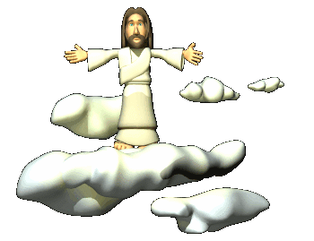
Depend on God W- Confidence in His Word
"As the Lord, the God of Israel, lives..." (17:1)
God is Alive and at Work
  Baal was a lifeless idol
  Our God is Alive and Active
  He is Not Detached or Distant, and is Certainly Not Dead
  Jesus said,"I am with you always" -Matt. 28:20
God's Word is Alive -Heb. 4:12
  Elijah's Prophetic Power was Based on Scripture.
  He Confronted Ahab with the Word of God (drought)
  We Too Have the Bible…
  …Which is the Living Word
  …to Guide Us

Slide 12

Depend on God w- Confidence in His Word
"As the Lord, the God of Israel, lives..." (17:1)
Give the Word of God Time to Work
Elijah appeared in Ahab's court with the message, then he went into obscurity for 3.5 years
He Gave the Word of God Time to Work
“My Word will not return to me void but will accomplish the purpose for which I sent it” -Isa. 55:11
We Want and Expect Everything to Happen Overnight
But the Word of God is like a Seed that Takes Time to Grow and Produce a Harvest of Righteousness.
The Word Will Do the Work!

Slide 13

Dedicate Yourself to God's Mission for Your Life
"whom I serve" (17:1)
Literally Hebrew, "before whom I stand"
Technical Expression= “one who stands in the service of a king”
Elijah Stands Before God as a Servant Stands Before His Master
Get Your Marching Orders From God
Don't Try to Get God to Support Your Mission, But Rather
…Submit Yourself to His Mission For Your Life and
…See What He Will Do Both in Your Life
…and With Your Life for His Glory

Slide 14


Slide 16


Slide 19
Elijah is central in Scripture and stands second in stature as a prophet only to Moses in the Old Testament. He lived about 850 years before Christ. His ministry was marked by miracles not seen since the days of Moses. The last Old Testament prophecy is about him. It said he would come before the Messiah appeared (Mal. 4:5-6), which was fulfilled in the ministry of John the Baptist according to Jesus (Matt. 11:11-15; 17:11-13), although John never claimed that for himself (John 1:21-27). John came "in the spirit and power of Elijah" (Luke 1:17). He was not a reincarnation, a concept the Bible refutes. Elijah appeared to Jesus at the Transfiguration along with Moses, shortly before His passion (Matt. 17:1-9). At the Passover each year to this day, a chair is left for Elijah at the table, and the door is opened in anticipation for him. Most importantly, "Elijah was a man just like us," from whom we can learn great lessons of faith (James 5:17-18).

