Slide 2
Getting to… …His Presence
Edward Church
Psalm 84
June 26, 2016

Slide 3
“Psalm of Pilgrimage”
¹ How lovely are Your dwelling places, O LORD of hosts! ² My soul longed and even yearned for the courts of the LORD; My heart and my flesh sing for joy to the living God. ³ The bird also has found a house, And the swallow a nest for herself, where she may lay her young, Even Your altars, O LORD of hosts, My King and my God. ⁴ How blessed are those who dwell in Your house! They are ever praising You. Selah. ⁵ How blessed is the man whose strength is in You, In whose heart are the highways to Zion! ⁶ Passing through the valley of Baca they make it a spring; The early rain also covers it with blessings. ⁷ They go from strength to strength, Every one of them appears before God in Zion. ⁸ O LORD God of hosts, hear my prayer; Give ear, O God of Jacob! Selah. ⁹ Behold our shield, O God, And look upon the face of Your anointed. ¹⁰ For a day in Your courts is better than a thousand outside. I would rather stand at the threshold of the house of my God Than dwell in the tents of wickedness. ¹¹ For the LORD God is a sun and shield; The LORD gives grace and glory; No good thing does He withhold from those who walk uprightly. ¹² O LORD of hosts, How blessed is the man who trusts in You!

Slide 4
Just Passing Through
Hebrews 11:13-16 (MSG) ¹³ Each one of these people of faith died not yet having in hand what was promised, but still believing. How did they do it? They saw it way off in the distance, waved their greeting, and accepted the fact that they were transients in this world. ¹⁴ People who live this way make it plain that they are looking for their true home. ¹⁵ If they were homesick for the old country, they could have gone back any time they wanted. ¹⁶ But they were after a far better country than that—heaven country. You can see why God is so proud of them, and has a City waiting for them.

Slide 5
“Psalm of Pilgrimage”
It is Set in the “Glory Days” of Israel
The Kingdom was United
King David was on the Throne
Every year- Pilgrimage fr Every Territory…
…to Jerusalem for Feast of Tabernacles
This Psalm is from One Unnamed Pilgrim as He Makes His Way
He Had an (Intense Desire) for the House of God...
…to be with God’s People, Worshipping
Note- Everybody was Involved…yet All Came…
Different Places
Different Distances
Same Purpose

Slide 6
Advice for Travelers (5-8)
In Order to Get to God’s Presence, there is a Journey to Be Made
He Describes this Journey as a “Happy” One (blessed is the man)
…Because the Thought of the Destination Motivates Him.
Even Through Harsh, Difficult, Dangerous Places – “He is Blessed”
Clear Picture of OUR Journey (Our Pilgrimage) Through Life
We are Passing Through This World, Our Destination is…
…God’s Presence – “Here and the Hereafter”
Here= Can Be Hindered- has to be sensed by Faith
Hereafter= Can Not Be Hindered- can be sensed by Sight
4 Guiding Principles for a Successful Journey…
…Into His Presence

Slide 7
Look to God Alone for Your Strength (5)
“Blessed is the man whose strength is in YOU….”
An All-Important Key Testified to by Every Page of Scripture
The Christian Life Is Not Merely “Hard”…
…it is IMPOSSIBLE Without God’s Strength
Jesus is Both “the author and finisher of our faith” -Hebrews 12:2
To Live This Life We MUST Have God’s Strength
Saving Strength
Sustaining Strength
Enabling Strength
Our Own Resources Are Completely Inadequate

Slide 8
Look to God Alone for Your Strength (5)
“Blessed is the man whose strength is in YOU….”
Power Principle #1: Your Power is Not Enough
“It’s not by might, nor by power, but by My Spirit says..Lord” -Zech 4:6
Power Principle #2: Your Timing is Not Enough
“They that WAIT upon the lord shall RENEW strength” -Isa 40:31
2 Cor 12:9 (AMP) ⁹ But He said to me, My grace (My favor and loving-kindness
and mercy) is enough for you [sufficient against any danger and enables you to bear the trouble manfully]; for My strength and power are made perfect (fulfilled and completed) and show themselves most effective in [your] weakness. Therefore, I will all the more gladly glory in my weaknesses and infirmities, that the strength and power of Christ (the Messiah) may rest (yes, may pitch a tent over and dwell) upon me! 2 Cor 11:25-28

Slide 9
Put Your Heart Into the Journey (5)
“Blessed is the Man Whose Strength is in You…
…Whose Heart Is Set On Pilgrimage”
Make Your Life Count!
We Ought Not to Be People Just Letting Life Pass Us By…
Being Dictated to By Our Circumstances
We Must Have Our Eyes On the Finish Line
Our Energies Ought to Be Occupied w-
…Making the Journey Count; Living For Jesus!
Paul Wrote: “For Me To Live Is Christ!”
Look for Opportunity Every Day Brings Grow/
…Develop for the Glory of God

Slide 10
See Opportunity in Every Trial (6)
Baca = Root Word= “to mourn, wail, or lament”
…Brokenness, Confusion, Affliction
Key To Life Is NOT to Pretend Trials Don’t Exist ...
…But Rather to See Trials as Opportunities
If The Lord Is Your Strength/ Your Heart Is Set On The Journey…
…You Can See The Valley of Weeping Become a Spring
…What Depletes You Actually Completes You!
Place of Bitterness Can Become a Place of Blessing/ Growth
“Faith Dares To Dig Blessings Out Of Hardships!”
It’s Not Easy, But W- God’s Help We Can Use Trials As Opportunities to…
Prove God
Grow in God
Be a Testimony for God

Slide 11
See Opportunity in Every Trial (6)
We All Love the “Mountain Top” Experiences…
….Times of Blessing and Sunshine
The View Is Nice Up There…
…But the Fruit Grows in the Valleys!
“Faith Digs Wells in the Driest Places/ Finds that Living Water”
Joseph
Job
David On The Run
Romans 8:28-29, “All Things Work Together For Good To Them That Love God And Are The Called According To His Purpose”!

Slide 12
Remember that God is in Control (7)
“they go from strength to strength”
Strength= Army, Force, Supply
He Will…
Always Be in Sovereign Control
Never Surrender His Position on the Throne…
…To Any Person or Any Thing
He Cannot Be Defied
He Is In Control
His Promise Never Fails

Slide 13
Remember that God is in Control (7)
⁸ O LORD God of hosts, hear my prayer; Give ear, O God of Jacob!
Selah. (He Hears)
⁹ Behold our shield, O God, And look upon the face of Your
anointed. (He Sees)
¹⁰ For a day in Your courts is better than a thousand outside. I
would rather stand at the threshold of the house of my God
than dwell in the tents of wickedness. (He Satisfies)
¹¹ For the LORD God is a sun and shield; The LORD gives grace
and glory; No good thing does He withhold from those who walk
uprightly. (He Protects/ Provides)
¹² O LORD of hosts, How blessed is the man who trusts in You!

Slide 14
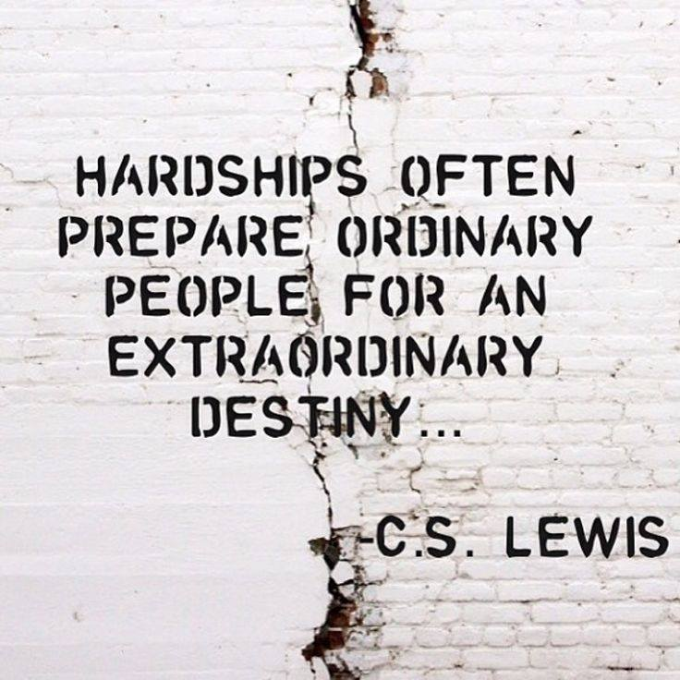
Remember that God is in Control (7)
He Will…
Direct My Steps In Strength
Bring Me Right Through Any Valley
This Is The Promise Of God
Through the Power of God
Into the Presence of God
This Journey Will…
Deplete Me…no
Complete Me…yes

Slide 17
