Slide 1
A priest and a rabbi from local parishes were standing by the side of the road holding up signs. The rabbi’s read, "The End is Near!" The priest, on the other side of the road, held up a sign which read, "Turn before it’s too late!" They planned to hold up their signs to each passing car. "Get a job." The first driver yelled. The second, immediately behind the first, yelled, "Leave us alone you religious freaks"! Shortly, from around the curve, they heard screeching tires and a splash followed by more screeching tires and another splash. The rabbi looked over at his companion and said, "Do you think we should try a different sign"? The other man responded, "Perhaps, ’Bridge Out’ might be better"?

Slide 3
When You See These Things
Luke 21:5-36
Edward Church
July 10, 2016

Slide 4
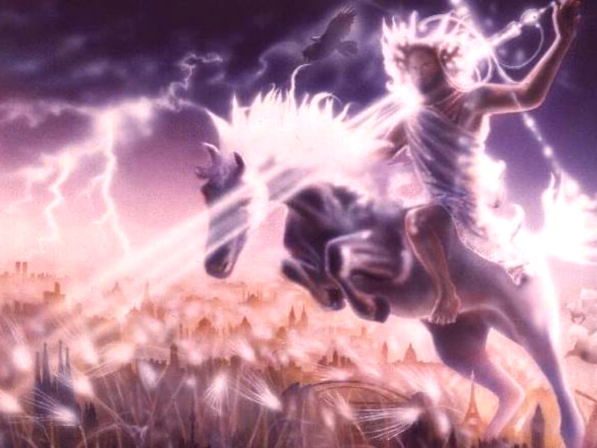
What Promise is Found Over 300 times in NT?
…the Promise of the Return of Christ
The Bible Does Not Give Us All the Specifics of His Return
Much Of Bible Prophecy Is Shrouded In Mystery…
…Sealed Up Until the Time of the End,
…as the Angel Told Daniel Concerning His Visions
Bible Prophecy is Seeing Through A Glass Darkly- 1 Cor. 13:12
But One Fact Is Clear:
Jesus Will Return to Earth Again…
…Visibly, Literally, And Victoriously -1 Thess. 4:16-18

Slide 5
The Last Week of Jesus' Life He Talked About His 2nd Coming
…And Prophetic Signs in the Last Days Before His Return
In Luke 21, Christ Addressed Two Subjects at the Same Time:
Destruction of the Temple (70 AD)
Last Days and His Return.
The Destruction of Jerusalem was ONLY a Foreshadowing of the Greater Suffering of the Last Days During a Period Described as the Tribulation -Matt. 24:21
At the End of the Tribulation, Jesus Will Return to Earth, Along With The Believers Who Are Already In Heaven, To Rule And To Reign As King Of Kings And Lord Of Lords
Rem- Difference in the Rapture and Second Coming
All Part of the Day of the Lord (lasts 7 years)

Slide 6
Today There is Widespread Interest About the End Of Days
What Are The Signs of His Coming ?

Slide 7
False Messiahs and Spiritual Deception (8)
As This Age Draws to a Close…
…False Messiahs Will Increase
…Spiritual Deception Reach Its Zenith In Human History
Satan is a Deceiver / Works Thru Spiritual Deception -John 8:44
Spiritual Deception Today Sets the Stage for the Greatest Deception in the Antichrist and the False Prophet -Matt. 24:24
In Our Own Times We Have Witnessed…
Jim Jones
Sun Myung Moon
Marshall Applewhite (Heaven's Gate cult)
David Koresh, and others

Slide 8
Wars and Revolutions (9-10)
War is Certainly No New Thing…
…since WW I, War Has Taken on New Meaning Because of Globalism
…War Today Can Escalate to Point of Global Conflict W/in Hours
Wars and Conflicts Still Engulf and Threaten the World
Iraq Has Lasted Longer And Cost More Than Anyone Imagined
Russia is Expanding Its Borders-invades Georgia To Flex Muscles
The Rise Of North Korea, Iran, China
Many Nations Either Possess or Seek to Possess Nuclear Weapons
Militant Islamic Nations are Armed With Nuclear Weapons
Biochemical Warfare is Now a Standard Part of Military Arsenals
War On Terrorism (ISIS, Al-Qaeda, Taliban, Hezbollah…plus Lone Rangers + Copycats)

Slide 9
Ecological and Cosmic Disturbances (11)
"earthquakes, famines and pestilences in various places, and fearful events and great signs from heaven"
Joel foresaw such disturbances in the ecology and in the heavens -Joel 2:10
Today- Global Warming, the Greenhouse Effect, an Increase in
Earthquakes and Ecological Disturbances, the Population Explosion
of Now Over Six Billion People, and the Scarcity of Resources that Can Come as a Result of Overpopulation, Drought, and War.

Slide 10
Intensified Persecution (12-19)
The History of the Church is Soaked in the Blood of the Martyrs
More Christians died for their faith during the twentieth century than at any other point in history.
Christian Pastors are being Imprisoned in China, India/ Islamic nations.
During the Tribulation people will come to salvation/ many will face death
Persecution is No Respecter Of Persons -2 Tim. 3:12
Whatever Suffering We May Endure…
…We Should Count It An Honor -1 Peter 4:12-13 ¹² Beloved, think it not strange concerning the fiery trial which is to try you, as though some strange thing happened unto you: ¹³ But rejoice, inasmuch as ye are partakers of Christ's sufferings; that, when his glory shall be revealed, ye may be glad also with exceeding joy. ¹⁴ If ye be reproached for the name of Christ, happy are ye; for the spirit of glory and of God resteth upon you:

Slide 11
Spiritual Apostasy (19)
Christ's Challenge to Stand Firm Contrasts those Who Will Fall Away
In the Last Days there Will Come a Great Falling Away -2 Thes 2:3
A Sifting of the Church Will Take Place…
…Separating True Believers from those Who
…Possess a Form of Godliness But Have No Real Faith
True Believers Are Promised Persevering Power
If You Are a True Follower Of Jesus…
…You Will Stand Firm To The End
Because Greater Is He Who Is In You Than…
…He Who Is In The World -1 John 4:4!

Slide 12
Jerusalem Focus (20-24)
This Passage has a Dual Application
1-It Refers to the Roman Invasion of Jerusalem in AD 70 (5-6)
Titus / His Army Invaded the Holy City / Destroyed the Temple
2-The Invasion by the Anti-Christ (15)
Antichrist Invades Jerusalem and…
…the Abomination of Desolation
What about Now?
Jerusalem Center of Judaism, Christianity, Islam
Islam wants it / is willing to Destroy Israel to Possess
Israel is Hated by the Islamic Nations…
…and Eventually Will Move In to Destroy

Slide 13
Global Evangelism (Matt. 24:14)
Today the Opportunity of Global Evangelism is a Reality
Missionary Organizations and Churches are…
Implementing Media Outreach
Missionary Activity to Reach the Unreached
But Evangelism Will Continue During the Tribulation
144,000 Jewish Evangelists

Slide 14
How Should These Signs Affect Us? (26-28)
3 Challenges/ Encouragements Toward Prophetic Signs:
1-Awareness: "When you see these things..." (28)
Greatest Danger the Church Faces Today is Complacency
We Must Stay Awake/ Alert, Seizing Every Opportunity For Christ
Two Truths:
1st, We Are to Be Ready For His Return Any Moment
2nd, We Are to Be Prepared to Be Faithful/ Persevere If…
…He Delays Longer than We Expect
Being "Ready" Means to be Both Expectant and Patient

Slide 15
How Should These Signs Affect Us? (26-28)
3 Challenges/ Encouragements Toward Prophetic Signs:
1-Awareness: "When you see these things..." (28)
2-Anticipation: "Stand up and lift up your heads…
…because your redemption is drawing near”
Our attitude toward life and the signs of the times should be …
…stand up, not slouch over in discouragement or
…draw back in fear.
3-Assurance: "Heaven / earth will pass away,
…but my words will never pass away" (33)
We Have No Fear When We Look At The Future…
…Because The Future Belongs To God
Are You Ready For Christ To Return Today?

