Slide 2
R.I.P.
Edward Christian Church
July 24, 2016
Died as a Fool
II Samuel 3:31-35

Slide 3
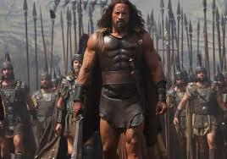
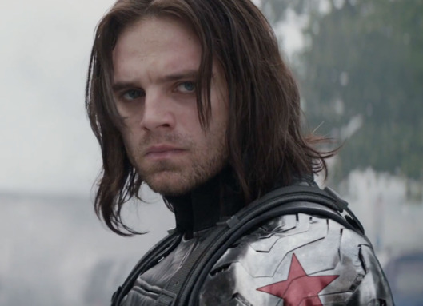
Abner
Joab
Story Starts with Divided Kingdom
Israel = King Ish-bo-sheth
Judah = King David
Israel= General Abner
Mighty Man of God…
…Great Swordsman -Valor –Dignity
…Sought to Please God
Judah= General Joab
Arrogant -One Sided –Deceitful
…Sought to Please Self

Slide 4
Abner
Destined to Change History
But…
Cut Down In His Prime
At the Point Where…
…He Could Make a Difference
He Dies Needlessly
In Order for Evil to Rise Up…
…Good Has to Lay Down

Slide 5
Abner
(33)“the king lamented over Abner, and said, Died Abner as a fool dieth?”
David was Not Cutting Him Down…
This was a Needless Death!
Fool= in Vain, Needless, Useless
…Serves No Purpose
Esp for God’s Kingdom

Slide 6
Many Today
Destined to Change History
But…
Cut Down In Their Prime
At the Point Where…
…They Could Make a Difference
They Die Needlessly
Not Realize- for Evil to Rise Up…
…Good Has to Lay Down

Slide 7
Many Today
They Die Needlessly…
Physically
Emotionally
Spiritually
Their Heart Stops Beating
Dream Dies Within Them

Slide 8
Accepted an Unauthorized Letter (26)
(26) “Joab…sent messengers after Abner, which
brought him again from the well of Sirah: but
David knew it not…
…“No Seal”
Abner Should Have Known Better-
Emotion-Based Decision
No Seal - David Knew Not!
Too Eager to See God Move…
…that He Moved Ahead of God!
Always Check God’s Expressed Will!
His Word!

Slide 9
Accepted an Unauthorized Letter (26)
2 Tim 4:3, “For the time will come when they will
not endure sound doctrine; but after their own
lusts shall they heap...themselves teachers,
having itching ears”
Power w/ Out Responsibility, Accountability
Amos 8:11,“famine in the land...for Word”
Romans 10:17,“Faith cometh by hearing....”
Heb. 11:1,“Now faith is....
…Evidence(title deed)..”
Always Examine the Title Deed!!!

Slide 10
Met in Unauthorized Meeting Place (27)
(27)“when Abner returned to Hebron, Joab took
…aside in the gate to speak with him quietly”
Hebron “City of Refuge”
Outside Anything Goes!
Inside No Weapons
Place of Peace/ Shelter/ Safety

Slide 11
Hebron Symbol of Church
There is No Other Place Like It..
It Is a Place of...
Refuge
Community
Fellowship
Discipleship

Slide 12
Met in Unauthorized Meeting Place (27)
Too Many Meet On.......
…Own Ground
…His Ground
…Always Loose!
Devil Can’t Get In - Must Be Blood Bought
He Can Attack but - He Can’t Destroy!
Matt. 16:18, “upon Rock..Gates of Hell Shall Not ..”
the Church......Battered/ Worn –
…Not Perfect - But Not Going Down!!

Slide 13
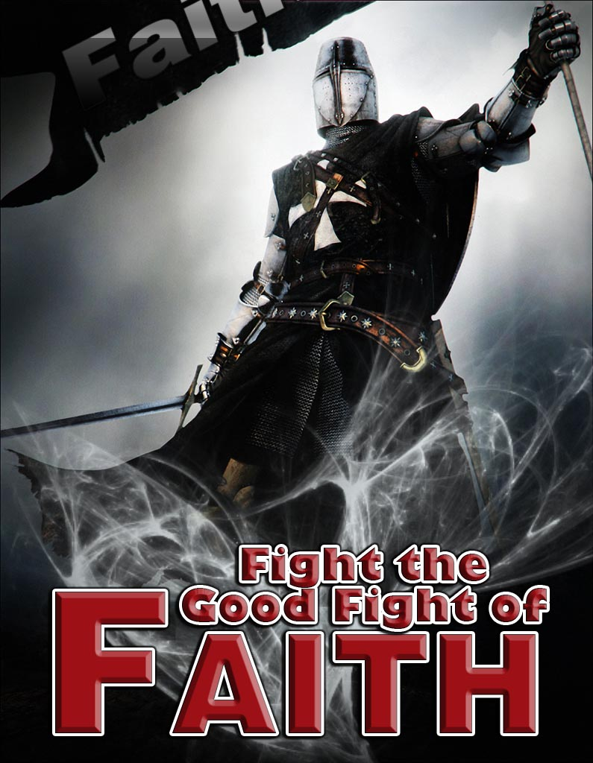
Gave into Unauthorized Surrender (27)
He was Beaten by an Inferior Swordsman
Not Try to Protect Self
Not Bound
Psa. 78:9, “Ephraim armed/ carrying bows turned back in day of battle”
Too Many Lost Fight!
Tired of Struggle!
“Fight..good fight- lay hold of Et. life” -I Tim 6:12
Don’t turn the Church Over to the Enemy!!!!!

Slide 14
Get Back Up!
Back Up to His…
Word
Church
Strength

Slide 15
No Surrender !

Slide 17
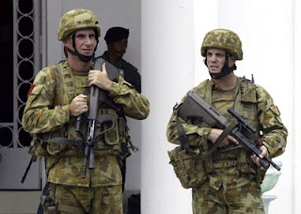
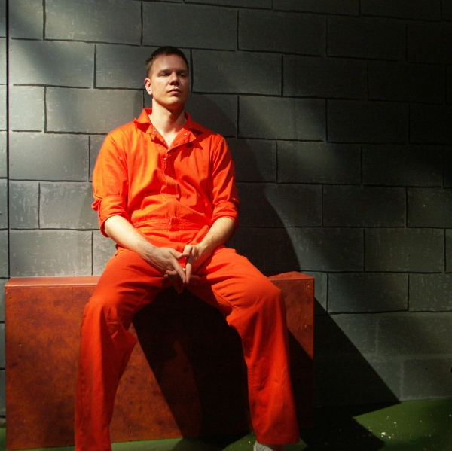
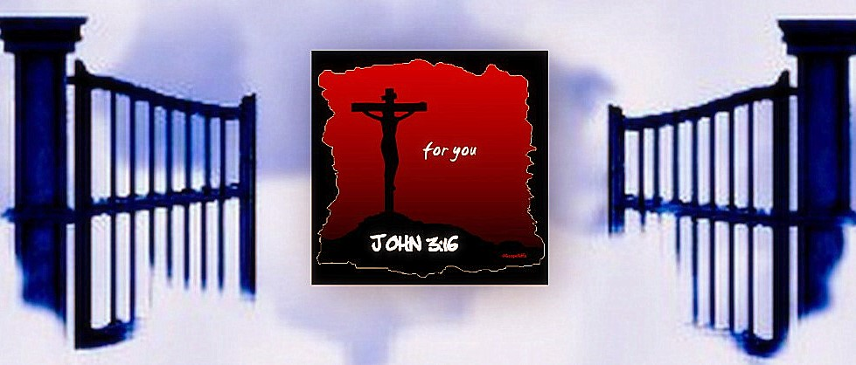

Slide 18
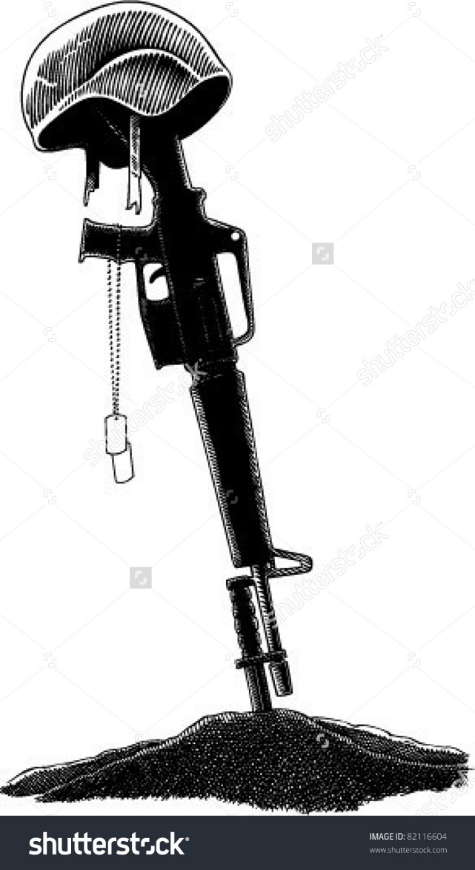
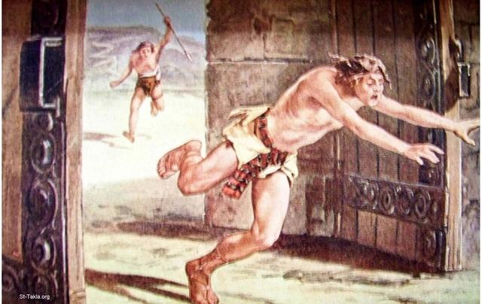

Slide 19
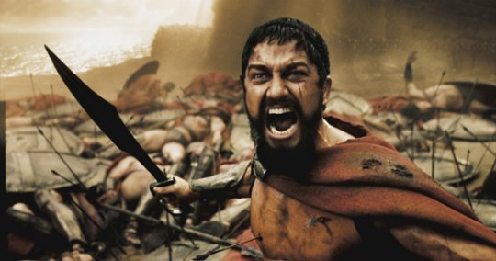
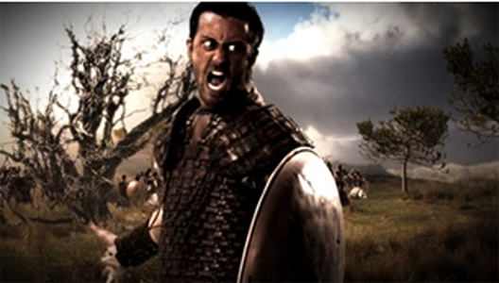
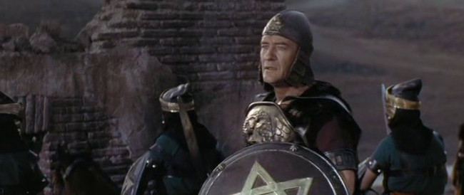

Slide 20
Peter warns-
1 Peter 5:8,
Jesus warns-
Matthew 26:41-Watch and pray, that ye enter
not into temptation: the spirit indeed is willing,
but the flesh is weak.
Paul warns-
1 Corinthians 10:12-Wherefore let him that
thinketh he standeth take heed lest he fall.

Slide 21
Peter warns-
1 Peter 5:8, 9—Be sober, be vigilant; because
your adversary the devil, as a roaring lion,
walketh about, seeking whom he may devour:
Whom resist steadfast in the faith, knowing that
the same afflictions are accomplished in your
brethren that are in the world.
The lion roars to mark his boundaries. He wants control of you and me.

