Slide 1
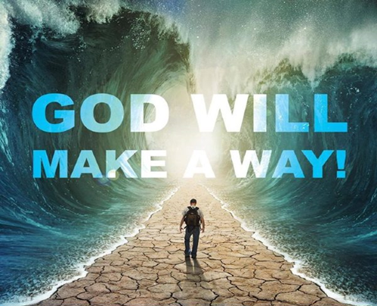
Called… but …Stalled
August 14, 2016
Edward Church
Exodus 14

Slide 2
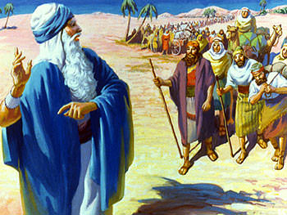
Called…
The Children Of Israel Just
Delivered From The Strong, Oppressive Hand Of Pharaoh.
Started Their Journey With High Hopes And Expectations
Marched Only A Few Days And Suddenly They Seem To Be Stopped In Their Journey.
They Have Encamped By The Sea.
Before Them Is The Great Red Sea, On Either Side Of Them Is A Mountain And Behind Them Are Pharaoh And His Army Closing In Fast.
On The Surface It Seems They Are Hopelessly Trapped.
No Way Out.

Slide 3
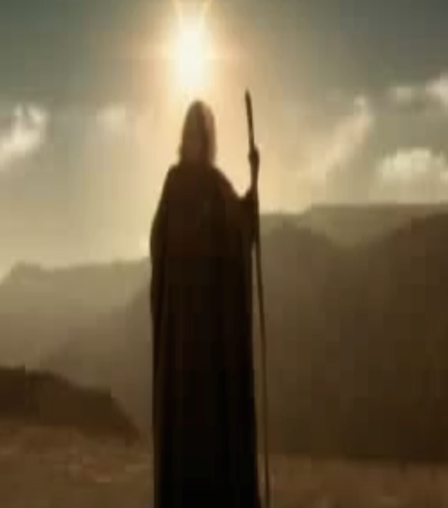
Called…
Moses Turns to the People and says…
Exodus 14:13-14 (KJV)
¹³ And Moses said unto the people, Fear ye not, stand still, and see the salvation of the LORD, which he will shew to you to day: for the Egyptians whom ye have seen to day, ye shall see them again no more for ever. ¹⁴ The LORD shall fight for you, and ye shall hold your peace.
Then -Moses Goes to God and he says God, what do you want me to do?
Exodus 14:15 (KJV)
¹⁵ And the LORD said unto Moses, Wherefore criest thou unto me? speak unto the children of Israel, that they go forward:
Exodus 14:15 (MSG)
¹⁵ GOD said to Moses: "Why cry out to me? Speak to the Israelites. Order them to get moving.

Slide 4
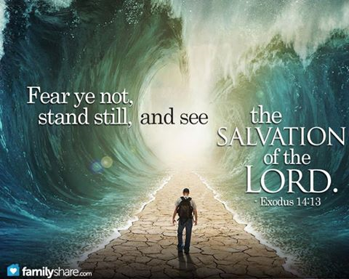
God said Go Forward!
Forward(Pull Up Tent Pegs)
What Does It Mean to Move Forward? (faith activated)
Faith is Always…
  Positive (forward)
  Powerful
  Hebrews 11:1 (AMP) NOW FAITH is the assurance (the confirmation, the title deed) of the things [we] hope for, being the proof of things [we] do not see and the conviction of their reality [faith perceiving as real fact what is not revealed to the senses].
  Pleasing
  Hebrews 11:6 (AMP) But without faith it is impossible to please and be satisfactory to Him. For whoever would come near to God must [necessarily] believe that God exists and that He is the rewarder of those who earnestly and diligently seek Him [out].

Slide 5

They Became Stalled
When You Fail to Go Forward
When You Are Called But Stalled Some Terrible Things Happen
Soon They Get Out 0f Your Control

Slide 6
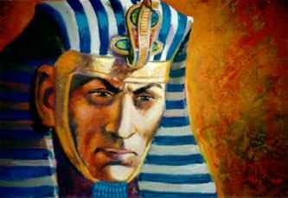
Symptoms of Being Stalled
1st- Look In –Fear
10 And when Pharaoh drew nigh, the children of Israel lifted up their eyes, and, behold, the Egyptians marched after them; and they were sore afraid: and the children of Israel cried out unto the LORD.
2nd- Look Around -Murmur and Complain
11 And they said unto Moses, Because there were no graves in Egypt, hast thou taken us away to die in the wilderness? wherefore hast thou dealt thus with us, to carry us forth out of Egypt?

Slide 7
Symptoms of Being Stalled
1st- Look In –Fear
2nd- Look Around -murmur and Complain
3rd- Look Back – Backsliding Spirit
12 Is not this the word that we did tell thee in Egypt, saying Let us alone that we may serve the Egyptians? For it had been better for us to serve the Egyptians, than that we should die in the wilderness
4th- Stall -Yourself and Others
Tent Pegs Become Firmly Planted…
..They Were Called But Stalled!!

Slide 8
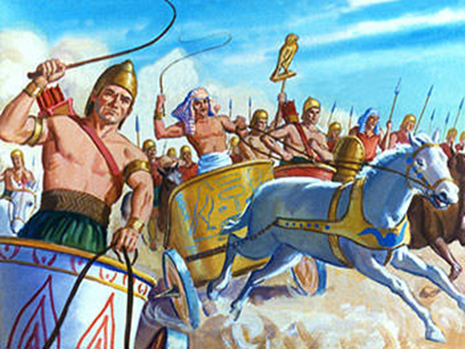
Are You Stalled?
Some of You Have Been Camped Out in the Place of…
  Anger for Too Long
  Depression for Too Long
  Bitterness for Too Long
  Hurt Feelings Long Enough
  Fear for Too Long
  Get By for Too Long
…It Is Time To Pull Up the Tent Pins and Go Forward!

Slide 9
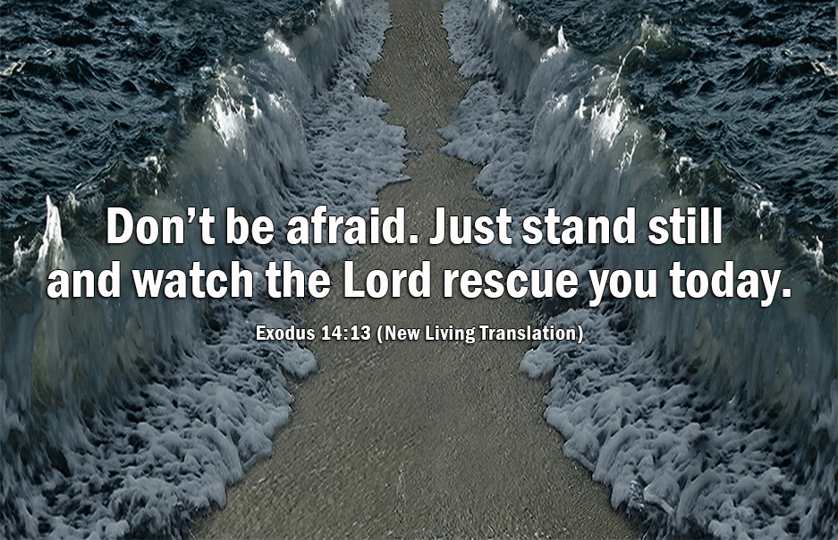
Moving Forward…
Involves Change in Thinking
  Knowing/ understanding that we are heading to something better
  What we are going through now is only temporary.
  This Is Not Our Final Destination.
They were Comfortable in Egypt
  They Were Used to Living As Slaves
  They Were Used to Settling For The Left Over.
Exodus 14:12 (KJV)
¹² Is not this the word that we did tell thee in Egypt, saying, Let us alone, that we may serve the Egyptians? For it had been better for us to serve the Egyptians, than that we should die in the wilderness.

Slide 10
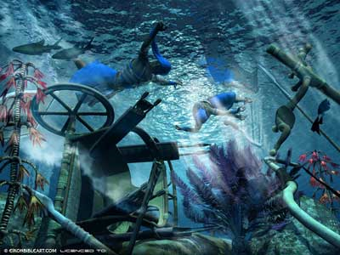
Moving Forward…
Involves a Change of Attitude
They Had Developed a Slave Mentality.
Exodus 14:11 (KJV)
¹¹ And they said unto Moses, Because there were no graves in Egypt, hast thou taken us away to die in the wilderness? wherefore hast thou dealt thus with us, to carry us forth out of Egypt?
God Says;
  You Are The Head And Not The Tail
  Victor/ Not The Victim
  Blessed In The City And Blessed In The Field
  Blessed Going In And Going Out

Slide 11
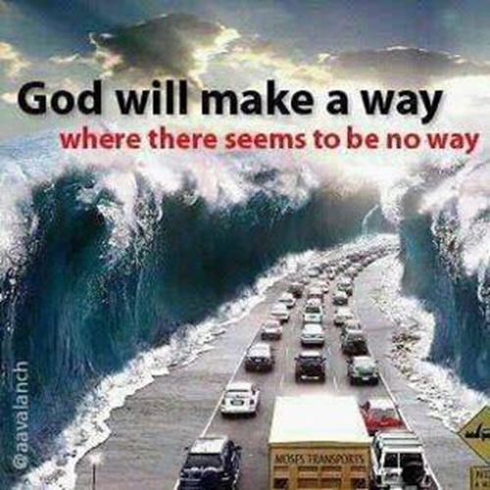
Moving Forward…
Call to Action-
Involves Faith In God/ Using What He Has Placed In Your Hand.
God said to Moses; “Raise your staff and stretch out your hand over the sea to divide the waters so that the Israelites can go through the sea on dry ground. (16)
The Only Thing that Moses had was Faith in What God had Promised…
…and a Stick.
What has He Given You to Move You Forward?
  Talent; singing, playing an instrument,
  Trade; fixing something or a trade like carpentry
  Spiritual gift; teaching or preaching or encouraging others.
It Doesn’t Matter What It Is..Use It for the Glory of the Lord

Slide 12
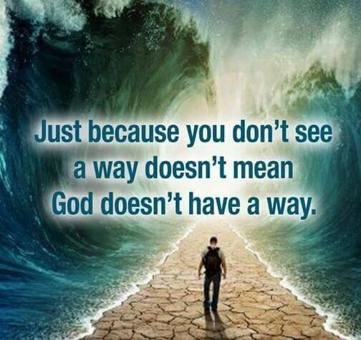
Moving Forward…
Charge of Faith-
Moving Forward also Depends on God’s Word
When we Follow God’s Word…
…We Invite God’s Power
“It’s not by power or by might but by My Spirit”- Zech 4:6
“And you will receive power when the Holy Spirit comes upon you and you will be my witnesses ….. Acts 1:8
“God has chosen the foolish things of the world to confound the wise. And God has chosen the weak things of this world to confound the things that are mighty”. 1 Cor 1:27

