Slide 2
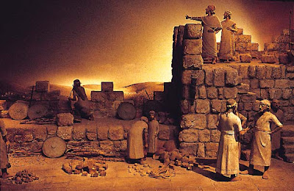
Edward Christian Church
August 21, 2016
Rebuilding the Wall-p2
Nehemiah 4/6

Slide 3
Set Backs
If Satan Can’t Stop Us…
…He Tries to Get Us at
…Place of Disadvantage
How?
Set Backs=
Unexpected, Unexplained …
…Hindrances, Distractions
This is Where Israel had been for 150 yrs

Slide 4
Nehemiah’s Time
Tough Days in Jerusalem:
Walls Down
Temple and Homes Exposed
Many Under Attack
Many had Been Taken Captive
Many Lives Trying to Rebuild
God Raised Up a Man!!
Same Today!

Slide 5
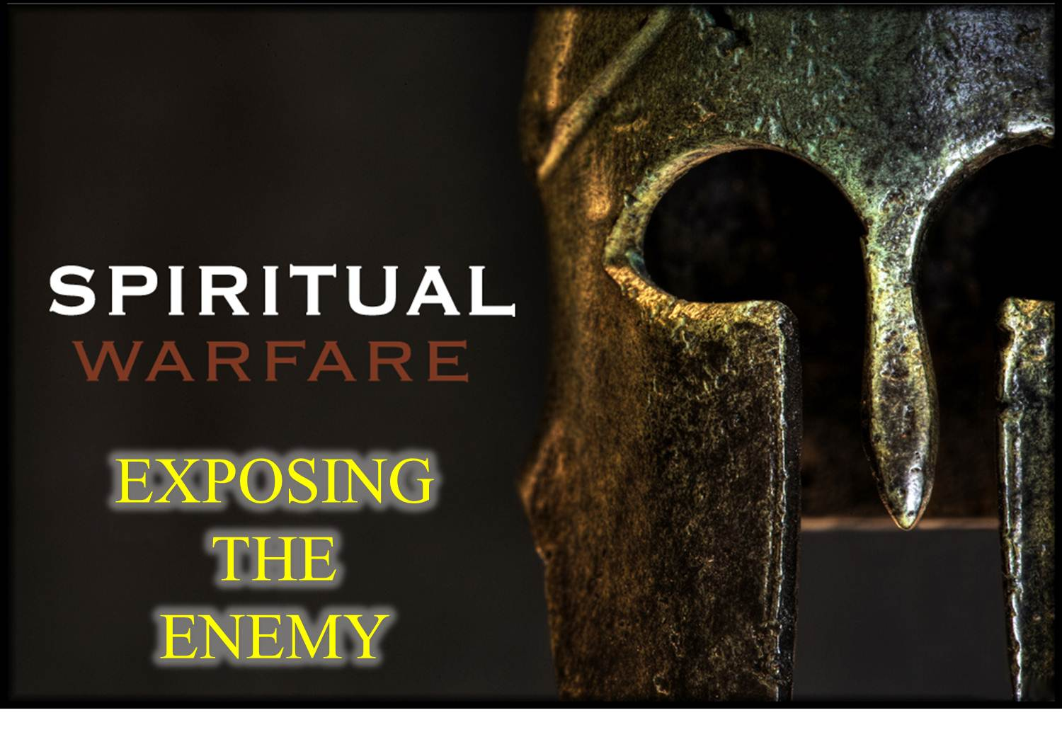
Satan Attacks
Whenever God Begins to Move…
…Whenever His Anointing is Present,
Satan Begins to Counter-Move
…He Counter Attacks

Slide 6
Anatomy of Satanic Attacks
Attacks at Point of …
#1 -Praise
Has to Do with Attitude
Invites God’s Presence
#2 -Commitment
Has to Do with Availability
Invites God’s Potential

Slide 7
Anatomy of Satanic Attacks
Attacks at Point of …
#3 –Anointing
Has to Do with Ability
Invites God’s Power

Slide 8
Anatomy of Satanic Attacks
Satan Attacks the Anointing Because It:
Breaks the Yoke -Isa 10:27
Uncommon Freedom
Moves Beyond Flesh -Zech 4:6
Uncommon Power
Makes a Way Where is No Way -Isa 59:19
Uncommon Preparation
They Did in 52 Days…
…What Couldn’t Be Done In 150 Yrs

Slide 9
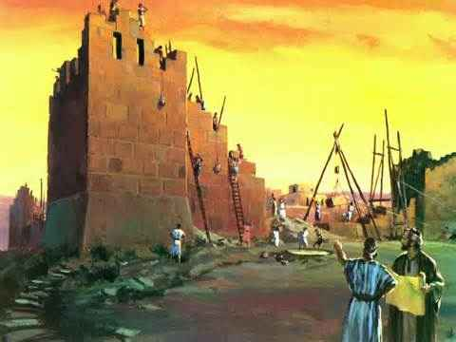
Overwhelming Task Calls for … Overwhelming Anointing
Jerusalem Walls...
2.5 Miles in Length
Avg Height - 39 ft
Avg Thickness - 8 ft
34 Watchtowers
8 Gates
Enclosing 90 Acres…
…Required the Hand of God

Slide 10
When Satan Saw (+)Momentum (1-6)
Momentum Shift (-)
Methods “tactics” still used today
Ridicule (4:1-6)
Intimidation - plots of war (7-9)
Discouragement (10)
Fear (11-23)
Selfishness (5:1-19)
The Wall Construction Did Not Stop!!

Slide 11
They Kept Working…
He Got Desperate…
…Stepped up the Attack
Compromise (6:1-4)
Slander (5-9)
Threats (10-14)
Intrigue (17-19)

Slide 12
How to “Stay on The Wall”
1st Perception (3)
He Kept Working
…do the Right Thing
2nd Purpose (3)
“great work…”
…for the Right Reason
3rd Prioritize (3)
“…can’t come down”
…in the Right Order

Slide 13
How to “Stay on The Wall”
4th Persistence (4-5)
…with the Right Resolve
5th Powerful Connection (9)
…through the Right Power
6th Patience (14-15)
…in the Right Season

Slide 14
The Wall Is Finished
¹⁵ So the wall was finished on the twenty-fifth [day] of [the month] Elul, in fifty-two days. ¹⁶ When all our enemies heard about it, and all the [Gentile] nations around us saw it, ^{[d]}they lost their confidence; for they recognized that this work had been accomplished with the help of our God

Slide 15
Stay on the Wall
God is Calling this Generation to…
…Get Back Up!
…Climb Back Up on the Wall
…Build for this Generation!

