Slide 1
OILY HAIR
Trying to control my dry hair, I treated my scalp
with olive oil before washing it.
Worried that the oil might leave an odor,
I washed my hair several times.
That night when I went to bed,
I leaned over to my husband and asked,
"Do I smell like olive oil?"
"No," he said, sniffing me.
"Do I smell like Popeye?"

Slide 3
Sept 4, 2016
Edward Christian Church
“Gap Stander”
The Difference Maker

Slide 4
Ezekiel 22:30
"I looked for someone among you
who could build walls or stand in front
of me by the gaps in the walls to
defend the land and keep it from being
destroyed. But I couldn't find anyone

Slide 5
The Problem
There’s a
G a p
in our Nation, Schools, Families, Homes
Separation between God and His People

Slide 6
God’s Plan / Pursuit - “I sought for a MAN..”
Not a
Committee
Neighbor
Someone Else
Better Time
But a Man!
Man(woman), Steward …
…Champion, Foot-man,
Mighty Man(woman)

Slide 7
Gap Standers
The Bible is Full of Gap Standers
i.e. “Difference Makers”
Nehemiah (wall)
David (Goliath)
Common Factors
Sent – God Called
Selfless
It’s Never About Them
Service
It’s About Helping Others

Slide 8
God’s Plan / Pursuit - “I sought for a MAN..”
God's Choice- "From among them..."
Able to Relate –Close to Heart
God’s Representative - “…before Me…”
God's Burden- “..for The Land…”
Our World, Community, Homes, Schools, Neighborhood, Employment.

Slide 9
God’s Path - “..stand in the gap”
Gap – breach/ broken wall
Gaps Between Man and God…
…That Only You Can Fill
Faith
Family
Found in the Land

Slide 10
God’s Path - “..stand in the gap”
Stand –appointed to arise…
…and remain firm
Time to Get…
Beyond Ourselves
Into the Fight
Stay in the Fight

Slide 11
God’s Power – “…to make up the hedge…”
Make up the Hedge –
Repair the Breach - close off- build a wall
Nehemiah- Trowel /Sword
David- Israel /Philistines
Jesus- Cross made up the Hedge –
Bridged the Gap

Slide 12
God’s Purpose – “…that I should not destroy it…”
Destroy - decay, ruin, corrupt, destroy, lose, perish, spill
Deliverance
Doesn’t Come from an Army…
…But a Man (woman)
Noah- Ark
Moses- Ark

Slide 13
God’s Purpose – “…that I should not destroy it…”
Ezekiel 22:30-31The Message (MSG)
“I looked for someone to stand up for me against all this, to repair the defenses of the city, to take a stand for me and stand in the gap to protect this land so I wouldn’t have to destroy it. I couldn’t find anyone. Not one.

Slide 14
God is Searching…
How About You?

Slide 16
Ezekiel 22:30
1. The Plan
-I sought a man among them
2. The Path
-To stand in the Gap
3. The Power
-To make up the Hedge
4. The Purpose
-That I would not Destroy it

Slide 17
God’s Purpose – “…that I should not destroy it…”
Stand in the Gap-
Builder of Walls-
Ck sermons ezek 22:30
Make sched..daniel special

Slide 22
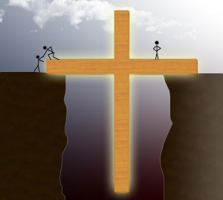
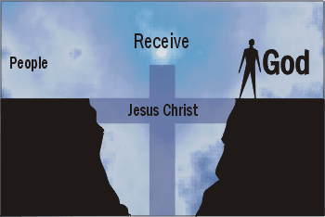
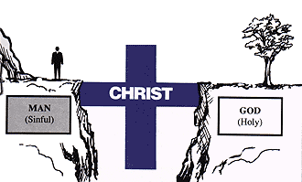
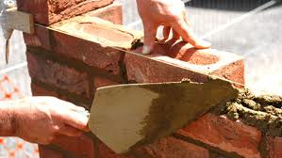

Slide 23
It’s Time…
F -
A -
T -
H -
E -
R -
-fighter
-attentive
-time
-help
-example
-restore

Slide 24
God’s Path - “..stand in the gap”
Gap – breach/ broken wall
There are “Gaps” that Only You Can Fill…
Family
in the Land
Stand
Time to Get…
Beyond Ourselves
Get into the Fight
our hands dirty!

Slide 25
God’s Purpose – “…that I should not destroy it…”
Destroy - decay, ruin, corrupt, destroy , lose, perish, spill
Make up the Hedge – Repair the Breach - close off- build a wall
Stand - to stand, abide (behind), arise, remain, repair, + serve, stand fast/ firm
In the Gap - a breach, a break

