Slide 2
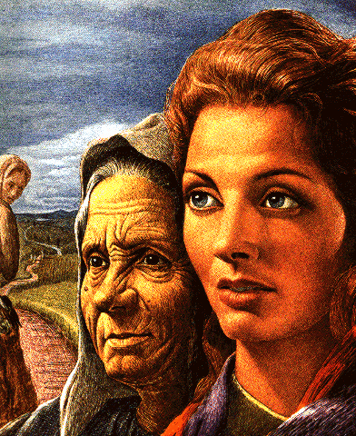
Ruth 1
Getting Beyond… …the Circumstantial Trap “Call Me Mara”
Edward Church
Oct 30, 2016

Slide 3
Ruth 1: 1-14: Now it came to pass, in the days when the judges ruled, that there was a famine in the land. And a certain man of Bethlehem, Judah, went to dwell in the country of Moab, he and his wife and his two sons. The name of the man was Elimelech, the name of his wife was Naomi, and the names of his two sons were Mahlon and Chilion— Ephrathites of Bethlehem, Judah. And they went to the country of Moab and remained there. Then Elimelech, Naomi’s husband, died; and she was left, and her two sons. Now they took wives of the women of Moab: the name of the one was Orpah, and the name of the other Ruth. And they dwelt there about ten years. Then both Mahlon and Chilion also died; so the woman survived her two sons and her husband. Then she arose with her daughters-in-law that she might return from the country of Moab, for she had heard in the country of Moab that the Lord had visited His people by giving them bread. Therefore she went out from the place where she was, and her two daughters-in-law with her; and they went on the way to return to the land of Judah. And Naomi said to her two daughters-in-law, “Go, return each to her mother’s house. The Lord deal kindly with you, as you have dealt with the dead and with me. The Lord grant that you may find rest, each in the house of her husband.” Then she kissed them, and they lifted up their voices and wept. And they said to her, “Surely we will return with you to your people.” But Naomi said, “Turn back, my daughters; why will you go with me? Are there still sons in my womb, that they may be your husbands? Turn back, my daughters, go— for I am too old to have a husband. If I should say I have hope, if I should have a husband tonight and should also bear sons, would you wait for them till they were grown? Would you restrain yourselves from having husbands? No, my daughters; for it grieves me very much for your sakes that the hand of the Lord has gone out against me!” Then they lifted up their voices and wept again; and Orpah kissed her mother-in-law, but Ruth clung to her.

Slide 4
Ten Years, Naomi Subjected to Life in Moab.
She Felt …
Alone - Husband and Sons Dead
Abandoned - Daughter-in-Law Left
Altered - Name Change Proved It
Naomi= “to be good, sweet, and pleasant.”
Mara= “bitter.”
She Didn’t See…
Attention – God was Watching
Active - And Waiting
Attending – Until She Turned to Him

Slide 5
Peter Walked on the Water Until…
…He Got His Eyes Off Jesus/ onto Circumstances.
…He Sank
Disciples with Jesus in Garden Until…
…They Got Eyes on Circumstances..
..They Ran
Circumstances Kept All but One Disciple from the Cross.
…They Stayed Away
Circumstances Kept Them Behind Locked Doors..
…They Hid
Circumstances Had Taken It’s Toll on Naomi…
…Call Me Mara

Slide 6
From Naomi to Mara
Names Very Important to Hebrew
…Represents
Picture of Self (Identity)
Potential (Path)
Prophet of Future (Destiny)

Slide 7
She was to be an Influence…
…in an Ungodly Land
Instead...
Her Environment…
Influenced her…
...Strongly
…Negatively
Circumstances Had Her Trapped

Slide 8
Four Ways To Overcome…
…Live Beyond
…Circumstantial Trap

Slide 9
Refuse to Let Circumstance… …Determine Your Identity
I Am Not What I Am Living Through…
…Nor Am I What I’ve Already Been Through.
Rachel Died in Child Birth
Named Son -Ben-Oni = “son of my sorrow”
Jacob Decided to Make a Difference
Changed Name – Benjamin = “son of the right hand”
What Does Your Father Call You?
I Am Blessed and Highly Favored. (Luke 1: 28).
We are the Head and Not the Tail (Deut 28:13)
Blessed Coming in and Going Out (Deut 28:6)
No Weapon Formed against Me shall Prosper (Isa 54:17)

Slide 10
Refuse to Let Circumstance… …Distort Your View of God
What Have You Been Through That Left You With A…
…Distorted View Of Your Heavenly Father?
“Do not call me Naomi; call me Mara, for the Almighty has dealt very bitterly with me” (20).
She is blaming God for all her misfortunes.
Do not allow the Enemy to Distort Vision of God
Consider All That Job Endured. Lost Health And Wealth.
His wife said, “Curse God and die!” (Job 2: 9).
This was spoken with a distorted view of God.
Job had a different opinion. “I Know my redeemer liveth…”
My troubles in Life Do Not Alter Who God Is.

Slide 11
Refuse to Let Circumstance… …Devalue Your Potential (Path)
Potential in Naomi is Revealed in Her Ability to Walk thru Difficulty of Moab/ Come Out w- Ruth by Her Side, Not Orpah
Orpah’s Name = “stiff neck”
Ruth’s Name = “beautiful”
You Can’t Always Help Finding Yourself In Moab, But …
…You Can Determine What You Walk Out With
You Can Walk Out W- Bitterness Or Something Beautiful.
The Choice Is Yours.

Slide 12
Refuse to Let Circumstance… …Destroy Your Destiny (Future)
Even in Her Old Age, Naomi had a Destiny to be…
…a Part of Something Greater than Her
Her Destiny was to Help Bring Ruth to Boaz and…
…Produce a Child Linked to the Throne of David.
Don’t Let Moab Destroy Your Destiny.
Come Out of the Wilderness…
…Refuse to Allow the Marks of Where You’ve Been
…to Be Your Identity.

Slide 13
Step Out of the Circumstantial Trap!
Naomi Stepped Out of the…
…Circumstantial Trap
…Stepped into
…Redemptive History
Her Grandson Obed
Begot Jesse
Jesse Begot David
David Begot Jesus!

