Slide 2
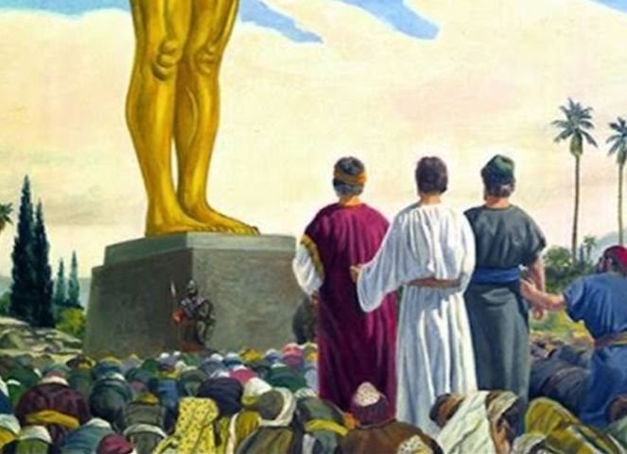
Lessons from Courage and Commitment
Edward Church
Oct 16, 2016
Daniel 3

Slide 3
God Desires Us to Engage in the Battle and Give It Our All (Time, Talent, Resources)
Satan Desires Us to Disengage or…
…At Least Give It Very Little. (Lack of Interest)
One Thing that Will Keep Us or Break Us is Our Focus.
Our Focus on God, His Word, His Ability, His Mission
In Order to Keep Our Focus Requires Courage/ Commitment.

Slide 4
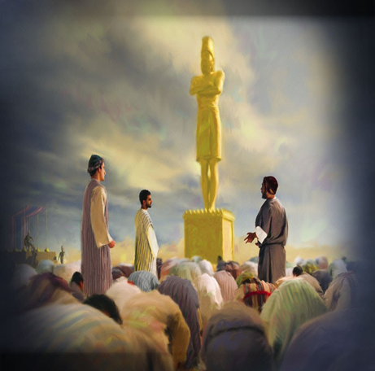
Lessons About …
…Courage and
…Commitment

Slide 5
Your Commitment Will Be Tested
It Usually Begins with a Struggle (8-12)
It Seldom Surrounds Abilities or Gifts…
…but Character
It Is the Result of Choice…
…Not Condition (8-12)

Slide 6

Your Courage Will Be Tested (17-18)
Courage is Not the Absence of Fear…
…Acting In Spite of Fear
…Knowing He is w- Us
“Our God is Able to Deliver us”
  They were Committed to God
“Our God Whom We Serve”
  They Had a History of Commitment to God
    Serve (worship- bond slave)-Lifestyle
    Direct Conflict w- King (status quo)

Slide 7
Courage is Not a Matter of Fearlessness…
…but a Matter of Trust/ Faith
…That’s How to Do It Afraid

Slide 8
Your Courage Will Be Tested (17-18)
Courage is Not the Absence of Fear
“Our God is Able to Deliver us”
“Our God Whom We Serve”
“He Will Deliver Us”
  They Believed God was Committed to Them
“But If Not…”
  They Were Committed to Let God Be God
…Do U Trust God to this Point?

Slide 9
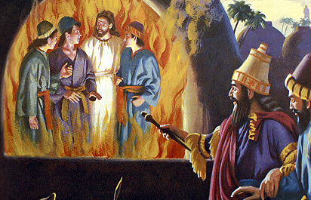
Your Courage/ Commitment to God Can Be Trusted
It Grows When We Settle the Issue Before It Arises Chap 1, 2
It is Enhanced by a Deep Trust in God (6-18)
You Will Discover…
…God Will Protect and Provide (19-23)
  Others Will See It and Recognize It (24-25)
  And See God Raise You to New Levels (26-30)

Slide 10
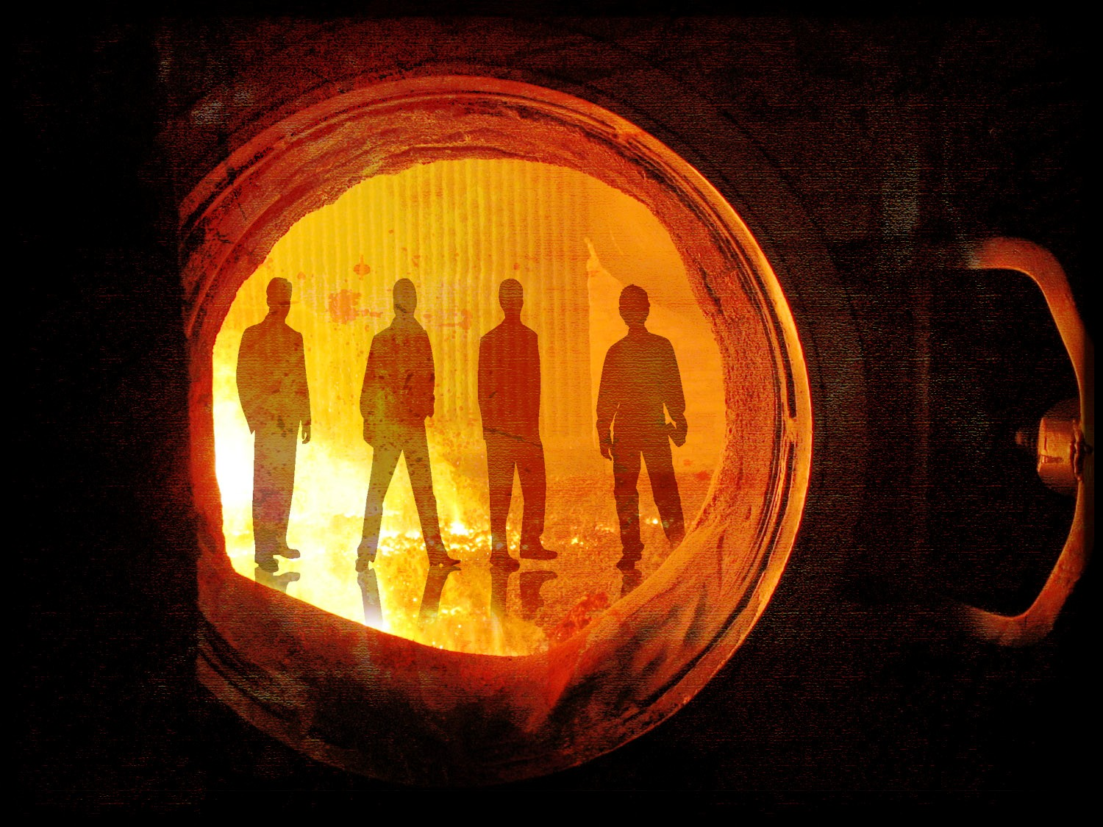
He Will Walk Through The Fire…
…With Me

