Slide 2
The Way It Really Is
“Getting Back Our Focus”
Isaiah 6:1-9
Edward Church
11-13-2016

Slide 3
Isaiah 6 (KJV)
In the year that king Uzziah died I saw also the Lord sitting upon a throne, high and lifted up, and his train filled the temple.
² Above it stood the seraphims: each one had six wings; with twain he covered his face, and with twain he covered his feet, and with twain he did fly.
³ And one cried unto another, and said, Holy, holy, holy, is the Lord of hosts: the whole earth is full of his glory.
⁴ And the posts of the door moved at the voice of him that cried, and the house was filled with smoke.
⁵ Then said I, Woe is me! for I am undone; because I am a man of unclean lips, and I dwell in the midst of a people of unclean lips: for mine eyes have seen the King, the Lord of hosts.
⁶ Then flew one of the seraphims unto me, having a live coal in his hand, which he had taken with the tongs from off the altar:
⁷ And he laid it upon my mouth, and said, Lo, this hath touched thy lips; and thine iniquity is taken away, and thy sin purged.
⁸ Also I heard the voice of the Lord, saying, Whom shall I send, and who will go for us? Then said I, Here am I; send me.

Slide 4
Unstable Times
Politically
Physically
Spiritually
Sound Familiar?
They Lost Their Focus

Slide 5
“Getting Back Our Focus”
The Way It Really Is

Slide 6
He is On the Throne (1)
Focus
He Is The…
King of Kings- Lord of Lords
Ruler of All Things
In Control –Always Has /Always Will Be
Absolute Sovereign Ruler of Everything
Not About To Give Up His Reign

Slide 7
He is High and Lifted Up (1)
He Is Above All Things
Nothing Has Dominion Over Him
Everything Is Under Him
All Governments…
All Power…
All People…
… And You
Focus

Slide 8
His Train Fills the Temple (1)
His Train Represents His Power
His Power is Everywhere…
…and Reaches Everywhere
We Cannot …
Escape God
Hide From Him
Run From Him
Sooner or Later…
…Everyone Will Stand Before Him
Focus

Slide 9
He is Holy (3)
Focus
He is…
…Set Apart from…
…Everyone and Everything
Perfect
Sinless
Uncompromising w- Sin

Slide 10
His Power is Awesome (4)
When He Speaks…
…the Earth Shakes
In His Hands He Holds…
All Creation
Our Lives
He Has The Power To…
Do Anything He Wishes
Speak and It’s Done
Focus

Slide 11
That’s How It Really Is
Focus

Slide 12
How We Really Are
We’re in Trouble. “Woe is me! for I am undone…”
How Can We Dare to Stand Before God?
Here Is The High and Almighty God
Here We Are, Low and Dirty and Weak
We’re Hopeless. “because I am a man of unclean lips…”
When We Stand Before God…
Our Sin Is Magnified
We See Ourselves As God Sees Us
Focus

Slide 13
How We Really Are
We’re in Trouble- “Woe is me! for I am undone…”
We’re Hopeless- “..I am a man of unclean lips…”
We Have No One to Help Us- “I dwell in the midst
of a people of unclean lips…”
Everybody is a Sinner
There is No One to Turn To
We Stand ALONE Before God
Even Trump and Clinton!
Focus

Slide 14
His Touch!
The Same one Who Reveals Our Condition…
…Heals Our Condition
He Loves us too Much…
…to Leave Us the Same as He Found Us
Focus

Slide 15
His Touch!
Then one of the seraphim flew to me with a burning coal he had taken from the altar with a pair of tongs. ⁷ He touched my lips with it and said, “See, this coal has touched your lips. Now your guilt is removed, and your sins are forgiven.”
#1- He Touches Us…
…in Order for Us to Touch Others
#2- God’s Actions Effected Isaiah’s Attitude
⁸ Then I heard the Lord asking, “Whom should I send as a messenger to this people? Who will go for us?”
I said, “Here I am. Send me”
Focus

Slide 16
Isaiah 6 (NLT)
6 It was in the year King Uzziah died^{[a]} that I saw the Lord. He was sitting on a lofty throne, and the train of his robe filled the Temple. ² Attending him were mighty seraphim, each having six wings. With two wings they covered their faces, with two they covered their feet, and with two they flew. ³ They were calling out to each other, “Holy, holy, holy is the Lord of Heaven’s Armies! The whole earth is filled with his glory!” ⁴ Their voices shook the Temple to its foundations, and the entire building was filled with smoke. ⁵ Then I said, “It’s all over! I am doomed, for I am a sinful man. I have filthy lips, and I live among a people with filthy lips. Yet I have seen the King, the Lord of Heaven’s Armies.” ⁶ Then one of the seraphim flew to me with a burning coal he had taken from the altar with a pair of tongs. ⁷ He touched my lips with it and said, “See, this coal has touched your lips. Now your guilt is removed, and your sins are forgiven.” ⁸ Then I heard the Lord asking, “Whom should I send as a messenger to this people? Who will go for us?” I said, “Here I am. Send me.”

Slide 18
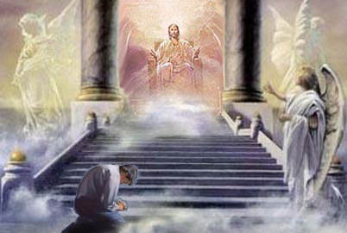
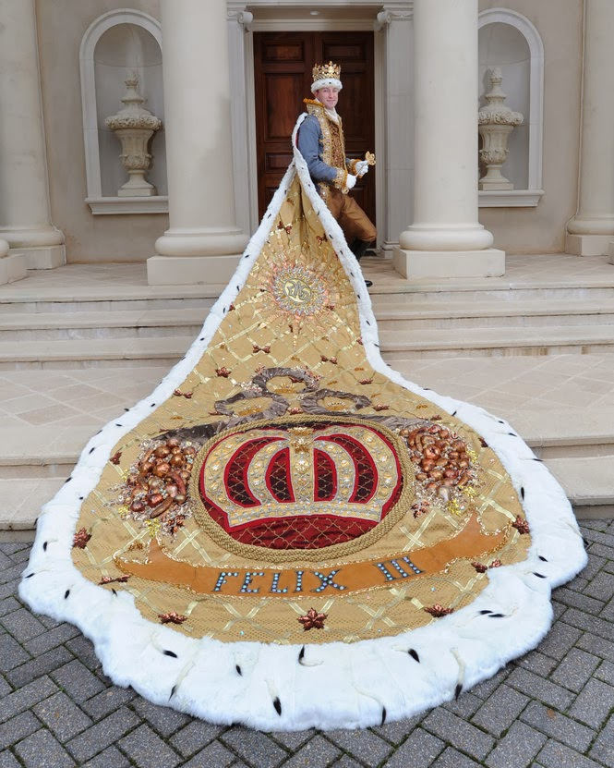

Slide 19
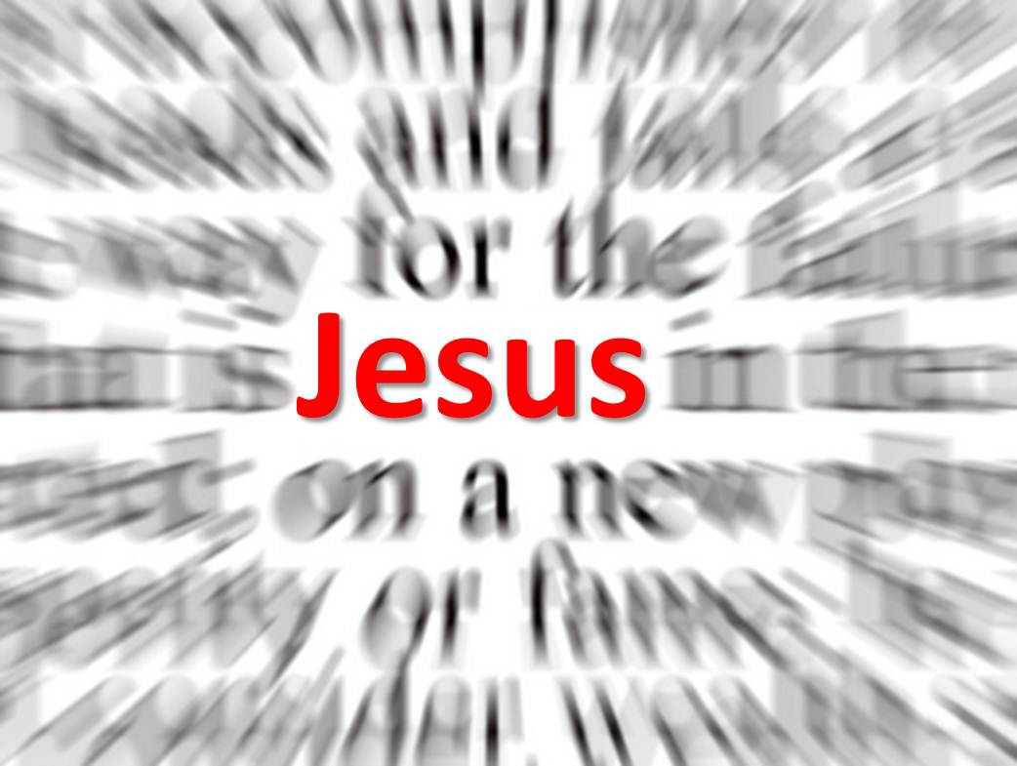
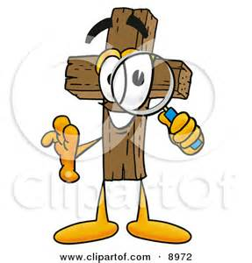
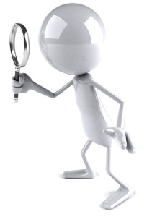

Slide 20
