Slide 2
Let Me Tell You… …About Christ
Dec 6, 2016
Edward Church
Revelation 1:12-18

Slide 3
Revelation 1:12-18: Then I turned to see the voice that spoke with me. And having turned I saw seven golden lampstands, and in the midst of the seven lampstands One like the Son of Man, clothed with a garment down to the feet and girded about the chest with a golden band. His head and hair were white like wool, as white as snow, and His eyes like a flame of fire; His feet were like fine brass, as if refined in a furnace, and His voice as the sound of many waters; He had in His right hand seven stars, out of His mouth went a sharp two-edged sword, and His countenance was like the sun shining in its strength. And when I saw Him, I fell at His feet as dead. But He laid His right hand on me, saying to me, “Do not be afraid; I am the First and the Last. I am He who lives, and was dead, and behold, I am alive forevermore. Amen. And I have the keys of Hades and of Death.”

Slide 4
Every Book in the Old Testament…
…Points Toward Him,
Every Book in the New Testament…
…Reveals Him.
Any Where You Cut the 66 Books of the Bible…
…They Bleed Red

Slide 5
All the Types and Figures Speak of Him are Significant and Beautiful to Consider.
He is Seen as a Lamb and the Lion…
…a Fountain, and a Rock.
He is Described as Wonderful, Counselor, Mighty God
Jesus is Living Bread and Living Water
He is the All-together Lovely One
Of the Many Descriptions of Jesus…
…None Are Any More Concise or Even Compact
…As the One John Gives As He Sees Him on Patmos

Slide 6
He Gave 10 Descriptions of Jesus in this Text that Speak
…Of His Deity, Dignity, and Distinction.
John’s Description Speaks of the...
…Lord’s Prominence, Purpose, and Power
Take Note Of What John Wrote About Jesus:

Slide 7
He Is the Resurrected Christ (13)
“One like unto the Son of man”
He is Seen in His Human Form, Yet Glorified.
Jesus Showed Some Aspects of His Glory, but Not All, Because It Would Have Been Too Overpowering!
As Mary Recognized Him in the Garden, and as the Disciples Enjoyed Him in the Upper Room…
…We Will Recognize the Ascended Savior Some Day

Slide 8
He Is the Reigning Christ (13)
“clothed with a garment down to the feet”
This Description Indicates Garments of a King / Judge
He Has Already Come as our Savior/, When He Returns…
…as Judge
Revelation portrays Jesus as no other book…
…He is Not the Meek and Lowly Lamb, But the Reigning King

Slide 9
He Is the Righteous Christ (14)
“His head and hair were white like wool, as white as snow.”
This Speaks of His Holiness.
A relationship with Jesus produces a cleansing and purity that aligns us with, and hides us in, His righteousness.
Isaiah 1:18: “‘Come now, and let us reason together,’” says the Lord. ‘Though your sins are like scarlet, they shall be as white as snow; though they are red like crimson, they shall be as wool.’”

Slide 10
He Is the Revealing Christ (14)
“His eyes were “like a flame of fire.”
His Discerning Vision Will Examine Everyone
Long before “X-Ray Vision” there was an All-Seeing Christ who Knows and Sees All. Nothing shall be hidden that will not be revealed.
“And there is no creature hidden from His sight, but all things are naked and open to the eyes of Him to whom we must give account” -Hebrews 4:13

Slide 11
He Is the Relentless Christ (15)
“His feet were like fine brass, as if refined in a furnace.”
This Verse Speaks of the Fact -He Is Unstoppable
Brass is a Symbol of judgment
His Feet Will Carry Him Forth to Judge the Earth. “And they cried with a loud voice, saying, ‘How long, O Lord, holy and true, until You judge and avenge our blood on those who dwell on the earth?’” -Revelation 6:10
“Fear God and give glory to Him, for the hour of His judgment has come; and worship Him who made heaven and earth, the sea and springs of water” -Revelation 14:7

Slide 12
He Is the Regal Christ (15)
“His voice [was] as the sound of many waters”
He always Has and Always Will Be in Control
“The voice of the Lord is upon the waters. The God of glory thunders. The Lord is upon many waters. The voice of the Lord is powerful. The voice of the Lord is full of majesty” -Psalm 29:3-4

Slide 13
He Is the Regulating Christ (16)
“He had in His right hand seven stars”
He is Able to Hold and Balance Everything in His hands.
“For in Him we live and move and have our being” -Acts 17:28
“And He is before all things, / in Him all things consist” -Col 1:17

Slide 14
He Is the Revenging Christ (16)
“Out of His mouth went a sharp two-edged sword”
The Sword is His Holy Word. He is not only coming back to Receive His Own, but He will also Take Vengeance upon the Enemy.
“Repent, or else I will come to you quickly and will fight against them with the sword of My mouth” -Revelation 2:16
“Now I saw heaven opened, and behold, a white horse. And He who sat on him was called Faithful and True, and in righteousness He judges and makes war” (19:11); “Now out of His mouth goes a sharp sword, that with it He should strike the nations. And He Himself will rule them with a rod of iron. He Himself treads the winepress of the fierceness and wrath of Almighty God” (19:15).

Slide 15
He Is the Remarkable Christ (16)
“His countenance was like the sun shining in its strength”
Paul Saw this Face Of Christ and Was Blinded.
The Light Of Heaven Is Jesus Christ.
He Is Brighter than the Noonday Sun.

Slide 16
He Is the Reassuring Christ (17-18)
“And when I saw Him, I fell at His feet as dead. But He laid His right hand on me, saying to me, ‘Do not be afraid; I am the First and the Last. I am He who lives, and was dead, and behold, I am alive forevermore. Amen. And I have the keys of Hades and of Death”
Sixty years earlier, John Leaned on Jesus…
…But Now, He Fell as Dead.
“And when I saw Him, I fell at His feet as dead. But He laid His right hand on me, saying to me, ‘Do not be afraid’” (17).
“These things I have spoken to you, that in Me you may have peace. In the world you will have tribulation; but be of good cheer, I have overcome the world” -John 16:33

Slide 17
That is the Message He Assures Us with Today
“Do not be afraid” (17)

Slide 18
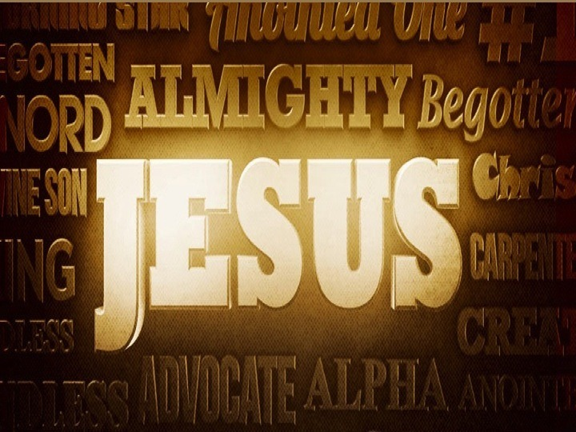

Slide 20
