Slide 2
5 Reasons… …Christmas is …Good News
Edward Church
Luke 2:1-14
Dec 11, 2016

Slide 3
⁸ And there were in the same country shepherds abiding in the field, keeping watch over their flock by night.
⁹ And, lo, the angel of the Lord came upon them, and the glory of the Lord shone round about them: and they were sore afraid.
¹⁰ And the angel said unto them, Fear not: for, behold, I bring you good tidings of great joy, which shall be to all people.
¹¹ For unto you is born this day in the city of David a Saviour, which is Christ the Lord.
¹² And this shall be a sign unto you; Ye shall find the babe wrapped in swaddling clothes, lying in a manger.
¹³ And suddenly there was with the angel a multitude of the heavenly host praising God, and saying,¹⁴ Glory to God in the highest, and on earth peace, good will toward men.

Slide 4
Good News
Jesus was Born
Not to sell cards and merchandise
He Came as Our…
Kinsman Redeemer
Daysman
It started at the Manger and Finished at the Cross
Christ- Mass
This is Good News …

Slide 5
Because it Attacks Fear (10)
Fear Can Be…
Normal
Healthy
Protective
The Fear Mentioned Here…
Unrealistic
Unnecessary
Unproductive
“Phobos = Phobia”

Slide 6
Because It Attacks… …with the Weapon of Joy (10)
Notice the Bible doesn’t say great happiness – it says JOY.
Happiness Comes And Goes= surroundings= happenings
BUT JOY Endures= surrounded = Relationship
Joy= full of cheerfulness – Calm Delight
The Daysman was Here
the fruit of the Spirit is love, joy, peace, longsuffering, gentleness, goodness, faith, Meekness, temperance: against such there is no law –Gal 5:22-23

Slide 7
Because It is for Everybody (10)
It is good news for everyone; red yellow black or white.
Everyone regardless of age, gender, height or shortness, educational level, the whosoever wills/ the whosoever wont’s
This is Good News it’s for everyone.

Slide 8
Because It Includes Me (11)
This is about God’s Christmas Present to Me
Do you know what – God so loved me that he sent his son – that if I believe in him I will not perish – but I’ll have Eternal Life.
2 Things About Spirituality
#1- I Have to Take Care of Me
#2- I Can Give What I Do Not Have
Salvation Comes to Individuals…
…Jesus is Our Personal Savior

Slide 9
Because It Is About a Savior (11)
If You Have a…
plumbing problem – you need a plumber.
car problem – you need a mechanic.
electrical problem - you need an electrician.
But We have a Sin Problem…
…We need a Savior= “Sozo” = Deliverer- Safe- Protector
…that is What God Sent.
…Jesus Who is the Christ.
That’s the Good News!

Slide 10
The Sky Filled with Host (13)
They Couldn’t Hold Back…
…They Were About to Burst at the Seams!!!
“Glory to God in the highest (Praise! Exalt Him!)
…and on earth Peace (Join together what was separated)
…good will toward men” (those who have allowed God to Affect
their Attitudes)

Slide 12
Fear -phobos
Behold -stop -look- listen
Good -Good News! -Change your focus
Joy- (chairo); cheerfulness, i.e. calm delight :- gladness, × greatly, (× be exceeding) joy (-ful, -fully, -fulness, -ous).
BORN- God is DOING a NEW Thing
Saviour- (sozo); a deliverer, i.e. God or Christ :- saviour. from- from a primary sos (contracted for obsolete saos, “safe”); to save, i.e. deliver or protect (literal or figurative) :- heal, preserve, save (self), do well, be (make) whole.
Christ-anointed, i.e. the Messiah, an epithet of Jesus :- Christ. -to smear with oil
Suddenly -the Heavenlies could not hold back and longer!
Multitude -(pletho); a fulness, i.e. a large number, throng, populace :- bundle, company, multi
Glory-
Highest-
Peace- primary verb eiro (to join); peace (literal or figurative); by implication prosperity :- one, peace, quietness, rest, + set at one again.- - He came to us in order that we could go to him
Earth-
Good will- compound of <G2095> (eu) and the base of <G1380> (dokeo); satisfaction, i.e. (subject) delight, or (object) kindness, wish, purpose :- desire, good pleasure (will), × seem good
Fr-
Toward-
Men

Slide 13
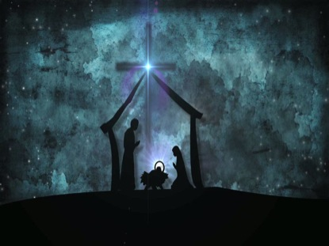
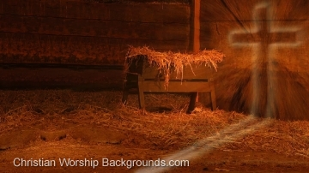
Dec 11, 2016

Slide 14
