Slide 2
Soul Mates
Someone Who is Aligned With Your…
…Soul (heart, mind, emotions)
Sent to…
Challenge
Awaken
Stir You
In Order For You to Be Better…
…Than You Could Be Alone

Slide 3
Why Do We Pick Our Spouse (soul mate)?
Both Unhealed and Incomplete
God Sends Us A Spouse To Help Fix Us…
Not The Way You May Be Thinking
You May Say …Well I Don’t Feel Healed? Complete?
Dating- Performance Mode…
After “I do” – We Go Into Our…
Actual Mode
Begin to Take Each Other for Granted…
It is At This Point…Say… This Is Not My Soulmate

Slide 4
Stale
Pt 2
Ecclesiastes 4:9-12
Edward Church
Feb 19, 2017

Slide 5
God’s Reasons for Marriage
Genesis 2:18-25 (KJV) ¹⁸ And the LORD God said, It is not good that the man should be alone; I will make him an help meet for him. ¹⁹ And out of the ground the LORD God formed every beast of the field, and every fowl of the air; and brought them unto Adam to see what he would call them: and whatsoever Adam called every living creature, that was the name thereof. ²⁰ And Adam gave names to all cattle, and to the fowl of the air, and to every beast of the field; but for Adam there was not found an help meet for him. ²¹ And the LORD God caused a deep sleep to fall upon Adam, and he slept: and he took one of his ribs, and closed up the flesh instead thereof; ²² And the rib, which the LORD God had taken from man, made he a woman, and brought her unto the man. ²³ And Adam said, This is now bone of my bones, and flesh of my flesh: she shall be called Woman, because she was taken out of Man. ²⁴ Therefore shall a man leave his father and his mother, and shall cleave unto his wife: and they shall be one flesh. ²⁵ And they were both naked, the man and his wife, and were not ashamed.

Slide 6
In the Garden God said, “it was not good that man be alone…”
incomplete
Gen 2:18, “I will make him a Help Meet…”
(Adsor) means to supply what is lacking… from rib –not dirt
Sign He Was Incomplete –Lacking
She Was Made from The Lacking Part =Perfect Companion
God Knew That Adam Didn’t Need Another Adam..
Then Have 2 Incompletes
God Knew He Needed Some One To Fill The Gaps
Compliment –Complete

Slide 7
Soul Mates
A Soul Mate is Someone who has…
…Locks that Fit Out Our Keys
…And Have Keys that Fit Our Locks
The Truth About Soulmates Are…
…They Are Two Incomplete Vessels…
…Two Broken Vessels
…Filled With Weaknesses
…But Our Soulmates Strengths
…Make Up For Our Weaknesses

Slide 8
Myths About Soul Mates
My Soul Mate Will…
#1- Be Like Me
#2- There Will Be NO Issues/ Problems (always be in love)
#3- Always Make Me Happy and Meet All My Needs
No Person Can Always Make Me Happy
No Person Can Always Meet My Needs
Happiness Foundations Come From God

Slide 9
How Do You Find…
…Your Perfect
…Soul Mate?

Slide 10
I Sam 18:1- …soul of Jonathan was knit with the soul of David, and Jonathan loved him as his own soul.
Deut 13:6- …thy friend, which is as thine own soul
Song of Solomon 3:4- I have found the one whom my soul loves

Slide 11
Quit Searching for the Perfect Soul Mate…
…Be the Perfect Soul Mate
Then Instead of You Searching…
…You Will Begin to Attract
…the Perfect Soul Mate

Slide 12
What is a Soul
Will and Emotions and Mind
One Of Biggest Decisions In Life ..Let Will Rule Your Emotions
If You Let Your Emotions Rule Over Your Will…
…Bible Call These Weak Willed People
Countless Times In Life Your Will Has to…
…Over Ride Your Emotions/ Say NO!
Not A Matter Of Chance But Choice
Not What- I Am Not Getting But…
…What I Can I Give Into This Marriage?

Slide 13
How Do I Become What I Am Looking For?
Choices..
#1- Empathy= Understanding/ entering into another's feelings
When Dating we Tend to Be Extremely Empathetic…
…Careful What We Say / Do
… Very Sensitive To Surroundings
….In Order to Guard / Positively Effect Their Feelings

Slide 14
How Do I Become What I Am Looking For?
If You Can Practice Empathy (5 min/ day)
…Your Mate will Begin to Feel
Protected… Safe… Appreciated…
Problem –After I Do –Get TOO Comfortable
Loose Interest – Take For Granted – Verbally Abuse
Empathy says, “I wonder what its like to be married to me?”
My Words- Lack Of Words- My Silence -My Sarcasm
How Does it makes them feel?

Slide 15
How Do I Become What I Am Looking For?
#1- Empathy- what is it like to be married to me?
#2- Generosity- Prov 11:25 –the gen soul will be made rich/ he who waters will also be watered himself
Generous SOUL is a Choice –it can have emotion w- it but doesn't have to
When you date – you give words. Attention…care
Soul mates invest in each other –but it begins with You!
You don’t just reap what your so but where you so
Sow your soul to your spouse and you will reap their soul

Slide 16
How Do I Become What I Am Looking For?
#1- Empathy- what is it like to be married to me?
#2- Generosity- Sow your soul to spouse / you will reap her soul
#3- Priority-
Make You Marriage 1st
Marriage ONLY Works in 1st Place (will not work in any other place)
Before Anything – Kids, Church, Work,
Anything But Your Relationship With God
When Dating Put Them 1st –But After Marriage
…Starts Slipping In Priority

Slide 17
How Do I Become What I Am Looking For?
It begins with…
…ME!!!

Slide 19
God’s Reasons for Marriage
#1- Plan
God’s Plan from Beginning
#2- Prevent Solitude
Not good for Man to be alone (18)
#3- Procreation
Be fruitful and multiply..Replenish… (1:27-28a)
#4- Protect Man’s Sanctity
Cleave to wife
#5- Produce an Powerful Team
Perfect Mates -made from Adams Rib (21)
Soul Mates -Naked and Not Ashamed (25)
Powerful Mates -Subdue and Dominion (1:28b)

Slide 20
Will -> Emotions
Emotions -> Will

Slide 21
Soul Mate Scriptures
I Sam 18:1- …soul of Jonathan was knit with the soul of David, and Jonathan loved him as his own soul.
Deut 13:6- …thy friend, which is as thine own soul
Song of Solomon 3:4- I have found the one whom my soul loves
Rather than looking for the perfect match…be the perfect match
True love is not based on a feeling
But is based on a decision, sacrificing, not self serving
I Cor 13 –characteristics of God Kind of love
Gal 5:22- God’s Personality

Slide 23
Myths About Soul Mates
My Soul Mate Will…
#1- Be Like Me
Compatibility is Based on Character/ Values…
…NOT Sameness
Your Perfect Soul Mate is VERY Different From You

Slide 24
Myths About Soul Mates
My Soul Mate Will…
#1- Be Like Me
#2- There Will Be NO Issues/ Problems (always be in love)
Soul Mates are Not Born…
…They are Made
Two Committed Souls Roll Up Sleeves…
…Fight the Good Fight
…Step Through the Fire

Slide 25
Soul Mates
Stale Mates
Two People that Are Connected But…
Broken:
Incomplete - weaknesses
Insufficient - unable to fix it
Incapable - cannot be all you can be
Believe It or Not …
… That’s Part of God’s Plan
Marriage is to Model the Church
I Cor 12:12 – the Need
Eph 5:22-25 –the Order

Slide 26
Power of Soul Mates
Ecclesiastes 4:9-12 (KJV)
⁹ Two are better than one; because they have a good reward for their labour.
¹⁰ For if they fall, the one will lift up his fellow: but woe to him that is alone when he falleth; for he hath not another to help him up.
¹¹ Again, if two lie together, then they have heat: but how can one be warm alone?
¹² And if one prevail against him, two shall withstand him; and a threefold cord is not quickly broken.

Slide 27
Soul Mates
Two People Connected and Informed…
Complete
Strengths Compliment Weaknesses
Sufficient
Ecclesiastes 4:9-11 (AMP) ⁹ Two are better than one, because they have a good [more satisfying] reward for their labor; ¹⁰ For if they fall, the one will lift up his fellow. But woe to him who is alone when he falls and has not another to lift him up! ¹¹ Again, if two lie down together, then they have warmth; but how can one be warm alone?
Capable
Ecclesiastes 4:12 (AMP) ¹² And though a man might prevail against him who is alone, two will withstand him. A threefold cord is not quickly broken.

Slide 28
Soul Mates Are…
…Not Perfect
…But Powerful in Their Imperfections
…When They Align with Each Other and God
Ecc 4:12 (AMP) A threefold cord is not quickly broken.

Slide 30
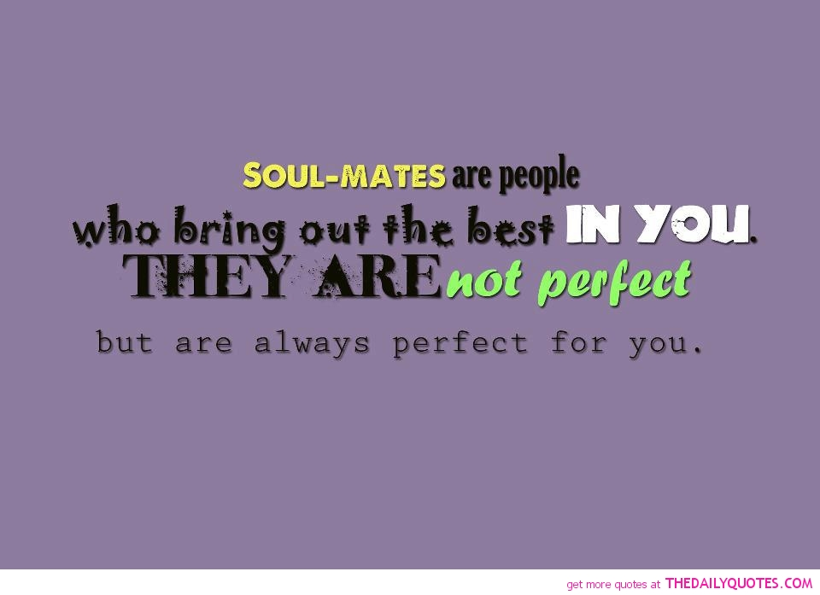
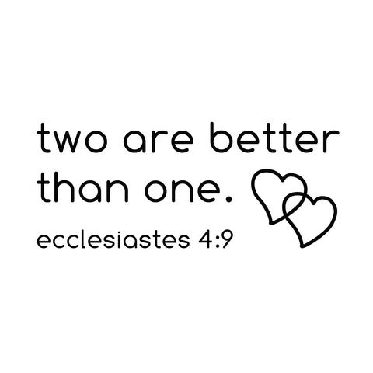

Slide 31
Gal 5:22-23
9 (relational gifts) qualities of Jesus

