Slide 2
How to Thrive in Tough Situations
Acts 27
Feb. 5, 2017
Edward Church

Slide 3
Tough Times
Come to Us All
Sometimes Because of…
Our Actions (in our control)
Others Actions (out of our control)
God’s Actions (out of everybody’s control)

Slide 4
How to Thrive…
Learn Lesson-
If God Allows Tough Times- Always a Lesson
When You Can’t See God’s Hand…
…You Can Trust His Heart. (20-25)
David/ Goliath = David(little is much w- God)
Goliath(never underestimate)
Dan/ Lions Den = Dan (trust God in worst times)
King (there is No God like ours)

Slide 5
How to Thrive…
Learn Lesson-
If God Allows Tough Times- Always a Lesson
When You Can’t See God’s Hand…
…You Can Trust His Heart. (20-25)
Listen
Listen to the Word of God.
You Never Know the Complete Truth About Any Situation…
…Until You Hear From Him. (26)

Slide 6
How to Thrive…
Lean
Don’t Panic and Take Matters Into Your Own Hands.
God’s Word is the Truth…
…Regardless of the Circumstances.
Isaiah 55:11, “My Word will not return void..”
Keep trusting the Lord along the way. (27-32)
Live
Don’t Stop Living…
…You Need Strength to Continue On. (33-38)
Neh 8:10, “the joy of the Lord is our strength”

Slide 7
How to Thrive…
Let (release)
Let God Have the Boat and Let Him Be the Pilot.
If He Wants to Wreck It, Let Him…
…He Really Does Know What He is Doing. (39-41)

Slide 8
(41), “Falling where two seas met”
Falling = into something that engulfs you
Place of
No PEACE
No Go!
Rush –Suction –Whirlpool
Place of Violence/ Unevenness –Forms Sandbar
Broke Up the Only Thing Left…
…Standing Between Them / Storm…
…the Boat
God Was STILL in CONTROL!

Slide 9
How to Thrive…
Let (release)
Let God Have the Boat and Let Him Be the Pilot.
If He Wants to Wreck It, Let Him…
…He Really Does Know What He is Doing. (39-41)
Look
Look for the Way of Escape God Provided- I Cor. 10:13
It Will Always Be There Even Though…
…It May Not Be The Way You Pictured It. (42-44)
Elijah- Brook/ Ravens(buzzards)- road kill café

Slide 10
The Great Escape -Melita 28:1
18 miles long x 8 miles wide
Imposs to Hit w/out Proper Navigation
But God Guided Them Through
…500 mi. of Turbulent Waters

Slide 11
First Things First
When They Found Themselves On This Island…
…They Took Time To Build A Fire. (2,3)
The Fire Would…
Comfort Them.
Change Their Condition…..Cold And Wet to Warm
Mark Them… Tell Others Where To Find Them.
Guard Them From the Beasts

Slide 12
Here is the Spiritual Key (1)
When You’re Weary, Weak, Confused…
…Just Don’t Know What to Do…
…Build a Fire!
Stir Up Those Holy Ghost Fires in Desolate Place…
…Watch God Can Do
The Holy Ghost Fire Will
Comfort You
Change Your Condition
Mark You
Guard You From This Old World

Slide 13
Just When You Thought it was Safe (3-10)
Serpent
Satan Will Rise Again
Shake It Off!!!
What Satan Meant for Bad…
…God can use for Good
…they brought the sick to him

Slide 15
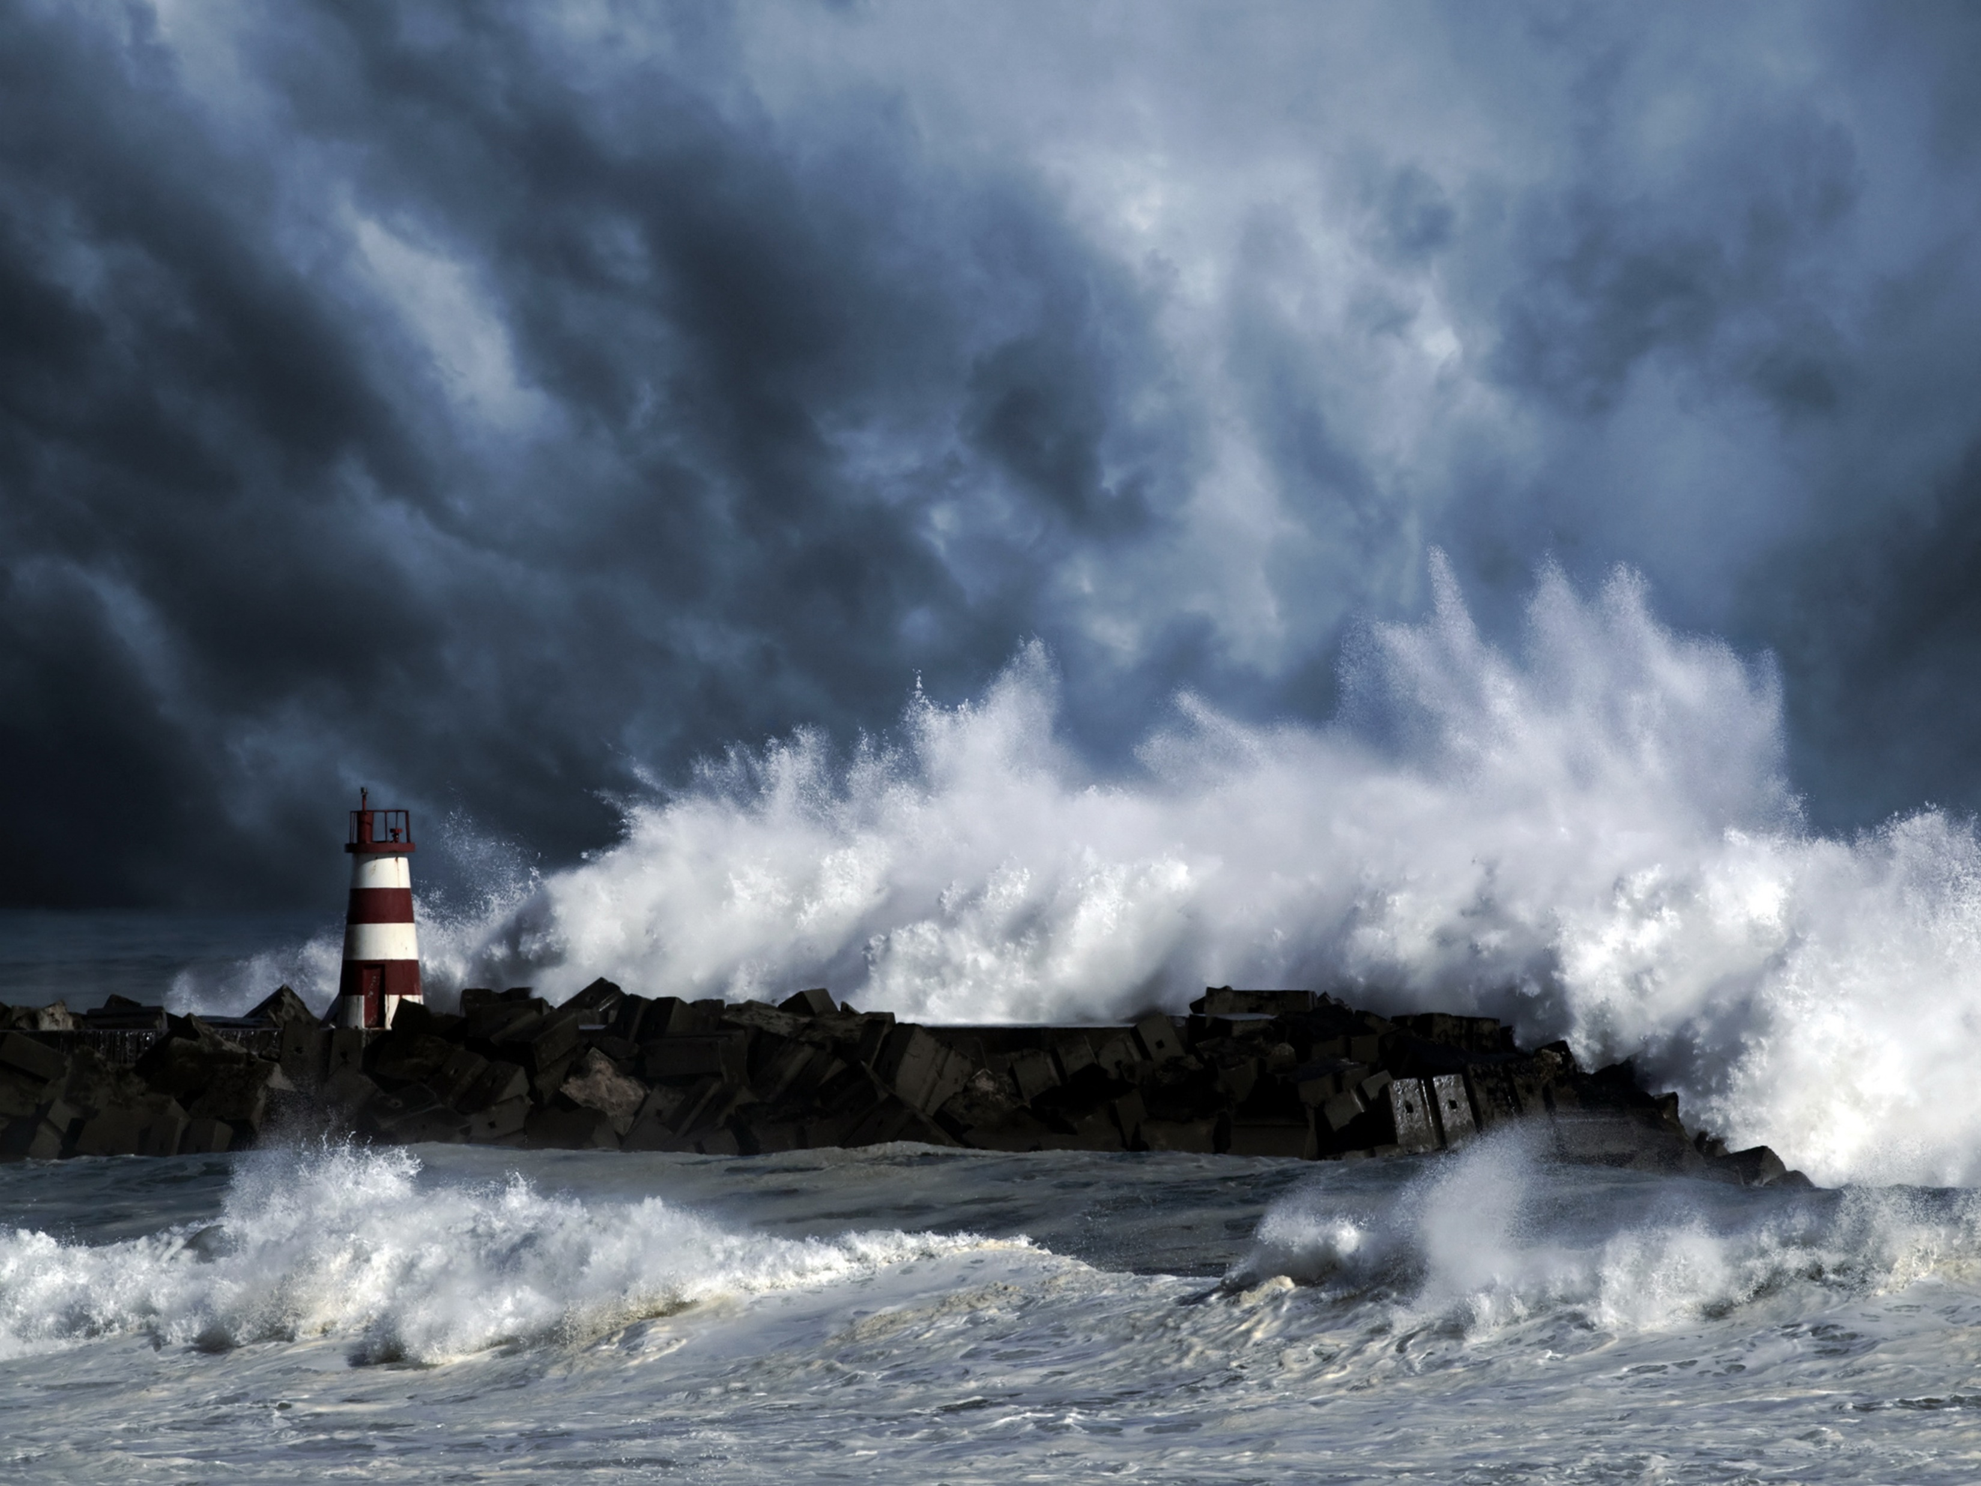
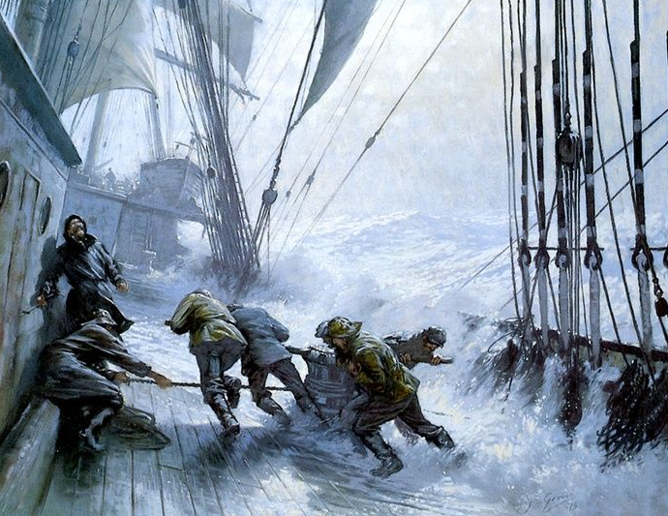
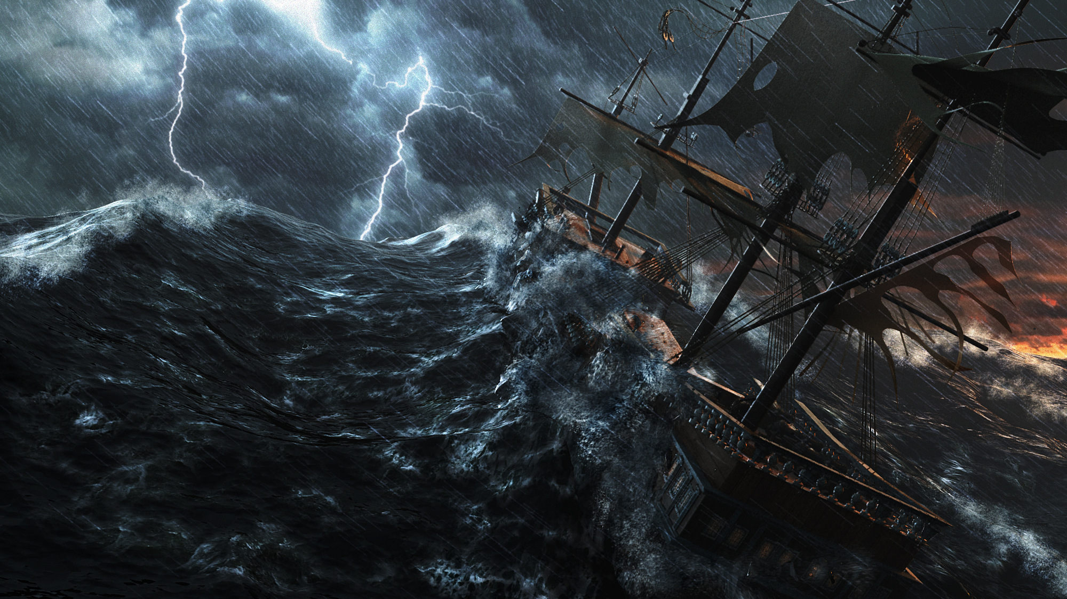

Slide 16
Look Out For Retribution (28:3)
Serious
Satan doesn’t take your victory lightly
a- came out of the heat
b- II Cor 11:14, “transformed angel..”
Sought
Paul was the one who led them to victory; therefore he was attacked
Shake It Off
It ain’t over ‘til it’s over!

Slide 17
Reach Out and Touch Others (28:7-9)
Tendency
To look within
Triumph
Comes when we look at others
Turned
Everybody’s attention to God
Demonstration of Holy Ghost power

