Slide 2
A Mother's Dictionary
Bottle Feeding:
An opportunity for Daddy to get up at 2 a.m. too.
Defense:
What you'd better have around de yard if you're going to let the children play outside.
Drooling:
How teething babies wash their chins.
Dumbwaiter:
One who asks if the kids would care to order dessert

Slide 3
A Mother's Dictionary
Feedback:
The inevitable result when the baby doesn't appreciate the strained carrots.
Full Name:
What you call your child when you're mad at him.
Grandparents:
The people who think your children are wonderful
even though they're sure you're not raising them right.
Hearsay:
What toddlers do when anyone mutters a dirty word.

Slide 4
A Mother's Dictionary
Look Out:
What it's too late for your child to do by the time you scream it.
Prenatal:
When your life was still somewhat your own.
Prepared Childbirth:
A contradiction in terms.
Puddle:
A small body of water that draws other small bodies wearing dry shoes into it.

Slide 5
A Mother's Dictionary
Sterilize:
What you do to your first baby's pacifier by boiling it and to your last baby's pacifier by blowing on it.
Temper Tantrums:
What you should keep to a minimum so as to not upset the children.
Two-Minute Warning:
When the baby's face turns red and she begins to make those familiar grunting noises.
Whodunit:
None of the kids that live in your house.

Slide 6
Hey Mom…
…Have You Ever
Felt Insufficient ?
Realized you are required to wear many hats…
…but only have one head
…and it is about to blow off!
…or Fall Off!
Sitting here now wondering if I’m going to preach another sermon about a perfect mom and make you feel even worse?
Today is Your Day!

Slide 7
Edward Christian Church
May 14, 2017
Is It Mother’s Day Again?
Matthew 15:21
Mother’s Day ‘17

Slide 8
Sayings about Mother
A Spanish proverb says: An Ounce of Mother is Worth a Pound of Clergy
Abraham Lincoln said: No One is Poor who has a Godly Mother
A Jewish Proverb may say it Best: A Child without a Mother is like a Door without a Knob
“The hand that rocks the cradle is the hand that rules the world.” -W.R. Wallace

Slide 9
Don’t Need to Be… …a Great Somebody …to be Somebody Great
She Was a…
Poor Woman –Husband Never Mentioned
Outcast:
Birth –Canaanite/ Gentile
Situation –Daughter/ devil
No Name
But Elevated by God
One of Only 2 Jesus said had “Great Faith”
What Did She Do to Catch Jesus’ Attention?

Slide 10
Overcome Great Barriers
Mark 7:26
She Stepped Beyond Own Crisis’…
Identity (Nobody –Unnamed)
Inferiority (Woman)
Prejudice (Gentile / Canaanite)

Slide 11
Empowered By Great Love
Her Love was Powerful than Her…
Fear
Shame
Hardship and Sacrifice
1 Peter 4:8, “…love covers a multitude of sins”
1 John 4:18, “ There is no fear in love; but perfect love casteth out fear: because fear hath torment. He that feareth is not made perfect in love”

Slide 12
Armed With Great Determination
She Conquered the Test of…
Patience in Divine Silence (22-23)
…Jesus did not answer
Doubt /Discouragement (23)
…send her away
Rejection (24)
…I was sent only to...Israel
Humility (25-27)
…It is not right.... to dogs

Slide 13
Knew Power of Great Prayer
She Acknowledged…
His Divinity…
…Worship
His Control…
…Lord
She Can’t Manage Her Life…
…Without His Help

Slide 14
Kept by Great Persistent
This Woman’s Faith was Tested
in Three Ways:
She Kept After Jesus Inspite of...
His Silence
Disciples Lack Of
Being Undeserving
…She Kept Coming!

Slide 15
Crumbs
Less than Leftovers…
Disposable - Napkins
Discarded - Thrown on Floor
Dogs - Would Clean the Floor
Not Even Considered Part of the Meal
But It wasn’t “What She Got”…
…but “Who She Got it From”!

Slide 16
She Stood Til Triumphed
She Received Great;
Commendation
…You have a great faith
Approval
…Your request is granted
Miracle
…Her daughter was healed

Slide 17
She Stood Til Triumphed
Don’t Give Up!
You Don’t Have to Be Perfect…
…to Make a Difference!!

Slide 18
Done

Slide 19
Images and Notes

Slide 20
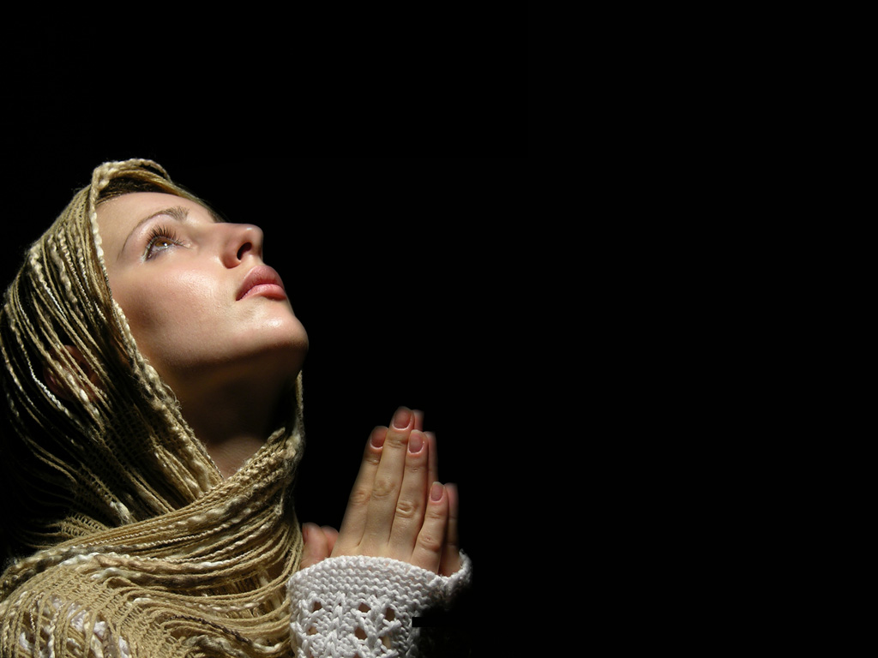

Slide 21
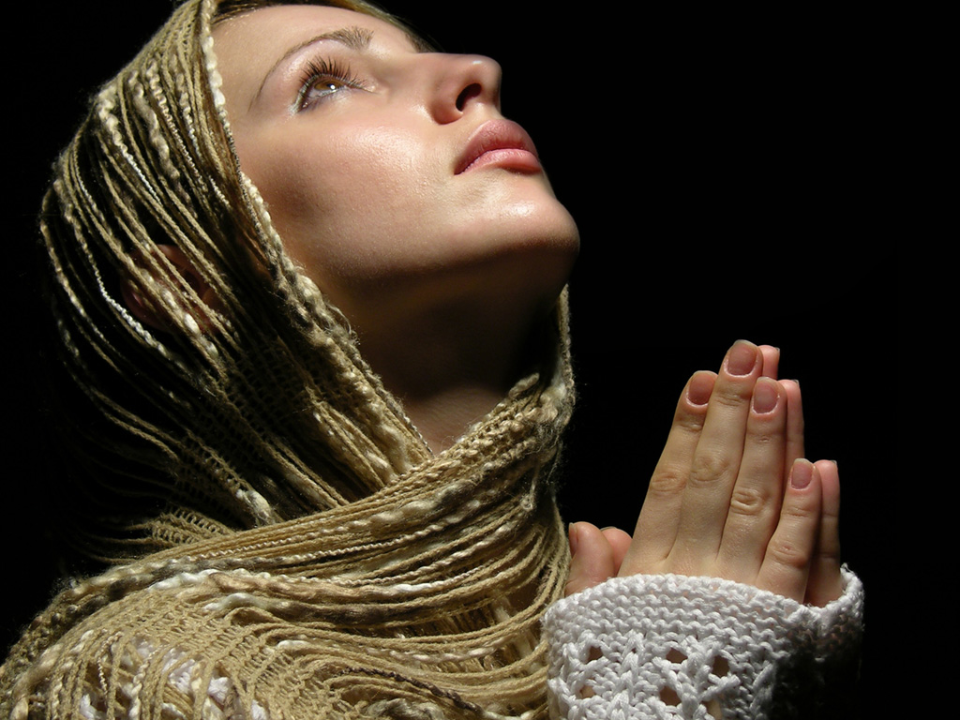

Slide 27
Mark 7:24-30 (KJV) ²⁴ And from thence he arose, and went into the borders of Tyre and Sidon, and entered into an house, and would have no man know it: but he could not be hid. ²⁵ For a certain woman, whose young daughter had an unclean spirit, heard of him, and came and fell at his feet: ²⁶ The woman was a Greek, a Syrophenician by nation; and she besought him that he would cast forth the devil out of her daughter. ²⁷ But Jesus said unto her, Let the children first be filled: for it is not meet to take the children's bread, and to cast it unto the dogs. ²⁸ And she answered and said unto him, Yes, Lord: yet the dogs under the table eat of the children's crumbs. ²⁹ And he said unto her, For this saying go thy way; the devil is gone out of thy daughter. ³⁰ And when she was come to her house, she found the devil gone out, and her daughter laid upon the bed.

Slide 28
Matthew 15:21-28 (KJV) ²¹ Then Jesus went thence, and departed into the coasts of Tyre and Sidon. ²² And, behold, a woman of Canaan came out of the same coasts, and cried unto him, saying, Have mercy on me, O Lord, thou Son of David; my daughter is grievously vexed with a devil. ²³ But he answered her not a word. And his disciples came and besought him, saying, Send her away; for she crieth after us. ²⁴ But he answered and said, I am not sent but unto the lost sheep of the house of Israel. ²⁵ Then came she and worshipped him, saying, Lord, help me. ²⁶ But he answered and said, It is not meet to take the children's bread, and to cast it to dogs. ²⁷ And she said, Truth, Lord: yet the dogs eat of the crumbs which fall from their masters' table. ²⁸ Then Jesus answered and said unto her, O woman, great is thy faith: be it unto thee even as thou wilt. And her daughter was made whole from that very hour.

