Slide 2
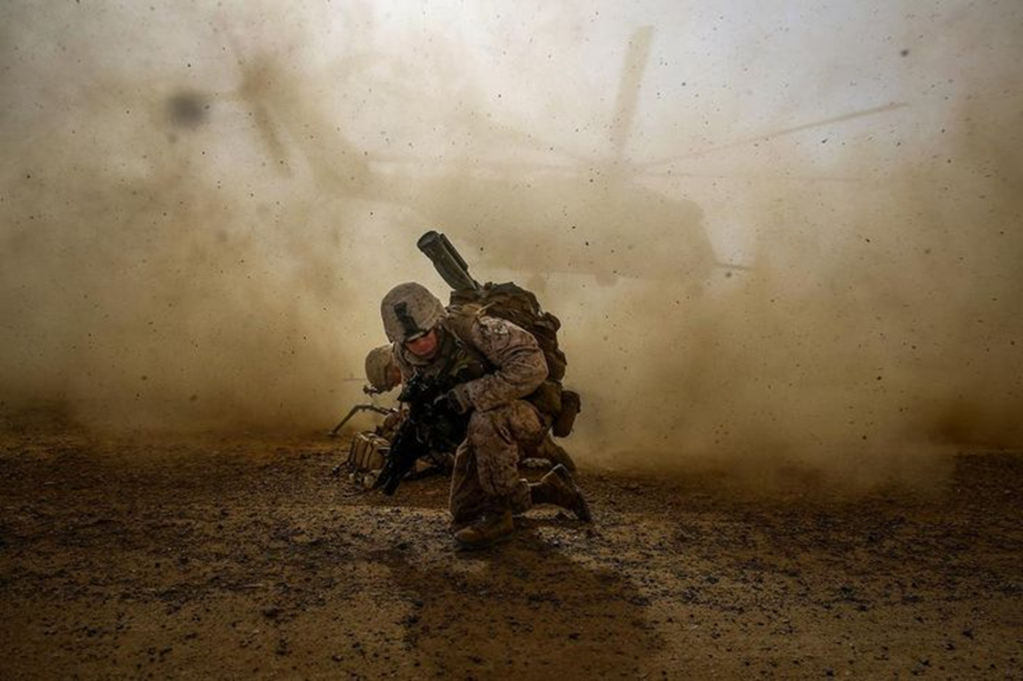
After the Dust Settles
II Cor 4:7-10
Edward Church
July 16, 2017

Slide 3
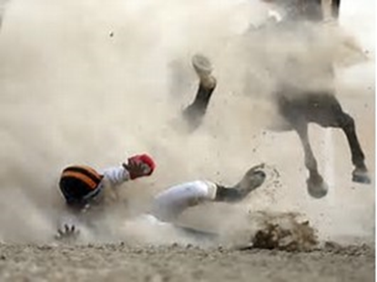
Ever Had One of Those Days?
  Weeks?
  Months?
  Years?
  Decades?
Often Your Crisis …
…Is Part of
…His Growth Plan

Slide 4

Instead of Asking God
    Why?
    Ask What?
…What Do You Want Me to Learn?
But What About After the Smoke Clears?
…What Then?

Slide 5
II Cor 4:7-10
7But we have this treasure in earthen vessels, that the excellency of the power may be of God, and not of us. 8We are troubled on every side, yet not distressed; we are perplexed, but not in despair; 9Persecuted, but not forsaken; cast down, but not destroyed; 10Always bearing about in the body the dying of the Lord Jesus, that the life also of Jesus might be made manifest in our body.
7We now have this light shining in our hearts, but we ourselves are like fragile clay jars containing this great treasure. This makes it clear that our great power is from God, not from ourselves. 8We are pressed on every side by troubles, but we are not crushed. We are perplexed, but not driven to despair. 9We are hunted down, but never abandoned by God. We get knocked down, but we are not destroyed. 10Through suffering, our bodies continue to share in the death of Jesus so that the life of Jesus may also be seen in our bodies.

Slide 6
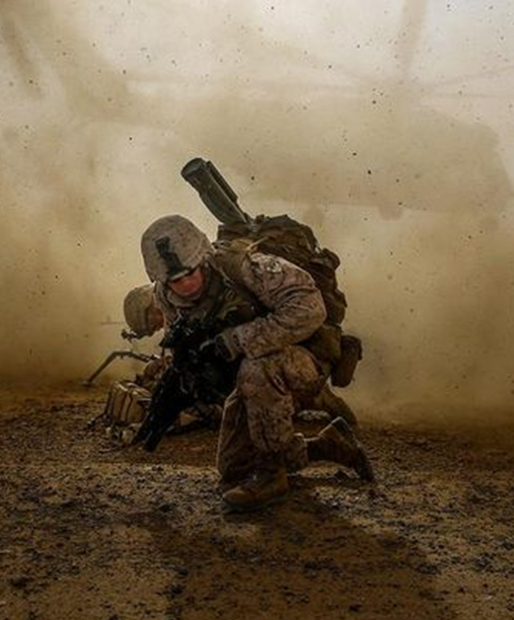
Learn The Lessons; Make The Changes
Every Crisis Has Lessons to Teach.
  Learn Those Lessons
  Make the Necessary Changes
  Move Forward
Give instruction to a wise man, and he will be still wiser; Teach
a just man, and he will increase in learning. - Proverbs 9:9
71It is good for me that I have been afflicted, That I may learn Your statutes. 72The law of Your mouth is better to me Than thousands of coins of gold and silver. -Psalm 119
I Can Do Nothing About the Direction of the Wind..
…But I Can Adjust the Sails.

Slide 7
Healing Continues After the Crisis Passes
After a Major Life Crisis, Don’t Expect Instantaneous Healing
  Expect a Emotional Aftershocks.
  You May Try to Dwell on the Past…
  …Don’t Get Stuck in It
  If Emotional Aftershocks Become Too Intense…
  …Seek Help.
Wait on the LORD; Be of good courage, And He shall strengthen your heart; Wait, I say, on the LORD! - Psalm 27:14

Slide 8
Get Connected; Get Involved
After the Crisis, It’s Your Responsibility to Engage…
  With The Proper the Support You Need.
    Local Church
    Neighborhood Service Organization,
    Local Support Group, Get Involved:
You Need Their Help . . . and They Need Yours.
Therefore comfort each other and edify one another, just as you also are doing. -1 Thess 5:11

Slide 9

If The Problem Recurs…
…You’ll Be Better Prepared When It Does
Sometimes, Trouble Rears His Head Again.
But If Trouble Does Return to Your House…
…You Can Take Comfort in the Fact that After this Crisis
…You Are Now Better Prepared
Now no chastening seems to be joyful for the present, but painful; nevertheless, afterward it yields the peaceable fruit of righteousness to those who have been trained by it. -Heb 12:11

Slide 10
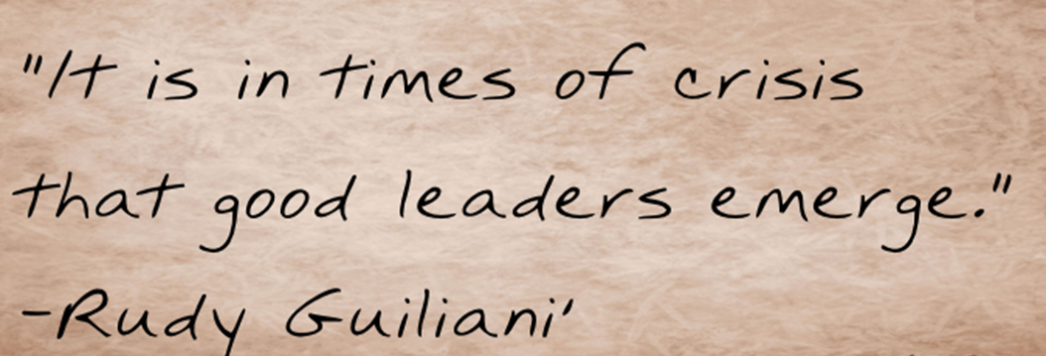
Share What You’ve Learned
Other People Will Endure the Same Hardships You’ve Faced,
  They Need the Benefit of Your Experiences Now.
  The Best Way to Keep Your Wisdom Fresh Is…
  …Give It Away Every Day.
“in all things showing yourself to be a pattern of good works; in doctrine showing integrity, reverence, incorruptibility, and sound speech that cannot be condemned, that one who is an opponent may be ashamed, having nothing evil to say of you.” -Titus 2:7

Slide 11
Know God Has a Plan and a Path
God Has a Unique Purpose and Path for Your Life…
…He Intends For You to Take In Order to Fulfill that Purpose.
  Keep Searching for that Plan,
  Keep Following His Path:
  Seek the Purpose; Walk the Path.
It’s Up To You To…
  Learn The Lessons that Tough Times Can Teach.
  Make Changes/ Choices that are Pleasing to Your Creator.
I will instruct you and teach you in the way you should go; I will guide you with My eye. -Psalm 32:8

Slide 12


