Slide 2

Getting Past Your Past -pt1
Independence Day
2017
Edward Church
July 2, 2017

Slide 3

Philippians 3:13, 14 instructs us to focus on the future, not the past: “One thing I do, forgetting those things which are behind and reaching forward to those things which are ahead, I press toward the goal for the prize of the upward call of God in Christ Jesus”
One Thing (First, Primary)
In Order to Move Forward…
…You Have to Let Go of the Past

Slide 4
Some Of Life’s Greatest Roadblocks are Not the Ones We See…
….Through the Windshield
…But the Ones that Fill the Rearview Mirror.
Because We Are Imperfect Human Beings Who
  Lack Perfect Control Over Our Thoughts…
  …Become “Stuck” In the Past
  …Even Though We Know Better.
  The Lord says, “Forget what happened before, and do not think about the past. Look at the new thing I am going to do. It is already happening. Don’t you see it?I will make a road in the desert and rivers in the dry land.” ISA 43:18, 19 NCV

Slide 5
Instead Of Focusing Our Thoughts/ Energies
  On the Opportunities of Today,
  We May Allow Painful Memories to Fill Our Minds
  And Sap Our Strength.
  We Simply Can’t Seem to Let Go of Our Pain…
…So We Relive It Again and Again . . .
…With Predictably Unfortunate Consequences.
Thankfully, God Has Other Plans
This is the day which the LORD hath made; we will rejoice and be glad in it. Psa 118:24

Slide 6
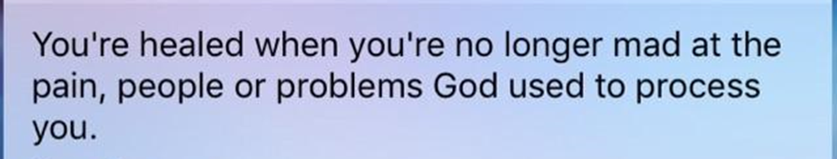
When We Find Ourselves Focusing Too Intently On the Past…
…It’s a Sign That We Need To Focus On a More Urgent Need:
    The Need to Forgive.
      Until We Thoroughly and Completely Forgive
      Those Who Have Hurt Us—
      Completely Forgive Ourselves
      We Are Never Fully Free From the Past.

Slide 7
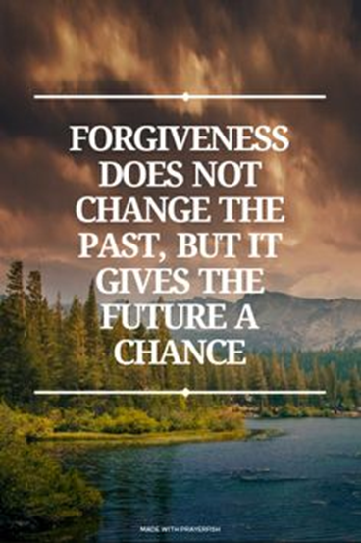
Col 3:13 NLT
Make allowance for each other's faults, and forgive anyone who offends you. Remember, the Lord forgave you, so you must forgive others.

Slide 8

Focusing Too Intently On the Past Is, Almost Without Exception, Futile
No Amount of Anger or Bitterness…
…Can Change What Happened Yesterday.
    Tears Can’t Change the Past;
    Regrets Can’t Change It.
    Our Worries Won’t Change the Past,
    Our Complaints Wont Either

Slide 9

Simply Put…
The Past Is…
…And Always Will Be
…the Past
…Forever!

Slide 10
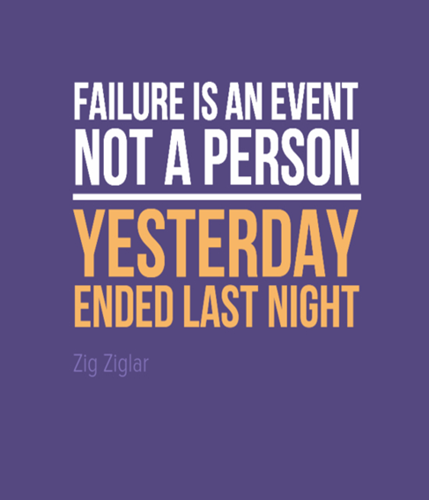
Questions…
Can You Summon the Courage and Wisdom…
…To Accept Your Past and Move On With Your Life?
  Can You Accept The Reality that Yesterday…
  …And All the Yesterdays Before It— Are Gone?
  Can You Entrust All Those Yesterdays to God?
  With God’s Help You Can.

Slide 11
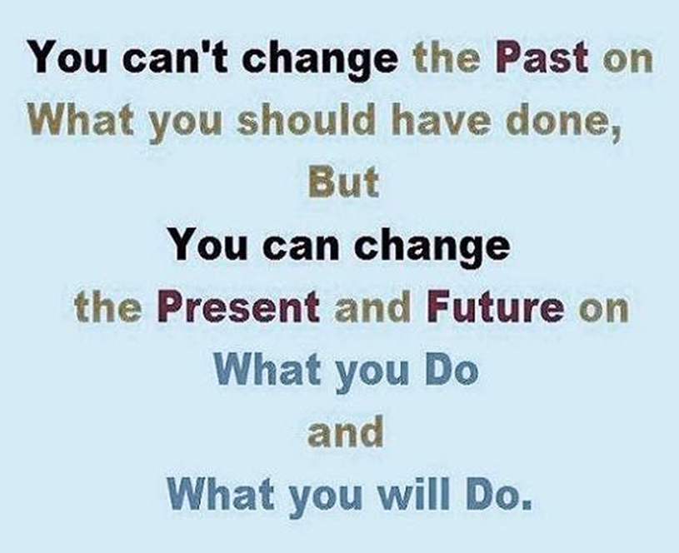
Shake the dust from your past, and move forward in His promises
Kay Arthur
Leave the broken, irreversible past in God’s hands, and step out into the invincible future with Him. -Oswald Chambers
We can’t just put our pasts behind us. We’ve got to put our pasts in front of God. -Beth Moore
The Lord says, “Forget what happened before, and do not think about the past. Look at the new thing I am going to do. It is already happening. Don’t you see it?I will make a road in the desert and rivers in the dry land.” ISA 43:18, 19 NCV

