Slide 2
Living
Aug. 13, 2017
Eph 5:18-21
pt 1
Edward Church

Slide 3
The Battle is…
Here
Hot
Hard
Help
Before Paul Talks About…
…the Power of the Spiritual Armor
…He Talks About the Power of the Spirit

Slide 4
18And do not be drunk with wine, in which is dissipation; but be filled with the Spirit, 19speaking to one another in psalms and hymns and spiritual songs, singing and making melody in your heart to the Lord, 20giving thanks always for all things to God the Father in the name of our Lord Jesus Christ, 21submitting to one another in the fear of God. Eph 5:18-21 NKJV
Don’t drink too much wine. That cheapens your life. Drink the Spirit of God, huge draughts of him. Sing hymns instead of drinking songs! Sing songs from your heart to Christ. Sing praises over everything, any excuse for a song to God the Father in the name of our Master, Jesus Christ. Eph 5:18-21 Message

Slide 5
D.U.I.
DUI = “Driving Under the Influence”
Paul Draws a Contrast Between Living Under the Influence of Alcohol and Living Under the Influence of the Holy Spirit.
Instead of Being Full of Wine (life’s Intoxicating Influences)…
…We Should Be Filled with the Holy Spirit(Heavenly Influence)

Slide 6
D.U.I.
The Contrast Between Being Under the Influence of Wine (world)…
…and Being Filled with the Spirit (not of this World)
Under the Influence of Wine Leads to Excess…
Debauchery=“seduction from duty”
Dissipation=“a wasting by misuse”
Living Under the Wrong Influence Life Will Be Wasted,
…as a Result of Not Fulfilling Responsibilities
By Contrast, the Believer who Lives a Spirit Filled Life Will Be…
…Characterized by Fulfilling Their Responsibility to God

Slide 7
There is a Difference
Born of the Spirit (Again) – Spirit Dwells Within=
Called the New Birth –John 3:5 unless
Prepares You for Heaven
For by one Spirit we were all baptized into one body— whether Jews or Greeks, whether slaves or free— and have all been made to drink into one Spirit. -I Cor 12:13
Baptized with Spirit – Spirit Dwells Without=
Called the Baptism of the Holy Spirit
Prepares You for Earth
“Behold, I send the Promise of My Father upon you; but tarry in the city of Jerusalem until you are endued with power from on high” -Luke 24:49

Slide 8
There is a Difference
Drunk with Wine
Filled with the Spirit
False Boldness
Invincible (numb)
Mutter
Repels Others
Divine Boldness
Acts 4:13
Invincible
Mark 16
Message
Acts 2:1-6
Attracts Others
Acts 2:41

Slide 9
Seek to Be Consciously Filled… …with the Holy Spirit (18b)
It is Not a Suggestion For Us to Consider…
…It is a Command to Obey
We are at War!
Get in the Battle!

Slide 11
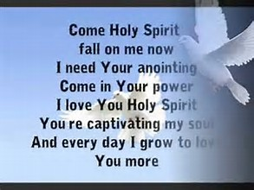
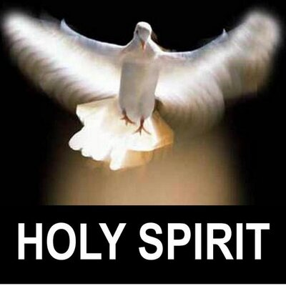

Slide 12
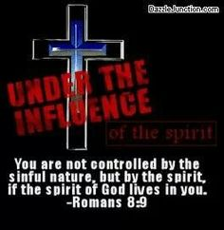
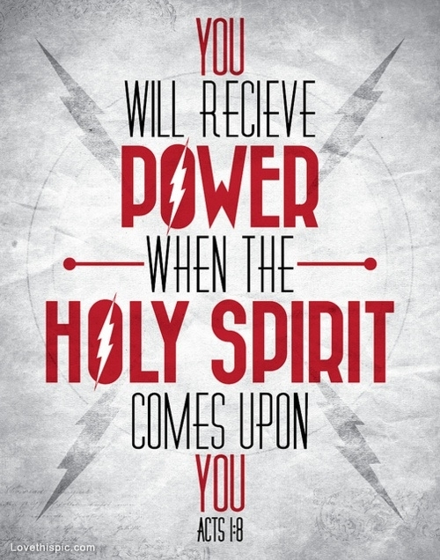

Slide 13
90 yo gma dated a 95 yo man-
Gdaughter asked how was the date?
Gma said I has to slap him 3 times!
Did he get fresh?
No! Thought he was dead!

Slide 14
Part 2

Slide 15
Seek to Be Consciously Filled… …with the Holy Spirit (18b)
It Is Not A Suggestion For Us To Consider…
…It Is A Command To Obey
Why? Because without the influence of the Holy Spirit over our lives, we are completely unable to live like a child of God ought to live.
The Christian is called to live like Christ, which is impossible for us to do on our own.
When we chose to accept Christ as our Savior, He came to dwell within us through the person of the Holy Spirit (Ephesians 1:13-14). The Holy Spirit resides in my life as a child of God, now I must choose to allow Him to preside over my life so I can live like a child of God.

Slide 16
Seek to Be Continuously Filled… ..with the Holy Spirit (18b)
“Keep on being filled with the Spirit.”
The command is a present tense, continuous action verb.
This means two things:
A. This is a command to obey every moment of every day.
There is not a moment when we can afford not to be living under the Holy Spirit’s influence. I must daily choose to surrender my life to the Holy Spirit.
B. This is a command to obey in ever-increasing measure.
The fact that this is a continuous action verb, what is emphasized is that I need to allow the Holy Spirit to influence every area of my life. I need to live under the Spirit’s influence at church; at home; at work; and when I am alone. Every area of my life needs to be lived under the
influence of the Holy Spirit.
Notice what Jesus promised all those who come to Him by faith:
“On the last and greatest day of the festival, Jesus stood and said in a loud voice, ‘Let anyone who is thirsty come to me and drink. Whoever believes in me, as Scripture has said, rivers of living water will flow from within them.’ By this he meant the Spirit, whom those who believed in him were later to receive. Up to that time the Spirit had not been given, since Jesus had not yet been glorified.” - John 7:37-39 (NIV)
After Jesus was glorified, that is, after he was resurrected from the dead and returned to heaven, the Holy Spirit was sent at Pentecost to permanently indwell and empower believers. Today, when a person comes to God through faith in Christ, the Holy Spirit comes to permanently indwell and empower them.

Slide 17
Seek to Be Continuously Filled… ..with the Holy Spirit (18b)
If you are a child of God, the Holy Spirit resides within you; and the nature of the Holy Spirit is to seek to flow through you, like “rivers of living water.” Now, every day and in every area of our lives, we need to seek to “keep on being filled with the Spirit.” In other words, we need to choose to surrender to the Holy Spirit and allow Him to flow into every aspect and area of our lives.
“There is no place in Scripture that indicates we can receive more of the Holy Spirit… The real issue is the release of the already present Spirit to have free reign in our hearts. It isn't about us getting more of Him, but of Him getting more of us.” - Eddie Rasnake
The secret to the Spirit filled life is not to endeavor to gain something we do not have; but to release what is already ours - the flow of the Holy Spirit - into every moment of every day in ever-increasing measure. The question is, “What might prevent the Spirit’s flow?” Anything
that is of sin or self.
“To be Spirit-filled means to be controlled by the Holy Spirit. While we are yet in this life we may do things that grieve the Spirit. We may assert our own authority. At such times we are not Spirit-filled; we are self-propelled.” - Tom Wells
So, daily, and as necessary through-out the day, I need to consciously turn from sin and reliance on self to rely on the Holy Spirit.
Dr. Bill Bright used to call this “spiritual breathing.”
1) Exhale: Confess your sin the moment you become aware of it.
2) Inhale: Surrender control of your life to Christ, and rely upon the Holy Spirit to fill you with His presence and power by faith.
“May not a single moment of my life be spent outside the light, love and joy of God’s presence and not a moment without the entire surrender of myself as a vessel for Him to fill full of His Spirit and His love.” - Andrew Murray

Slide 18
Seek to Be Conspicuously Filled… …with the Holy Spirit (19-21)
“People notice a difference when someone is drunk… Is it difficult for others to to tell who has been drinking of the living waters? It shouldn’t be. There ought to be a noticeable difference in our lives from God’s Spirit being in control.”
Yielding to the Holy Spirit’s influence in our lives will impact our relationship with God (vs. 19-20) and our relationship with one another (v. 21). Paul goes on in verses 22-33 of chapter 5 to detail what all relationship should be positively impacted by the influence of the Holy Spirit in our lives.
Jesus said this about the power of the Spirit at work in our lives:
“You will receive power when the Holy Spirit comes on you; and you will be my witnesses.” - Acts 1:8 (NIV)
“Spirit filled souls are ablaze for God. They love with a love that glows. They serve with a faith that kindles. They serve with a devotion that consumes. They hate sin with fierceness that burns. They rejoice with a joy that radiates. Love is perfected in the fire of God.” - Samuel Chadwick
Conclusion: there’s an old saying, “Let go and let God.” That is what the committed Christian daily chooses to do. Are you letting God’s Spirit flow through you? How do you need to “let go” today?

Slide 19
Facing the Day… …the Marks of a “Holy Spirit” Filled Person
Joyful (19)
Your past, present and future circumstances do not determine your joy.
It says in Nehemiah 8: 10 ‘Do not sorrow. For the Joy of the Lord is your strength.’ The text here expresses that we are joyful with one another in the body of Christ and that joy is targeted towards our Lord and Savior. Are you happy or joyful? What are you joyful about? With whom are you joyful? What or Who are you targeting your joy toward?
“Speaking to yourselves in psalms and hymns and spiritual songs, singing and making melody in your heart to the Lord.” Beloved, when the Spirit of God fills you, you will not only speak, but sing. Let the holy power have free course: do not quench the Spirit. If you feel like singing all the while, sing all the while, and let others know that there is a joy in the possession of the Spirit of God which the world does not understand, but which you are experiencing, and to which you wish to bear witness. Oh, that the Spirit of God would come upon this entire church, and fill you all to overflowing! Here “melody” is an agreeable succession of sounds; a succession so regulated and modulated as to please the ear. It differs from “harmony,” inasmuch as melody is an agreeable succession of sounds by a single voice; harmony consists in the accordance of different sounds. The word which he uses - ψάλλω psallō - means to touch, twitch, pluck - as the hair, the beard; and then to twitch a string - to “twang” it - as the string of a bow, and then the string of an instrument of music. It is most frequently used in the sense of touching or playing a lyre, or a harp; and then it denotes to making music in general, to sing - perhaps usually with the idea of being accompanied with a lyre or harp. The idea here is that of singing in the heart, or praising God from the heart. The psalms, and hymns, and songs were to be sung so that the heart should be engaged, and not so as to be mere music, or a mere external performance. It is not a mental praising of God but distinctly speaking, teaching … Apparently the joyful praise is of the Lord and also addressed to Him. Singing, as here meant, is a direct and solemn act of worship, and should be considered such as really as prayer. In singing we should regard ourselves as speaking directly to God, and the words, therefore, should be spoken with a solemnity and awe becoming such a direct address to the great Yahweh. So Pliny says of the early Christians, “and they sang among themselves hymns to Christ as God.”
What will be the evidence of it? One will be fullness of joy (Galatians 5: 22). The Holy Spirit is a Spirit of gladness, the Spirit of joy. Now do not misunderstand me, there is a difference between holy joy and mere natural merriment. Take the life of our blessed Lord Jesus Christ. Even though He was the Man of Sorrows and acquainted with grief (Isaiah 53: 3), as we read the records in the four Gospels we cannot help but be impressed with the fact that we are not reading the life of a sad Man but of a glad Man. "At that time Jesus rejoiced in spirit and said, Father, I thank Thee." (Luke 10: 21) That is characteristic of the blessed Lord. In spite of all the grief and sorrow that He bore He was joyful. But having said that, let me remind you that in these records you do not see depicted what the world calls a jolly man. His was no mere worldly jollity, no mere worldly merriment, but a deep-rooted gladness that was based upon unbroken communion with the Father, and that is the joy that you and I should possess. The one who is filled with the Spirit will be a glad, joyous believer.

Slide 20
Facing the Day… …the Marks of a “Holy Spirit” Filled Person
Thankful (20)
Here Paul addresses that a Spirit filled person is thankful to God in Christ Jesus for ALL things. He answers the queries to what to give thanks for and who to give thanks to … This is a very clear identity of a ‘Holy Spirit’ filled person. His attitude is not to give thanks for few things or those things which he/she likes but for all things. And he/she give thanks to God, not to focus giving thanks to a person or earthly individual but to God alone. Let us not forget that Job gave thanks and praised God for even those things that were unpleasant and uncomfortable for him.
The Spirit-filled Christian is evident by his on-going thanksgiving, expressed in the name of Christ to the Father. Such thanksgiving not only recognizes the existence of God, but the sovereign involvement God has in the life of the believer. It recognizes that all that happens in the believer’s life is from God, that every good and perfect gift is from Him (James 1: 17), and that even suffering is a gift (Philippians 1: 29) which comes from God for our good and His glory (Romans 5: 3-5; 8: 28). It recognizes and responds with thanksgiving for God’s gracious involvement in our lives as the result of His fathomless wisdom.
There seems to be three attitudes towards thanksgiving in our world today, especially in Christianity.
(a) First of all, thanksgiving is not even necessary because we deserved it anyway. You can see this in Scripture. Remember the rich farmer who took all of his crops and stored the produce of it in his barns, never understanding the fact that he didn’t grow those crops, God grew those crops. You know, if anybody understands what God can do and what man can’t do, it is the farmer. All the farmer can do is plow the soil, put the seed in it. The rest is up to God. He gave no thanksgiving to God. For some reason he thought that everything that God produced was his, so he put it into his barns and stored them up. God came to him and said, "You fool. Tonight your soul shall be required of you." A lot of people don’t thank God for anything. They think they deserve it. They think they have earned it.
(b) Now this is a person in scripture who will give thanks but his thanksgiving is like in that singer, it always calls attention to himself. He is not really giving thanks to God, but he loves to talk about it all the time. "Oh, thank God. I really thank God." Luke 18:11-12 describes a Pharisee ...
(c) In Luke 17: 15-17 when the ten lepers were healed, how many came back and thanked the Lord Jesus? Only one.

Slide 21
Facing the Day… …the Marks of a “Holy Spirit” Filled Person
Submissive (21)
This Biblical principle of being an identity of a ‘Spirit’ filled person is contrary to our culture. That is why it identifies with a person who is filled of the ‘Holy Spirit.’ Otherwise there would be no difference between him/her and the world. That person is not of the world but is soaked and saturated with the Holy Spirit. It makes that person stick out for Christ.
Maintaining due subordination in the various relations of life. This is also a general principle of our faith in Jesus Christ as He exemplified it by being submissive to God the Father. Here Paul at the same time enforces this duty of submission, however, he enjoins on others to use their authority in a proper manner, and gives solemn injunctions that there should be no abuse of power. This may be understood either in a political sense, of giving honor, obedience, and tribute, to civil magistrates, since they are set up by God for the good of men, and it is for the credit of religion for the saints to submit to them; or in an economical sense; thus the wife should be subject to the husband, children to their parents, and servants to their masters, which several things are afterwards insisted on, as explanative of this rule; or in an ecclesiastic sense, so the Ethiopic version renders it, "subject yourselves to your brethren": thus members of churches should be subject to their leadership, not in the same sense as they are to Christ, the head, nor are they obliged to believe or do everything they say, right or wrong; yet honor and esteem are due to them, and submission and obedience should be yielded to their doctrines, precepts, and exhortations, when they are agreeably to the word of God; since God has set them in the highest place in the church, called them to the highest service, and most honorable work, and bestowed on them the greatest gifts; the younger members should also submit to the elder, and the minority to the majority; one member should submit to another, to the superior judgment of another, and to the weakness of another, and to the admonitions of others, and so as to perform all offices of love: and the manner in which this duty is to be performed, is in the fear of God; which may be considered as the moving cause of submission, or, as the rule of it; submission should be on account of the fear of God, and so far as is consistent with it; and indeed, the fear of God is that which should influence and engage to every duty; and which should be before our eyes, and in exercise in our hearts, in all concerns.
But here the text very much implies on our submission to one another within the body of Christ with the fear of the Lord. The reason being that the fear of the Lord is the beginning of wisdom and how many people today, even in the body of Christ our pursuing Godly wisdom. This has become a rarity as more and more people within the body of Christ desire to pursue worldly wisdom and its ways in order to stay politically right with the world and at the same time try to be right with God and be relevant to the contemporary. At the same time the world does what is right in their sight and pleases them. Apparently it doesn’t work that way. You may have worldly success but for sure staying Godly, an utter failure!

