Slide 2
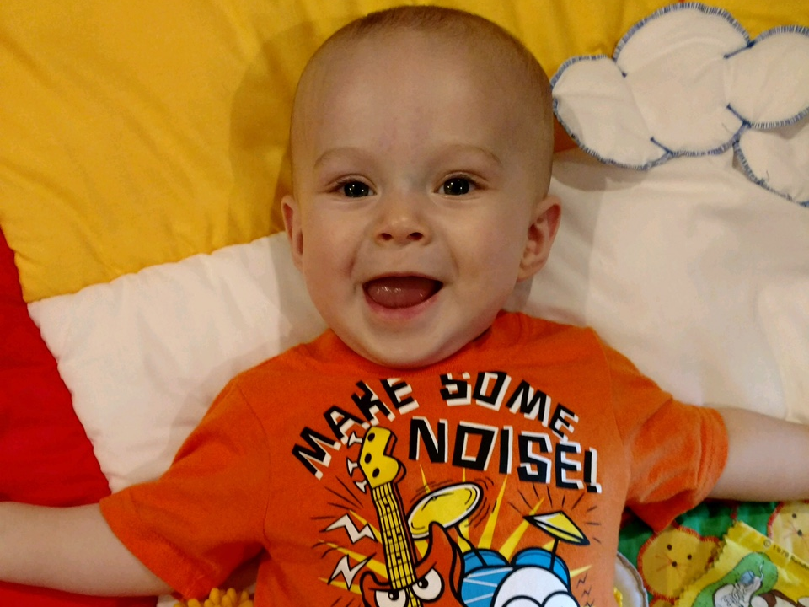
Liam Gold
Mommy and Daddy said They were
Sharing Me with You God! ☺

Slide 3
A four-year-old was at the pediatrician for a check up. As the doctor looked in her ears, he asked, "Do you think I'll find Big Bird in here?"
The little girl stayed silent.
Next, the doctor took a tongue depressor and looked down her throat. He asked, "Do you think I'll find the Cookie Monster down there?"
Again, the little girl was silent.
Then the doctor put a stethoscope to her chest. As he listened to her heartbeat, he asked, "Do you think I'll hear Barney in there?"
"Oh, no!" the little girl replied. "Jesus is in my heart. Barney's on my
underpants."

Slide 4
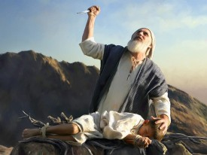
Edward Christian Church
Sept 24, 2017
Giving Your Children…
…Back To God
Genesis 22
Dedicating Our Children to God

Slide 5
Children’s Prayers:
Dear God: Please send a new baby for Mommy.
The new baby you sent last week cries too much.
Debbie, 7
Dear God: Who did you make smarter? Boys or
girls? My sister and I want to know. Jimmy, 6
Dear God: How many angels are there in heaven?
I would like to be the first kid in my class to know
the answer. Norma, 8

Slide 6
Children’s Prayers:
Dear Lord: Thank you for the nice day today.
You even fooled the TV weather man. Hank, 7
Dear God: I need a raise in my allowance.
Could you have one of your angels tell my
father. Thank you. David, 7
Dear God: This is my prayer. Could you please
give my brother some brains. So far he doesn’t
have any. Angela, 8

Slide 7
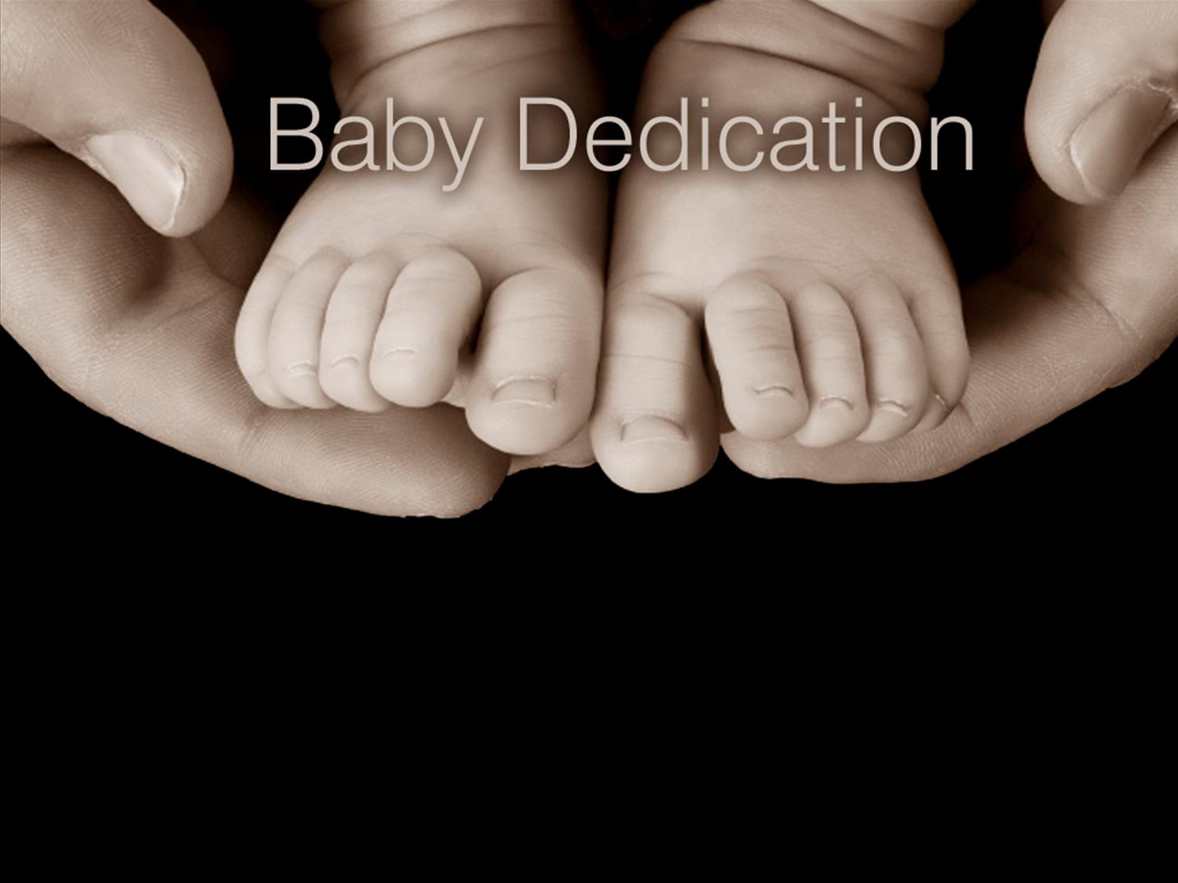
Dedicate
What It Is Not:
Service
Ceremony
What It Is:
Promise
Powerful
It is Not a…
…Ceremony
…but a
…Commitment

Slide 8
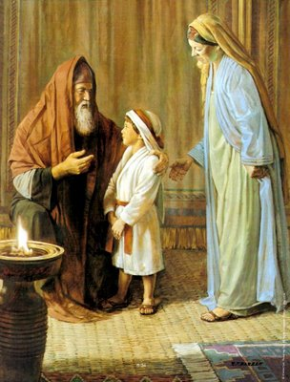
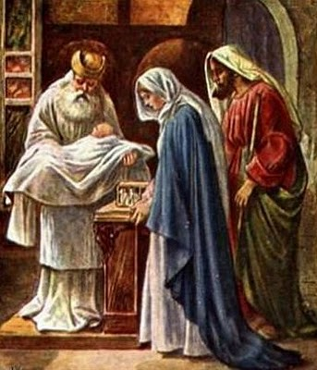
Biblical Examples
Hannah
Samuel (the son for whom she had prayed)
Eli the Priest(I Sam. 1:27-28)
“For this child I prayed/ the LORD hath given me my petition which I asked of him: 28 Therefore also I have lent him to the LORD; as long as he liveth he shall be lent to the LORD”
Joseph and Mary
Infant child Jesus
Temple Dedicated 8 days(Lk. 2:22)

Slide 9
Genesis 22:1-13
Abraham Literally, Totally, Irrevocably…
…Gave Isaac Back To God.
God said, “Take your son, your only son, whom you love, and sacrifice him ...” (2)
Isaac had been a Miracle baby.
Sarah was 90/ Abraham was 100
Now Give Him Back!

Slide 10
“What If”
Abraham refused to give Isaac back to God,
Forfeited all God’s promises /plans for Isaac.
Isaac would have lived/ died in obscurity
Abraham obeyed and gave Isaac back to God,
received the fullness of God’s plan/ promise
became a powerful man
became the forefather of God’s own Son
Isaac’s life is still having an impact on world
We need to learn from Abraham today.

Slide 11
Genesis 22:1-13
Isaac Represents Abrahams
Hopes
Dreams
Future…
His Promise from God
Not Only How to Dedicate our Child to God but-
Our Family
Our Selves

Slide 12
Genesis 22:1-13
God Knew..
Abraham was a Man of..
Faith
Action
Plans
Abraham Didn’t Know…
God was About to Test…
Plans
Faith
Action

Slide 13
Genesis 22:1-13
Gen 22:5, “Abraham said unto his young men,
Abide ye here with the ass; and I and the lad will
Go yonder and worship, and come again to you”
Heb 11:17-19, “By faith Abraham, when he was
tried, offered up Isaac:/ he that had received the
promises offered up his only begotten son, Of
Whom it was said, That in Isaac shall thy seed be
called: Accounting that God was able to raise
him up, even from the dead; from whence also
he received him in a figure.

Slide 14
Four Elements of Giving Your Child Back to God
1st- Giving Your Child to God is a
“Confirmation” of Your Love for God
His child was most prized possession…but
don’t allow them to take the place of God!
This is exactly what Abraham proved by his
willingness to offer Isaac.

Slide 15
1st- Giving Your Child to God is a
“Confirmation” of Your Love for God
Matt 10:37-38, “Anyone who loves his father or
mother more than me is not worthy of me;
anyone who loves his son or daughter more than
me is not worthy of me; 38 and anyone who does
not take his cross/ follow me is not worthy of me”

Slide 16
Four Elements of Giving Your Child Back to God
2nd- Giving Your Children to God is a…
“Clarification” of Ownership
When You Give Your Child Back to God…
…You Are Openly Declaring:
This Child…
is a Gift from God.
Does Not Really Belong to You.
Belongs to God

Slide 17
Four Elements of Giving Your Child Back to God
3rd- Giving Your Children To God Is a…
“Commitment” to Raise Your Child God’s Way!
Eph. 6:4, “we are to bring our children up in the
nurture and admonition of the Lord.”
Be a Godly parent
Teach this child of Christ
Love this child.
Pray for this child.
Train this child.
Stay married for this child. (stability)
Live a righteous life.

Slide 18
Four Elements of Giving Your Child Back to God
4th- Giving Your Children To God is a…
“Claiming” of God’s Plan / Promises for Child’s Life
Isaac Inherited God’s …
Blessings
Protection
Promises
Because Abraham Gave Him Back to God.

Slide 19
Gen 22:16-18
“and said, By myself have I sworn, saith the LORD,
for because thou hast done this thing,/ hast not
withheld thy son, thine only son: ¹⁷ That in blessing I
Will bless thee, and in multiplying I will multiply thy
seed as the stars of the heaven /as the sand which
Is upon the sea shore; and thy seed shall possess
The gate of his enemies;¹⁸ And in thy seed shall all
the nations of the earth be blessed; because thou
hast obeyed my voice.”

Slide 22
Four Elements Of Giving Your Child Back To God
This is exactly what transpired when Abraham took
Isaac up Mt. Moriah and laid him on the altar to give
him to God. Abraham was..
1- Confirming his love and fear of Jehovah
2- Clarifying that Isaac really belonged to God
3- Committing to be a Godly parent
4- Claiming God’s plan and promises for Isaac.

Slide 23
Four Elements Of Giving Your Child Back To God
What it means to give your children back to God?
1- Confirmation of your love for Christ
2- Clarification of ownership (God owns that child)
3- Commitment to raise that child under the
Lordship of Jesus Christ
4- Claiming of God’s best plan and promises for
that child’s life

Slide 24
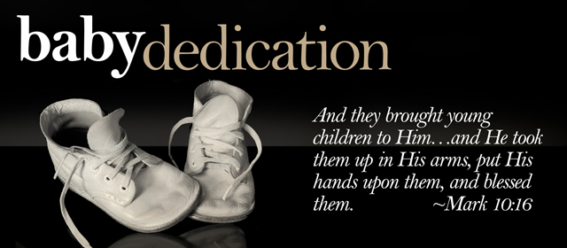

Slide 25
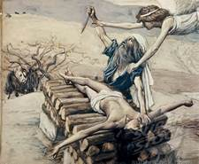
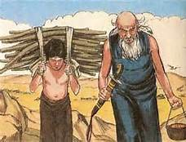

Slide 26
https://youtu.be/re5EIUIXbhc

