Slide 2
Becoming a Can DO Christian
Edward Church
Phil 4:13
Oct 29, 2017

Slide 3
Too Many Christians are Living in the
“Land of Can Nots”
Can Nots
What If’s
Wish I Could
Time to Turn the Page
Change the Recording

Slide 4
“I”
not just for them, those, her or him ..It’s For ME!
not for the super saint- struggling saint …It’s For ME! …this is my verse it belongs to me
encourages me when I feel defeated
comforts me when I am sad
emboldens me when I am afraid
empowers me when I am weak
…this is my verse it belongs to me!

Slide 5
“Can”
No Room For Maybes or Might’s- Possibly or Perhaps
…Word of Certainty
Psalms 18:32 It is God that girds me with strength, and makes my way perfect.
Isaiah 41:10 Fear you not; for I am with you: be not dismayed; for I am your God: I will strengthen you; yea, I will help you; yea, I will uphold you with the right hand of my righteousness.

Slide 6
“Do”
Not Gripe About or Think About – DO!!
Verb – word of action; …Christianity is not sitting it is striving
Eph 6:12, ‘ For we wrestle not - against flesh and blood, but against principalities, against powers, against the rulers of the darkness of this world, against spiritual wickedness in high places.

Slide 7
“All”
Not Some or Most – ALL!!
Genesis 18:14 Is any thing too hard for the LORD?
Jeremiah 32:17 Ah Lord GOD! behold, You have made the heaven and the earth by Your great power and stretched out arm, and there is nothing too hard for You:

Slide 8
“Things”
Every Situation – Every Relationship – Every “Thing”
whatever you face put its name in place of “things”
Romans 8:28 And we know that all things work together for good to them that love God, to them who are the called according to his purpose.

Slide 9
“Through”
Small Word –en = fixed position & instrumentality
only through a “certain path and instrument”

Slide 10
“Christ”
John 15:5 I am the vine, you are the branches: He that abides in me, and I in him, the same brings forth much fruit: for without me you can do nothing.

Slide 11
“Which”
Because of this person and the path laid out
This will always be the results…
…if we stay w/ person & on His path

Slide 12
“Strengthens”
Dynamis = power that produces more power
To Infuse inner strength and ability (unstoppable)
Dynamo

Slide 13
“Me”
Ends where we started –
if you don’t personalize it… it doesn’t means a thing!!
If you do then “I can do all things through Christ which strengthens me”
is your Battle Cry

Slide 14
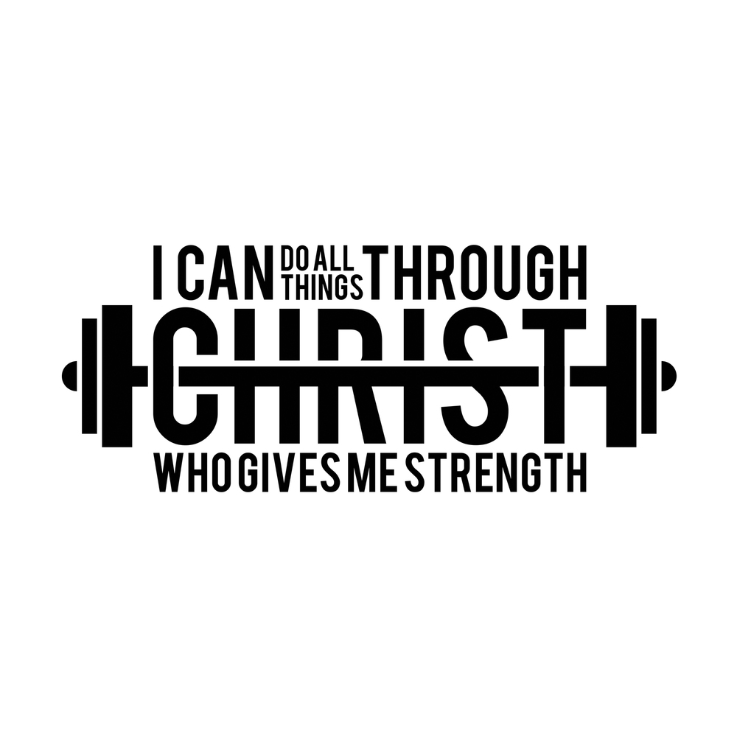

Slide 16
