Slide 3
February 11, 2018
Edward Christian Church
Galatians 6:7-10
7 Laws of the Harvest -pt1

Slide 4
This Year is a Year of…
Resurrection (2000)
New Life (18)
New Beginnings (8)
But in Order to See it Fully…
…In Our Own Lives
…We Have to Fulfill Our Part

Slide 5
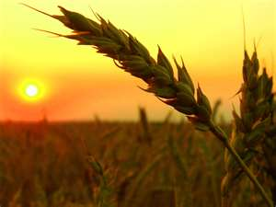
God Set Up a System of Laws
These Laws or Principles…
Govern and Guide Man
His Spiritual Development And Maturity
Govern Nature and the Universe
These Laws Are:
Universal
Simple
Absolute
Stable

Slide 6
God Set Up a System of Laws
The Law of Gravity:
whatever goes up must come down
The Law of Mathematics:
two parallel lines do not meet
1 + 1 = 2 (except with hamsters)
The Law of Housekeeping:
as you make your bed so you will sleep on it
The day you clean is …
…the day the kids bring guests
The Law of the Prophets:
what you want men to do to you…
…do the same to them

Slide 7
God Set Up a System of Laws
But there are No Laws More Important or Significant
Than the Principles that …
…Govern the Harvest We Reap
The Law of Harvest:
whatsoever a man sows…shall he also reap

Slide 8
The Law of the Harvest
The Law of Harvest Can Be Divided into…
…7 Laws and
…3 Basic Principles
The First Principle…
#1- Harvest is a Consequence
“You Will Always Reap What You Sow”

Slide 9
We Reap Only What Has Been Sown
The First Law Can Be Divided into:
Reaping From What We Sow
Reaping From What Others Sow
Sowing Always Involves Seeds
Seeds = Potential
Seeds Always Produces a Harvest
Harvest = Results

Slide 10
Reaping From What Others Sow
Positive -Blessings We Reap Because of …
What God Has Done on Our Behalf
The Cross (decision + action)
What Others Have Done In Our Behalf
Right Choices (decisions)
Right Actions (decisions carried out)
Negative
We Reap the Wrong Others Have Sown
Bad Choices
Bad Actions

Slide 11
Reaping From What We Sow
We Receive Positive or Negative…
…From the Seeds We Plant
Choices
Action
Remember…
…Every Choice
…Every Action
= Seed (potential)

Slide 12
Reaping From What We Sow
Negative…
"He that soweth iniquity shall reap vanity" -Prov 22:8
"For they have sown the wind, and they shall reap the whirlwind" -Hosea 8:7
James 4:17 (KJV) ¹⁷ Therefore to him that knoweth to do good, and doeth it not, to him it is sin.

Slide 13
Reaping From What We Sow
Positive…
Psalms 126:5-6 ^{5 “}They that sow in tears shall reap in joy. ⁶ He that goeth forth and weepeth, bearing precious seed, shall doubtless come again with rejoicing, bringing his sheaves with him.”
Galatians 6:9-10 (KJV) ⁹ And let us not be weary in well doing: for in due season we shall reap, if we faint not. ¹⁰ As we have therefore opportunity, let us do good unto all men, especially unto them who are of the household of faith.

Slide 14
Reaping From What We Sow
What are You Sowing?
Positive?
Negative?

Slide 17
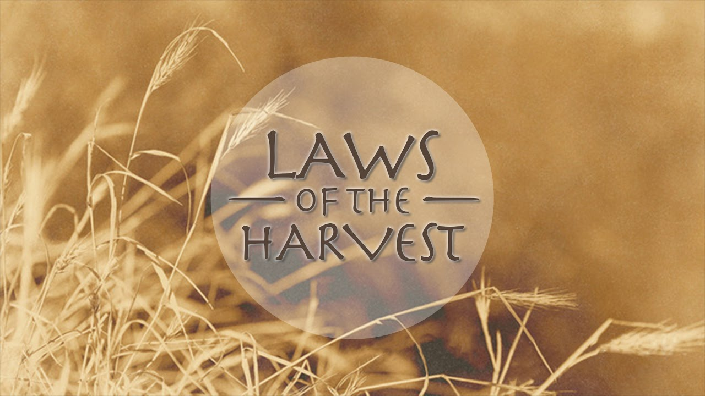
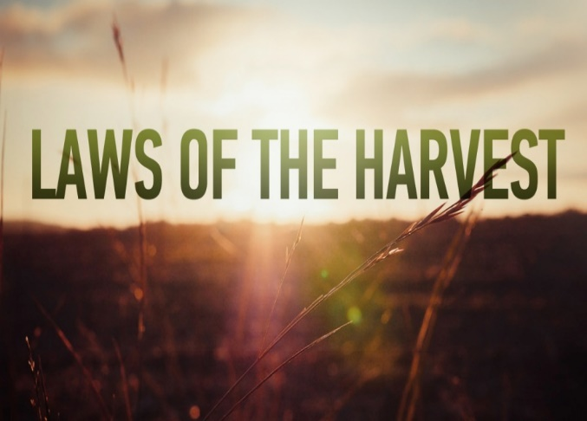
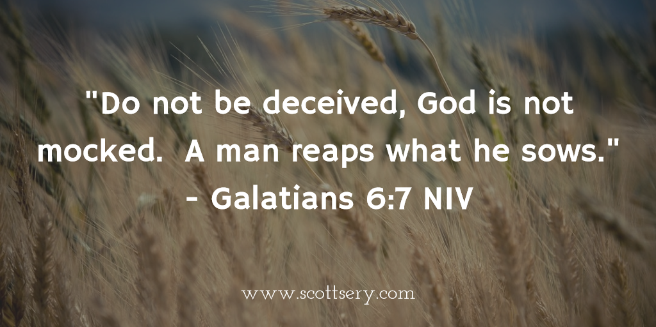
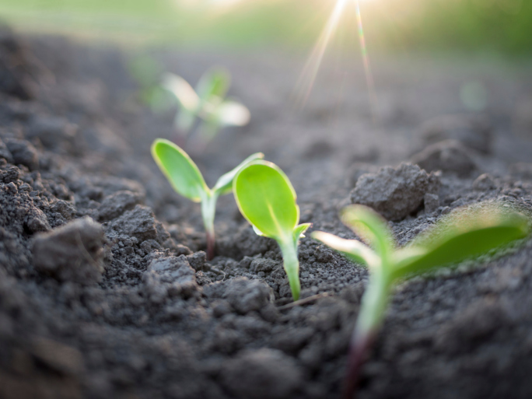
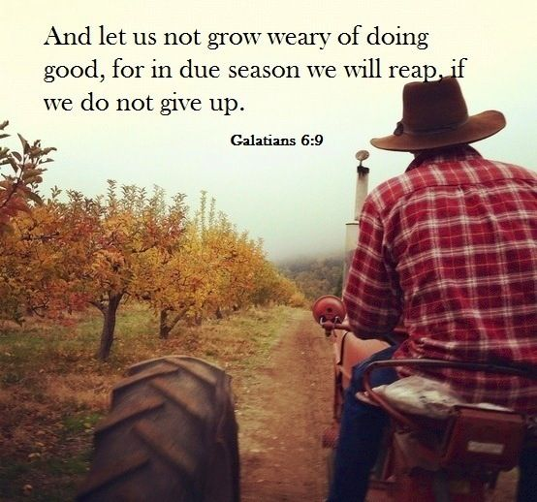

Slide 18
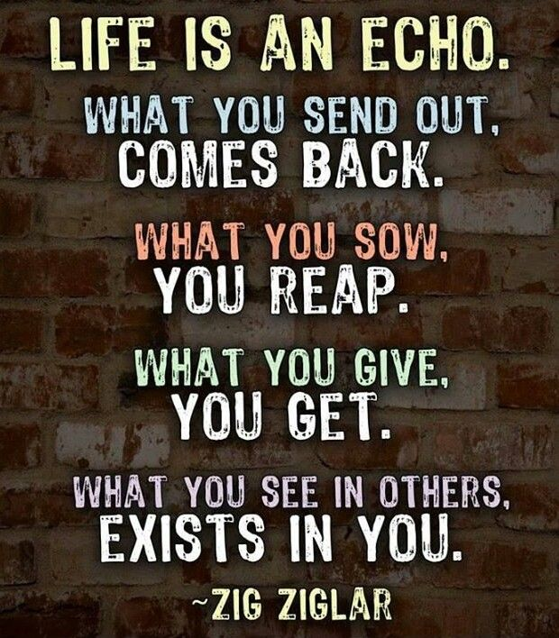
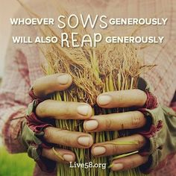
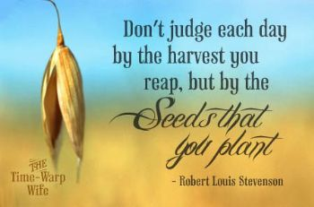
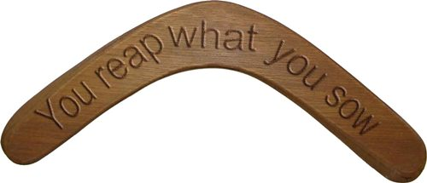

Slide 22
You Reap
What you Sowed
Where you Sowed
More than you Sowed
Longer than you Sowed
Therefore –this Eternal Principle can be..
Positive or Negative

Slide 23
Harvest
Life is filled with choices, choices that affect us on an everyday basis in everything we do which means our everyday choices are not without significance. Our choices affect us and others in dramatic ways whether we see it immediately or not. While earth remains, no man will mock God by changing for even one time these laws of the harvest.

