Slide 2
February 18, 2018
Edward Christian Church
Galatians 6:7-10
7 Laws of the Harvest -pt 3

Slide 3
This
is
a
Year
of..

Slide 4
God Set Up a System of Laws
None are More Important or Significant
Than the Principles that …
…Govern the Harvest We Reap
The Law of Harvest:
whatsoever a man sows that shall he also reap.

Slide 5
The Law of the Harvest
The Law of Harvest Can Be Divided into…
…7 Laws and
…3 Basic Principles
The First Principle…
#1- Harvest is a Consequence
“You Will Always Reap What You Sow”

Slide 6
Whatsoever
Seed Always Surrenders to the…
…Law of Reproduction
Seed Also Surrenders to the…
…Power of Reproduction
“We Always Reap More Than We Sow”
And to the Path of Reproduction
“We Always Reap Where We Sow”

Slide 7
Harvest Principles
#1- Harvest is a Consequence
“You Will Always Reap What You Sow”
#2- Harvest is a Process
“It Takes Time and Steps”
#3- Harvest is a Season
“There is an Appropriate Time or Due Season”

Slide 8
We Reap In Proportion to What We Sow
2 Cor. 9:6, “Now this I say, he who sows sparingly
shall also reap sparingly; and he who sows bountifully shall also reap bountifully”
This Deals With Personal:
Responsibility –quit looking to blame
Faithfulness –start planting –quit talking
Faith –it is possible to limit our harvest

Slide 9
We Reap In Proportion to What We Sow
If You Want to Have…
…More than Enough … Give!
…Less than Enough … Grasp!
If You Want Abundance … Scatter!
If You Want To Be Needy ... Hoard!
This Includes Every Area of Your Life !

Slide 10
“...for in due season"
refers to an occasion, set or proper time:
(convenient, due) season, (due, short) time
This is God's Appointed Time,
It Cannot be Changed by Us
“While the earth remains, Seedtime / harvest,
cold and heat, /summer / winter, / day and night
Shall not cease” - Genesis 8:22

Slide 11
“Grow Weary…if we faint not”
Means More Than Taking a Breather
It Means to Do More Than Quit
Grow Weary= Process (fade away)
Well Doing= the Right Thing
Picture of Someone Quitting with…
…the Finish Line in Sight
Faint= Means to Quit and Quit Trying

Slide 12
Luke 9:62, “And Jesus said unto him, No man,
having put his hand to the plough, and looking
back, is fit for the kingdom of God”
Looking Back Brings Choices…
Regret (which usu will hold you back)
Life Lessons (to move you forward)
As We Have Opportunity… Season to Plant
actively, energetically pursue …
…a course of good for others

Slide 13
Sowing and Reaping
You Can Count the Number of Seeds…
…in an Apple
You Cannot Count the Number of Apples…
…in a Seed

Slide 15
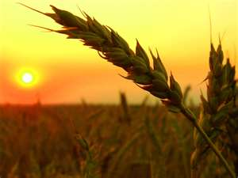
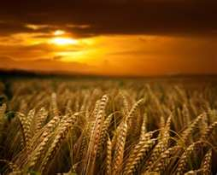
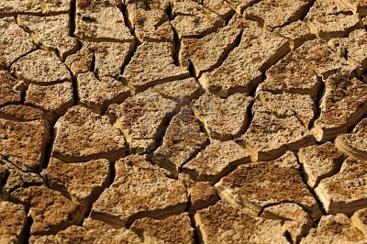
Reaping From What We Sow
What are You Sowing?
Positive?
Negative?

Slide 16
This Year is a Year of…
Perfect Government
Turnaround
Potential
But in Order to See it Fully…
…In Our Own Lives
…We Have to Fulfill Our Part

Slide 17
Reaping From What We Sow
What are You Sowing?
Positive?
Negative?

Slide 18
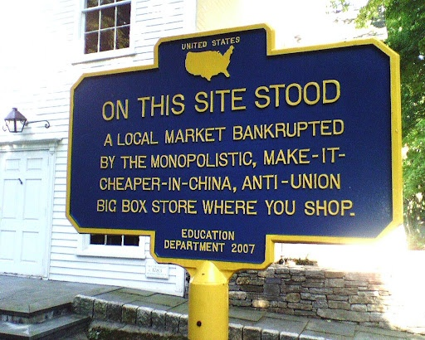
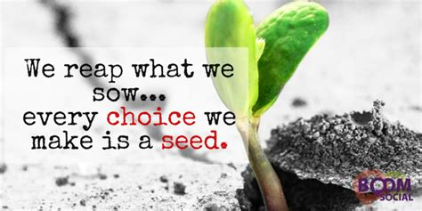

Slide 19
We Can’t do Anything About Last Year’s Harvest…but We Can About This Year’s
Phil 3:13-14 (AMP) “I do not consider, brethren, that I have
captured and made it my own [yet]; but one thing I do [it is
my one aspiration]: forgetting what lies behind and straining
forward to what lies ahead, ¹⁴ I press on toward the goal to
win the [supreme and heavenly] prize to which God in Christ Jesus is calling us upward”
As We Have Opportunity… Season to Plant
actively, energetically pursue a course of good for others

Slide 20
We Reap In Proportion to What We Sow
Luke 6:38, “Give, and it will be given to you; good
measure, pressed down, shaken together,
running over, they will pour into your lap. For by
your standard of measure it will be measured to
you in return”
Ephesians 3:20, “Now to Him who is able to do
exceeding abundantly beyond all that we ask or think,
according to the power that works within us”

Slide 21
We Reap More Than We Sow
Seed Always Surrenders to the…
…Law of Reproduction
Seed Also Surrenders to the…
…Power of Reproduction
“We Always Reap More Than We Sow”
And to the Path of Reproduction
“We Always Reap Where We Sow”

Slide 22
We Reap in a Different Season than” “”
Ecclesiastes 11:1-6, “Cast your bread on the surface
of the waters, for you will find it after many days.
Process
Problem
Promise
Ecclesiastes 3:1-2, “To every thing there is a season,
and a time to every purpose under the heaven: ² A
time to be born, and a time to die; a time to plant, and
a time to pluck up that which is planted;

Slide 23
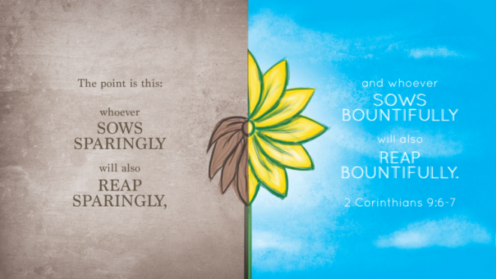

Slide 24
We Reap More Than We Sow
The Power of Reproduction
1 Kernel of Corn Will Produce 1 Corn Stalk
On Average, Each Stalk will Produce 3 Ears
The Average Ear of Corn has 250 Kernels
So a Single Kernel of Corn …
…will Yield a 750x Increase
What Do You Need?

Slide 25
We Reap More Than We Sow
Seed Always Surrenders to the…
…Law of Reproduction
Seed Also Surrenders to the…
…Power of Reproduction
“We Always Reap More Than We Sow”

Slide 26
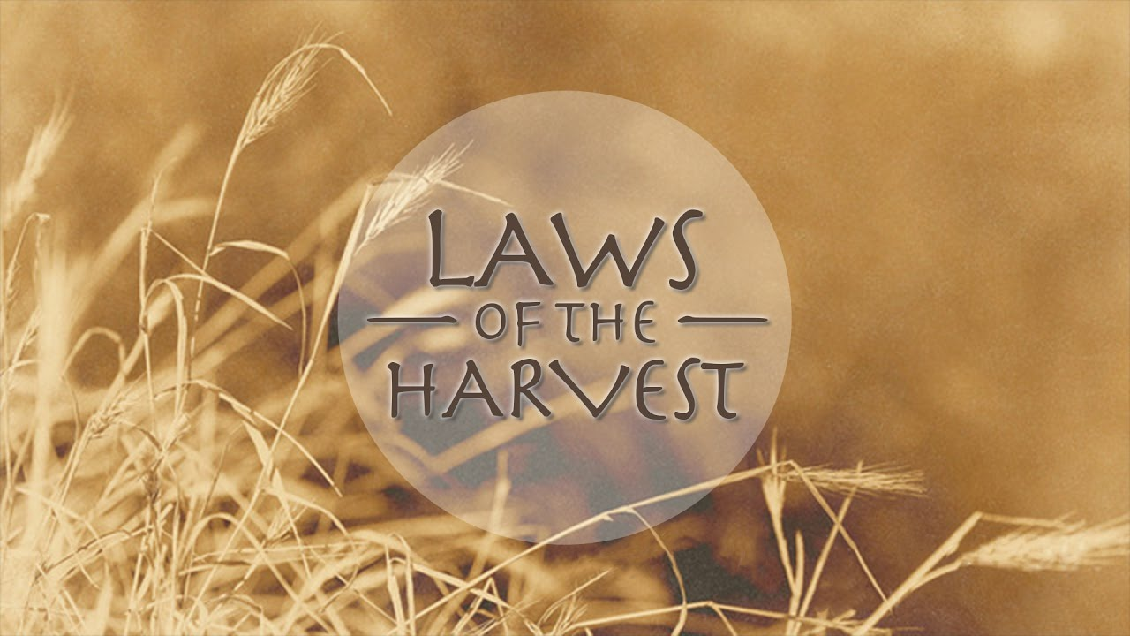

Slide 27
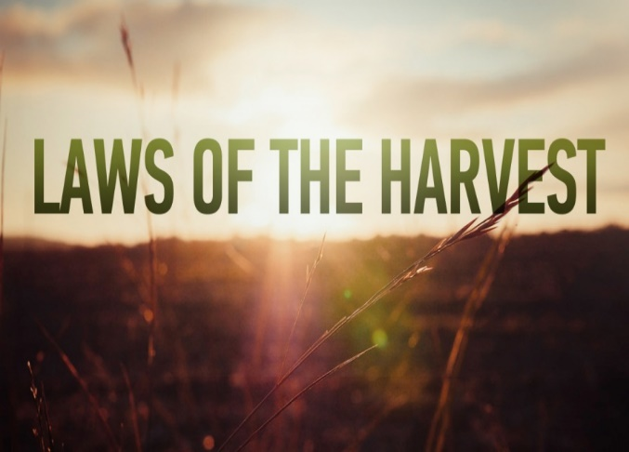
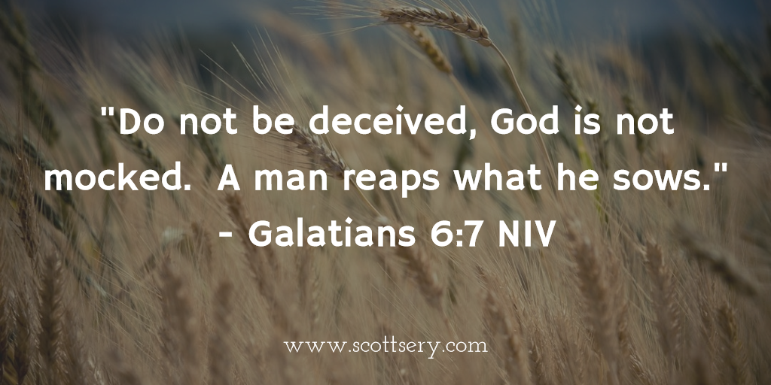
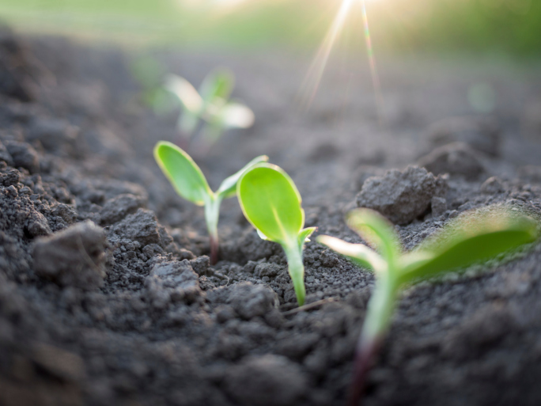
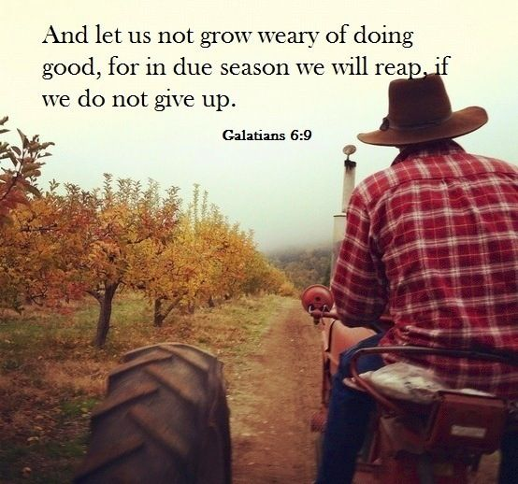
Universal
Simple
Absoute
Stable

Slide 28
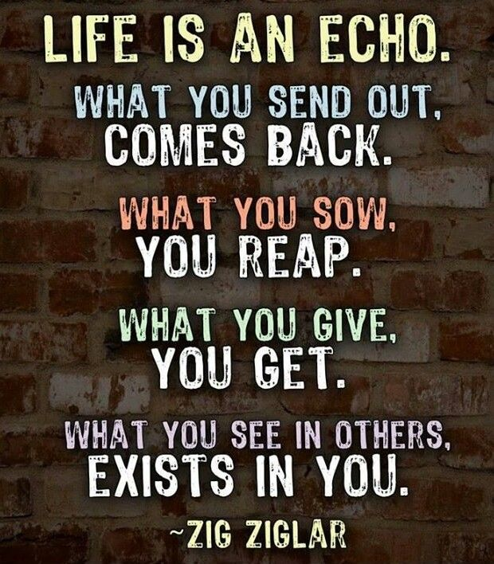
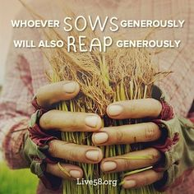
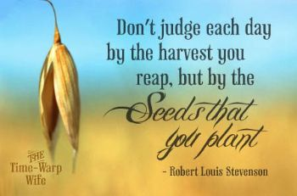
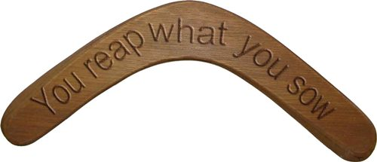

Slide 31
We Reap the Same In Kind As We Sow
Seed Always Surrenders to the…
…Law of Reproduction
Genesis 1:11-13, 21-25
Grass, Seed Plants & Trees (11-12)
Sea Creatures (21a)
Birds (21b)
Land Creatures (24-25)
Not Just Natural Seeds…
⁷ Be not deceived; God is not mocked: for
whatsoever a man soweth, shall he also reap.

Slide 32
We Reap More Than We Sow
Mark 4:1-8
the First Case the Seed Produces Nothing
the Second it Produces Only the Blade
the Third it is Near the Point of Producing Fruit, but Fails to Bring Forth to Harvest
the Fourth it Yields Fruit, but in Different Measures

Slide 33
We Reap More Than We Sow
If You Want to Reap…
Better Marriage
…Sow into Your Marriage
Better Work Relationships
…Sow into Work Relationships
Better Personal Relationships
…Sow into Personal Relationships
Better Spiritual Life
…Sow into Spiritual Things

Slide 34
We Reap More Than We Sow
If You Want to Reap a Good Crop
It Requires Proper …
Planning
Preparation
Planting
Patience

Slide 35
We Reap the Same In Kind As We Sow
Job 4:8 (AMP)
As I myself have seen, those who plow iniquity
And sow trouble and mischief reap the same.
Proverbs 11:18 (NASB)
The wicked earns deceptive wages, But he who sows
righteousness gets a true reward.
Matthew 7:12 (KJV)
Therefore all things whatsoever ye would that men
should do to you, do ye even so to them: for this is
the law and the prophets.

Slide 36
We Reap More Than We Sow
Mark 4:1-8
Jesus Showed us the Potential of the Seed
A Single Grain Grew to be a Plant that Produced
Thirty, Sixty, or a Hundred More Seeds.
Reaping More than We Sow is Fundamental to the Laws of the Harvest.
Every Farmer Lives by this Principle. If His Work Only Returned Exactly What He had Planted in the Ground, His Labor Would be Futile.

Slide 37
We Reap the Same In Kind As We Sow
Seed Always Surrenders to the…
…Law of Reproduction
Not Just Natural Seeds…
…But
Gal.6:7 (KJV) ⁷ Be not deceived; God is not mocked: for whatsoever a man soweth, that shall he also reap.

Slide 38
We Reap More Than We Sow
What Do You Need?
Love
Joy
Peace
Help
Physical
Mental
Financial
Spiritual
Quit Placing Blame and…
Start Planting Seed!!!

Slide 40
We Reap Only What Has Been Sown
The First Law Can Be Divided into:
Reaping From What We Sow
Reaping From What Others Sow
Sowing Always Involves Seeds
Seeds = Potential
Seeds Always Produces a Harvest
Harvest = Results

Slide 43
We Reap in a Different Season than” “”
#1- Harvest is a Consequence
“You Will Always Reap What You Sow”
#2- Harvest is a Process
“It Takes Time”

Slide 44
We Reap in a Different Season than” “”
The World is made up of certain laws

Slide 45
We Reap In Proportion to What We Sow
The World is made up of certain laws

Slide 46
We Reap the Full Harvest Of the Good Only if We Persevere
The World is made up of certain laws

Slide 47
We Can’t do Anything About Last Year’s Harvest…but We Can About This Year’s
The World is made up of certain laws

Slide 49
You Reap
What you Sowed
Where you Sowed
More than you Sowed
Longer than you Sowed
Therefore –this Eternal Principle can be..
Positive or Negative

Slide 50
Harvest
Life is filled with choices, choices that affect us on an everyday basis in everything we do which means our everyday choices are not without significance. Our choices affect us and others in dramatic ways whether we see it immediately or not. While earth remains, no man will mock God by changing for even one time these laws of the harvest.

Slide 51
Reaping From What Others Sow
Positive -Blessings We Reap Because of …
What God Has Done on Our Behalf
The Cross (decision + action)
What Others Have Done In Our Behalf
Right Choices (decisions)
Right Actions (decisions carried out)
Negative
We Reap the Wrong Others Have Sown
Bad Choices
Bad Actions

Slide 52
Reaping From What We Sow
We Receive Positive or Negative…
…From the Seeds We Plant
Choices
Action
Remember…
…Every Choice
…Every Action
= Seed (potential)

Slide 53
Reaping From What We Sow
Negative…
"He that soweth iniquity shall reap vanity" -Prov 22:8
"For they have sown the wind, and they shall reap the whirlwind" -Hosea 8:7
James 4:17 (KJV) ¹⁷ Therefore to him that knoweth to do good, and doeth it not, to him it is sin.

Slide 54
God Set Up a System of Laws
The Law of Gravity:
whatever goes up must come down
The Law of Mathematics:
two parallel lines do not meet
1 + 1 = 2 (except with hamsters)
The Law of Housekeeping:
as you make your bed so you will sleep on it
The day you clean it is the day the kids bring guests
The Law of the Prophets:
what you want men to do to you do the same to them

Slide 55
Reaping From What We Sow
Positive…
Psalms 126:5-6 ^{5 “}They that sow in tears shall reap in joy. ⁶ He that goeth forth and weepeth, bearing precious seed, shall doubtless come again with rejoicing, bringing his sheaves with him.”
Galatians 6:9-10 (KJV) ⁹ And let us not be weary in well doing: for in due season we shall reap, if we faint not. ¹⁰ As we have therefore opportunity, let us do good unto all men, especially unto them who are of the household of faith.

