Slide 2
I Tim 6:12
March 25, 2018
Edward Church

Slide 3
Fight the good fight of faith,
lay hold on eternal life,
to which you were also called
and have confessed the good confession
in the presence of many witnesses.
I Tim 6:12

Slide 4
This is Palm Sunday
This was a Day of Celebration (short-lived)
This was the Beginning of the Passion
If There Was to Be Turning Back….
..It Needed to Be Now
But Jesus Fought the Good Fight…
..He Laid Hold of Eternal Life for Us All!

Slide 5
Get on the Offense
Fight Against the Enemy
Don’t Be Passive
Actively Attack Your Problems / Struggles W- the Will to Win
What Steps Can You Take?

Slide 6
Close Doors of Opportunity for Satan
“Be angry, and do not sin : do not let the sun go down on your wrath, 27nor give place to the devil.” Eph 4:26-27
Go ahead and be angry. You do well to be angry— but don’t use your anger as fuel for revenge. And don’t stay angry. Don’t go to bed angry. Don’t give the Devil that kind of foothold in your life. Eph 4:26-26 Message

Slide 7
Close Doors of Opportunity for Satan
What is a door of opportunity for Satan
to wreck havoc in our lives?
Unprocessed Anger
Unconfessed Sin
Unforgiveness / Grudges
Resentment / Grudges
Shut the Door On Anything in Your Life that Opens the Door for Spiritual Attack

Slide 8
Remember the Reason
Therefore I do not run without a definite goal; I do not flail around like one beating the air [just shadow boxing]. I Cor 9:26
Lay Hold of Eternal Life
Eternal Life is Free…
…But the Fight Here is Real
…and Costly

Slide 9
Maintain the Proper Attitude
“which you were also called and have confessed the good confession in the presence of many witnesses.”
The way we communicate has a great deal to do…
…with our level of success
We Can Talk…
Ourselves Into or Out of Success
Others In or Push Them Away

Slide 10
“Words Winners Never Say”
“I Can’t”
I can do all things [which He has called me to do] through Him who strengthens and empowers me [to fulfill His purpose—I am self-sufficient in Christ’s sufficiency; I am ready for anything and equal to anything through Him who infuses me with inner strength and confident peace.] Philippians 4:13 (AMP)
Have Confidence in God and His Power to See You Though
Make this Verse Your New Affirmation

Slide 11
“Words Winners Never Say”
I Can’t …I can do all things
“I’ll Try”
²⁸ Have you not known? Have you not heard? The everlasting God, the Lord, the Creator of the ends of the earth, does not faint or grow weary; there is no searching of His understanding. ²⁹ He gives power to the faint and weary, and to him who has no might He increases strength [causing it to multiply and making it to abound]. ³⁰ Even youths shall faint and be weary, and [selected] young men shall feebly stumble and fall exhausted; ³¹ But those who wait for the Lord [who expect, look for, and hope in Him] shall change and renew their strength and power; they shall lift their wings and mount up [close to God] as eagles [mount up to the sun]; they shall run and not be weary, they shall walk and not faint or become tired. …Isaiah 40:28-31 (AMPC)
Commit Your Self to Your Goals

Slide 12
“Words Winners Never Say”
I Can’t –I can do all things
I’ll Try – I shall walk and not be weary(quit)
“I’ll Do it Tomorrow”
Take therefore no thought for the morrow: for the morrow shall take thought for the things of itself. Sufficient unto the day is the evil thereof -Matt 6:34
“Give your entire attention to what God is doing right now, and don’t get worked up about what may or may not happen tomorrow. God will help you deal with whatever hard things come up when the time comes” Matt 6:34 Message
There is a Difference in Us Waiting on God…
…and God Waiting on Us!

Slide 13
“Words Winners Never Say”
I Can’t - I can do all things
I’ll Try - I shall walk and not be weary(quit)
I’ll Do it Tomorrow - redeeming the time
“I have a Problem”
Joseph replied, “Don’t be afraid. Do I act for God? Don’t you see, you planned evil against me but God used those same plans for my good, as you see all around you right now—life for many people. Easy now, you have nothing to fear; I’ll take care of you and your children.” He reassured them, speaking with them heart-to-heart. Genesis 50:20-21 (MSG)
Let God Turn Your Stumbling Blocks into Stepping Stones

Slide 14
“Words Winners Never Say
I Can’t - I can do all things
I’ll Try - I shall walk and not be weary(quit)
I’ll Do it Tomorrow - redeeming the time
I have a Problem – I have an opportunity
“It’s Not my Fault”
Even if it’s not your fault ask yourself “what part did I play”
Winners Assume Responsibility and they don’t blame others.
Take Charge of Your Attitudes, Values, Beliefs and Behavior
Winning is a Matter of Choice… …Not Chance

Slide 15
Set a guard, O Lord, over my mouth; Keep watch over the door of my lips
[to keep me from speaking thoughtlessly]
Psalm 141:3 (AMP)

Slide 18
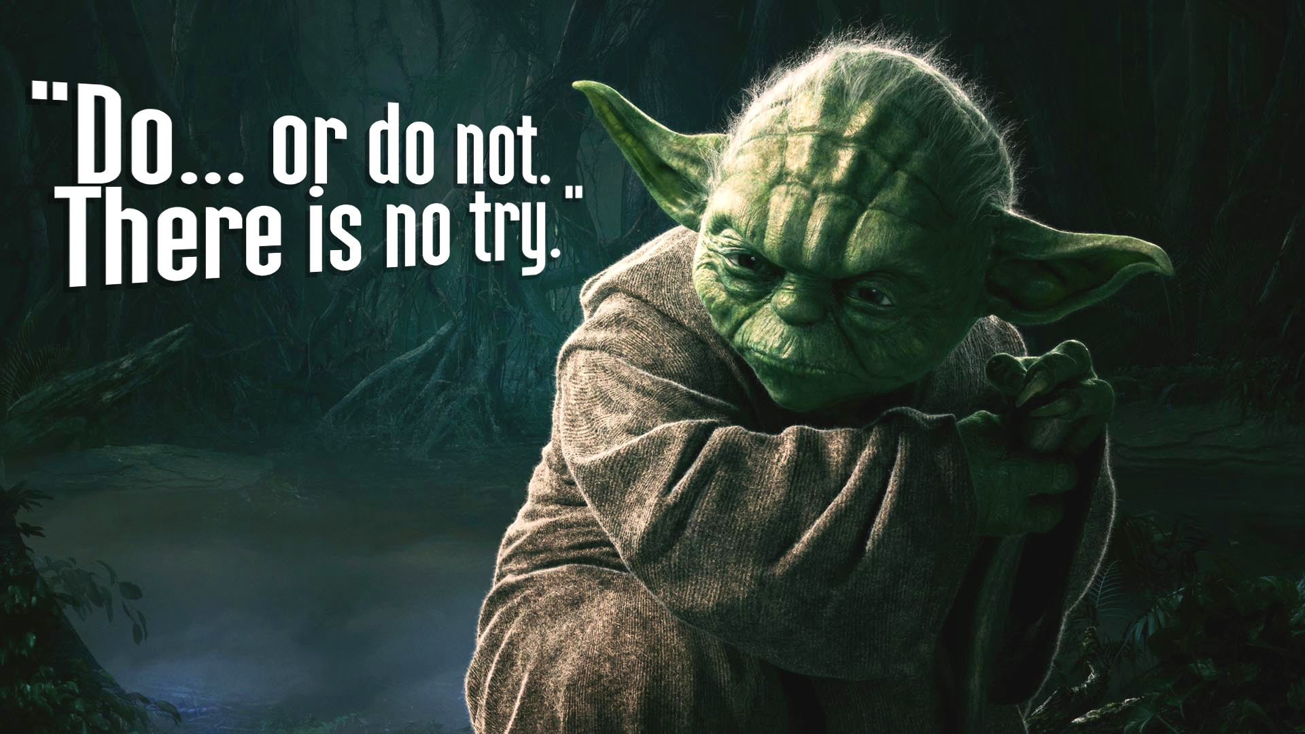

Slide 19
