Slide 2
What’s the Big Deal About Church Membership?
March 18, 2018
Edward Church

Slide 3
Ekklesia is the original Greek word for "church."
Ekklesia means "the called-out ones."
It denotes being called out of something (the world)…
…and into something else (the church)
We cannot be called out of one thing without…
…being called into another.

Slide 4
It Identifies You W- a Local Body of Believers
Soldiers wear an ID tag necklace (or “dog tag”).
This tag identified the soldier and where he served
Much in the same way, membership is your ID tag.
It identifies you with a group of believers /common doctrines.
The world needs to know where you stand.
Church membership helps make that statement.

Slide 5
It Identifies Your Commitment
Our Culture Teaches Limited Commitment…
..marriage, friendship, job, school, or country
Christ is ALL ABOUT COMMITMENT (Eph. 5:25)
Membership speaks of Your Commitment
It Provides Opportunity for your Spiritual Family to…
…support, pray, encourage each other in the Lord
It Helps you Face Life’s Problems by Providing the Support…
…Encouragement of other Christians as well.

Slide 6
It Identifies You as a Team Player
Membership = Covenant
One part of that Covenant emphasizes the importance of…
…working together for kingdom purposes.
…no place for a “lone ranger.”
The church family becomes God’s laboratory for us…
…to learn how to get along and work together as a family.
In this environment we practice unselfish / unconditional love.
…we learn to care for others, nurture each other
…and the opportunity to practice teamwork.
(1 Cor. 12:26; 1 John 3:16)

Slide 7
It Helps to Identify Your Giftings
Membership enables us to develop and use our giftings.
Each of us has a unique role
Our gifting then helps us carry out God’s purpose (1 Cor. 12:7).
Jesus said, “I will build my church” (Matt 16:18).
He builds it when people commit themselves to use their giftings to advance the Kingdom of God with others.

Slide 8
It Identifies Accountability
We are expected to contribute w- the resources God has given us,
not only our tithes and offerings
but also our time and talents
We accept this accountability when we become members,
provides a tangible way to cooperate with God.
builds character and inspires faith.
Such accountability strengthens the church family…
… we show that we can be counted on.

Slide 9
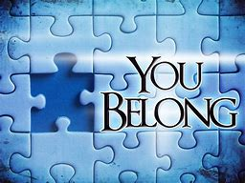

Slide 10
5 Reasons for Church Membership
by Joe Finley
When I was a youth pastor many years ago, I was surprised to learn that a wonderful couple who had attended our church for 20 years had not become members. They were faithful in their tithes and attendance but felt they didn’t need to be members. Why was membership not valued by them? What could have been done to motivate them to become members? What would have demonstrated the benefit of membership? After all, Ephesians 2:19 (LB) says, “Now you are no longer strangers to God and foreigners to heaven, but you are members of God’s very own family…and you belong in God’s household with every other Christian.”
I believe there are at least five genuine reasons for church membership:
1. It identifies you with a local body of believers As a fifth- and sixth-grader I wore an ID tag necklace (or “dog tag,” as we used to call it). This tag identified who I was. Much in the same way, membership is your ID tag. It identifies you with a group of believers and common basic doctrines. It identifies you as genuine believer. The world needs to know where you stand. Church membership can help make that statement.
2. It identifies your commitment So few in our culture want to be committed to anything-marriage, friendship, job, school, or country. However, Christ is committed to the church (Eph. 5:25). Since that is true, membership speaks of your commitment to the people of the church as well. It says you are not a “church hopper.”
This commitment provides opportunity for your spiritual family to support, help, pray, encourage you in your walk with the Lord, and vice versa. It helps you face life’s problems by providing the support and encouragement of other Christians and shows your commitment to them as well.
3. It identifies you as a team player
In the church I’m currently Pastoring, people take a class on membership and are then expected to agree to and sign a membership covenant. One part of that covenant emphasizes the importance of working together for kingdom purposes. In God’s kingdom there is no place for a “lone ranger.”
The church family becomes God’s laboratory for us to learn how to get along and work together as a family. It is in this environment that we practice unselfish and unconditional love. It’s where we learn to care for others, nurture each other, and when necessary be a peacemaker. We have the opportunity to practice teamwork. (1 Cor. 12:26; 1 John 3:16)
4. It helps to identify your giftings One of the things that blesses me is watching children grow and develop. When a first-grader becomes a second-grader, it is amazing how much that child develops intellectually, physically, and emotionally. At the beginning of first grade the child was struggling to write a complete sentence. Now in second grade the child writes paragraphs.
Membership enables one to develop and use their giftings. Each of us has a unique role to play in the Kingdom of God. Our gifting then helps us carry out God’s purpose (1 Cor. 12:7). Jesus said, “I will build my church” (Matt 16:18). He builds it when people commit themselves to use their giftings to advance the Kingdom of God with others.
5. It identifies accountability We are expected to contribute with all of the resources God has given us, not only our tithes and offerings, but also our time and talents. We accept this accountability when we become members, realizing that this provides a tangible way to cooperate with God. It builds character and inspires faith. Such accountability strengthens the church family as the church family knows that we can be counted on.
When you agree to be a member you allow others to enter your life to hold you spiritually on track. It provides an avenue for spiritual protection.
Since Christians have the same DNA, “members of God’s very own family,” and since “Christ is committed to the church,” it only makes sense to me that we make that same kind of commitment to each other through membership.

Slide 12
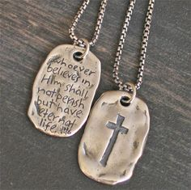
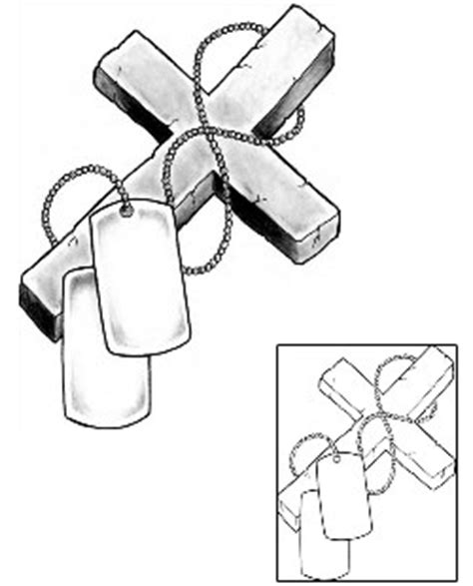

Slide 13
