Slide 2
10 Relationship Principles
Edward Church
April 22, 2018

Slide 3
How Would You Like…
… to See a
Positive Difference
…In Any and All Relationships?

Slide 4
Communication Can Be...
Negative
Discouraging- cannibal
Distrust– caution
Disharmony- can’t com
Disruption- cease com
Positive
Encouragement
Trust
Harmony
Connection

Slide 5
Principle #1
We See People Through Our Own Lens.
The Way You View Yourself / Life Shapes…
… How You See/ Relate To Others.
Your Self-Awareness- where am I
Self-Esteem- who am I
Self-Worth- Am I good enough
…Establish the Foundation of All Your Relationships.
Whether you see the cup as half full or half empty will transfer
Prov 23:7, “for as he thinketh in his heart, so is he…..”

Slide 6
Principle #2
People Don’t Care How Much You Know…
…Till They Know How Much You Care.
Caring About People Isn’t Automatic.
Not Everyone Cares.
You Can’t Learn to Care, It’s Not a Skill..
…But You Can Decide to Care.
You Can Ask God to Help You Become More Caring.

Slide 7
Principle #3
Learn to Listen From the Heart
One of the Greatest Gifts you can give someone is to truly listen.
You Can Listen to Understand or to Respond
Listening to Understand Communicates Value
It Requires Listening From the Heart
It Makes a Soul Level Connection
You Communicate Empathy, Interest and a Desire to be Helpful Far More By Listening than Merely By Your Words.

Slide 8
Principle #4
Believing the Best in People Usually Brings Out Best of People
Even a Broken Clock is Right Twice a Day
What You Look For You Will Find
We Are All Flawed and Imperfect
…But When Someone Calls Out the Best In Us
…We Often Rise to that Higher Standard

Slide 9
Principle #5
Hurting People Hurt People
When the Response Is Greater Than the Issue at Hand
…The Real Issue Is Always About Something Else.
We Need to Learn How to Get to the Real Issue
People Who Are Hurting Don’t Want To Hurt People, But ..
…It’s Like a Lion W- a Thorn In His Paw, He Can’t Help It.
If We Can Help People Take the Thorn Out…
…We Can Help Them Live Better.
…Your Life Becomes Better Too.

Slide 12
Principle #6
Admit wrongs and forgive quickly.
Taking responsibility for your actions is core to healthy and productive relationships.
If you make a mistake, own it. If you treat someone poorly, ask forgiveness. Getting defensive or bowing up never makes a relationship better. You might be right, but if you need to win, you’ll lose in the long run.
When you are wronged, forgive quickly. You’ll live with less stress and enjoy life more fully.

Slide 13
Principle #7
Always give more than you take.
There may be a few people in your life that you think it’s impossible to out give them. I understand that. John would be one of those people in my life. But that doesn’t mean we shouldn’t purpose to be generous anyway.
And with the majority of people, you will ever know, you can set your sights to give more than you take. However, this is not about a scorecard. If you keep track, you’ve missed the point. It’s a heart level thing. It’s a way of living, and when your motives are pure, it will bring you great joy.

Slide 14
Principle #8
Add value to people.
You can add value to people in simple ways and big ways. Adding value is no more complex than the idea of how you contribute to their life, so their life is better.
It can be as simple as a kind and encouraging word, and it can be as involved as a lifetime of mentoring. Sometimes it involves enough love and courage to have a tough and honest conversation.
The greatest value you can add to anyone is the message of Jesus Christ. The gift of eternal life is the greatest and highest value you can bring to someone.

Slide 15
Principle #9
You can never encourage anyone too much.
We both know the answer, but let me ask anyway. Have you ever been encouraged too much by someone? Of course not.
Whether it’s your kids, an employee, volunteers at the church, a co-worker or your neighbor, take the time to give frequent and sincere encouragement. Your leadership will rise because of it.

Slide 16
Principle #10
Trust is the lifeblood of all relationships.
When it comes to a relationship, trust is like a promise. And you should never break a promise.
In fact, that’s the essence of trust. People are counting on you to keep your promises. This reflects your character and ultimately who you are.
No reasonable person expects perfection, but they do expect honesty, kindness and doing what you say you’ll do.

Slide 17
Ephesians 4:31-32 Amplified Bible (AMP)
³¹ Let all bitterness and wrath and anger and clamor [perpetual animosity, resentment, strife, fault-finding] and slander be put away from you, along with every kind of malice [all spitefulness, verbal abuse, malevolence]. ³² Be kind and helpful to one another, tender-hearted [compassionate, understanding], forgiving one another [readily and freely], just as God in Christ also forgave ^{[a]}you.

Slide 18
“Be careful with your words. Once they’re said, they can only be forgiven not forgotten.”
“Words scar more than you think.”
“The tongue has no bones, but is strong enough to break a heart.”

Slide 19
Communication
Brings Connection
Builds a bridge or a wall

Slide 20
Communication Musts…
Clear
Consisitent
Credible
Confident
Concise

Slide 21
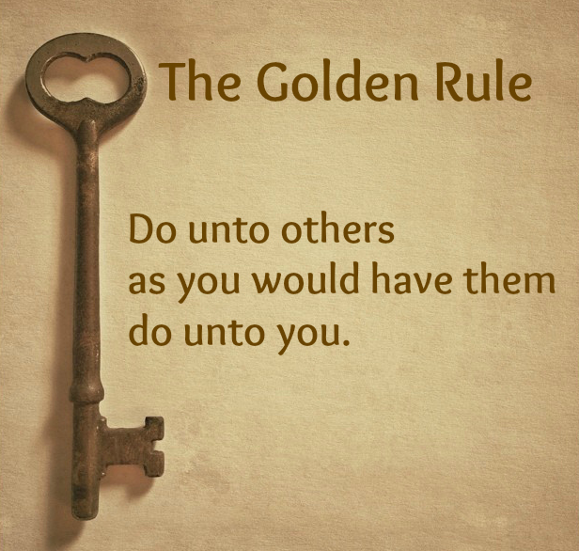

Slide 22
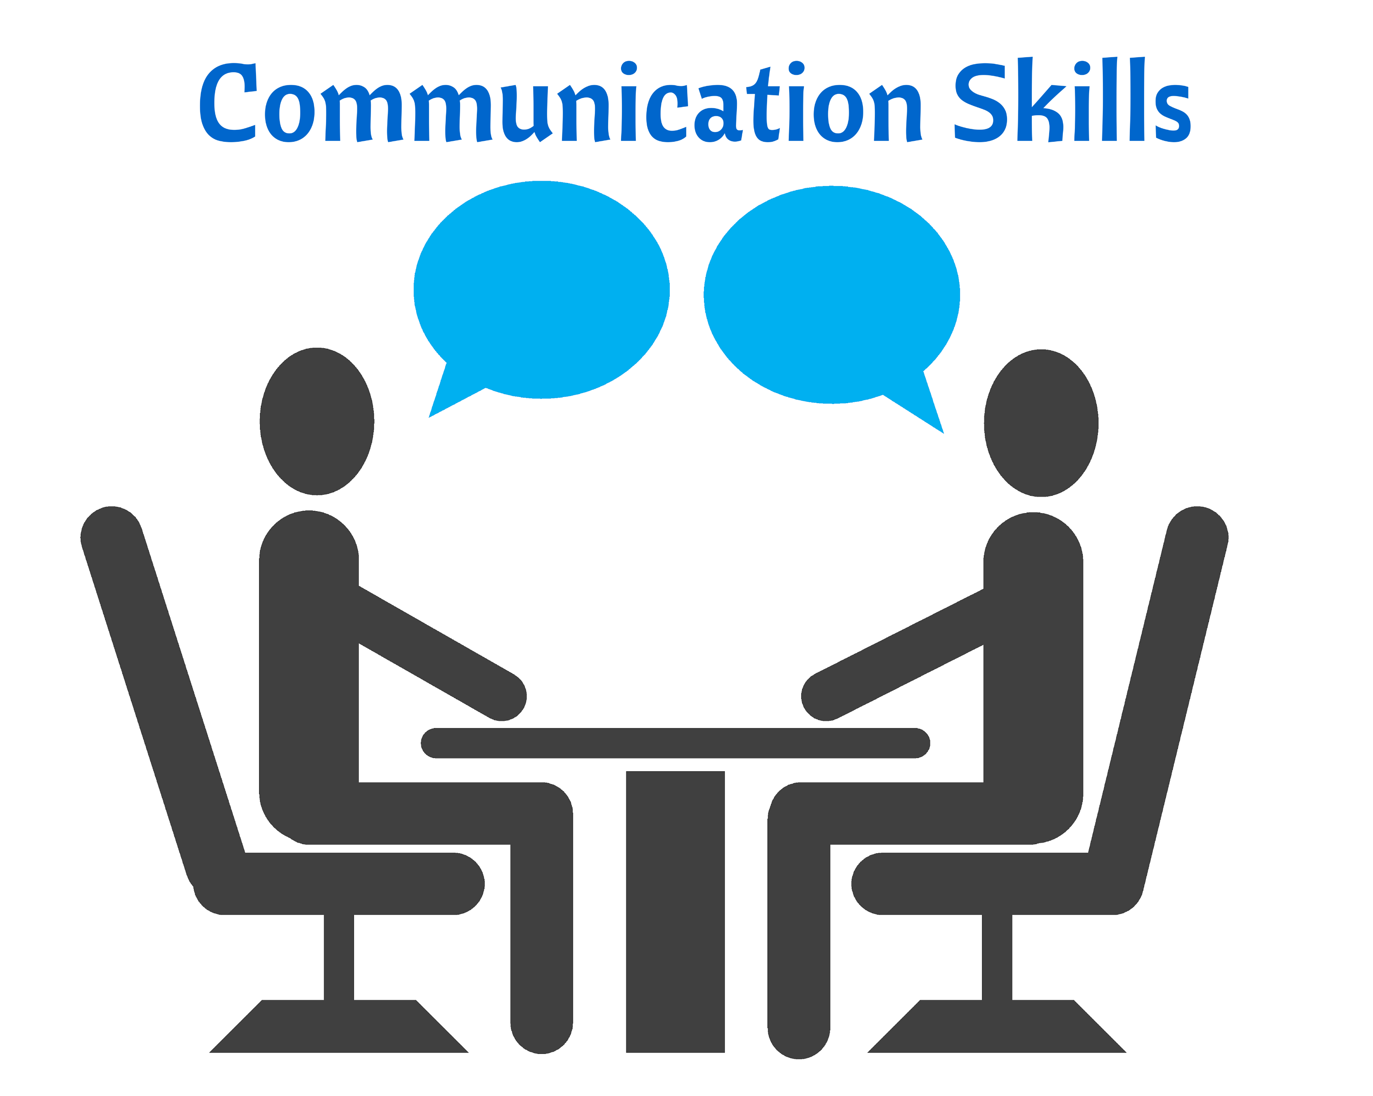
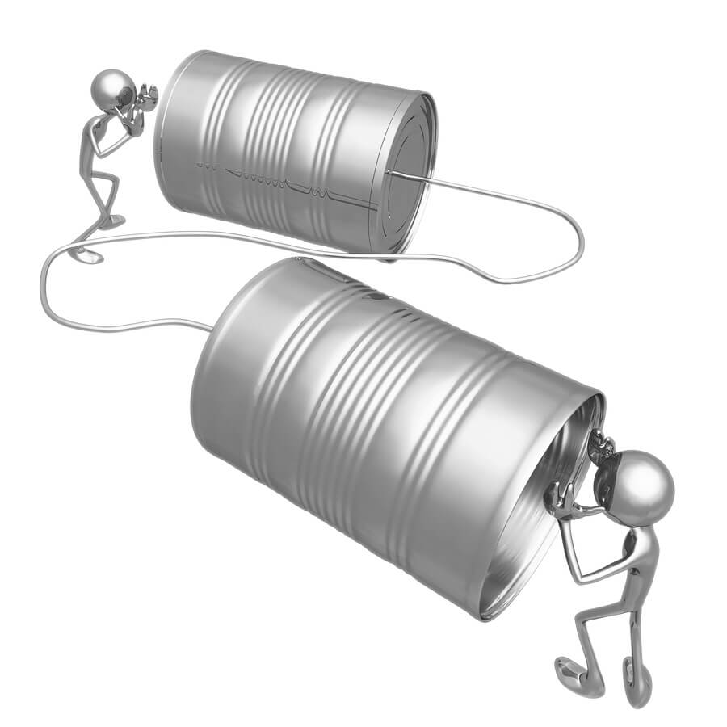
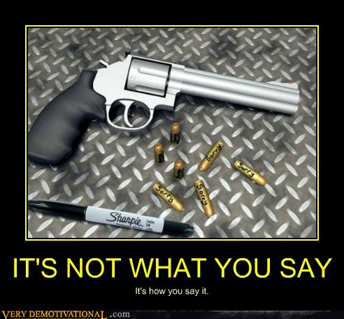

Slide 23
Communication Positive or Negative Can Be...
Negative
Discouraging- cannibal
Distrust– caution
Disharmony- cant com.
Disruption- cease com
Positive
Encouragement
Trust
Harmony
Flow

