Slide 2
Heart Conditions
April 8, 2018
Edward Church
Matthew 13:18-23

Slide 3
¹⁸ “Therefore hear the parable of the sower: ¹⁹ When anyone hears the word of the kingdom, and does not understand it, then the wicked one comes and snatches away what was sown in his heart. This is he who received seed by the wayside. ²⁰ But he who received the seed on stony places, this is he who hears the word and immediately receives it with joy; ²¹ yet he has no root in himself, but endures only for a while. For when tribulation or persecution arises because of the word, immediately he stumbles. ²² Now he who received seed among the thorns is he who hears the word, and the cares of this world and the deceitfulness of riches choke the word, and he becomes unfruitful. ²³ But he who received seed on the good ground is he who hears the word and understands it, who indeed bears fruit and produces: some a hundredfold, some sixty, some thirty.” Matt 13:18-23

Slide 4
The Silent Killer
I’m leaving you well and whole. That’s my parting gift to you. Peace. I don’t leave you the way you’re used to being left—feeling abandoned, bereft. So don’t be upset. Don’t be distraught John 14:27 message
#1 Killer in America…
Heart Disease (Conditions)
1 in every 4 deaths
#1 Killer in the Church…
Spiritual Heart (Condition)
Intellect
Will
Emotions
Courage
John 14:27, Peace I leave with
you; my peace I give you. I do
not give to you as the world
gives. Do not let your hearts be
troubled and do not be afraid.
Heart
Troubled (cant think)
Afraid (cant move)
The Cure for Heart Trouble=
the Word

Slide 5
God’s Word is a Powerful Seed
Three Ways
1st- It has Life Giving Power
John 6:63, “My words are spirit and life”
2nd- It has Fruit-Bearing Quality
Just One Seed can Produce a Great Harvest
3rd- It has to be Planted and Nourished
James 1:21, “Humbly accept the word planted in you,
which can save you”

Slide 6
Matters of Heart
The Seed Fell on…
…Four Different Types of Soils…
Each Represent a…
…Different Condition of the Heart

Slide 7
The Unguarded Heart
The Seed on the Path
The Path Was Hardened…
…So the Seed Could Not Take Root
The Birds Of Prey Came and Took The Seed
Lesson
When the Word of God Is Not Accepted…
…It Can Be Taken Away
…And Needs to Be Sown Again

Slide 8
The Shallow Heart
The Seed on Rocky Places
Rocky Places ..a Thin Layer of Soil Over a…
…Rock Base of Limestone
Seed Sprang Up Quickly…
…Showing An Absence of a Root System and Moisture
Lesson
The Shallow Heart Is Spiritually Unstable In Times of Testing
“since they have no root, they last only a short time. When trouble or persecution comes because of the word, they quickly fall away”
Mark 4:17
Superficial Christianity Will Not Stand in Times of Testing

Slide 9
The Cluttered Heart
The Seed Among Thorns
Thorns 1st Appeared On the Earth After the Fall
…Reminder of the Curse
Three Kinds of Thorns that Choke Our Spiritual Growth
Hebrews 6:8
the Worries of Life
the Deceitfulness of Riches
the Desire for Other Things
Lesson
Being Trapped on Life’s Treadmill Produces an…
Anxious & Deceived Christianity

Slide 10
The Receptive Heart
The Seed On Good Soil
The Good Heart is One Who…
Hears the Word
Accept It
Produces a Crop
Lesson
Hearing God is Predicated on Our Desire to…
…Act On What God Reveals to Us
Genuine Change of Heart is Seen by its Fruits

Slide 12
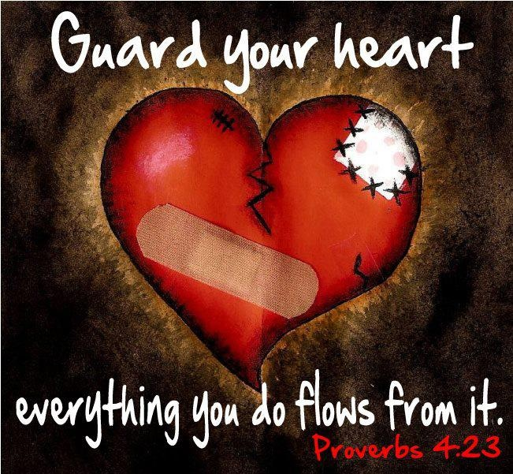

Slide 13
¹⁸⁻²³ “Now listen to the parable of the sower. When a man hears the message of the kingdom and does not grasp it, the evil one comes and snatches away what was sown in his heart. This is like the seed sown by the road-side. The seed sown on the stony patches represents the man who hears the message and eagerly accepts it. But it has not taken root in him and does not last long—the moment trouble or persecution arises through the message he gives up his faith at once. The seed sown among the thorns represents the man who hears the message, and then the worries of this life and the illusions of wealth choke it to death and so it produces no ‘crop’ in his life. But the seed sown on good soil is the man who both hears and understands the message. His life shows a good crop, a hundred, sixty or thirty times what was sown.” Matt 13 Philips

Slide 14
¹⁸ “Now listen to the explanation of the parable about the farmer planting seeds: ¹⁹ The seed that fell on the footpath represents those who hear the message about the Kingdom and don’t understand it. Then the evil one comes and snatches away the seed that was planted in their hearts. ²⁰ The seed on the rocky soil represents those who hear the message and immediately receive it with joy. ²¹ But since they don’t have deep roots, they don’t last long. They fall away as soon as they have problems or are persecuted for believing God’s word. ²² The seed that fell among the thorns represents those who hear God’s word, but all too quickly the message is crowded out by the worries of this life and the lure of wealth, so no fruit is produced. ²³ The seed that fell on good soil represents those who truly hear and understand God’s word and produce a harvest of thirty, sixty, or even a hundred times as much as had been planted!” NLT

Slide 15
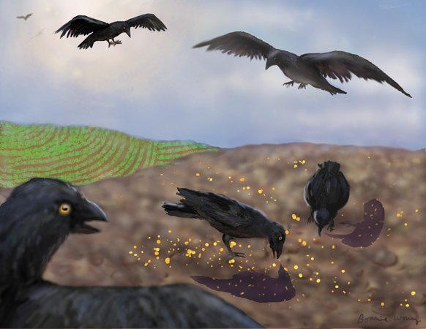
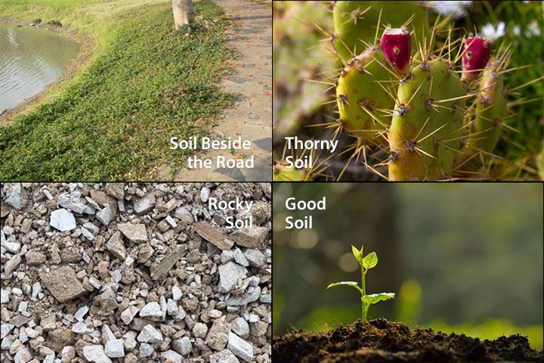
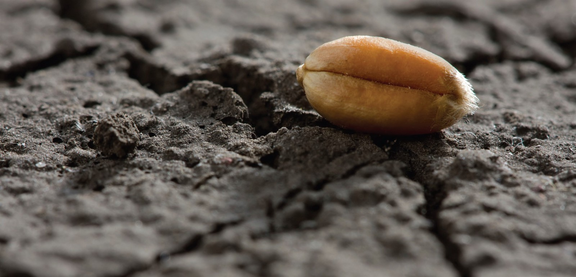
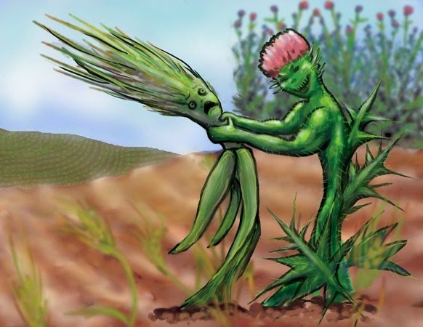

Slide 16
