Slide 1
Pastor went to his church office on Monday morning and discovered a dead mule in the church yard. He telephoned the police. Since there did not appear to be any foul play, the police referred the Pastor to the Health Department. They explained, "Since there was no health threat you'll need to call the Sanitation Department." When the pastor called the Sanitation Department, the Manager of the Sanitation Department said, "I can't pick up that dead mule without authorization from the mayor." The Pastor was not at all too eager to call the mayor, who possessed a very bad temper and was always extremely unpleasant and hard to deal with, but, eventually, the Pastor called the mayor anyway. The mayor did not disappoint the Pastor. The mayor immediately began to rant and rave. After his continued rant at the pastor, the mayor finally said, "Why did you call me any way? Isn't your job to bury the dead?" The pastor paused for a brief prayer, and asked the Lord to direct his response. The Lord led the pastor to the words he was seeking, "Yes, Mayor, it IS my job to bury the dead, BUT I always like to notify the next of kin first!"

Slide 3
Lessons from Lot’s Wife
Luke 17:32
Edward Church
June 3, 2018

Slide 4
Lot’s Wife at Sodom’s Destruction
Abram dwelt in the land of Canaan, and Lot dwelt in the cities of the plain and pitched his tent even as far as Sodom. 13But the men of Sodom were exceedingly wicked and sinful against the LORD. Gen 13:12-13
“Lot was a righteous man, who was distressed by the filthy lives of lawless men (for that righteous man, living among them day after day, was tormented in his righteous soul by the lawless deeds he saw and heard)”
2 Peter 2:7-8
His daughters married ungodly men /became part of the pagan culture.
God sent two angels to warn Lot of the judgment to come.
Lot told his sons-in-law, but they thought he was joking -Gen 19:14

Slide 5
One of Strangest Statements in Scripture
“Lot hesitated” -Gen 19:16
He should have been Decisive, but he was Indecisive.
He should have been Prompt, but he Lingered.
So the angels grasped his hands and led them out of the city “for the Lord was merciful to them” -Gen 19:16
“Flee for your lives! Don’t look back or …be swept away!” -Gen 19:17
“But Lot’s wife looked back / became a pillar of salt” -Gen 19:26

Slide 6
She Was Surrounded By Faith… …But Had No Faith
She was in a family filled with the faith of Abraham, the man of faith (Gen 15:6; Gen 22:1; Rom 4:17; Heb 11:8-12).
Needed a Move to a personal faith.
Make up their own minds /believe in Jesus
You decide the life you want to…
…Live, Believe and Destiny
Nobody, not even an angel of God can do it for you.
Angels basically dragged them out of Sodom.

Slide 7
She Held On to a World… …that had No Lasting Value
Her Body was Facing a City that was Destroyed.
This present world is temporary, and we need to remember that
Jesus said lay up for ourselves treasures in heaven -Matt 6:19-20
Paul said fix our eyes on what is unseen -2 Cor 4:18
We hold on to the things we need to let go of, let go of things we need to hold on to.
“For here we have no enduring city, but we are looking for the city that is to come” -Heb 13:14

Slide 8
She Forfeited Grace… …for Judgment
“those who cling to worthless idols forfeit the grace that could be theirs -Jonah 2:8
Judgment is Inevitable
it is appointed for men to die once, but after this the judgment -Heb 9:27
Mercy Will Keep Us From Judgment
Much more then, having now been justified by His blood, we shall be saved from wrath through Him. -Rom 5:9

Slide 9
She Believed That Good Times… …Would Continue
She Did Not Believe the Warning…
Jesus means in the last days people won’t be ready for the
Antichrist
Tribulation
His Return
They just don’t believe that God will bring an end to the world as we know it and make a new heaven and a new earth (2 Pt 3:12-13).

Slide 10
She Looked Back… …When She Should Have Been Looking Ahead
The Devil Will Tempt You to Go Back to Your Own Life…
…Your Old Ways, Your Old Relationships.
You Have to Make A Clean Break and Move On…
…Or You Will Be Destroyed (Phil 3:13-14)
Remember Lot’s Wife!

Slide 11
Where You Are Going is More Important… …Than Where You’ve Been
Life is Ahead of You…
…Not Behind You

Slide 13
The Bible isn’t clear whether Lot’s wife was covered in the salt that rained down with the brimstone or if her remains were dusted with a coating of salt later. But it is interesting that she is described as a “pillar.” The Hebrew for “pillar” refers to a garrison or a deputy, that is, something set to watch over something else. The image of Lot’s wife standing watch over the Dead Sea area—where to this day no life can exist—is a poignant reminder to us not to look back or turn back from the profession of faith we have made, but to follow Christ without hesitation and abide in His love (Luke 17:32).

Slide 17
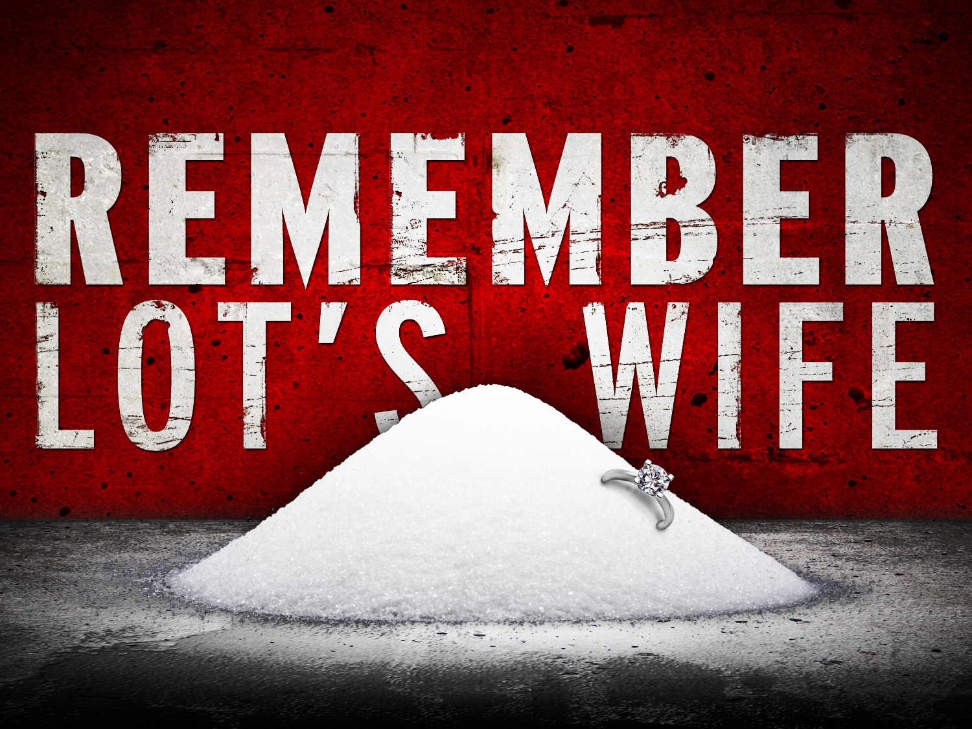

Slide 18
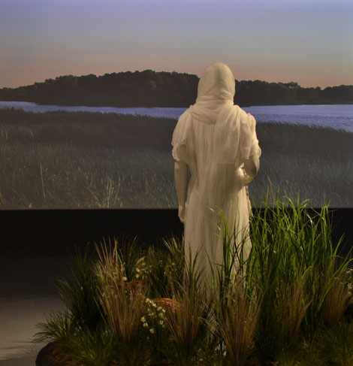
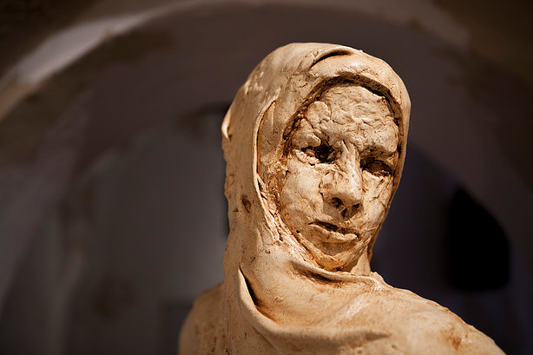
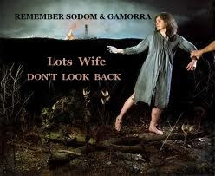
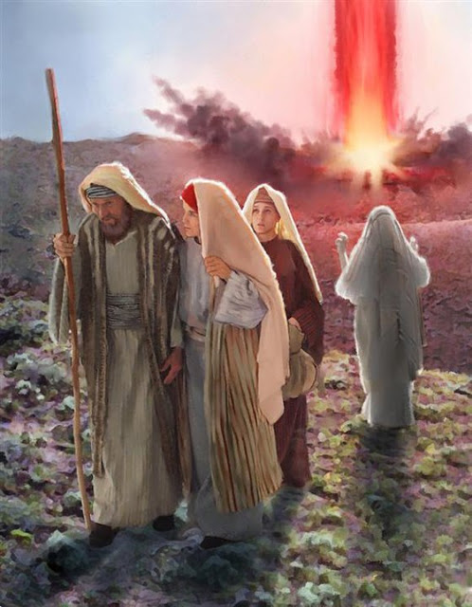
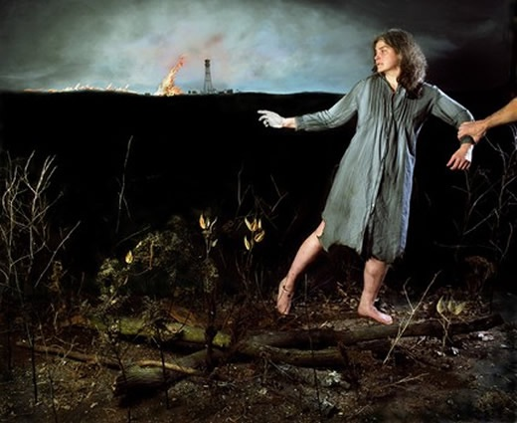

Slide 20
Roman City of Pompeii
Roman city of Pompeii was being excavated, the body of a woman was found mummified by the volcanic ashes of Mount Vesuvius.
Her position told a tragic story. Her feet pointed toward the city gate, but her outstretched arms and fingers were straining for something that lay behind her. The treasure for which she was grasping was a bag of pearls.

Slide 21
The Challenge of this Statement:
Who She Was and What Happened To Her
She was the wife of Lot, Abraham’s nephew.
…became enmeshed in Sodom’s culture.
…looked back/ probably started back,/ was turned into a pillar of salt.
People He Doesn’t Mention
Matriarchs of Faith – Sarah, Rebecca, Leah, Rahab or Ruth. But Remember Lot’s wife.
One Who Said It
Jesus the Prince of Peace, the one who taught that the greatest commandment is love, who was meek and lowly of heart, yet he said to remember Lot’s wife.
Those He Spoke These Words To
Not to Casual Onlookers, or the Pharisees / Teachers, nor the Crowds
His Closest Disciples who would be responsible for continuing his ministry
The Subject Matter
he was speaking of his second coming to this world. be ready, watchful, Faithful

