Slide 1
A little boy watched, fascinated, as his mother gently massaged cold cream on her face.
"Why are you rubbing that on your face, Mommy?" he asked.
"To make myself beautiful," said his mother.
A few minutes later, she began removing the cream with a tissue.
"What's the matter?" he asked. "Are you giving up?"

Slide 3
Identity Theft
Edward Church
July 7, 2018
Psalm 139:13-14

Slide 4
One of the Fastest Growing
Problems…
…Identity Theft
Business
…Identity Theft Recovery
Same Problem Found in Christians All Over
John 10:10
Satan is the Most Powerful Identity Thief
He knows Our Natural Self-Search…
…and Uses it to His Advantage

Slide 5
Three Questions Everyone Asks?
Who Am I?
…Person
Why am I Here?
…Purpose
How Do I Get There?
…Preparation

Slide 6
Psalm 139: 13-14
For You created my inmost being; You knit me together in my mother’s womb. I praise You because I am fearfully and wonderfully made; Your works are wonderful.
Genesis 1:26-27
Then God said, “Let us make man in Our image, in Our likeness, and let them rule over the fish of the sea and the birds of the air, over the livestock, over all the earth, and over all the creatures that move along the ground. “ So God created man in His own image, in the image of God He created him; male and female he created them.”

Slide 7
In this World There Are Two Voices
The Lie
o What the Enemy…
…wants you to believe
…about who you are
o There are Many Lies
The Truth
o What God says about…
…who you are
o There is Only ONE Truth
When It Comes to Your Identity There Are Some
Lies that the Devil Wants to Be Sure You Believe

Slide 8
The Identity Thief Wants You Here…
Anxiety—"I don't know who I really am."
Depression—"I have no hope for the future."
Self-doubt—"I am so inadequate."
Self-consciousness—"I am unacceptable and unloved."
Low self-worth—"I am not good enough."

Slide 9
Satan and the World has Beaten Us with the Belief that We Are Too Far Out there to be Used By, Loved By, and Trusted By God…
…Always Coming Up Short
But the Word tells us we have been “fearfully and wonderfully made.” and that the God who creates us also loves us and accepts us as we are. JUST as we are.
We are fearfully made and fearfully loved, and when that message sinks deep into us, we finally catch a glimpse of the goodness of God that is in each of us. It is good news – this news of our uniqueness, splendor, and beauty.

Slide 10
Psalm 139 –the Message
¹³⁻¹⁶ Oh yes, you shaped me first inside, then out; you formed me in my mother’s womb. I thank you, High God—you’re breathtaking! Body and soul, I am marvelously made! I worship in adoration—what a creation! You know me inside and out, you know every bone in my body; You know exactly how I was made, bit by bit, how I was sculpted from nothing into something. Like an open book, you watched me grow from conception to birth; all the stages of my life were spread out before you, The days of my life all prepared before I’d even lived one day.

Slide 11
Take Back Your Identity
Lie:
"My life has no value because I have failed and deserve to be punished."
Truth:
I have God-given value based not on my past performance but on Christ,
who lives in me and who gives me freedom from condemnation.
I Am Free From Accusation. "He has reconciled you by Christ's physical body through death to present you holy in his sight, without blemish and free from accusation." -Col 1:22
I Am Free From Condemnation. "Therefore, there is now no condemnation for those who are in Christ Jesus." –Rom 8:1

Slide 12
Take Back Your Identity
Lie:
"My life has no value because I have failed and deserve to be punished."
Truth:
I Am Free From the Law. "So, my brothers, you also died to the law through the body of Christ, that you might belong to another, to him who was raised from the dead, in order that we might bear fruit to God." –Rom 7:4
I Am Free From Sin. "In the same way, count yourselves dead to sin but alive to God in Christ Jesus." -Rom 6:11
I Am Free From God's Wrath. "Since we have now been justified by his blood, how much more shall we be saved from God's wrath through him!" -Rom 5:9

Slide 13
Take Back Your Identity
Lie:
"My life has no value since I've done so many things wrong—my life is ruined."
Truth:
I have God-given value, for I've been given a new life in Jesus Christ.
I Am Redeemed. "In him we have redemption through his blood, the forgiveness of sins, in accordance with the riches of God's grace." -Eph 1:7
I Am Washed. "That is what some of you were [wicked]. But you were washed, you were sanctified, you were justified in the name of the Lord Jesus Christ and by the Spirit of our God." -1 Cor 6:11

Slide 14
Take Back Your Identity
Lie:
"My life has no value since I've done so many things wrong—my life is ruined."
Truth:
I have God-given value, a new life in Jesus Christ.
I Am Purified. "If we walk in the light, as he is in the light, we have fellow ship with one another, and the blood of Jesus, his Son, purifies us from all sin." -1 John 1:7
I Am Justified. "Since we have been justified through faith, we have peace with God through our Lord Jesus Christ." -Rom 5:1
I Am Sanctified. "You were washed, you were sanctified, you were justified in the name of the Lord Jesus Christ and by the Spirit of our God." -1 Cor 6:11

Slide 16
End of Part 1

Slide 17
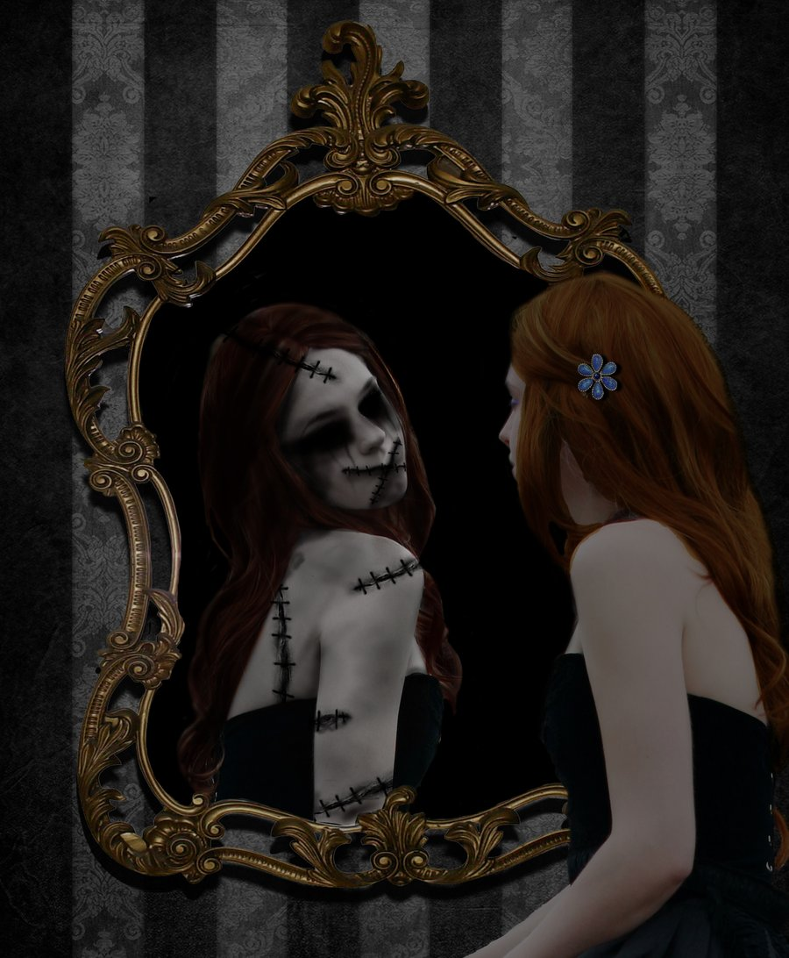
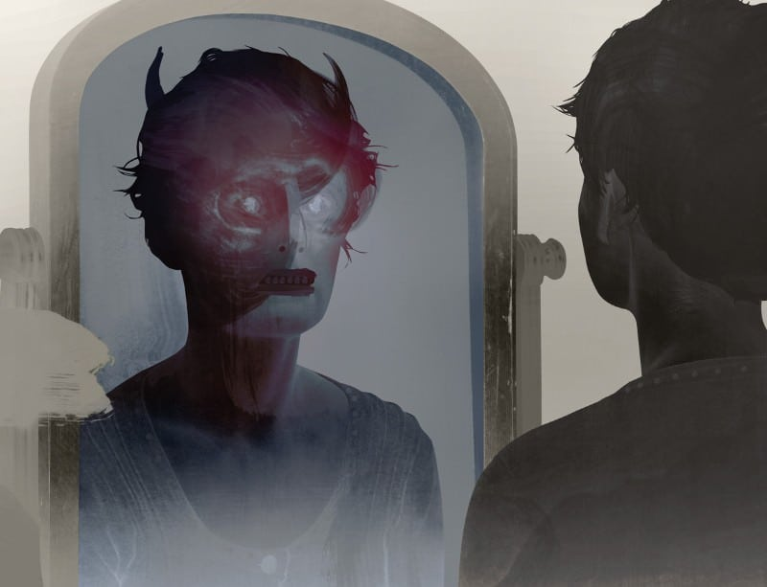
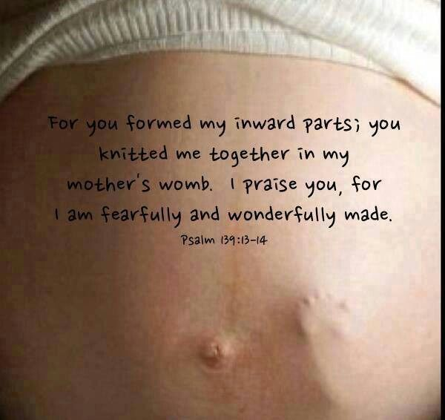
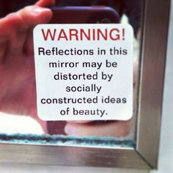

Slide 18
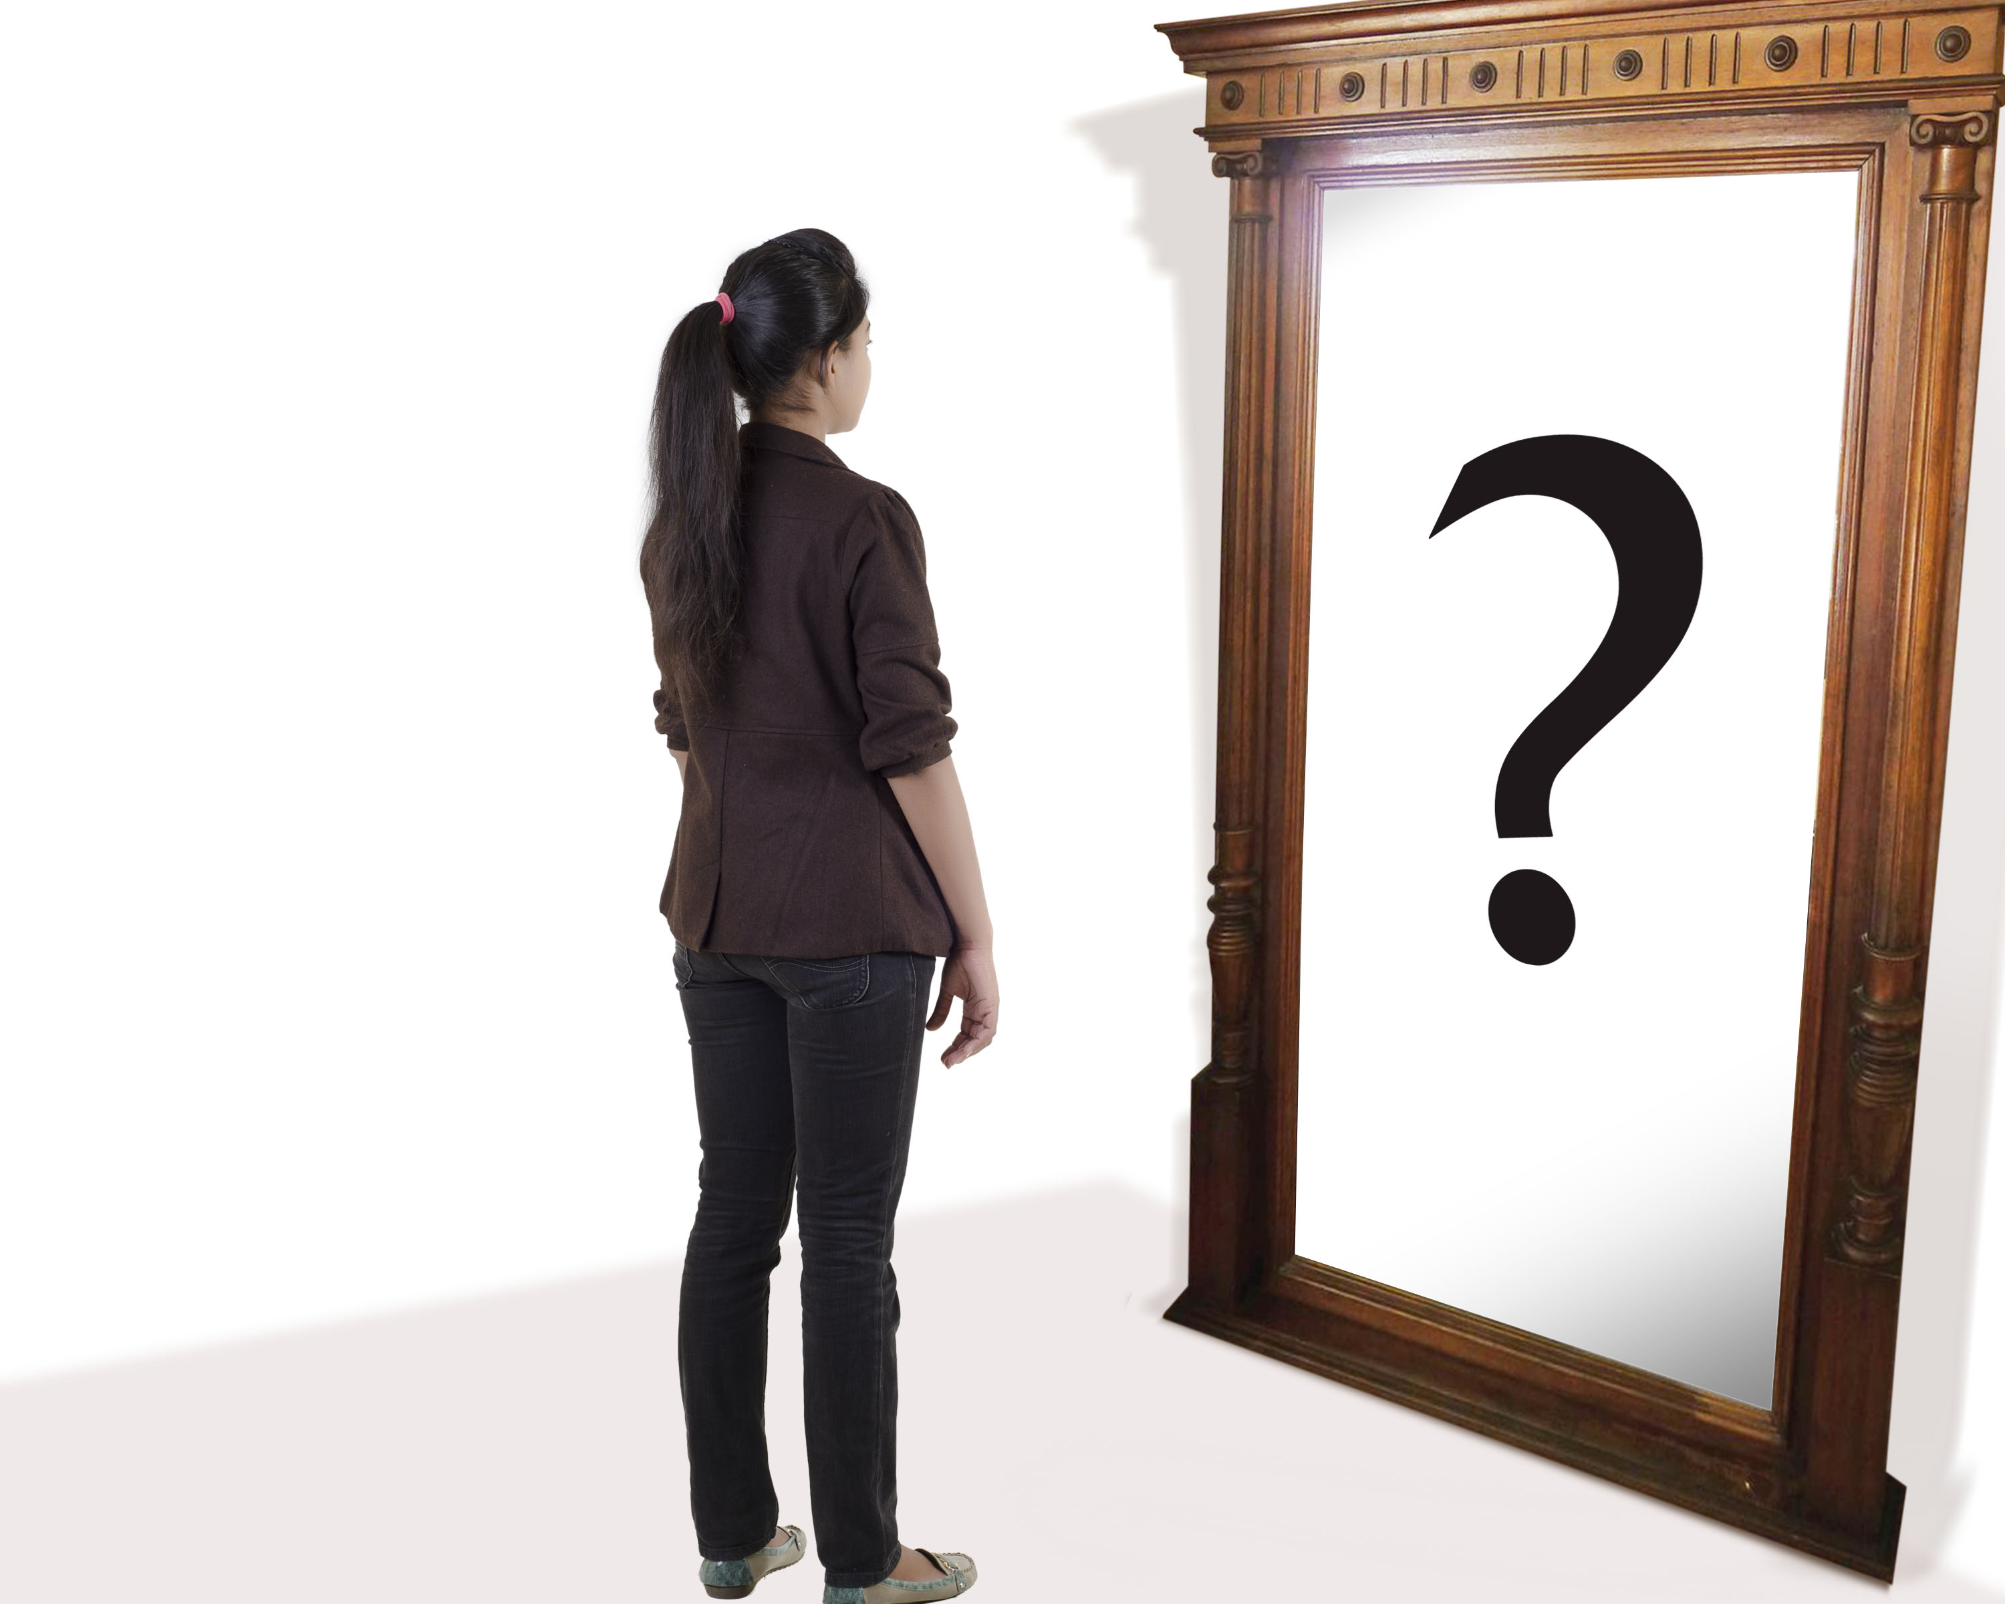

Slide 19
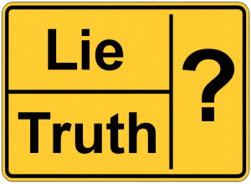
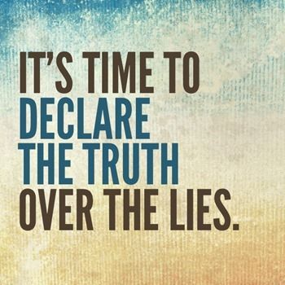
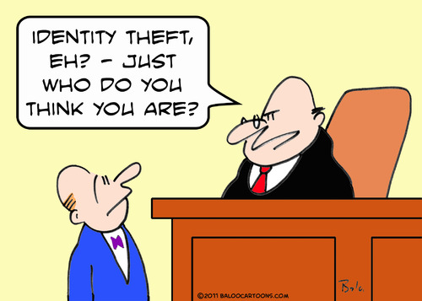
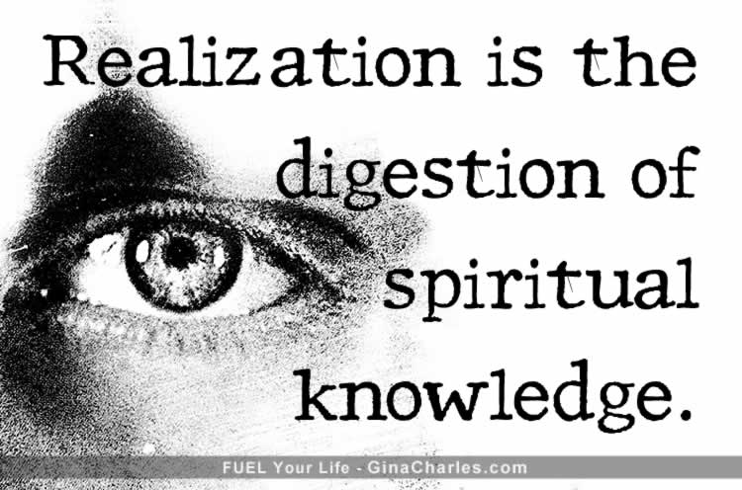
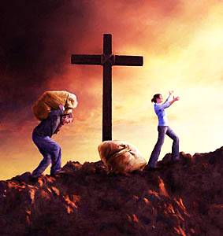
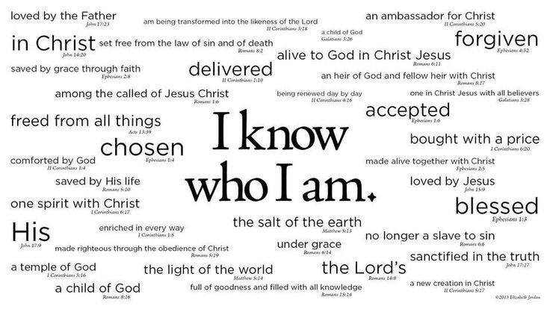

Slide 20
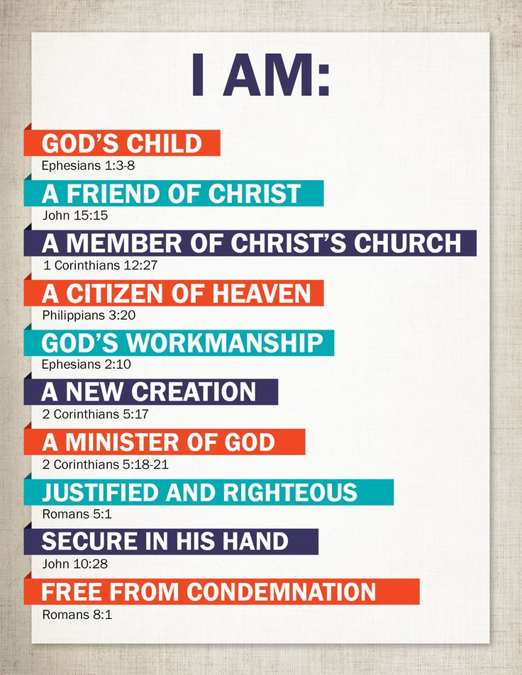

Slide 21
Take Back Your Identity
Lie:
"My life has no value because I have failed and deserve to be punished."
Truth:
I have God-given value based not on my past performance but on Christ, who lives in me and who gives me freedom from condemnation.
I am free from accusation. "He has reconciled you by Christ's physical body through death to present you holy in his sight, without blemish and free from accusation." (Colossians 1:22)
I am free from condemnation. "Therefore, there is now no condemnation for those who are in Christ Jesus." (Romans 8:1)
I am free from the law. "So, my brothers, you also died to the law through the body of Christ, that you might belong to another, to him who was raised from the dead, in order that we might bear fruit to God." (Romans 7:4)
I am free from sin. "In the same way, count yourselves dead to sin but alive to God in Christ Jesus." (Romans 6:11)
I am free from God's wrath. "Since we have now been justified by his blood, how much more shall we be saved from God's wrath through him!" (Romans 5:9)

Slide 22
Take Back Your Identity
Lie:
"I'll never feel valuable because this is just the way I am. I cannot change."
Truth:
I have God-given value because God has changed me on the inside -given me new characteristics.
I am a New Creation
"If anyone is in Christ, he is a new creation; the old has gone, the new has come!" -2 Cor 5:17
I have a New Nature
"In him you were also circumcised, in the putting off of the sinful nature, not with a circumcision done by the hands of men but with the circumcision done by Christ." -Col 2:11
I have a New Heart
"I will give you a new heart/..new spirit in you; ..remove..heart of stone/ ..heart of flesh." -Ezk 36:26
I have a New Spirit
"I will put my Spirit in you/ move you to follow my decrees/ be careful to keep my laws." -Ezk 36:27
I have a New Mind
“…But we understand these things, for we have the mind of Christ” -1 Cor 2:16 NLT

Slide 23
Take Back Your Identity
• An adopted child
Wrong Belief:
"I wasn't worth keeping."
Right Belief:
God not only cares about me, He adopted me, and He'll never leave me.
"He predestined us to be adopted as his sons through Jesus Christ." (Ephesians 1:5)
• A child of divorce
Wrong Belief:
"I must be the reason my parents are divorced."
Right Belief:
I am not responsible for the actions of others. Each person is accountable to God.
"Each of us will give an account of himself to God." (Romans 14:12)
• A multiple birth child (twin, triplet)
Wrong Belief:
"I felt lost in the shuffle."
Right Belief:
I am a unique creation of God. He knew me before I was born.
"For you created my inmost being; you knit me together in my mother's womb. I praise you because I am fearfully and wonderfully made; your works are wonderful, I know that full well." (Psalm 139:13-14)
• A fatherless child (death)
Wrong Belief:
"I never had a real father who loved me and cared for me."
Right Belief:
God will be my helper, defender and encourager. He is the Father of the fatherless.
"But you, O God, do see trouble and grief; you consider it to take it in hand. The victim commits himself to you; you are the helper of the fatherless.... You hear, O Lord, the desire of the afflicted; you encourage them, and you listen to their cry, defending the fatherless and the oppressed, in order that man, who is of the earth, may terrify no more." (Psalm 10:14, 17-18)
• A child born in poverty
Wrong Belief:
"I didn't get a fair start in life."
Right Belief:
God has not forgotten me, for He defends the cause of the needy.
"I know that the Lord secures justice for the poor and upholds the cause of the needy." (Psalm 140:12)

Slide 24
Take Back Your Identity
Lie:
"My life has value as long as I can look good to others."
Truth:
I have God-given value even though I have fallen in the past and may stumble in the future. He has given me a new image.
I am totally accepted by Christ. "Accept one another, then, just as Christ accepted you, in order to bring praise to God." (Romans 15:7)
I am totally blameless before Christ. "He has reconciled you by Christ's physical body through death to present you holy in his sight, without blemish and free from accusation." (Colossians 1:22)
I am totally righteous in Christ. "God made him who had no sin to be sin for us, so that in him we might become the righteousness of God." (2 Corinthians 5:21)
I am totally complete in Christ. "In Christ all the fullness of the Deity lives in bodily form, and you have been given fullness [made complete] in Christ, who is the head over every power and authority." (Colossians 2:9-10)
I am totally perfect because of Christ. "By one sacrifice he has made perfect forever those who are being made holy." (Hebrews 10:14)

