Slide 1
Do u remember Buckwheat from the Little Rascals?
I heard some sad news this week
He has converted to Islam
He was called Buckwheat …
…but now his Islamic name is
“Kareem of Wheat”

Slide 3
Edward Christian Church
August 26, 2018
Stay On the Wall
Weapons of Mass Distraction
Nehemiah 6

Slide 4
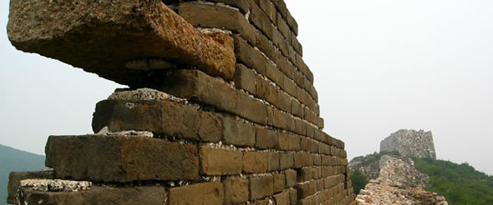
Tough Days in Jerusalem:
Walls Down
Temple and Homes Exposed
Many Under Attack
Many had Been Taken Captive
Many to Rebuild
God Raised Up a Man!!

Slide 5
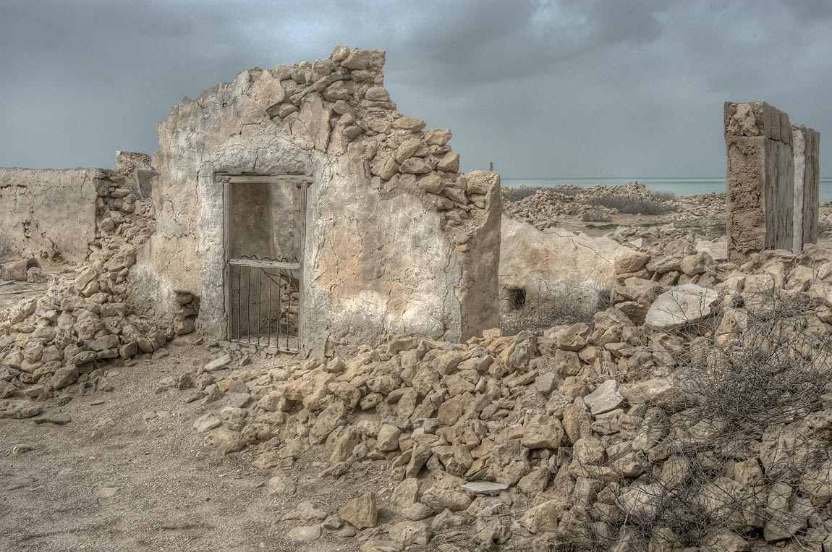
We Are Living in a Similar Time:
Walls Down
Temple and Homes Exposed
Many Under Attack
Many had Been Taken Captive
Many Lives Trying to Rebuild
God is Raising Up a People !!

Slide 6
Satan Attacks
Whenever God Begins to Move…
…Whenever His Anointing Is Present
Satan Begins to Counter-Move
…His 3-Point Attack

Slide 7
Anatomy of Satanic Attacks
Attacks at Point of …
#1- Praise
Has to do with Attitude
Invites God’s…
Presence
Power
Provision
Peace
“But You are holy, enthroned on the praises of Israel” -Psa 22:3

Slide 8
Anatomy of Satanic Attacks
Attacks at Point of …
#2- Commitment
Has to do with Availability
Invites God’s Potential
There is No Limits to the Man / Woman Who Just Wont Quit…
...But Commits Their Way to the Lord
Mighty Army

Slide 9
Anatomy of Satanic Attacks
Attacks at Point of …
#3 Anointing
Has to Do with Ability
Invites God’s Power

Slide 10
Satan Attacks the Anointing Because It:
Breaks the Yoke -Isa 10:27
Uncommon Freedom
Moves Beyond Flesh -Zech 4:6
Uncommon Power
Makes a Way Where is No Way -Isa 59:19
Uncommon Preparation

Slide 11
2 Types of Attacks
Aggressive
Primary
Purpose:
Get you down
Stop forward momentum
Plural; multi-faceted
Assyria…
…attacked Israel
Babylon
…attacked Judah

Slide 12
Aggressive
Suppressive
Secondary
Purpose:
Keep you down
Prevent forward momentum
Plural; multi-faceted
Assyria…
…held Israel Captive
Babylon…
…held Judah Captive

Slide 13
There Came a Time When…
…God Said Enough is Enough
They Still Had…
…Their Part To Play
Believe That …
God had a Better Plan
God had a Better Way
God had a Better Power

Slide 14
Breakthrough
God Sent:
Ezra to Build the Temple
Starts W- a Relationship
Nehemiah to Build The Wall
Protect the Relationship
Satan Began To:
Lose Grip
Lose Momentum
Lose Captives

Slide 15
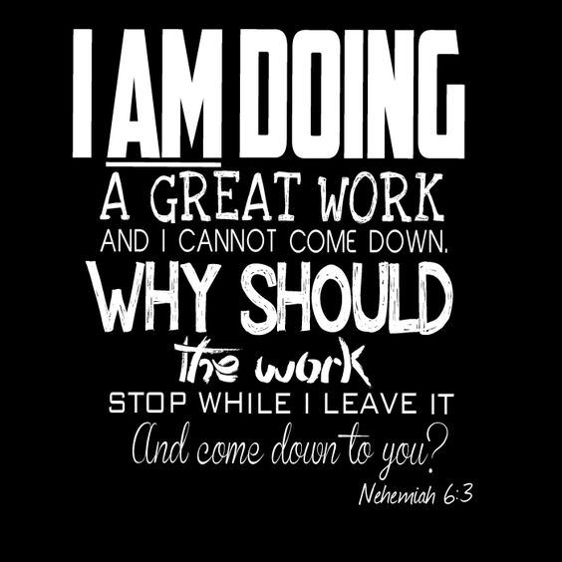
Satan Wanted the Wall Stopped
He Wanted God’s People at a Place of:
Vulnerability
Attack at Will
Instability
Apparent was Unapparent
Irritability
Attitudes Effected

Slide 17
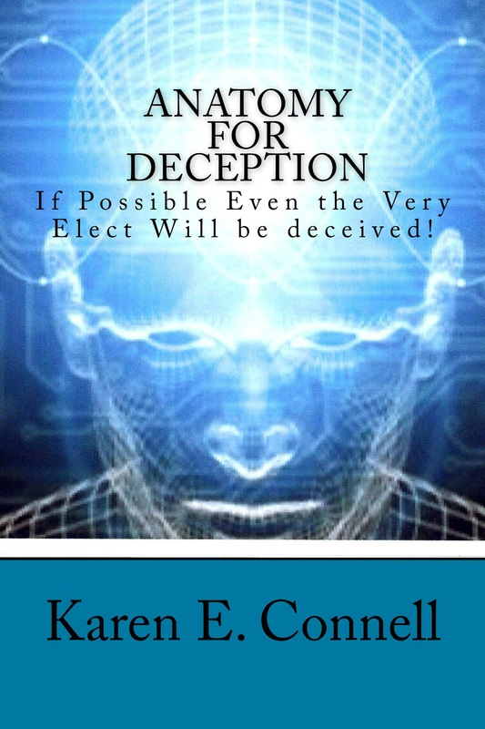

Slide 18
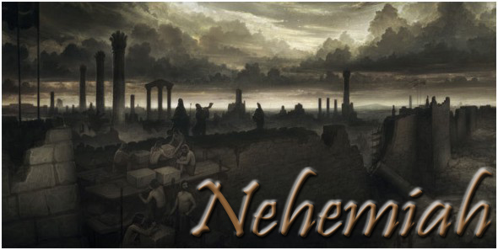

Slide 19
