Slide 1
At the end of their first date, a young fellow takes the girl back to her home. On the front porch, leaning against the wall with a bit of swagger, he decides to try for that important first kiss.
He: "Sweet thing, how 'bout a good night kiss?"
She: "Oh, I couldn't do that. My parents will see us!"
He: "Oh come on! Who's gonna see us at this hour?"
She: "No, please. I would just die of embarrassment if someone saw us."
He: "Baby, there's nobody around, they're all sleeping!"
She: "No way. It's just too risky!"
He: "Oh please, please, I like you so much!!"
She: "No. I like you too, but I just can't!"
He: "Oh yes you can. Please, Sugar? Please?"
She: "No, no. I just can't."
He: "Pleeeeease?..."
Then the porch light goes on and the girl's sister shows up in her pajamas, sleepy, hair disheveled. "Dad says go ahead and give him a kiss. Or I can do it. Or if need be, he'll come down himself and do it. But for crying out loud tell him to take his hand off the intercom button!"

Slide 3
Seven Downs that are Able to Lift You Up -pt2
Romans 15:1
Edward Church
August 5, 2018

Slide 4
Fear has become a Epidemic in this Age-
Jesus warned – in last days hearts failing for fear
F-
E-
A-
R-
…Fervently
…Erodes
…All
…Rest

Slide 5
The Lord has 7 “Downs" …that We Might Have the “Ups."
Fear has become a Epidemic in this Age
Jesus warned – in last days hearts failing for fear
If fear is allowed to persist it can become Depression “Down”
Many Christians now have more "downs" than they have "ups."
“down in the mouth Christianity” will never win anyone to the Lord.
We need to get all excited about being saved.

Slide 6
The Lord Looked Down
Psalm 14:2-3, “The LORD looked down from heaven upon the children
of men, to see if there were any that did understand, and seek God”³
They are all gone aside, they are all together become filthy: there is
none that doeth good, no, not one.
He Saw the…
Depravity of Fallen People
Death that Stalks and Plagues the Earth
Destiny that Awaits the Lost Souls.

Slide 7
The Lord Came Down
John 3:31-32, “ He that cometh from above is above all: he that is of
the earth is earthly, and speaketh of the earth: he that cometh from
heaven is above all. ³² And what he hath seen and heard, that he
testifieth; and no man receiveth his testimony”
Christ Came to…
Reveal God's Love and Purpose
Reaffirm God's Laws and Precepts
Redeem God's Lost People.

Slide 8
The Lord Laid Down
1 John 3:16 (AMP) By this we come to know (progressively to recognize, to perceive, to understand) the [essential] love: that He laid down His [own] life for us; and we ought to lay [our] lives down for [those who are our] brothers [in Him].
He Stayed on the Cross
He Sacrificed His life as Lamb
He Satisfied God's demands for Salvation.

Slide 9
The Lord Went Down
1 Peter 3:18-19, ¹⁸ Christ suffered for our sins once for all time. He never sinned, but he died for sinners to bring you safely home to God. He suffered physical death, but he was raised to life in the Spirit.¹⁹ So he went and preached to the spirits in prison
He Went Down to Hell to…
Preach to Captives
Put Devil in His Place
Push Away the Fear of Death

Slide 10
The Lord Sat Down
Hebrews 12:1-3 (KJV) ¹ Wherefore seeing we also are compassed about with so great a cloud of witnesses, let us lay aside every weight, and the sin which doth so easily beset us, and let us run with patience the race that is set before us, ² Looking unto Jesus the author and finisher of our faith; who for the joy that was set before him endured the cross, despising the shame, and is set down at the right hand of the throne of God. ³ For consider him that endured such contradiction of sinners against himself, lest ye be wearied and faint in your minds.
He Finished the Work of Redemption (never chairs in Temple)
He Fulfilled the Types and Shadows
He Furnishes the Believer with Power to Serve.

Slide 11
The Lord Reaches Down
Matthew 14:31-33 (KJV) ³¹ And immediately Jesus stretched forth his
hand, and caught him, and said unto him, O thou of little faith, where
fore didst thou doubt? ³² And when they were come into the ship, the
wind ceased. ³³ Then they that were in the ship came and worshipped
him, saying, Of a truth thou art the Son of God.
Lift you out of your Death into Life Eternal
Lead you out of your Defeats into Victories
Loose you from all that Prevents Devotion to Christ.

Slide 12
The Lord Is Coming Down
1 Thessalonians 4:13-16 (KJV) ¹³ But I would not have you to be ignorant, brethren, concerning them which are asleep, that ye sorrow not, even as others which have no hope. ¹⁴ For if we believe that Jesus died and rose again, even so them also which sleep in Jesus will God bring with him. ¹⁵ For this we say unto you by the word of the Lord, that we which are alive and remain unto the coming of the Lord shall not prevent them which are asleep. ¹⁶ For the Lord himself shall descend from heaven with a shout, with the voice of the archangel, and with the trump of God: and the dead in Christ shall rise first:
Raise the Dead Saints
Rapture the Living Saints
Reward the Faithful Saints.

Slide 13
The Lord Will Put Down
Hebrews 2:7-8 (KJV) ⁷ Thou madest him a little lower than the angels; thou
crownedst him w- glory /honour, and didst set him over the works of thy hands: ⁸
Thou hast put all things in subjection under his feet. For in that he put all in
subjection under him, he left nothing that is not put under him. But now we see
not yet all things put…
Under Him..
…He will Place
Satan in the Bottomless Pit
Separated in their Rightful Place
Saints in a Glorious Paradise.

Slide 14
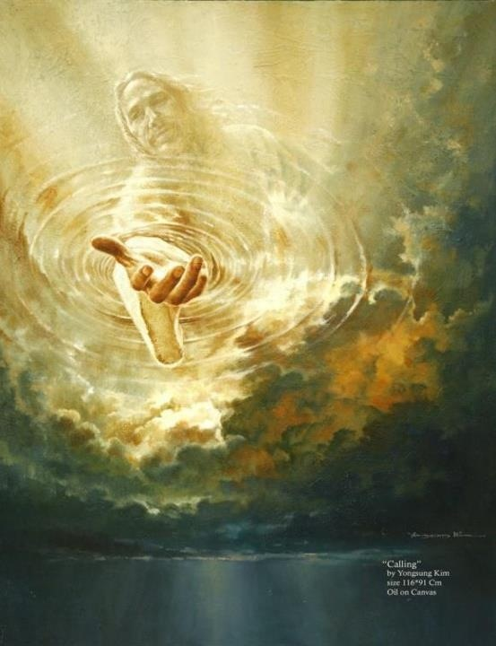

Slide 16
F. E. A. R.
F-
E-
A-
R-
…Fervently
…Erodes
…All
…Rest

Slide 17
Seven
Downs

Slide 19
FEAR
I Have the Keys
of
Death and Hell

Slide 20
Hebrews 1:1-3 ¹ God, who at sundry times and in divers manners spake in time past unto the fathers by the prophets, ² Hath in these last days spoken unto us by his Son, whom he hath appointed heir of all things, by whom also he made the worlds; ³ Who being the brightness of his glory, and the express image of his person, and upholding all things by the word of his power, when he had by himself purged our sins, sat down on the right hand of the Majesty on high;

