Slide 2
Thanks After the Storm
Edward Church
Sept 23, 2018

Slide 3
“give thanks in all circumstances; for this is God's will for you in Christ Jesus” -1 Thessalonians 5:18

Slide 4
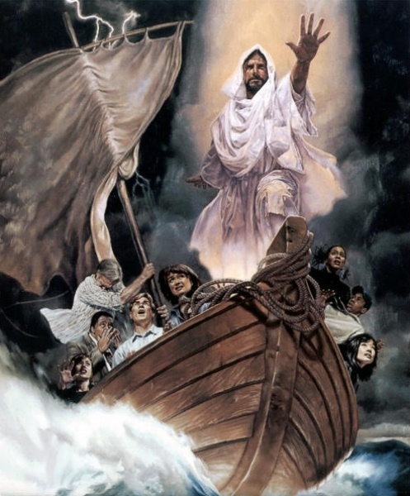
How Many Saw the News?
How Many…
Prepared?
Prayed?
Pressed?
Praised?

Slide 5
T- Take…
….Nothing for Granted
Whatever We..
…Are, Have and Do
…Can Be Gone Tomorrow

Slide 6
H- Humble…
…Yourself Before God
I Can Stop / Change Alot of Things
I Cant Change the Wind…
…But I Can Adjust My Sails

Slide 7
A- Action-
…Keep Moving Forward
…Don’t Let Circumstances Stop You
You May Have to Pick Up Pieces/ Rebuild…
…God is there W/ You

Slide 8
N- Never…
…Forget God Is Always In Control
There is Never a Time that He Isn’t

Slide 9
K- Keep…
…Your Eyes on the Blesser
…Not the Blessing

Slide 10
S- Say…
…Thanks Often
Thank You God…
…Help Me Remember
…This is Only Temporal
…Heaven is Eternal!

Slide 12
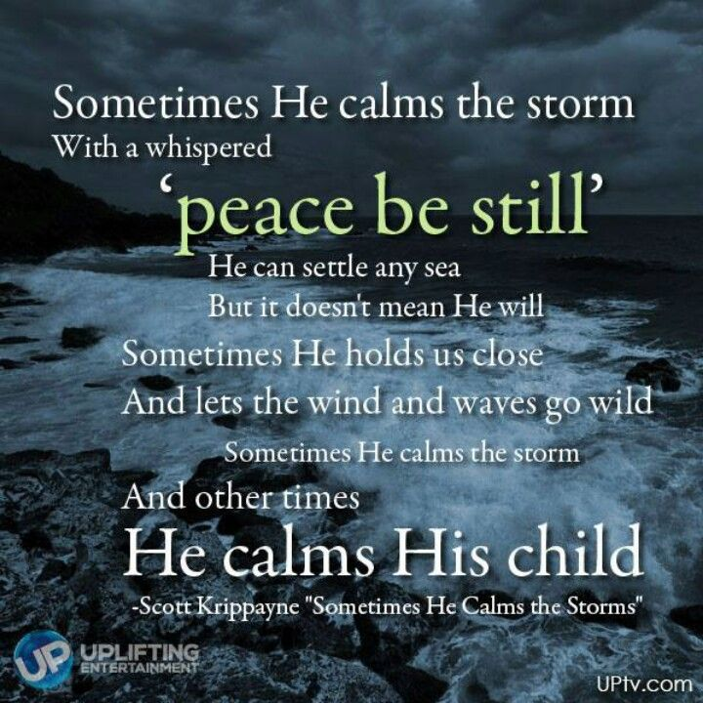

Slide 13
