Slide 1
WWJD -- What Would Jesus Drive?
One theory is that Jesus would tool around in an old Plymouth because the Bible says, "God drove Adam and Eve out of the Garden of Eden in a Fury."
But in Psalm 83, the Almighty clearly owns a Pontiac and a Geo. The passage urges the Lord to "pursue your enemies with your Tempest and terrify them with your Storm."
Perhaps God favors Dodge pickup trucks, because Moses' followers are warned not to go up a mountain "until the Ram's horn sounds a long blast."
Some scholars insist that Jesus drove a Honda but didn't like to talk about it. As proof, they cite a verse in St. John's gospel where Christ tells the crowd, "For I did not speak of my own Accord..."
Meanwhile, Moses rode an old British motorcycle, as evidenced by a Bible passage declaring that "the roar of Moses' Triumph is heard in the hills."
Joshua drove a sports car with a hole in its muffler, "Joshua's Triumph was heard throughout the land."
And, following the Master's lead, the Apostles car pooled in a Honda: "The Apostles were in one Accord."

Slide 3
Five Lessons from “Five Smooth Stones”
Edward Christian Church
October 21, 2018
Pt 2
I Sam 17

Slide 4
David and Goliath
from Goliath's Viewpoint

Slide 5
Goliath
This was Another Day at the Office for Goliath
Goliath= Beheader
Champion= Gap-Stander
Challenger= 40 Days Unanswered
Beheaded Israel w-out a Fight
Typical Warfare for Goliath
Then He Met a Little Shepherd Boy…
...Goliath's Perspective was About to Change

Slide 6
David and Goliath
There are Five Things that Goliath Did to Bring
...His Defeat by David the Shepherd Boy
…Five Misconceptions
He is Still Using These Five Things…
…to Bring Us Down
We Must Never Allow these Things…
…on the Spiritual Battlefields of Life
This Should Bring Hope to Us in Our Battles...

Slide 7
He Judged the Outcome by the… “Size of His Opponent”
(42) "...he disdained him; for he was only a youth.."
Goliath was Insulted
Boy was Sent
Not Mighty Experienced Warrior
He Laughed and Mocked
He Had Already Determined Winner
An Easy..Quick Victory
Big Mistake!

Slide 8
He Judged the Outcome by the… “Size of His Opponent”
(42) “he was a youth / ruddy ..fair countenance”
Zechariah 4:10, “who hath despised the day of small things?”
Small Beginnings
Goliath Did...
...Goliath Died

Slide 9
He Did Not Respect His… …“Opponent's Weapon” (43)
Goliath saw the Sling as an Insult - not worth time
Sling Looked Primitive and Harmless.
Goliath had No Respect For It
That was His Downfall
David was a Master at Sling
Eph 6:11: "Put on the whole armor of God, that you
may be able to stand against the wiles of the devil.”

Slide 10
He Did Not Respect His… … “Opponent's Weapon”
1 Cor 1:27, "But God hath chosen the foolish things of the world to confound the wise; and God hath chosen the weak things of the world to confound the things which are mighty”
Foolish- absurd
Wise- practical
Weak-w-out strength-feeble
Mighty- powerful
2 Cor 10:4, “For the weapons of our warfare are not carnal, but mighty through God to the pulling down of strong holds”

Slide 11
He was Overconfident (43)
It never once entered his mind that he might lose.
Goliath asked, "Am I a dog?"
40 days...Nothing
Thought Nothing Would Change
Satan is Propelled by Pride..
….Isa 14:12-19
He Knows He's Defeated..
…His Pride Won’t Let Him Accept It

Slide 12
He was Overconfident
1 Cor 10:12 , “Wherefore let him that thinketh
he standeth take heed lest he fall”
It is Possible to become Too Confident in your Strengths And Neglect Your Weaknesses.
Abraham was a Man of Faith.
Abe Lost His Faith Going Down to Egypt

Slide 13
He Left a “Place of Vulnerability” Uncovered (49)
Out of all of his body, the open place was a small opening on his head
Satan doesn't play fair. He will find the uncovered place and play on it until he brings you down.
The Place of Vulnerability may be your finances, your desires, or your pride.
Take No Chances.
Cover everything with Jesus' blood.

Slide 14
He Left a “Place of Vulnerability” Uncovered (49)
Satan is a Powerful Foe.. But
…He Is Still Vulnerable
2 Cor 2:11, “Lest Satan should get an advantage of us: for we are not ignorant of his devices”
Devices= Plans, Strategy
The Beheader Lost His Head...
His Plans – Strategies Destroyed !

Slide 15
He Risked His Life… …on a Lost Cause
Goliath was on the Losing Side
Set Themselves Against God
God Will Always Win
Rev 20:3. ... 1k yrs Bottomless Pit..
….When Released He Still Attacks
2 Thes 2:8, “then shall that Wicked be revealed,
whom the Lord shall consume with the spirit of his
mouth/ ..Destroy with the brightness of his coming”
All Jesus Has to Do is Show Up!

Slide 16
Don’t Loose Your Head

Slide 17
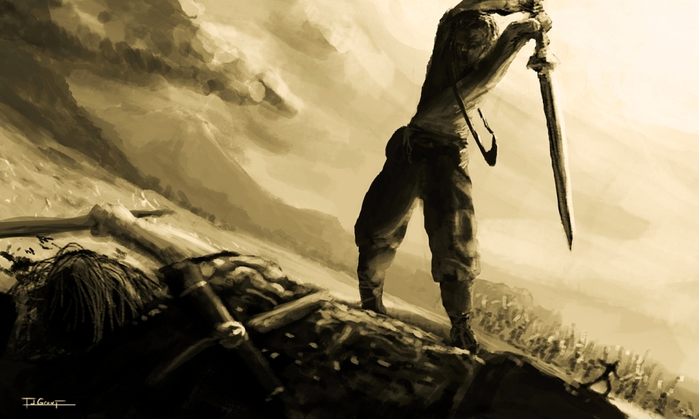
Don’t Loose Your Head
of course this is a play on words
John 14:27, “Peace I leave with you; my peace I give
you. I do not give to you as the world gives. Do not let
your hearts be troubled and do not be afraid”
Phil 4:6-8, “⁶ Do not be anxious about anything, but in
everything, by prayer and petition, with thanksgiving,
present your requests to God. ⁷ And the peace of God,
which transcends all understanding, will guard your
hearts and your minds in Christ Jesus”

Slide 19
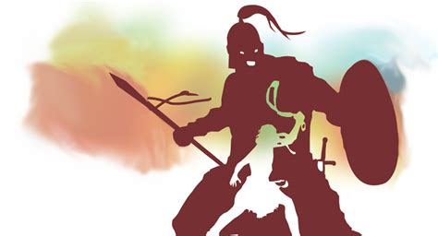
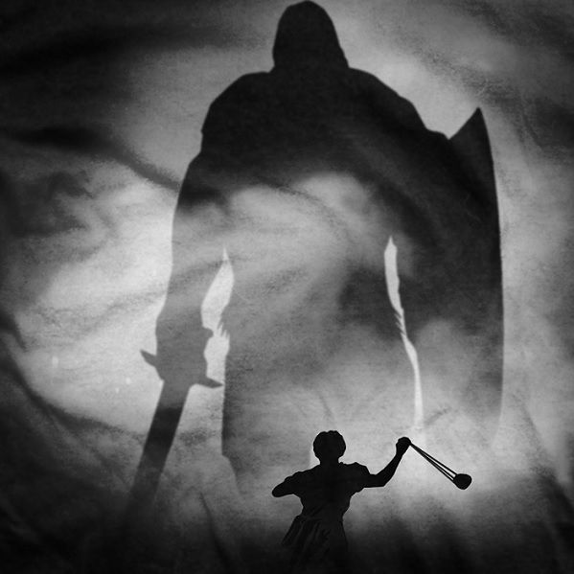

Slide 20
End part 1

Slide 21
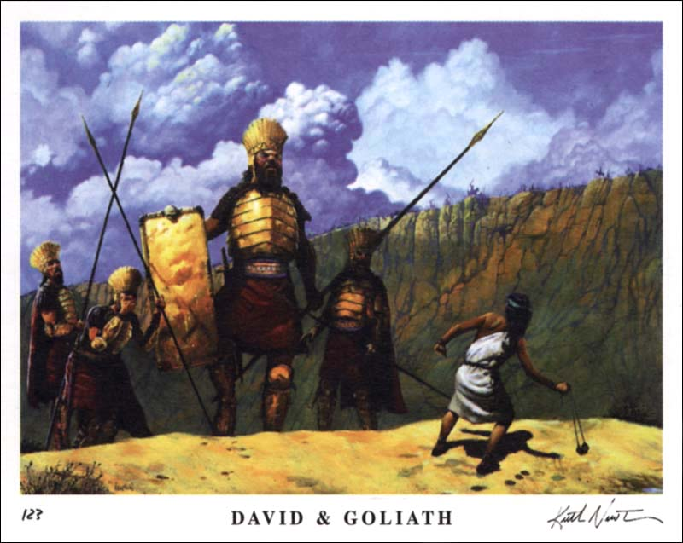
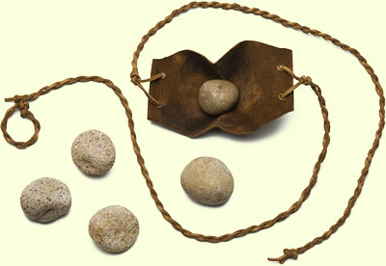
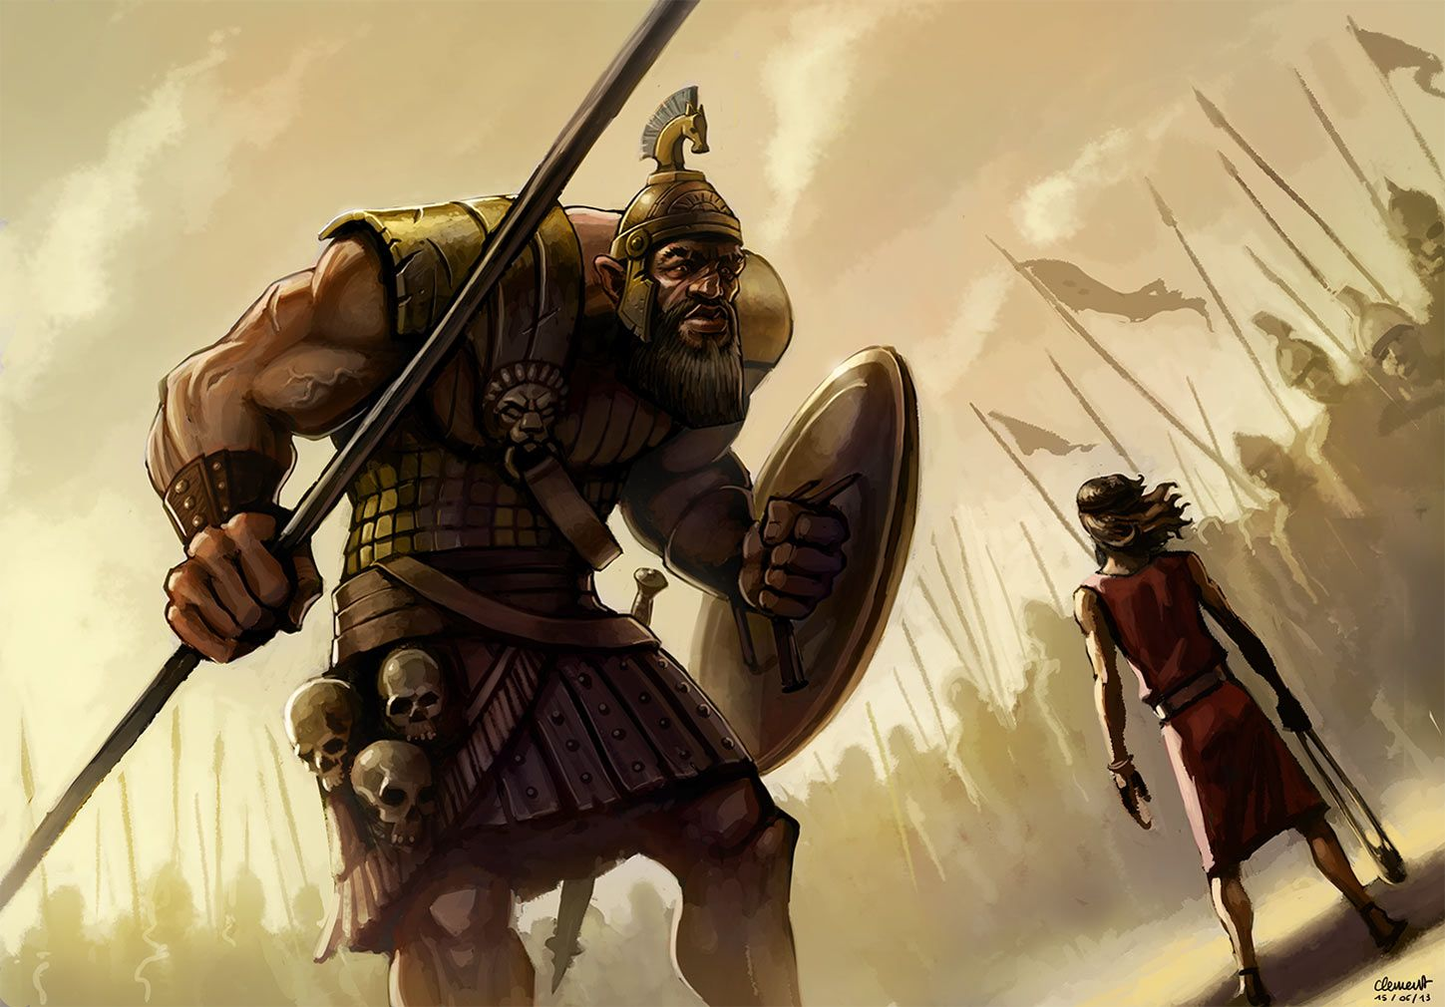
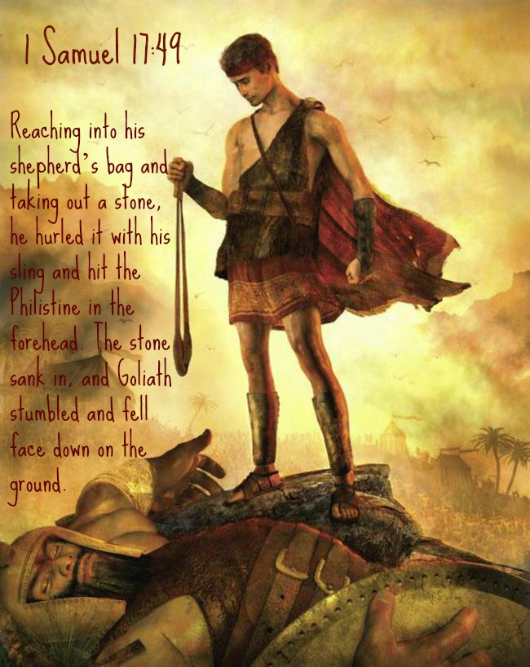

Slide 22
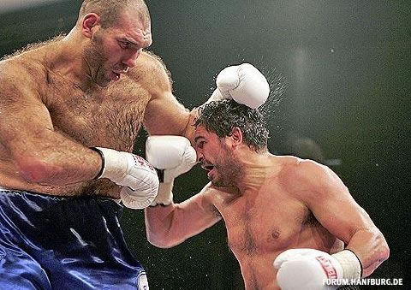
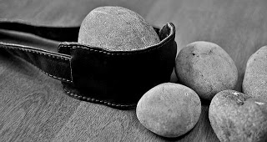

Slide 23
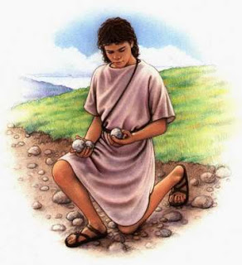
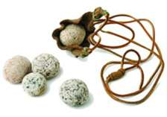
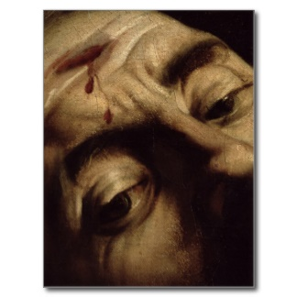
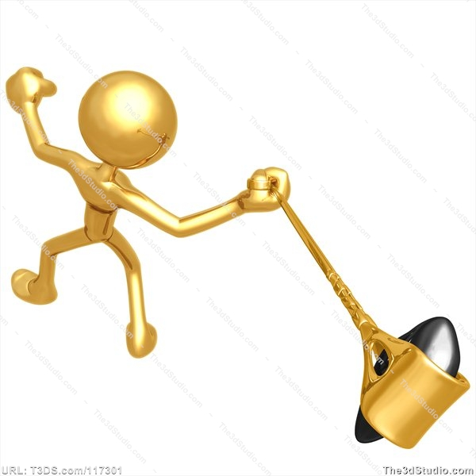

Slide 24
He Judged the Outcome by the… “Size of His Opponent”
Mightiest Dangerous Things Wrapped in Tiny Packages.
Tiny Atom has the Ability of Massive Destruction
Small Rattlesnake as Deadly as Large One.
the Midians overthrown by Gideon's 300.
Elijah / his Servant Stopped the Syrians.
Mustard Seed
Matt 17:20, “Jesus said unto them, Because of your unbelief: for verily I say unto you, If ye have faith as a grain of mustard seed, ye shall say unto this mountain, Remove hence to yonder place; and it shall remove; and nothing shall be impossible unto you”

Slide 25
He Judged the Outcome by the… “Size of His Opponent”
1 Sam 14:6 And Jonathan said to the young man that bare his armour, Come, and let us go over unto the garrison of these uncircumcised: it may be that the LORD will work for us: for there is no restraint to the LORD to save by many or by few.

