Slide 1
Here are some resolutions that you can use as a starting point:
Gain weight. At least 30 pounds.
Stop exercising. Waste of time.
Read less. Makes you think.
Procrastinate more. Starting tomorrow.
Get in a whole NEW rut!
Create loose ends.
Get further in debt.
Don't swim with piranhas or sharks.
Wait for opportunity to knock.
Focus on the faults of others.

Slide 2
In 2019
Edward Church
Phil. 2:5
Pt 2
January 6, 2019

Slide 3
Becoming a Better You
How Many Look Back over Last Year…
…and Would Like for 2019 to Be Better?????
Realize that We Have a Part to Play…
Attention
What We See
Attitude
How We Think About It
Actions
How We Respond

Slide 4
Be a Better Person
“Let this mind be in you, which was also in Christ Jesus” -Phil. 2:5
Mind= Attitude
Be= Constant
You= Personal
Jesus Attitude Toward Others was He was a Servant…
…His Attitude Toward Self was
…He Had No Problem with That

Slide 5
Quit Looking Out to Find Someone/ Something
…to Blame
But
Look In and
…Take Responsibility

Slide 6
Think Better Thoughts
⁸⁻⁹ Summing it all up, friends, I’d say you’ll do best by filling your minds and meditating on things true, noble, reputable, authentic, compelling, gracious—the best, not the worst; the beautiful, not the ugly; things to praise, not things to curse. Put into practice what you learned from me, what you heard and saw and realized. Do that, and God, who makes everything work together, will work you into his most excellent harmonies. Philippians 4:8-9 (MSG)
Hear Better Sounds
Romans 10:17-21 (NLT)
¹⁷ So faith comes from hearing, that is, hearing the Good News
about Christ

Slide 7
Becoming a Better You
See Better Sights
“Looking unto Jesus the author and finisher of our faith” -Heb. 12:2
Many Look for the Bad In People and Circumstances…
…Seeing Only The Faults and Negatives.
To Be a Better/ Positive You Must Look for the Good and Look to Jesus.
Heb 12:2 (AMP)
[looking away from all that will distract us and] focusing our eyes on Jesus, who is the Author and Perfecter of faith [the first incentive for our belief and the One who brings our faith to maturity], who for the joy [of accomplishing the goal] set before Him endured the cross, ^{[a]}disregarding the shame, and sat down at the right hand of the throne of God

Slide 8
Becoming a Better You
Speak Better Words
“Talk ye of all his wondrous works” -Ps. 105:2
Many People Talk Mostly About Evil and Bad Events…
…Some are Harsh, Unkind, and Take God’s Name In Vain.
We Should Talk Positively, Seeking to Glorify God…
…Words of Encouragement, Healing Words
“Death and life are in the power of the tongue, and those who love it will eat its fruits.” – Proverbs 18:21, ESV
“Let the words of my mouth and the meditation of my heart be acceptable in your sight, O Lord, my rock and my redeemer.” (Amen!) – Psalm 19:14, ESV
“There is one whose rash words are like sword thrusts, but the tongue of the wise brings healing.” – Proverbs 12:18, ESV

Slide 9
Building a Better You…
…Will build a Better
Marriage
Family
Church
Work Place

Slide 11
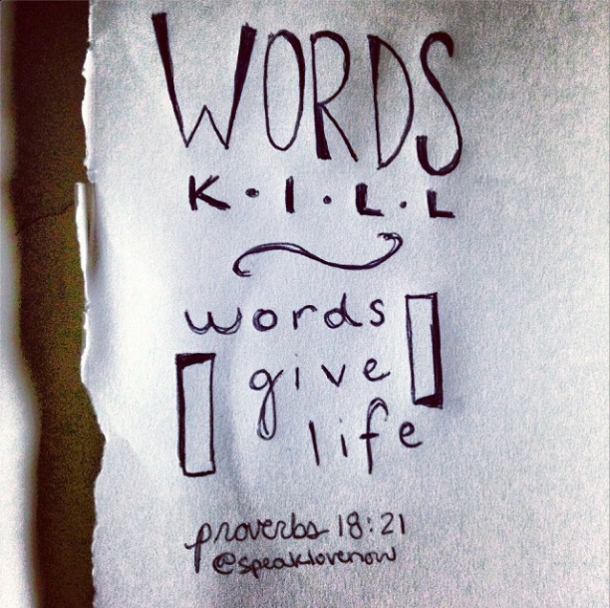

Slide 12
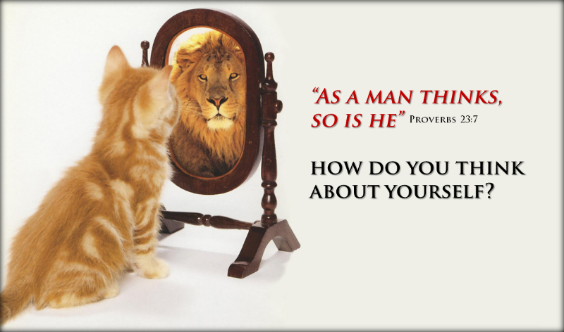

Slide 13
Perform Better/ Positive Deeds
“And whatsoever ye do, do it heartily, as to the Lord, and not unto men” (Col. 3:23).
The deeds of many are negative.
They are selfishly motivated, dishonest, and displeasing to God.
We must be truthful, ready to lift those who are down, and witness for Christ.
Attend Better/ Positive Places
“I was glad when they said . . . Let us go into the house of the LORD” (Ps. 122:1).
Christians hurt their influence when they go to the wrong places in search of
Be a positive Christian.
Attend church faithfully.
Go with God and he will go with you

Slide 14
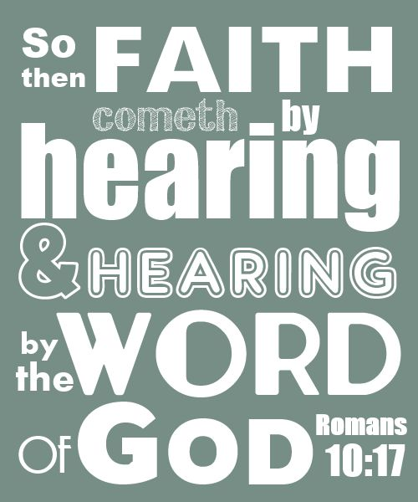

Slide 15
Discipline Our Thinking.
Quit Allowing Negatives To Dominate Our Minds.
We Must Take Deliberate Action,
…Replacing Negative Thoughts With Positives
…And Keeping An Optimistic Outlook.

Slide 16
Becoming a Better You
Hear Better Sounds
Romans 10:17-21 (NLT)
¹⁷ So faith comes from hearing, that is, hearing the Good News
about Christ
Quit Listening Negative, and Destruction
It Will Dwarf Your Spirit
We Must Listen to the Good, Resist the Bad.
We Must Hear From the Lord And Heed His Word.

Slide 17
From the Lost Book of the Bible – “Yeah But”
The Prophet “Yeah But” says:
Anything Before BUT…
Doesn’t Really Matter
Mighty Army
Take the Sentence….
I Meant To BUT…
…Out of Your Vocabulary

Slide 18
Think Better Thoughts
“Whatsoever things are of good report . . . think on these things” Phil. 4:8
Philippians 4:8-9 (MSG)
⁸⁻⁹ Summing it all up, friends, I’d say you’ll do best by filling your minds and meditating on things true, noble, reputable, authentic, compelling, gracious—the best, not the worst; the beautiful, not the ugly; things to praise, not things to curse. Put into practice what you learned from me, what you heard and saw and realized. Do that, and God, who makes everything work together, will work you into his most excellent harmonies.

Slide 19
2018

