Slide 1
The devout cowboy lost his favorite Bible while he was mending fences out on the range.
Three weeks later a cow walked up carrying the Bible in its mouth.
The cowboy couldn't believe his eyes.
He took the book out of the cow's mouth, raised his eyes heavenward and exclaimed, "It's a miracle!"
"Not really," said the cow. "Your name was written inside the cover."

Slide 3
Lessons from Gideon pt3
Judges 6
Edward Church
February 10, 2019

Slide 4
Gideon is a Mighty Example of…
…How God Can Take a…
Nobody (Inferiority Complex)
Ran (Fear Led)
Hid (Victim Mentality)
And Turn Him Around…
…and Use Him
…Turn the Situation Around

Slide 5
What Gideon Could See
Under Attack
Looked Like God was Silent
He Depended on Self
He was Hiding
Does This Sound Familiar?

Slide 6
Inferiority Complex?
¹⁵ “But Lord,” Gideon replied, “how can I rescue Israel? My clan is the weakest in the whole tribe of Manasseh, and I am the least in my entire family!”
When You Live by Fear …
…You Will Be Led By Fear
…You Leave Others Your Fear

Slide 7
The First Thing God was Going to Do is…
…Help Gideon Move Beyond His Fear

Slide 8
God Uses Tough Times to Get Our Attention -Jud 6:1-6
Actually…
…God Uses Tough Times to Bring Out the Tough in Us
Direct Us …Up
Draw Us …Out
Say This…
My Trouble Didn’t Happen to me…
…It Happened For Me

Slide 9
God Sees More Than We Do (6:7-12)
Gideon Did Not Act Like a Mighty Warrior…
All We See are the Present Conditions/ Circumstances…
And Ask How? Why?
God Sees the Past, Present, Future…
…All at One Time
God says ..I Know How ! And Asks, Why Not !
He Looked at Simon (reed) …
…and Called Him Peter (Rock)

Slide 10
God Confirms His Priorities with His Presence (6:13-24)
(16) The Lord answered Gideon and said, “I will be with you, so you can defeat the Midianites as easily as if they were only one man.”
As Long as We are Sitting Still or Moving Backwards…
…Don’t Expect to Experience His Powerful Presence
But When We Advance…Move Beyond Spectators….
We are Never Alone!

Slide 11
God is Patient with Our Faith Process (6:33-40)
Faith Doesn’t Mature Overnight
He Meets You Right Where You Are…
…With What You Need.
God had Called Him to an Extraordinary Mission
Gideon Didn’t Have A lot of Extraordinary Examples
Personal
Public
God was Patient …He Knew
Gideon Needed Extraordinary Confirmation
Fleece x 2

Slide 12
Success is Determined by God's Power, Not Ours (7:1-8)
First Test - 32,000-22,000 = 10,000
Dividing the Faithful from the Fearful
Looking for a Warrior Spirit
God said…Still Too Many
Second Test(4) 10,000-9700=leaving only 300 men
Dividing the Serious from the Not- So Serious
Looking for a Warrior Mentality

Slide 13
Success is Determined by God's Power, Not Ours (7:1-8)
God Created An Impossible Situation Of Human Weakness…
…to Exalt His Own Strength
God Uses Difficulties to Build Our Faith.
He Wants To Strip Us of Our Dependence On…
…Anything Other than Him
He Always Leads Us to Do What Will Bring Him Glory.

Slide 15
God Took Gideon’s 300 and Rocked His World
God Will Rock Yours If You Let Him!

Slide 16
4. God sends encouragement when we need it the most.
He is sensitive to our weaknesses and knows the proper time to send help and an encouraging word.
5. The Lord always works behind the scenes on our behalf. The night before Gideon marched into battle, God instilled confusion in the hearts of the enemy. The enemy fled in fear.
6. God provides specific instructions for victory. If we will rely on Him, He will lead us through every trial we face, step-by-step, according to His plan for our lives.
Bring your foe before God. No enemy is too great for Him.
Oh, Lord, lead me step-by-step. Work behind the scenes in my behalf.

Slide 17
Now the camp of Midian lay below him in the valley. 9During that night the Lord said to Gideon, “Get up, go down against the camp, because I am going to give it into your hands. 10If you are afraid to attack, go down to the camp with your servant Purah 11and listen to what they are saying. Afterward, you will be encouraged to attack the camp.” So he and Purah his servant went down to the outposts of the camp. 12The Midianites, the Amalekites and all the other eastern peoples had settled in the valley, thick as locusts. Their camels could no more be counted than the sand on the seashore.
13Gideon arrived just as a man was telling a friend his dream. “I had a dream,” he was saying. “A round loaf of barley bread came tumbling into the Midianite camp. It struck the tent with such force that the tent overturned and collapsed.”
14His friend responded, “This can be nothing other than the sword of Gideon son of Joash, the Israelite. God has given the Midianites and the whole camp into his hands.”
15When Gideon heard the dream and its interpretation, he bowed down and worshiped. He returned to the camp of Israel and called out, “Get up! The Lord has given the Midianite camp into your hands.” 16Dividing the three hundred men into three companies, he placed trumpets and empty jars in the hands of all of them, with torches inside.
17“Watch me,” he told them. “Follow my lead. When I get to the edge of the camp, do exactly as I do. 18When I and all who are with me blow our trumpets, then from all around the camp blow yours and shout, ‘For the Lord and for Gideon.’ ”

Slide 18
33Now all the Midianites, Amalekites and other eastern peoples joined forces and crossed over the Jordan and camped in the Valley of Jezreel. 34Then the Spirit of the Lord came on Gideon, and he blew a trumpet, summoning the Abiezrites to follow him. 35He sent messengers throughout Manasseh, calling them to arms, and also into Asher, Zebulun and Naphtali, so that they too went up to meet them.
36Gideon said to God, “If you will save Israel by my hand as you have promised— 37look, I will place a wool fleece on the threshing floor. If there is dew only on the fleece and all the ground is dry, then I will know that you will save Israel by my hand, as you said.” 38And that is what happened. Gideon rose early the next day; he squeezed the fleece and wrung out the dew—a bowlful of water.
39Then Gideon said to God, “Do not be angry with me. Let me make just one more request. Allow me one more test with the fleece, but this time make the fleece dry and let the ground be covered with dew.” 40That night God did so. Only the fleece was dry; all the ground was covered with dew.

Slide 19
Success is Determined by God's Power, Not Ours (7:1-8)
God created an impossible situation of human weakness to exalt His own strength
1. God uses difficulties to build our faith. He wants to strip us of our dependence on anything other than Him. We are to fix our focus on Christ, the Author and Perfecter of our faith (Heb. 12:2).
2. At times God may require the unreasonable. Gideon was allowed to take only three hundred men into battle with him, a fraction of the size of the enemy’s army.
3. The Lord always leads us to do what will bring Him glory. Had Israel won the battle in their own strength, the credit would have gone to them and not to God.

Slide 20
Lessons of Gideon
The story of Gideon reveals six biblical truths that can lead to victory in impossible situations.
1. God uses difficulties to build our faith. He wants to strip us of our dependence on anything other than Him. We are to fix our focus on Christ, the Author and Perfecter of our faith (Heb. 12:2).
2. At times God may require the unreasonable. Gideon was allowed to take only three hundred men into battle with him, a fraction of the size of the enemy’s army.
3. The Lord always leads us to do what will bring Him glory. Had Israel won the battle in their own strength, the credit would have gone to them and not to God.
4. God sends encouragement when we need it the most. He is sensitive to our weaknesses and knows the proper time to send help and an encouraging word.
5. The Lord always works behind the scenes on our behalf. The night before Gideon marched into battle, God instilled confusion in the hearts of the enemy. The enemy fled in fear.
6. God provides specific instructions for victory. If we will rely on Him, He will lead us through every trial we face, step-by-step, according to His plan for our lives.
Bring your foe before God. No enemy is too great for Him.
Oh, Lord, lead me step-by-step. Work behind the scenes in my behalf.

Slide 21
Faith Must Be Challenged
Faith can be
Neglected
Rejected
Respected
Reflected
But to Grow it has to be…
…Challenged

Slide 23
When Tough Times Come…
…Instead Of Looking at Them as If
…God is Punishing You,
…Try to See Them as God's Gift of Grace

Slide 24
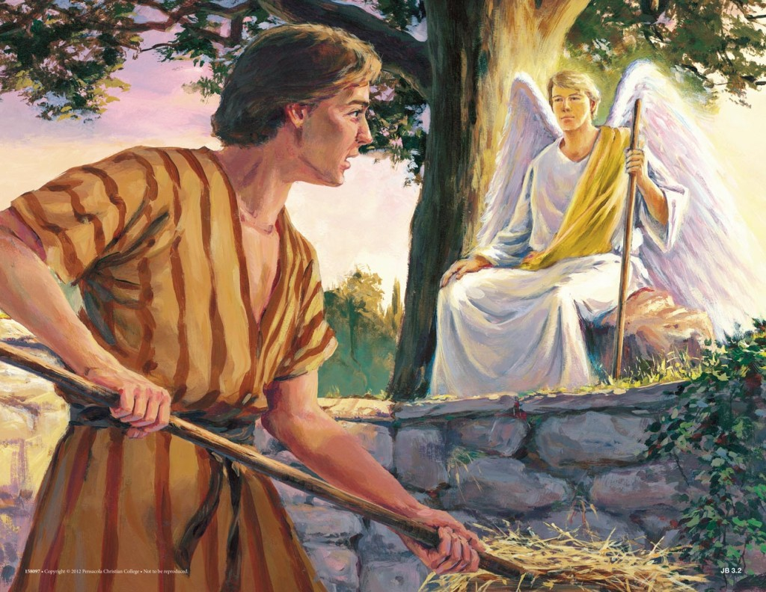
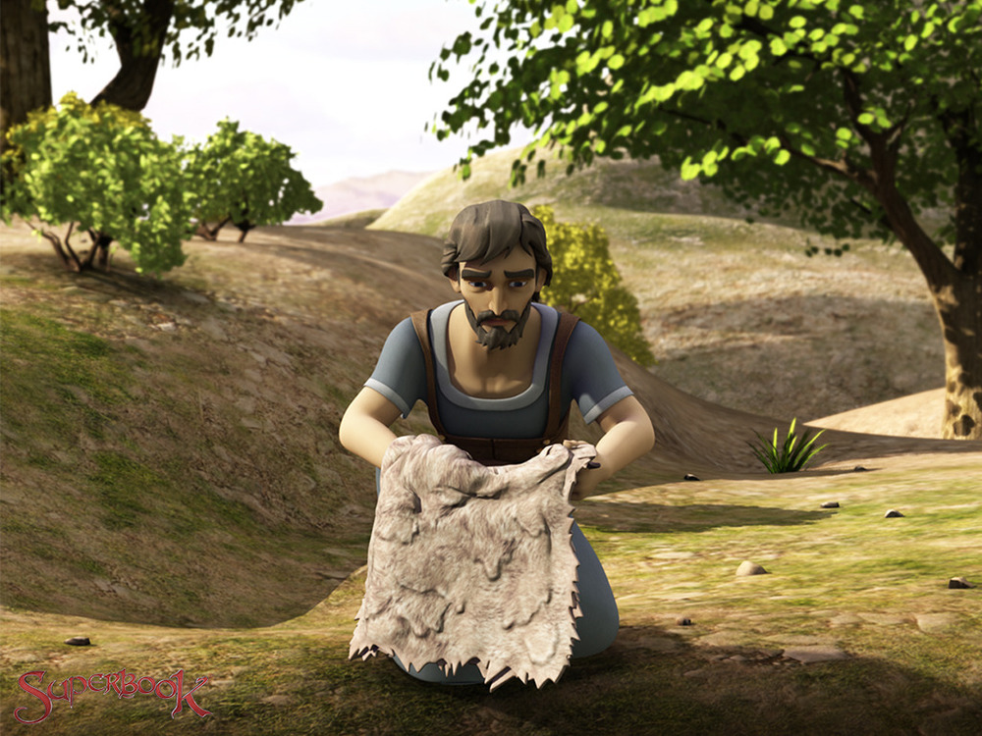
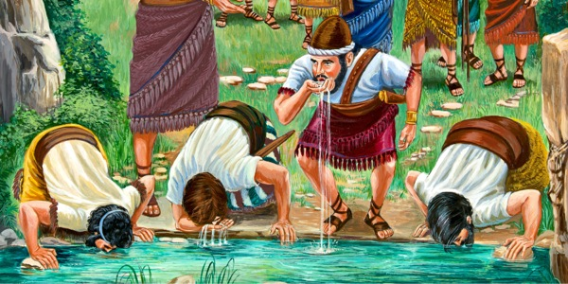
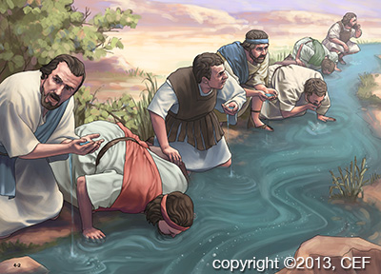
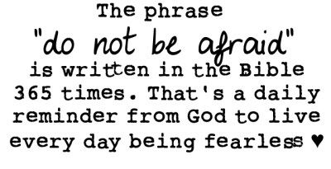
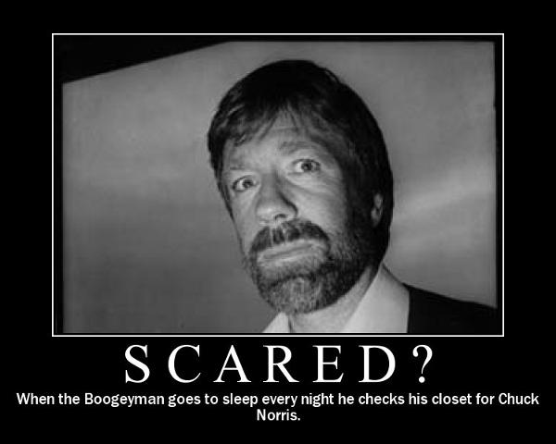
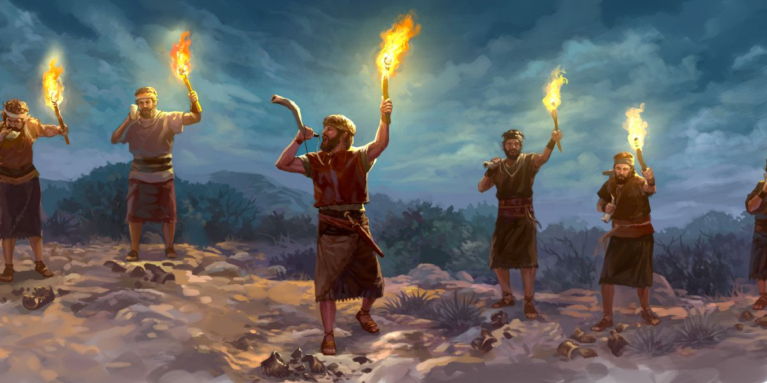
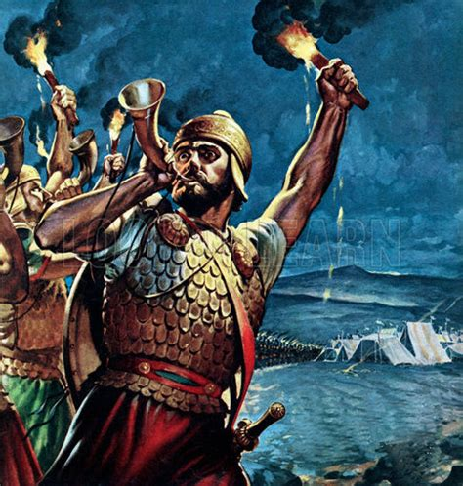
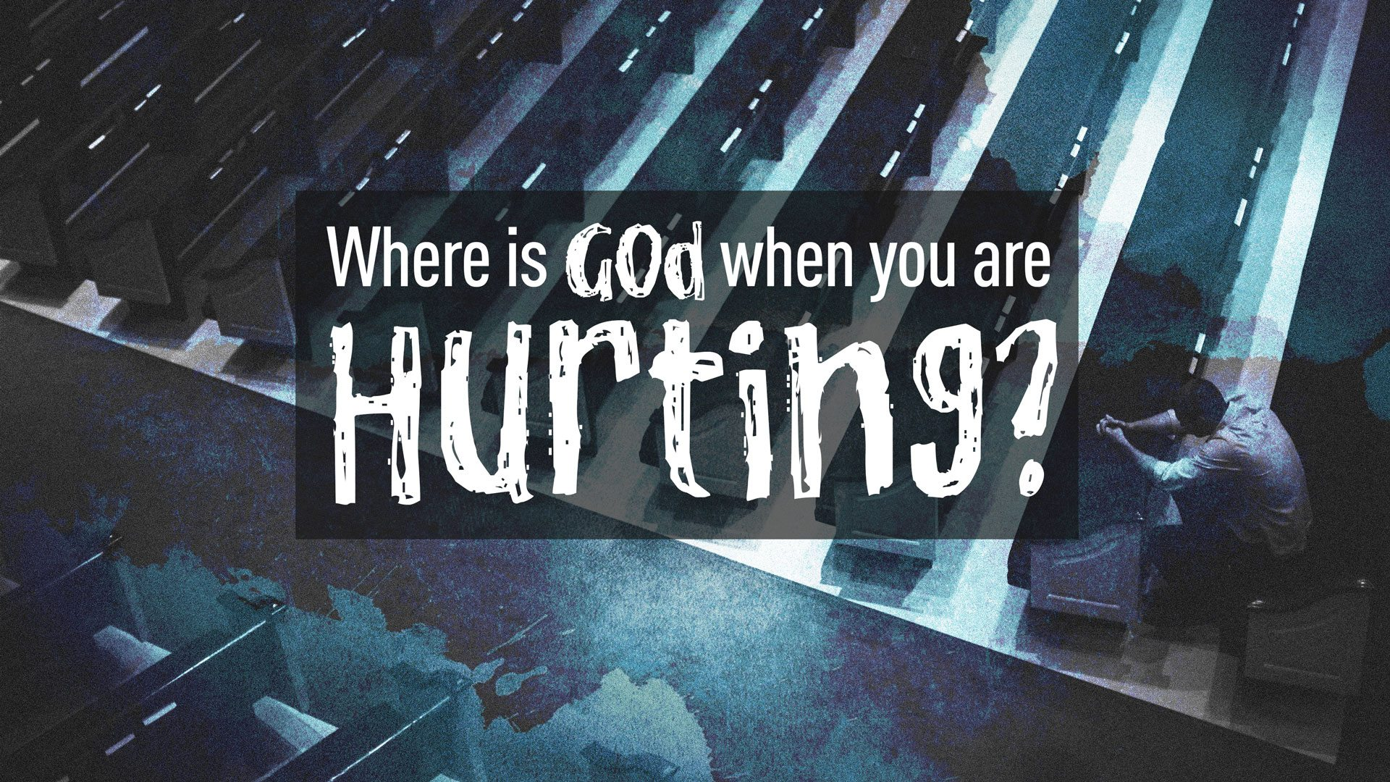
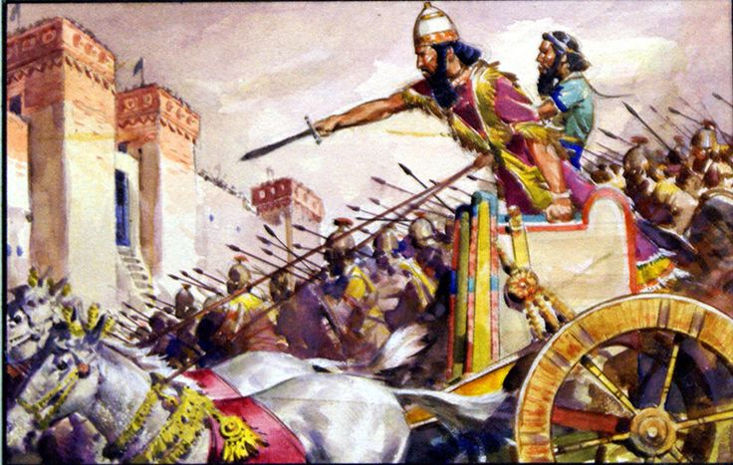

Slide 25
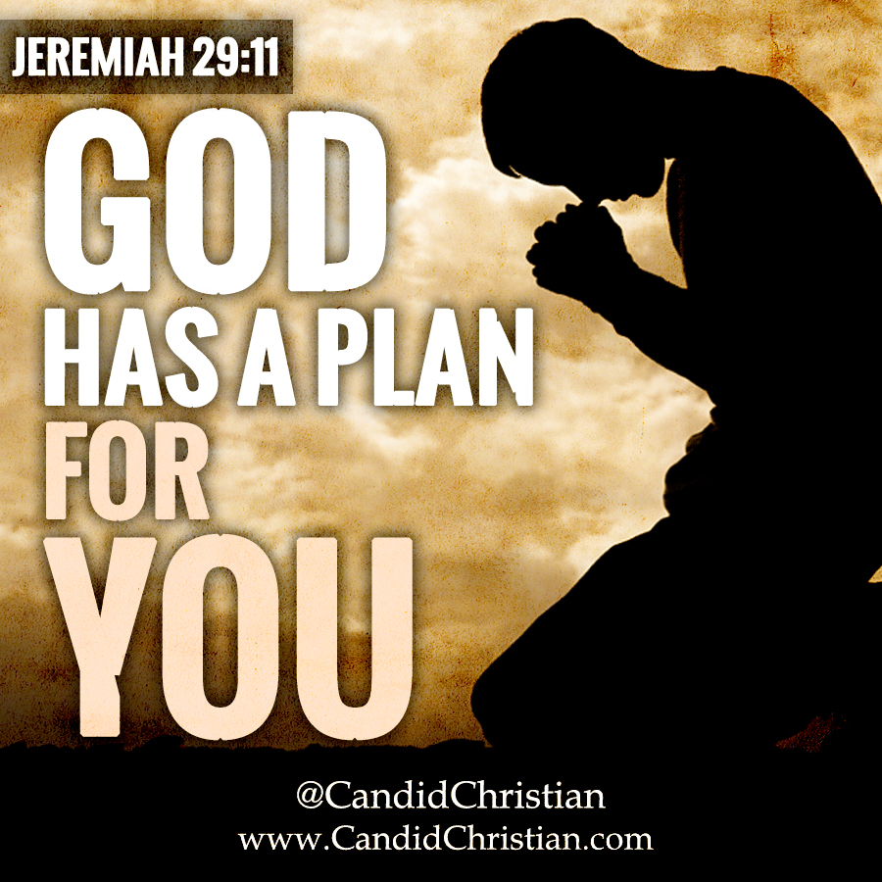
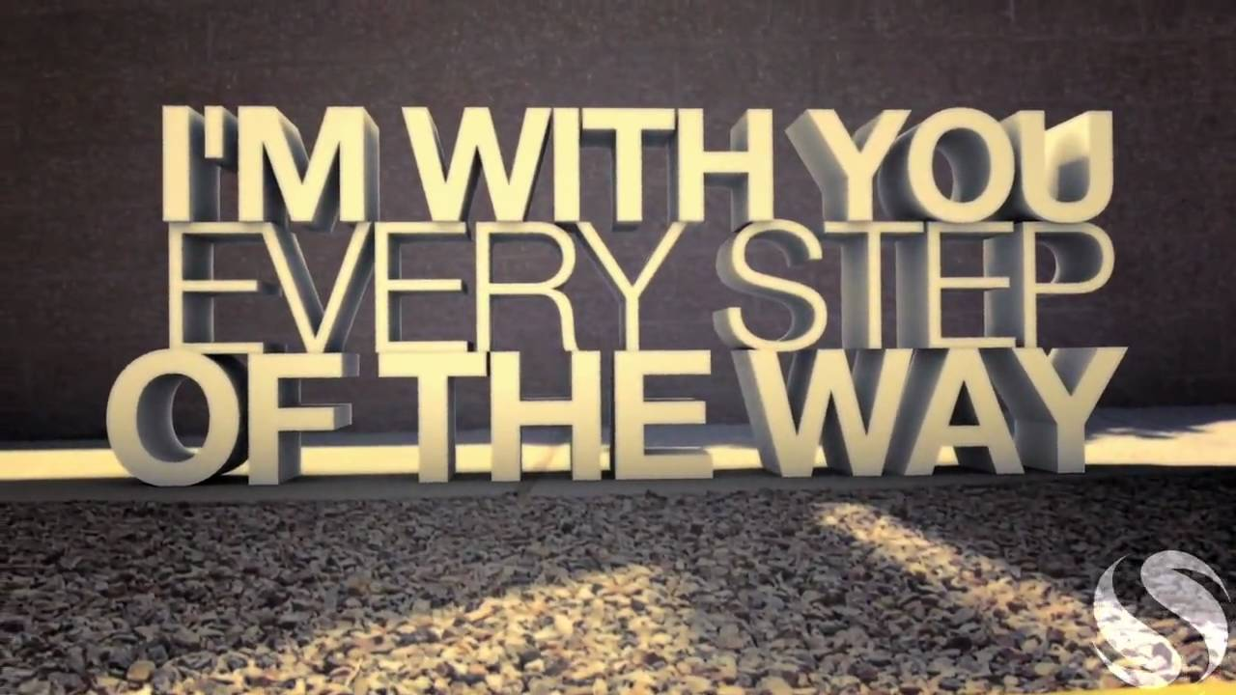
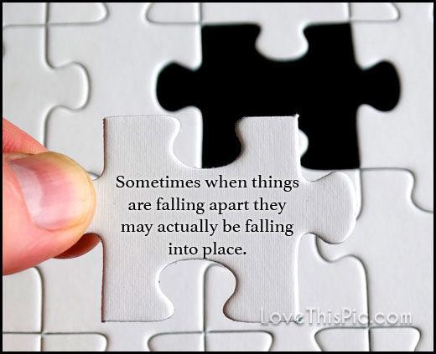
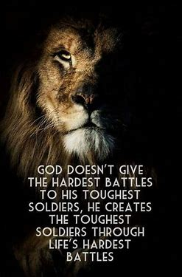
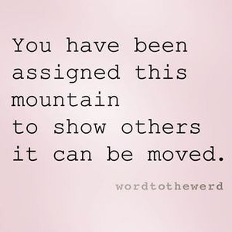
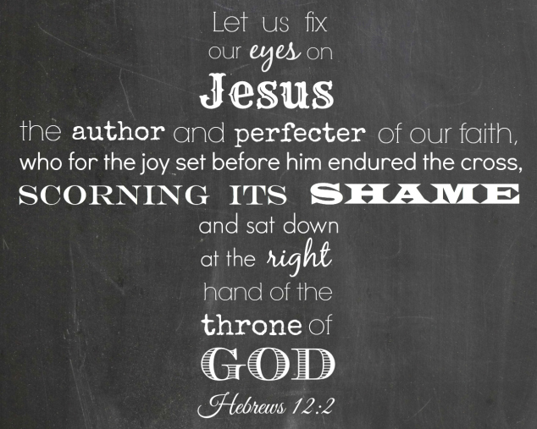

Slide 27
Fear Can Be Passed Down

Slide 28
Be Aware that Living in a “State of Fear” is
…Not Part of God’s Plan for You
Fear-Based Thinking…
Suggests You May Not Be Fully Trusting God.
Does Not Appropriate the Grace of God.
Keeps You in Bondage to Fear.
Is Physically, Emotionally, / Spiritually Damaging.
“In God I trust; I will not be afraid. What can mortal man do to me?” -Psalm 56:4

Slide 29
Begin with a Healthy Fear (Awe) of God
Believe That God…
Created You Because He Loves You
Has a Purpose and a Plan for Your Life.
Has the Right to Have Authority Over You.
Wants You to Entrust Your Life to Him.
Has the Power to Change You.
Will Keep You Safe as You Trust in Him.
“The fear of the LORD is the beginning of knowledge,
but fools despise wisdom and discipline.” -Prov 1:7

Slide 30
What Gideon Could See
Under Attack
Looked Like God was Silent
He Depended on Self
He Was Hiding
What Gideon Could Not See
God was Not Silent !

Slide 31
Private Preparation Leads to Public Usefulness (6:25-32)

Slide 32
God Sees More Than We Do
He Looked at Simon (reed) …
…and Called Him Peter (Rock)
He Knew Simon was Easily Shaken By Circumstances
Deserted Jesus in the Garden
Denied Jesus 3 Times at His Trial
Disappeared Behind Closed Doors
But the Day was Coming when He was Unshakeable
Acts 4:13, When they saw the courage of Peter and John and realized that
they were unschooled, ordinary men, they were astonished and they took
note that these men had been with Jesus

