Slide 1
A little boy came home from the playground with a bloody nose, black eye, and torn clothing. It was obvious he'd been in a bad fight and lost. While his father was patching him up, he asked his son what happened.
"Well, Dad," said the boy, "I challenged Larry to a duel. And, you know, I gave him his choice of weapons."
"Uh-huh," said the father, "that seems fair."
"I know, but I never thought he'd choose his big sister!"
today'sThot============================
I finally got my head together and my body fell apart.

Slide 3
Are You Dreaming Big Enough? -pt1
Edward Church
February 17, 2019
Isa 54:2

Slide 4
Question of the Hour
What is the Biggest Enemy of the Church?
Families?
Marriages?
Work?
Satan?
World?
Nope…
Mediocrity

Slide 5
The Choice is Ours…
Mediocre = (med= Get By)
Excellence = (excel= Go Beyond)
God Called Israel to Excel…
…They Chose to Get By
…They Lost Their Freedom
…They Didn’t Lose Grace

Slide 6
“Enlarge the place of your tent, stretch your tent curtains wide, do not hold back; lengthen your cords, strengthen your stakes.” Isa 54:2
Extreme Time in Israel’s History
Some Going Into Captivity
Some Coming Out of Captivity
All Got this Challenge

Slide 7
Everything About this Verse Speaks of Increase
Nothing that Encourages Us to Maintain the Status Quo…
…But to Enlarge Our Perspective of God
Some People See God as Limiting and Controlling…
…As If His Nature Is to Hold Us Back
Nothing Could Be Further from the Truth

Slide 8
John 10:10 -Jesus Came to Give Us An Abundant, Full Life
Too Many Line Up with the 1st Part –
“the thief cometh to kill steal destroy…
But Fall Short on the 2nd part of that verse –
…I am come to that they may have life and life more abundant”
Eph 3:20 -God is able to do more than we could ever think or imagine

Slide 9
1 Corinthians 2:9 “No eye has seen, no ear has heard, and no mind has imagined what God has prepared for those who love him.”
Paul Isn’t Talking About Heaven in this Passage.
All Throughout the Bible,
…God Is Calling His People
…to Expand and Stretch,
…to Believe for More.

Slide 12
Remember this…
…When ever God Gives us a Promise…
…it is Wrapped in a Problem!
The Problem Can…
Destroy Us or
Develop Us

Slide 13
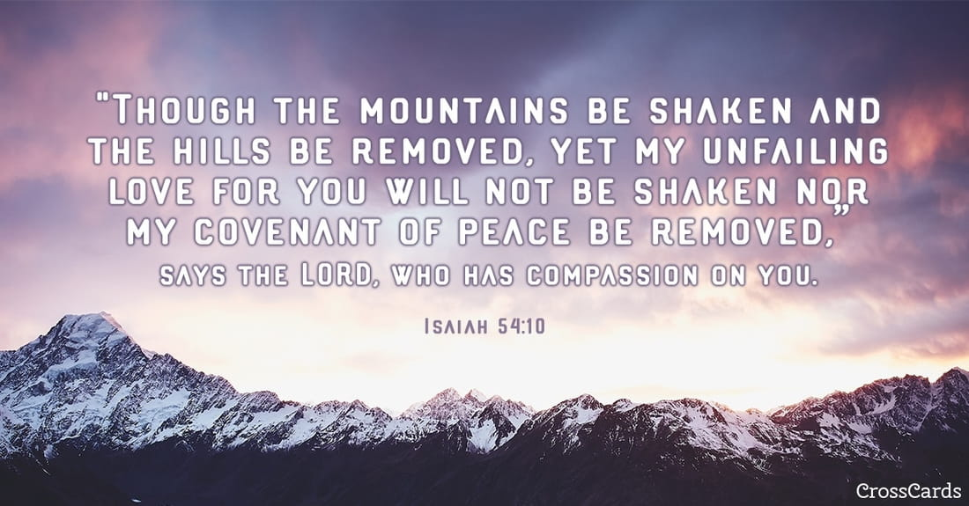
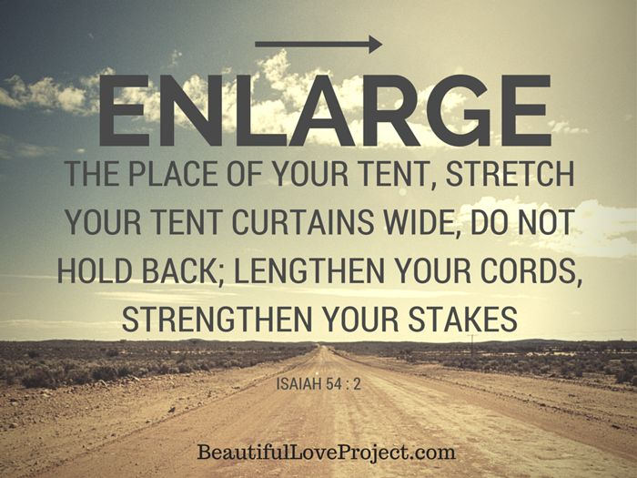
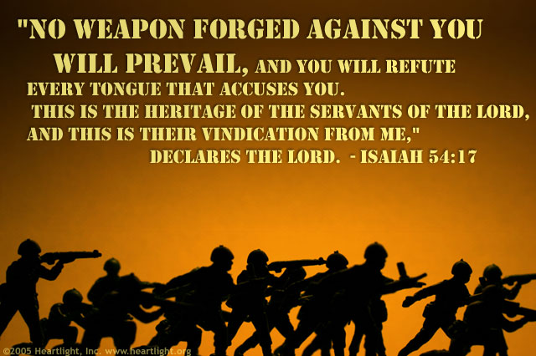
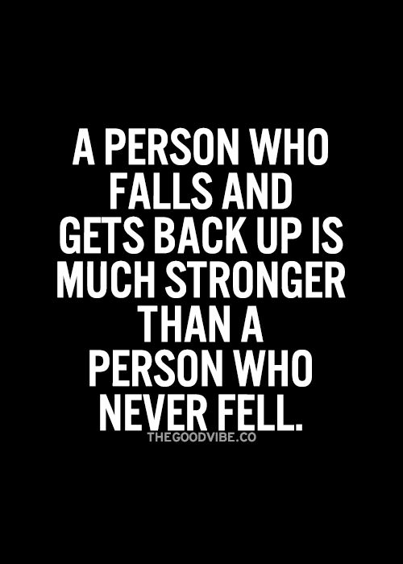
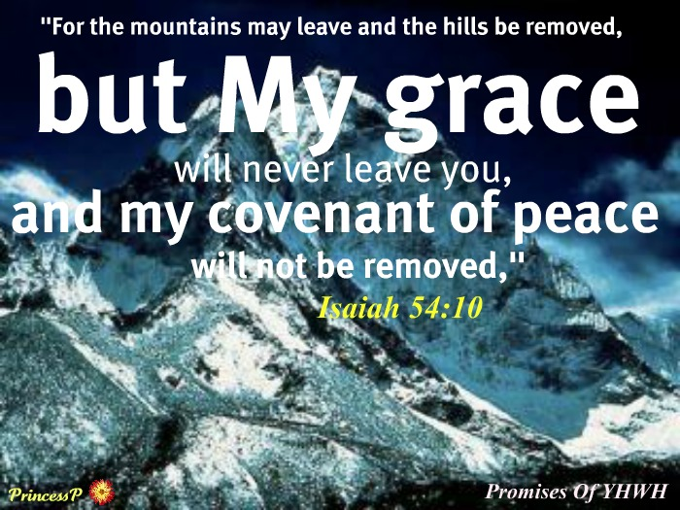

Slide 14
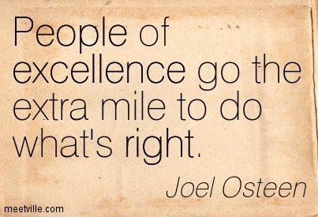
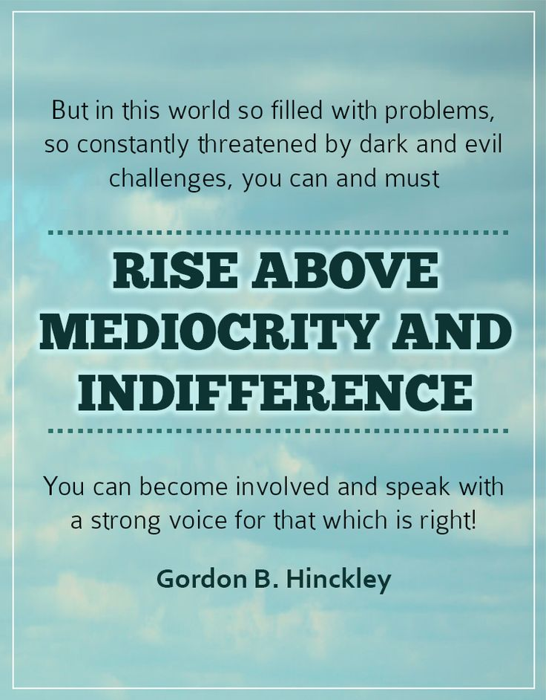
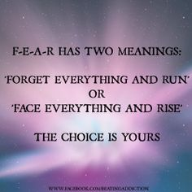

Slide 15
Abraham
God told Abraham, “I’m going to make you the father of many nations…your descendants will be more than the stars in the sky.”
That was declared while he and Sarah were barren and childless.
…But God Calls things that are not as they as they were
God had plans to make Joseph the second in command of the greatest nation on the earth, and he was just a young boy in a desert.
…But Got Used a Pit..Potiphar.and a Prison to Develop a Ruler and go to the Palace!

Slide 16
Esther
God showed Esther, he had some big plans for you.
He didn’t want her to remain some unknown orphan girl living in captivity. God had plans to make her queen over the nation!
Called to risk it all
-1st She had to realize that she had been born for such a time as this
-2nd she had to engage –move forward…no matter the cost

Slide 17
David
God Sent Samuel to Anoint David King…but he kept herding sheep. God gave him a problem. Goliath…
Goliath was Destroying Saul...
But Goliath Developed David…
Without a Goliath in David’s’ Life…
…He May Have Never Become King

Slide 18
Look at that verse again:
“Enlarge the place of your tent, stretch your tent curtains wide, do not hold back; lengthen your cords, strengthen your stakes.”
It’s like God is saying, “I can’t fit what I want to do in your life in the space you have now. So, I need you to stretch.
You’re not thinking BIG enough. You’re not dreaming BIG enough. I need you to make some room for what I want to do in you – and through you!”
Let me ask you. Are you dreaming big enough?
When was the last time you believed God for something so big that if someone else heard about it they would think you’re crazy?

Slide 19
When was the last time you prayed such bold, audacious prayers that if someone overheard your prayers they would think you seriously lost it?
I’m convinced that how we pray and what we pray for reflects what we believe about God.
And we don’t serve a puny, weak God.
We serve the God that holds the world in the palm of His hands – a God that can move the mountains because He created them.
So, I want to challenge you to pray some BIG prayers.
There are times Deep calling unto deep! time to get in over our head!

Slide 20
Believe God for that “abundant, more than you can imagine” life He has for you.
Don’t think small.
Don’t pray small.
Because we serve a big God.
Are you just a Get by Christian?

