Slide 1
Rem Last Week – are you fencing in or fencing out!
Prepping to grow or dwindle?
Prof. told class at final exam – if they would accept a “C” on their exam sign the back and walk out- after they walked out- he told the few that stayed to turn test over. It said they had made an “A”
Too many readily accept mediocre

Slide 2
A man goes into a drugstore and asks the pharmacist if he can give him something for the hiccups. The pharmacist promptly reaches out and slaps the man's face.
"What did you do that for?" the man asks.
"Well, you don't have the hiccups anymore, do you?"
The man says, "No, but my wife out in the car still does!"

Slide 4
Are You Dreaming Big Enough? -pt2
Edward Church
February 24, 2019
Isa 54:2

Slide 5
Question of the Hour
What is the Biggest Enemy of the Church?
Families?
Marriages?
Work?
Satan?
World?
Nope…
Mediocrity

Slide 6
If 99.9% Is Good Enough, Then . . .
12 newborns will be given to the wrong parents daily
114,500 mismatched pairs of shoes will be shipped/year
18,322 pieces of mail will be mishandled/hour
2.5 million books will be shipped with the wrong covers
Two planes crash at Chicago's O'Hare airport daily
315 entries in Webster's dictionary will be misspelled
20,000 incorrect drug scripts will be written this year
103,260 income tax returns will be processed incorrectly
291 pacemaker operations will be performed incorrectly.

Slide 7
The Choice is Ours…
Mediocre = (med= Get By)
Excellent (excel= Go Beyond)
God Called Israel to Excel…
…They Chose to Get By
…They Lost Their Freedom
…They Didn’t Lose Grace

Slide 8
“Enlarge the place of your tent, stretch your tent curtains wide, do not hold back; lengthen your cords, strengthen your stakes.” Isa 54:2
Extreme Time in Israel’s History
Some Going Into Captivity
Some Coming Out of Captivity
All Got this Challenge

Slide 9
Everything About this Verse Speaks of Increase
Nothing that Encourages Us to Maintain the Status Quo…
…But to Enlarge Our Perspective of God
Some People See God as Limiting and Controlling…
…As If His Nature Is to Hold Us Back
Nothing Could Be Further from the Truth

Slide 10
1 Corinthians 2:9 “No eye has seen, no ear has heard, and no mind has imagined what God has prepared for those who love him.”
Paul Isn’t Talking About Heaven in this Passage.
All Throughout the Bible,
…God Is Calling His People
…to Expand and Stretch,
…to Believe for More.

Slide 11
Remember this…
…When ever God Gives us a Promise…
…it is Wrapped in a Problem!
The Problem Can…
Destroy Us or
Develop Us

Slide 12
God told Abraham, “I’m going to make you the father of many nations…your descendants will be more than the stars in the sky.”
Declared While He and Sarah were Barren and Childless
…But God Calls Things That are Not as They as They Were
God had Plans to Make Joseph Second in Command of Greatest Nation on the Earth While Just a Young Boy In A Desert.
…But Got Used a Pit, Potiphar, Prison to Develop
a Ruler and Go to the Palace!

Slide 13
God Sent Samuel to Anoint David King…
…But He Kept Herding Sheep
God Gave Him a Problem - Goliath…
Goliath was Destroying Saul...
But Goliath Developed David…
Without a Goliath in David’s’ Life…
…He May Have Never Become King

Slide 14
Look at that Verse Again:
“Enlarge the place of your tent, stretch your tent curtains wide, do not hold back; lengthen your cords, strengthen your stakes.”
It’s like God is saying, “I can’t fit what I want to do in your life in the space you have now. So, I need you to stretch.
You’re Not Thinking BIG enough. You’re Not Dreaming BIG enough. I Need You to Make Some Room for What I Want to Do In You – and Through You!”
Let Me Ask You. Are You Dreaming Big Enough?
When was the Last Time You Believed God for Something So Big that If Someone Else Heard About It They Would Think You’re Crazy?

Slide 17
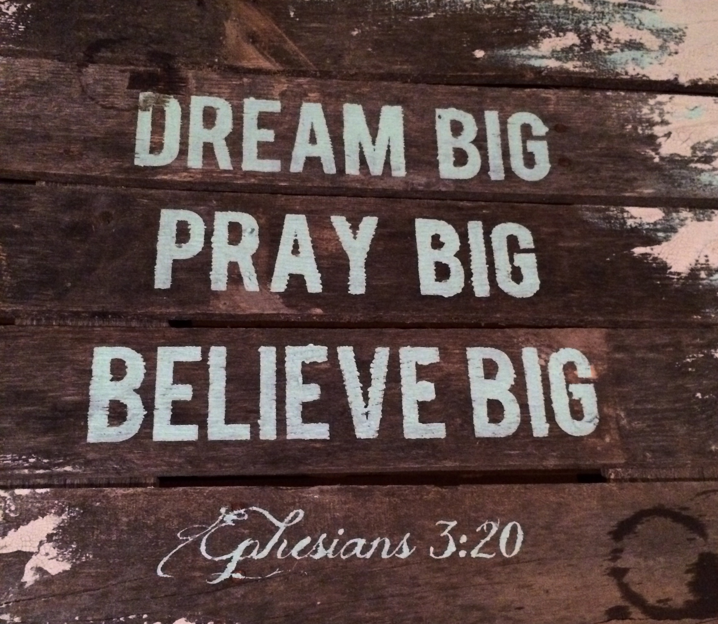
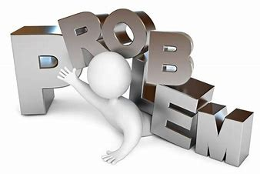

Slide 18
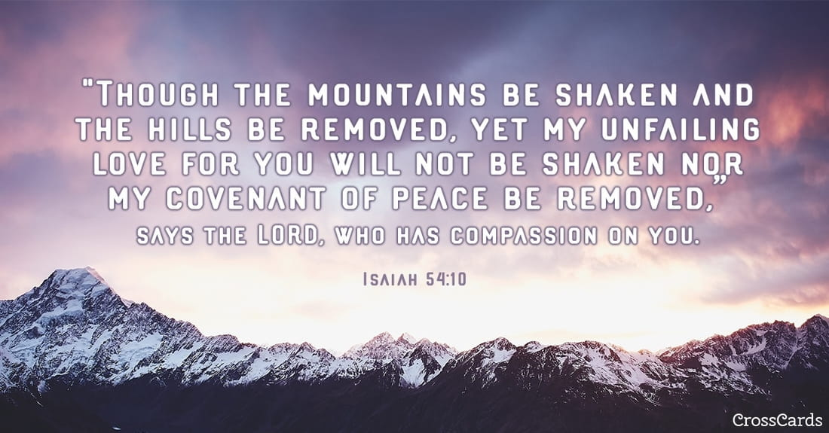
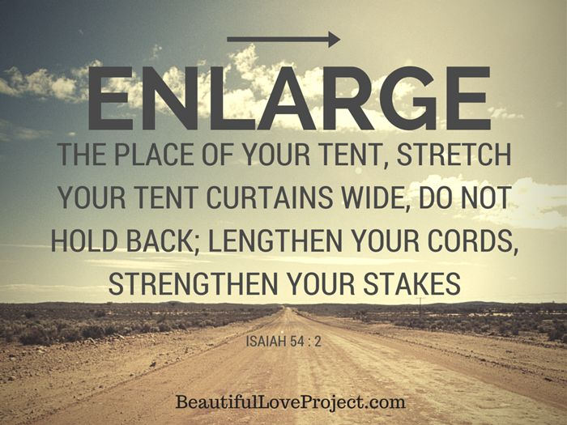
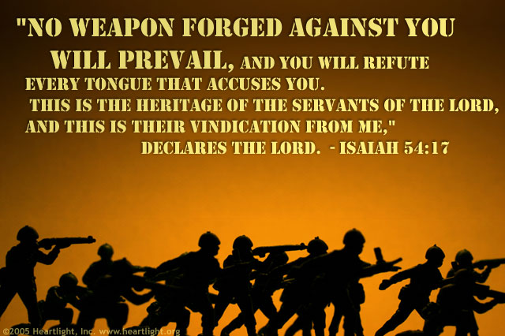
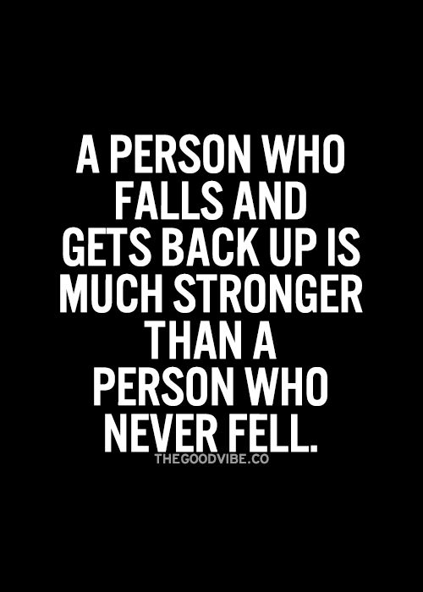
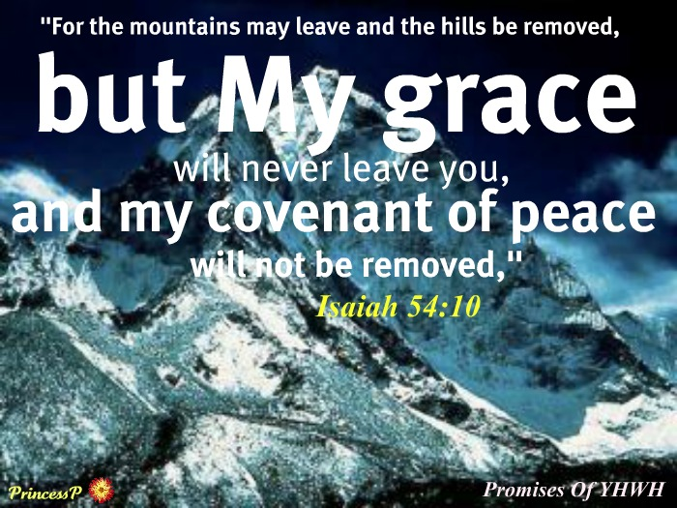

Slide 19
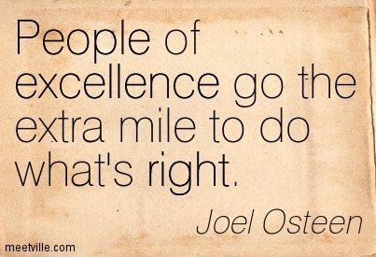
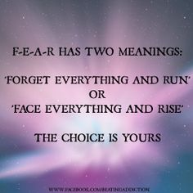

Slide 20
Esther
God showed Esther, he had some big plans for you.
He didn’t want her to remain some unknown orphan girl living in captivity. God had plans to make her queen over the nation!
Called to risk it all
-1st She had to realize that she had been born for such a time as this
-2nd she had to engage –move forward…no matter the cost

Slide 21
When was the last time you prayed such bold, audacious prayers that if someone overheard your prayers they would think you seriously lost it?
I’m convinced that how we pray and what we pray for reflects what we believe about God.
And we don’t serve a puny, weak God.
We serve the God that holds the world in the palm of His hands – a God that can move the mountains because He created them.
So, I want to challenge you to pray some BIG prayers.
There are times Deep calling unto deep! time to get in over our head!

Slide 22
Believe God for that “abundant, more than you can imagine” life He has for you.
Don’t think small.
Don’t pray small.
Because we serve a big God.
Are you just a Get by Christian?

Slide 28
John 10:10 -Jesus Came to Give Us An Abundant, Full Life
Too Many Line Up with the 1st Part –
“the thief cometh to kill steal destroy…
But Fall Short on the 2nd part of that verse –
…I am come to that they may have life and life more abundant”
Eph 3:20 -God is able to do more than we could ever think or imagine

