Slide 1
The minister was preoccupied with thoughts of how he was going to ask the congregation to come up with more money than they were expecting for repairs to the church building.
Therefore, he was annoyed to find that the regular organist was sick and a substitute had been brought in at the last minute. The substitute wanted to know what to play.
"Here's a copy of the service," the pastor said impatiently. "But, you'll have to think of something to play after I make the announcement about the finances."
During the service, the minister paused and said, "Brothers and sisters, we are in great difficulty; the roof repairs cost twice as much as we expected and we need $4,000 more. Any of you who can pledge $100 or more, please stand up."
At that moment, the substitute organist played "The Star Spangled Banner."
And that is how the substitute became the regular organist.

Slide 2
2 Samuel 23:9-10 (KJV) ⁹ And after him was Eleazar the son of Dodo the Ahohite, one of the three mighty men with David, when they defied the Philistines that were there gathered together to battle, and the men of Israel were gone away: ¹⁰ He arose, and smote the Philistines until his hand was weary, and his hand clave unto the sword: and the LORD wrought a great victory that day; and the people returned after him only to spoil.

Slide 3
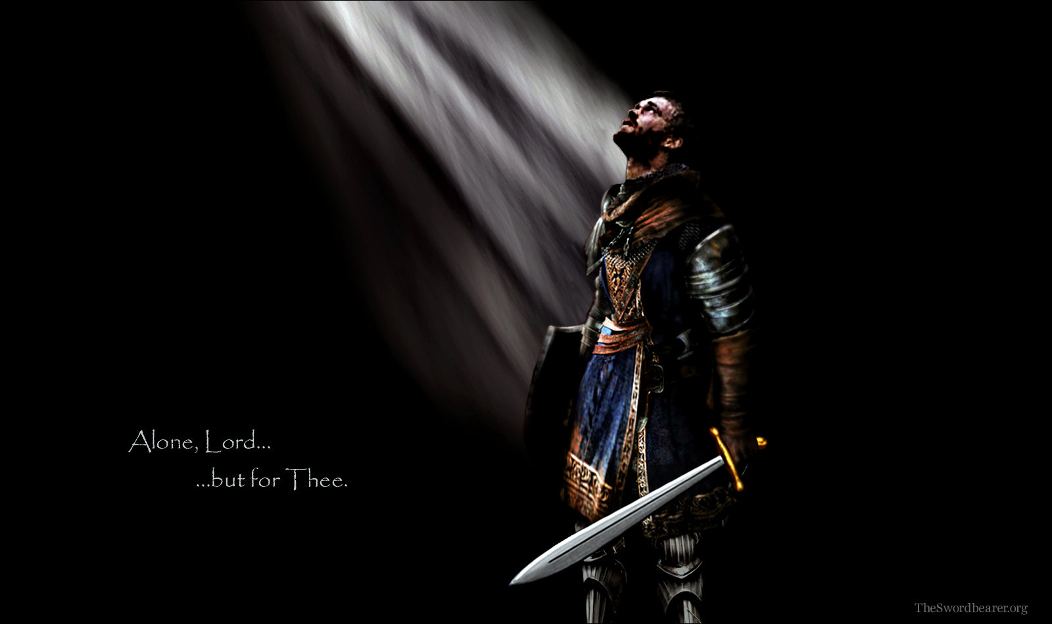
Getting a Grip…
II Sam 23:9-10
Edward Christian Church
July 14, 2019

Slide 4
David’s Mighty Men
They Refused To Join The Crowd
…They stood
They Refused To Be Beat By The Odds
…alone if necessary
They Refused To Sit There And Do Nothing
…and succeeded
They Saw God’s Hand
…for God gave them the Victory!!
They Stood, Alone if Necessary
…and Succeeded
…for God Gave Them the Victory

Slide 5
Eleazar's Moment
Surge of Demonic Activity
Phil. Gathered(come to bring destruction)
to Battle(to engage in actual warfare…)
Surrender
Army Gone Away(move to higher ground)

Slide 6
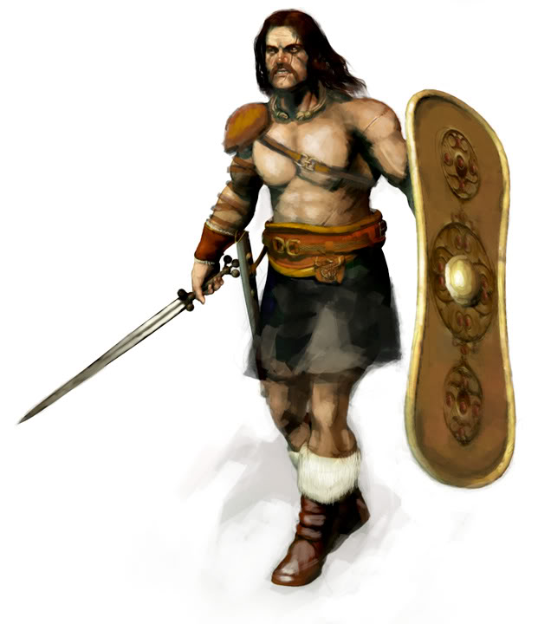
Eleazar's Moment
Surge of Demonic Activity
Surrender of God’s People gideon moment
Stamina of God’s Man
Intent
Defied (to expose…to bring down)
Extent
Arose (to arise w/ purpose -again -est)
Smote (go forward -to strike severely)

Slide 7
Eleazar's Moment
He Stood
Alone
And Fought

Slide 8
Eleazar's Moment
Grew Tired -“Weary”
Grew Trust - Refused to Give Up!
Jer 12:5 -if footmen wearied…
II Cor 4:16
Faint Not (quit, give up)
Renewed (intense radical renovation)
Each Step
Invited
Attack
Power
Romans 5:20

Slide 9
Eleazer
He Refused to...
Quit
Let Go
Not to Fight
How did He Accomplish So Much?
He had a Grip on…

Slide 10
His Past
He Came from Behind…
Not to Life of Excuses But…
…to Excel in Life
Among the 400 at Adullam
His Focus was Ahead Not Behind
His Past Didn’t Prevent But Propelled

Slide 11
His Present (9)
His Name
Eleazar (God is Helper)
El “Almighty” + “to surround”
Dodo (burning love-passion)
son of (builder -to carry on)
His Position
2nd of David’s Mightiest
Tribe of Benjamin…
…Most Warlike Tribe

Slide 12
Hebrews 10:35 (KJV) ³⁵ Cast not away therefore your confidence, which hath great recompence of reward.

Slide 14
Hebrews 10:35 (KJV) ³⁵ Cast not away therefore your confidence, which hath great recompence of reward.

Slide 15
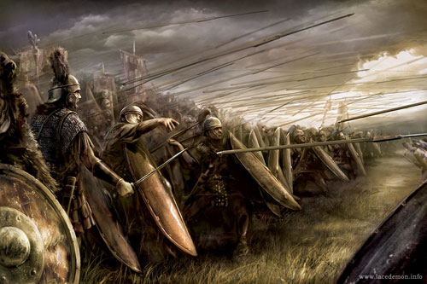
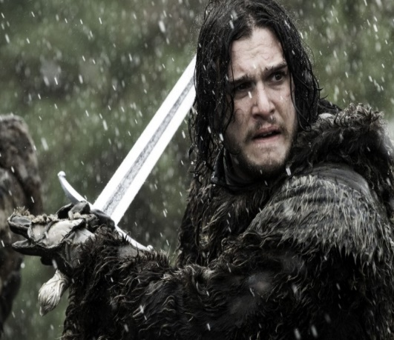
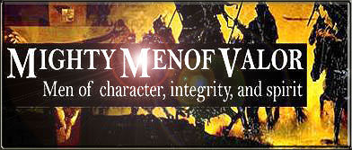
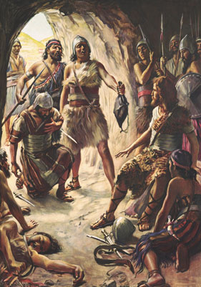
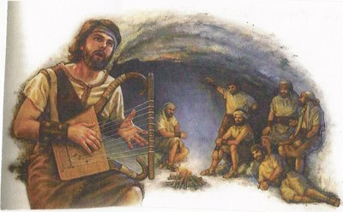

Slide 16
Eleazar's Moment
look @ situation his time..stand in gap/watch God move or refuse to stand /watch satan win
the Surge of Demonic Activity
Phil. gathered(come to bring destruction)
to battle(to engage in actual warfare…)
the Surrender
Army gone away(move to higher ground)

Slide 17
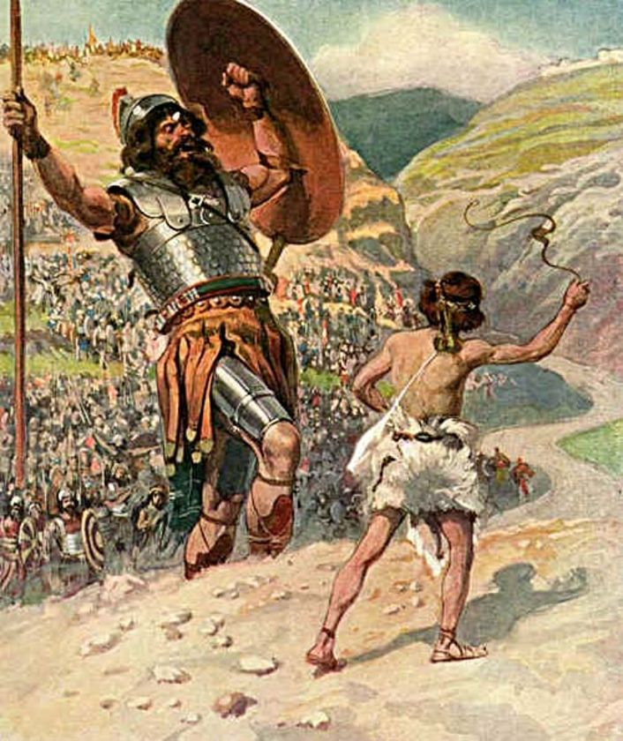
His Example
Had a Great Example "David”
Not Afraid of Challenge
Put It All On The Line...
Gave It All to God
Gave It All He Had

Slide 18
Example
1st- You Follow Example
David- “ran toward giant”
Saul- “ran from giant”
2nd- You Become an Example
Stood Ground
Refused to Quit

Slide 19
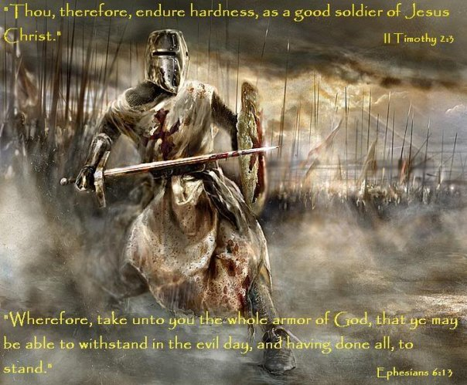
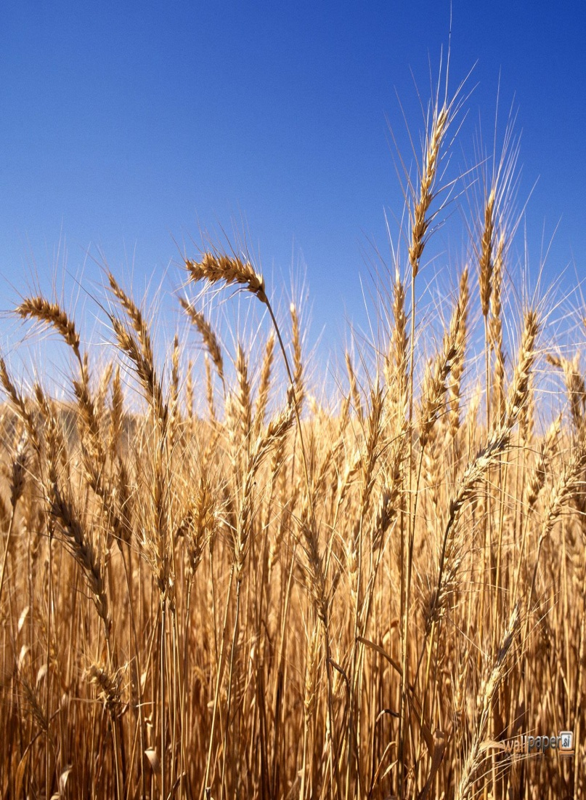
His Place of Battle
He was on a Field of
Harvest – “Lentils”
John 4:35 - Say not ye,
There are yet four months, /cometh
harvest? behold, .Lift up your eyes/
look on the fields; for they are
white already to harvest.
Matt 9:37…the harvest truly
[is] plenteous, but the labourers
[are] few;
Battle – “Pasdammin”
Boundary of Blood

Slide 20
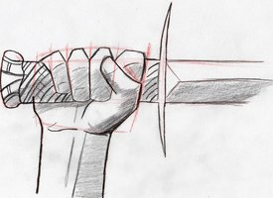
His Weapon (10)
1- it was a Sure Weapon
Sword -short 2-edged- curved up -12”…
…used in hand / hand combat
Prominent in Infantry
2- it was a Powerful Weapon
Eph 6:17, “Sword of the Spirit”- “machete”
Rhema Word -Word in Season …
God’s Word Applied to my Situation
Isa 50:4,“word in season to weary..”
…Power of Hope and Guidance

Slide 21
His Grip (10)
His Grasp was Made Firmer…
…by the Conflict
Heb 10:35, “Cast not away therefore your
confidence, which hath great recompence of
reward.”
Psa 78:9, “children of Ephraim, being armed, and
carrying bows, turned back in the day of battle.”
Eph 6:13-14,“having done all to stand (exhaust
self)….stand(hold ground)

Slide 22
His Grip (10)
His Refusal to Let Go “Grip”…
…Made his Sword Cleave to him!
Principles
#1 -Whatever we Cling to Shapes our Grasp
#2 -When we Cling to the Right Thing…
…It Will Get us Beyond the Bad Things
#3 -the Word is the Right Thing… it has
Unique Staying Power…it Clings Back!
Luke 21:33, “Heaven and earth shall pass away: but my words shall not pass away”

Slide 23
His Weapon

Slide 25
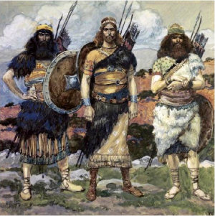
1 Chronicles 11:12-14 (KJV) ¹² And after him was Eleazar the son of Dodo, the Ahohite, who was one of the three mighties. ¹³ He was with David at Pasdammim, and there the Philistines were gathered together to battle, where was a parcel of ground full of barley; and the people fled from before the Philistines. ¹⁴ And they set themselves in the midst of that parcel, and delivered it, and slew the Philistines; and the LORD saved them by a great deliverance.

Slide 28
His Present -v9
#3- His Courage -look @ situation
a- the Surge of Demonic Activity
Phil. gathered(come to bring destruction)
to battle(to engage in actual warfare…
…not just talk)
b- the Surrender
Army gone away(move to higher ground)

Slide 29
His Present -v9
a- the Surge of Demonic Activity
b- the Surrender of God’s People
c- the Stamina of God’s Man
The Intent
-Defied (to expose…to bring down)
The Extent
-Arose (to arise w/ purpose –again -estab)
-Smote (go forward -to strike severely)

