Slide 1
Well Duh!!!
A visitor to the town approached a local person and asked, "What's the quickest way to the next town?"
The local, scratched his head, "Are you walking or driving?" he asked the stranger.
"I'm driving," said the stranger.
"Well, that's the quickest way.“
A couple of Goobers are out in the woods hunting when one of them falls to the ground. He doesn't seem to be breathing and his eyes are rolled back in his head. The other guy whips out his cell phone and calls 911.
Panic-stricken, he says to the operator, "I think Cletus is dead! What should I do?"
The operator, in a calm soothing voice says, "Just take it easy. I can help. First, let's make sure he's dead."
There is a silence, then a shot rings out.
The goober comes back on the line and says, "OK, now what?"

Slide 3
Plug Into the Power of Praise 2
Edward Church
September 15, 2019

Slide 4
Praise
Powerful-
Never leaves situation the same
Positive-
Hard to praise and pout at same time
Predictor-
It effectively predicts the outcome
Productive-
It can do what nothing else can…
We Plug Into………..

Slide 5
…Gets Our Focus Off Ourselves… Back On God
When We Get Eyes on Self… “Hurt” is Magnified
When Our Eyes are On Him … “Hope” is Magnified
He is Worthy of Our Praise…
…No Matter What We Face From Day to Day
…Brings Us to a Place of Humility
We remember our dependency on God, as we acknowledge our need for Him.
As we praise Him as Creator/ King of this world…
…we recognize that we’re not in control, but He is!

Slide 6
…Makes the Enemy Flee
It pushes back the darkness that surrounds
Evil will not stick around if we’re praising our God…
…who will fight our battles for us
…Leaves No Room For Complaining and Negativity
Sometimes Problems Overwhelm Us
Prayers Become Complaints
Problems Become Set In
Praise Reminds Us Of…
What He Has Already Done In Our Lives.
He Can Do It Again

Slide 7
Praise Makes Room For God’s Blessings Over Our Lives
He Will Not Hold Back His Goodness,
Praise Opens the Gateway of Blessing as we Come into His Presence
“Enter his gates with thanksgiving, and his courts with praise!
Give thanks to him; bless his name!” Psa. 100:4
"Blessed be the God and Father of our Lord Jesus Christ,
who has blessed us with all spiritual blessings in
heavenly places in Christ:" Eph. 1:3

Slide 8
…Praise Invites His Presence
God dwells close to us when we praise Him
He lives there
He looks for it
“He inhabits the praises of His people.” Psa. 22:3
"But you are a chosen generation, a royal priesthood, an holy nation, a peculiar people; that you should show forth the praises of him who has called you out of darkness into his marvelous light;"
1 Pet. 2:9

Slide 9
…Our Spirits are Refreshed and Renewed in His Presence
We're strengthened by His peace and refueled by His joy.
Through a Heart of Praise…
…We Realize that God Doesn’t Just Change Our Situations
…and Work Through Our Problems,
…He Changes Our Hearts.
“In His presence, there is fullness of joy.” Psa. 16:11
"Because your love is better than life, my lips will glorify you.
I will praise you as long as I live,
and in your name I will lift up my hands." Psa. 63:3-4

Slide 10
…It Paves the Way for God’s Power to be Displayed- Miracles
People's lives are affected and changed.
God shakes things up through praise.
As Paul and Silas sat in prison, shackled, but praising God.
Praise Moved God
God Moved Heaven /Earth -God sent an earthquake
Power Moved Hearts –jailer/ all his family saved-
“About midnight Paul and Silas were praying and singing hymns to God,
and the prisoners were listening to them, and suddenly there was a great earthquake, so that the foundations of the prison were shaken.
And immediately all the doors were opened,
and everyone's bonds were unfastened.” Acts 16:25-26

Slide 11
…It Paves the Way for God's Power to be Displayed- Miracles
We have a choice every day in this life.
live absorbed in worry and stress…
…focused only on what surrounds us
We can ask God to help us take our eyes off all the…
problems and mess, or the voices of others…
…look up...to the One who holds it all together
God desires our whole heart.
He longs for us to know the power of His presence
…He desires to bless us more than we could imagine
…His Spirit urges us onward, calling us closer

Slide 12
We praise you today with our hearts and songs, we praise you for your faithfulness, we praise you for your great power and love. We confess our need for you, our lives don't go so well when we just spin around on our own. We struggle and worry, get weary and worn. Yet you never leave us. Thank you for your presence. Thank you for your care over us, thank you that you breathe renewal right into our souls. We ask for your spirit to fill us, to draw us close to yourself, and to work your purposes through us, as we set our eyes on you.

Slide 13
They Didn’t Focus on the Crucifixion
But their Focus was on the Resurrection

Slide 14
Dear God
We praise you today with our hearts and songs, we praise you for your faithfulness, we praise you for your great power and love. We confess our need for you, our lives don't go so well when we just spin around on our own. We struggle and worry, get weary and worn. Yet you never leave us. Thank you for your presence. Thank you for your care over us, thank you that you breathe renewal right into our souls. We ask for your spirit to fill us, to draw us close to yourself, and to work your purposes through us, as we set our eyes on you.
Hear My Cry…
In Jesus' Name, Amen

Slide 15
Pt 2

Slide 16
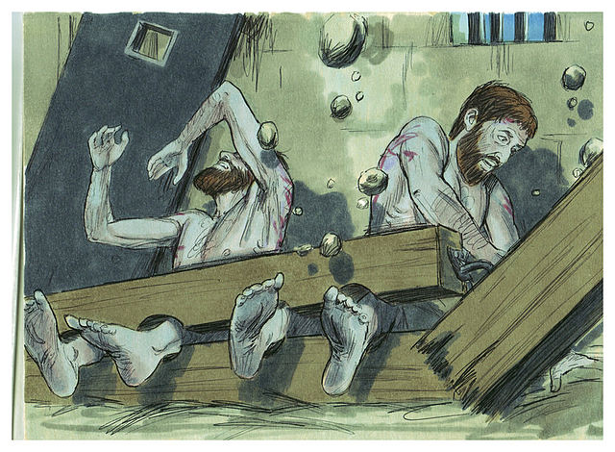
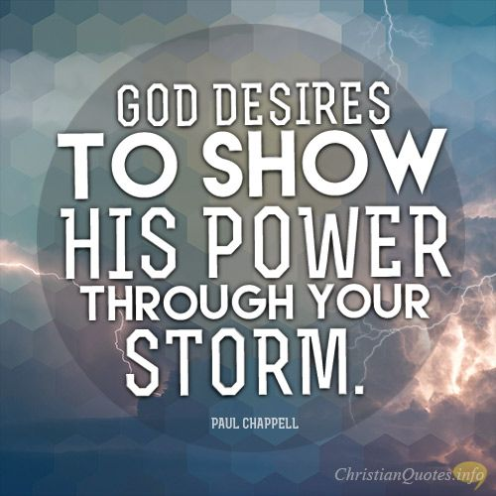
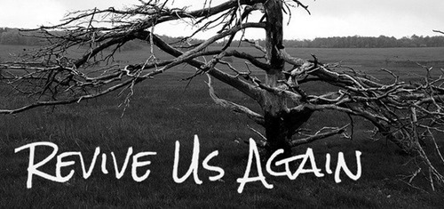

Slide 17
We have so much to praise God for, there's great power in giving honor to Him. And many of you live that truth out, every single day of your lives. The Bible is filled with examples of praise when we see His power released - life-changing miracles, dramatic stories of the enemy being halted or defeated, hearts being changed and drawn closer to Him.
Yet reality is that way too often, daily struggles or constant life demands can crowd out our praise to God. We might check the worship box at church and somehow think we’re good for the week. And all the while, with souls distant and cold, we sing words, we listen to music, then we go home.
Sometimes it really is a sacrifice to offer praise. We may not feel like it. We’re struggling. We're weary. Or maybe, we feel like He let us down. We think God seems distant, like he's far away, or doesn't really care about what's troubling us. Painful life blows and losses might have recently sent us spiraling.
Here’s what can make a lasting difference. When we make that decision to fix our eyes on Him, and daily give Him praise, no matter what's staring us straight in the face, we suddenly realize that God has already begun to release the grip those struggles can have over us.
There’s power in our acknowledgement that He is worthy, above all else, of our worship and praise.
His Spirit urges us onward, to press in close to him. Doesn't matter how good or "not so good" we feel like we can sing, doesn't matter if we like upbeat worship, more reflective songs, or traditional hymns. Doesn't matter if we're alone, with a few, or in a big group. Doesn't even matter whether we "feel" like it or not. What matters is this - our hearts in tune with our Creator and King.

Slide 18
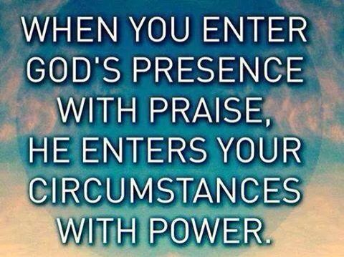
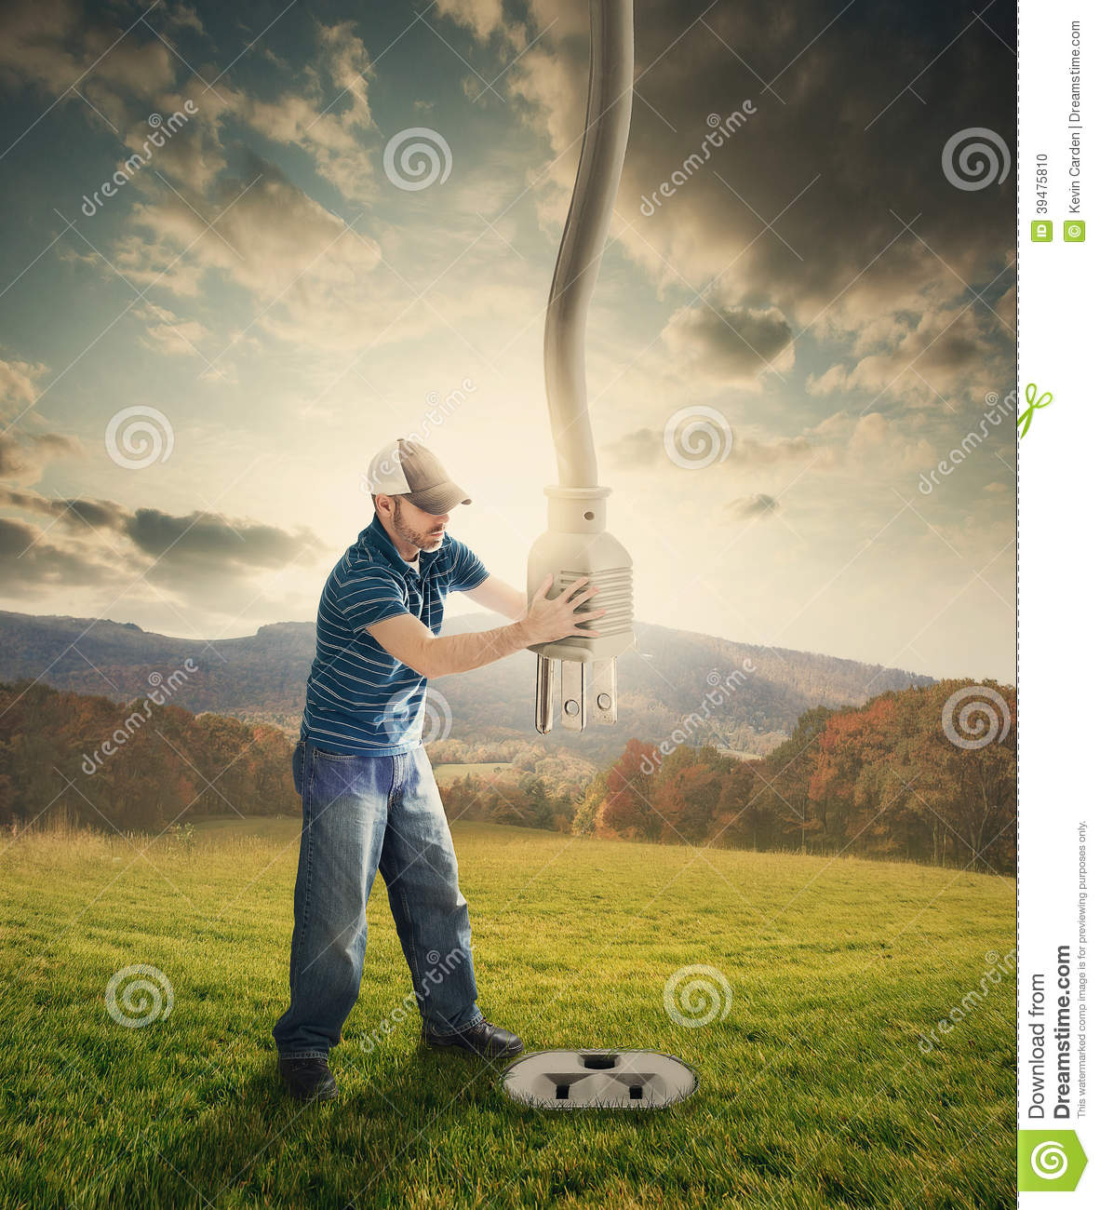

Slide 19
Floods

Slide 20
We have so much to praise God for, there's great power in giving honor to Him. And many of you live that truth out, every single day of your lives. The Bible is filled with examples of praise when we see His power released - life-changing miracles, dramatic stories of the enemy being halted or defeated, hearts being changed and drawn closer to Him.
Yet reality is that way too often, daily struggles or constant life demands can crowd out our praise to God. We might check the worship box at church and somehow think we’re good for the week. And all the while, with souls distant and cold, we sing words, we listen to music, then we go home.
Sometimes it really is a sacrifice to offer praise. We may not feel like it. We’re struggling. We're weary. Or maybe, we feel like He let us down. We think God seems distant, like he's far away, or doesn't really care about what's troubling us. Painful life blows and losses might have recently sent us spiraling.
Here’s what can make a lasting difference. When we make that decision to fix our eyes on Him, and daily give Him praise, no matter what's staring us straight in the face, we suddenly realize that God has already begun to release the grip those struggles can have over us.
There’s power in our acknowledgement that He is worthy, above all else, of our worship and praise.
His Spirit urges us onward, to press in close to him. Doesn't matter how good or "not so good" we feel like we can sing, doesn't matter if we like upbeat worship, more reflective songs, or traditional hymns. Doesn't matter if we're alone, with a few, or in a big group. Doesn't even matter whether we "feel" like it or not. What matters is this - our hearts in tune with our Creator and King.

Slide 21
…Brings Us to a Place of Humility
We remember our dependency on God, as we acknowledge our need for Him.
As we praise Him as Creator/ King of this world…
…we recognize that we’re not in control, but He is!
“Let us come into his presence with thanksgiving; let us make a joyful noise to him with songs of praise! For the Lord is a great God, and a great King above all gods” Psa. 95:2-3
"I will give you thanks in the great congregation: I will praise you among much people" Psa. 35:18

Slide 22
…Leaves No Room For Complaining and Negativity
Sometimes Problems Overwhelm Us
Prayers Become Complaints
Problems Become Set In
Praise Reminds Us Of…
What He Has Already Done In Our Lives.
He Can Do It Again
“Bless The Lord, O My Soul, And Forget Not All His Benefits, Who Forgives All Your Iniquity, Who Heals All Your Diseases, Who Redeems Your Life From The Pit, Who Crowns You With Steadfast Love And Mercy.” Psa. 103:2-4
"By Him Therefore Let Us Offer The Sacrifice Of Praise To God Continually, That Is, The Fruit Of Our Lips Giving Thanks To His Name." Heb. 13:15

Slide 23
...Leaves No Room For Complaining and Negativity
Luke 24:50-53 ⁵¹ And it came to pass, while he blessed them, he was parted from them, and carried up into heaven. ⁵² And they worshipped him, and returned to Jerusalem with great joy: ⁵³ And were continually in the temple, praising and blessing God. Amen.
Acts 2:1-2 ¹ And when the day of Pentecost was fully come, they were all with one accord in one place. ² And suddenly there came a sound from heaven as of a rushing mighty wind, and it filled all the house where they were sitting.

