Slide 1
Reporters were interviewing a 104-year-old woman.
"And what do you think is the best thing about being 104?" the reporter asked. She simply replied, "No peer pressure."

Slide 2
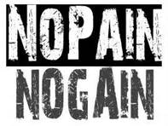
Edward Christian Church
February 3, 2013
Numbers 13:23
-Pt 2
Dealing with Life’s Struggles

Slide 3
The Struggle Principle
The Christian Life Requires Us to…
…Walk by Faith Not by Sight (2 Cor 5:7)
Move Beyond Our:
Feelings
Limitations
Prepare for Battle:
Major Events (Expected)
Everyday Struggles (Unexpected)

Slide 4
The Struggle Principle
When We Choose to Walk by Faith
We Are Met With Resistance
Resistance = Struggle
Without Struggle…
…Faith is Hindered
We Don’t Want to Experience Struggle
But Cant Walk by Faith Without It

Slide 5
The Struggle Principle
Whenever God Gives Us a Promise…
He Also…
…Gives Us a Problem
…Problems Produce Struggle
Abraham
David
Faith Causes Us to Grasp the Promise…
…Problems Cause the Promise to Grab Back

Slide 6
The Struggle Principle
Has God Given You a Promise…
And Your Facing…?
Loss
Hurt
Health Problems
Remember…

Slide 7
Struggle is a Sign…
#1- There is Still Life in You! - Potential
#2- Satan Does Not Have You Yet – Problem
#3- God Still Has Need of You - Purpose
#4- God is Defending You – Power
#5- Break Thru is On the Way –Promise
Psalms 34:19 (KJV) Many are the afflictions of the righteous: but the
LORD delivereth him out of them all.

Slide 8
God Left Giants in Promised Land On Purpose..to Produce Struggle
God Knows a Lack of Struggle Produces:
Spiritual Weakness
Loss of Spiritual Edge
Thanklessness
Spiritual Laziness

Slide 9
God Left Giants in Promised Land On Purpose..to Produce Struggle
#1- Because They Needed to Learn How to Fight
We are at War!
Eph 6:10-12, ¹⁰ Finally, my brethren, be strong in the Lord, / in
the power of his might.¹¹ Put on the whole armour of God, that
ye may be able to stand against the wiles of the devil. ¹² For we
wrestle not against flesh and blood, but against principalities,
against powers, against the rulers of the darkness of this world,
against spiritual wickedness in high places.
This War is…
Daily -Attacks can come at any hour
Powerful -all your strength not enough
All Inclusive -No One is Excluded

Slide 10
God Left Giants in Promised Land On Purpose..to Produce Struggle
#1- Because They Needed to Learn How to Fight
Psalms 18:34 (KJV) ³⁴ He teacheth my hands to war, so that
a bow of steel is broken by mine arms.
Speaks of the Ordinary Doing the Extra-Ordinary
Dependant on God for…
Guidance -teaches
Strategy -to war
Purpose -bow of steel broken
Strength -broken by mine arms

Slide 11
God Left Giants in Promised Land On Purpose..to Produce Struggle
#2- Because Giants Distinguish the Difference …
…Between Professors and Possessors
It’s one thing to confess the promises of God, it’s another thing to strap on your sword /go toe to toe with your giants and possess your promises.
#3- Giants Expose the Grasshoppers in the Crowd
(When giants show up grasshoppers speak up).
Grasshoppers usu Blend into Their Environments … …But Giants Uncover Them

Slide 12
God Left Giants in Promised Land On Purpose..to Produce Struggle
Remember :
Grasshoppers Don’t Eat Grapes…
…You Will Never Have Promise Land Faith
…with a Grasshopper Mentality

Slide 13
The Struggle
#4- You Get to Know Yourself in the Struggle
(the real you comes out under pressure)
#5- You Get to Know Your God…
…You Realize that God is Your Only Help
…You Realize that He is More Than Enough!

Slide 16
The Struggle
God left the giants in the promised land on purpose... 1. Because they needed to learn how to fight their own battles...looking to God for guidance, strength, strategy, and purpose. 2. Because giants distinguish the difference between those who profess and those who possess...those who are all talk and not much action---and those who talk the talk and walk the walk... You know, it is one thing to confess the promises of God, but it is another thing to strap on your sword (The Worde)and go toe to toe with your giants (the enemy and his devices)and possess the land(your Christian inheritance and promises) 3. The Giants expose the grasshoppers in the crowd (When giants show up grasshoppers speak up). Grasshoppers usually blend into their environments but giants uncover them.... grasshoppers don’t eat grapes, You will never have promised land type of faith if you have a grasshopper type mentality. 4. You get to know yourself in the struggle and what you are really made of( the real you comes out under pressure). Christians are like tea bags---you don’t really know what is in them until they are put in hot
5. You get to know God, you realize that God is your only help...you realize what level of faith you are on and this also gives opportunity to grow..

Slide 17
The Struggle
#4 You get to know yourself in the struggle ( the real you comes out under pressure).
#5 You get to know your God, you realize that God is your only help.
#6 You get stronger, you put down roots, you dig into the word and prayer.
#7 You become aware of the excesses and unnecessary things in your life.
#8 The struggle produces thankfulness (example ) someone survives a tornado, their house is gone their car is gone but they are so thankful that they are still alive, the family is together.
When you know you had to fight for what you got: a.You appreciate it more b.You won’t let anyone take it from you
#9 Struggles test your level of commitment
The only way to truly gauge your level of commitment is through the struggle

Slide 18
God Left Giants in Promised Land On Purpose..to Produce Struggle
#1 Because They Needed to Learn How to Fight
He Teaches My Hands to War
2 Samuel 22:35 (KJV) ³⁵ He teacheth my hands to war; so that a bow of steel is broken by mine arms.
Psalms 18:34 (KJV) ³⁴ He teacheth my hands to war, so that a bow of steel is broken by mine arms.
Psalms 144:1 (KJV) ¹ Blessed be the LORD my strength, which teacheth my hands to war, and my fingers to fight:

Slide 19
God Left Giants in Promised Land On Purpose..to Produce Struggle
#1 Because They Needed to Learn How to Fight
He Teaches My Hands to War
2 Samuel 22:35 (KJV) ³⁵ He teacheth my hands to war; so that a bow of steel is broken by mine arms.
Psalms 18:34 (KJV) ³⁴ He teacheth my hands to war, so that a bow of steel is broken by mine arms.
Psalms 144:1 (KJV) ¹ Blessed be the LORD my strength, which teacheth my hands to war, and my fingers to fight:

Slide 20
The Struggle –pt 3
#6 You get stronger, you put down roots, you dig into the word and prayer.
#7 You become aware of the excesses and unnecessary things in your life.
#8 The struggle produces thankfulness (example ) someone survives a tornado, their house is gone their car is gone but they are so thankful that they are still alive, the family is together.
When you know you had to fight for what you got: a.You appreciate it more b.You won’t let anyone take it from you
#9 Struggles test your level of commitment
The only way to truly gauge your level of commitment is through the struggle

Slide 21
1- Even if the Healing doesn’t come
2- the Hurt and the Healer Collide
3- Blessings - Laura Story
4- Praise you in this Storm
5- Bring the rain

Slide 22
There’s Something In the Struggle -Numbers 13:25-13:33 So many people in this life want everything without any effort.

Slide 25
The Struggle
#10 The struggle qualifies you for rest Mt 11:28 Come unto me, all ye that labour and are heavy laden, and I will give you rest. Hebrews 4:11 Let us labour therefore to enter into that rest, lest any man fall after the same example of unbelief.
#11 The struggle qualifies you for the reward: David heard them speak of a reward, but he knew the reward was only for the person who would fight and KILL Goliath. 1Sam 17:25 And the men of Israel said, Have ye seen this man that is come up? surely to defy Israel is he come up: and it shall be, that the man who killeth him, the king will enrich him with great riches, and will give him his daughter, and make his father’s house free in Israel.
We should understand that many times the struggle, the fight, the warfare, the praying, the waiting patiently, the enduring, is as important as the blessing or reward While we are looking at the reward, God is looking at the development that is taking place through the struggle. Faith is forged in the furnace of adversity.
If you will be truthful tonight: what has made you what you are in God is the struggle What you had to fight for, What you had to fight against What you had to overcome

Slide 26
The Struggle
David needed Goliath
The children of Israel needed the giants
The 3 hebrew children needed the fiery furnace
Sampson needed the philistines
And we need the struggle
There is no testimony without a test and no victory without a battle. A victorious life is not a problem free life, it is a life in which we overcome our enemies by virtue of struggle and fight. Finally let me say: The struggle don’t last forever Weeping may endure for the night but joy cometh in the morning The struggle is an instrument of transition. The struggle means you are on your way somewhere. The devil wouldn’t fight you if you were not going somewhere The struggle prepares you for your future. The struggle is an indication of transition Don’t feel sorry for me (I’m just in Transition).

Slide 27
The Struggle

Slide 28
The Struggle

Slide 29
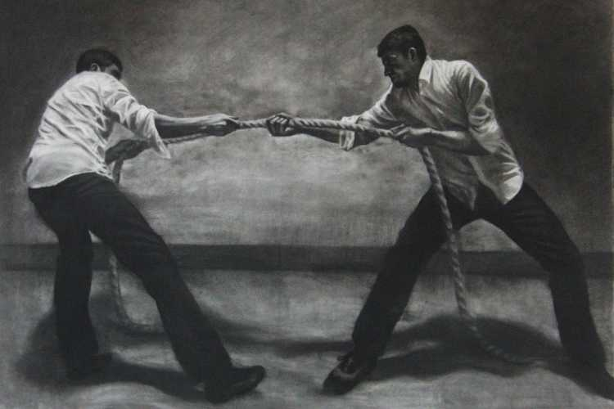

Slide 30
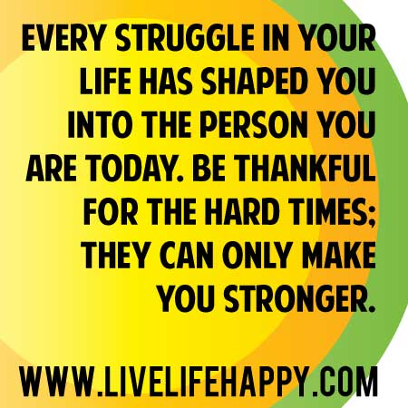

Slide 31
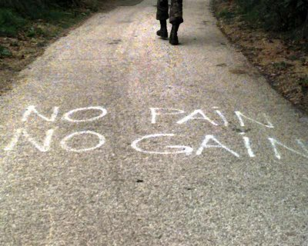
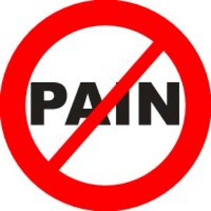

Slide 33
Struggle and Psalms 34:19
Delivereth (defend, deliver, escape, × without fail, part, pluck, preserve, recover)
Notice:
Promise (same)
Method (different)
God Steps Up, in Front of, Pulls You Out,
Pulls You Through
Results (same)
Romans 8:37, “Nay, in all these things we are more than conquerors through him that loved us”

Slide 34
war
2 Samuel 22:35 (KJV) ³⁵ He teacheth my hands to war; so that a bow of steel is broken by mine arms. Psalms 18:34 (KJV) ³⁴ He teacheth my hands to war, so that a bow of steel is broken by mine arms. Psalms 144:1 (KJV) ¹ Blessed be the LORD my strength, which teacheth my hands to war, and my fingers to fight:

Slide 35
Struggle is a Sign…
Psalms 34:19 (KJV) Many are the afflictions of the righteous: but the
LORD delivereth him out of them all.
Many (abundant and Increasing)
Afflictions (stress- struggles)
Righteous (God’s Children)
Lord (Self-Existent One - Father)
Delivereth (defend, deliver, escape, × without fail, part, pluck, preserve, recover)

Slide 36
Faith Without Struggle is…
Weak
Puny
Ineffective
Wishful thinking

