Slide 1
Leaving church one Sunday, a woman said to her husband, "Do you think that Flanagan girl is dyeing her hair?"
"I didn't even see her," replied the husband.
"And that skirt Mrs. Jones was wearing," continued the wife. "Don't tell me you thought that was appropriate attire for a mother of four??"
"I'm afraid I didn't notice that either," said the husband.
"Huh!" scoffed the wife. "A lot of good it does bringing YOU to church."

Slide 3
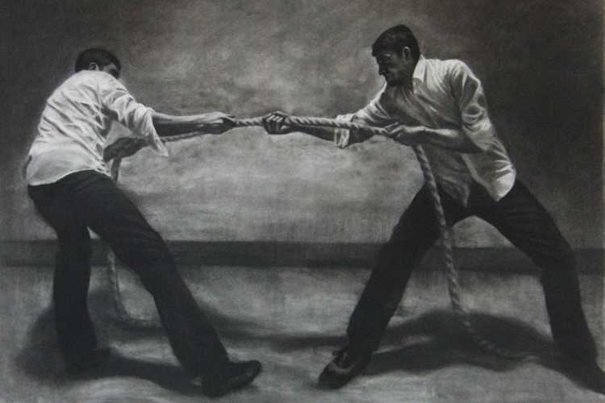
Edward Church
November 10, 2019
Numbers 13:23
-Pt 3b
Dealing with Life’s Struggles

Slide 4
The Struggle Principle
The Christian Life Requires Us to…
…Walk by Faith Not by Sight (2 Cor 5:7)
Move Beyond Our:
Feelings
Limitations
Prepare for Battle:

Slide 5
The Struggle Principle
When We Choose to Walk by Faith
We Are Met With Resistance
Resistance = Struggle
Without Struggle…
…Faith is Hindered
We Don’t Want to Experience Struggle
But Cant Walk by Faith Without It

Slide 6
God Left Giants in Promised Land On Purpose..to Produce Struggle
God Knows a Lack of Struggle Produces:
Spiritual Weakness
Loss of Spiritual Edge
Thanklessness
Spiritual Laziness

Slide 7
God Left Giants in Promised Land On Purpose..to Produce Struggle
#1- Because They Needed to Learn How to Fight
#2- Because Giants Distinguish the Difference …
…Between Professors and Possessors
#3- Giants Expose the Grasshoppers in the Crowd
(When giants show up grasshoppers speak up)
#4- You get to Know Yourself in the Struggle
(the real you comes out under pressure)
#5- You get to Know Your God…
…You Realize that God is Your Only Help
…You Realize that He is More Than Enough!

Slide 8
#6- You Get Stronger, You Put Down Roots,
You Dig Into The Word And Prayer
Jeremiah 17:7-8 (KJV) ⁷ Blessed is the man that trusteth in the LORD, and whose hope the LORD is. ⁸ For he shall be as a tree planted by the waters, and that spreadeth out her roots by the river, and shall not see when heat cometh, but her leaf shall be green; and shall not be careful in the year of drought, neither shall cease from yielding fruit.
#7- The Struggle Produces Thankfulness
#8- You Become Aware of the Excesses and
Unnecessary Things in Your Life

Slide 9
#9- Struggles Test Your Level of Commitment
The only way to truly gauge your level of commitment is through the struggle
Joshua 24:15 (KJV) ¹⁵ And if it seem evil unto you to serve the LORD, choose you this day whom ye will serve; whether the gods which your fathers served that were on the other side of the flood, or the gods of the Amorites, in whose land ye dwell: but as for me and my house, we will serve the LORD.

Slide 10
The Struggle
#10- The Struggle Qualifies You for Rest
Mt 11:28 Come unto me, all ye that labour and are heavy laden, and I will give you rest.
Hebrews 4:11, “Let us labour therefore to enter into that rest, lest any man fall after the same example of unbelief.

Slide 11
#11- The Struggle Qualifies You for the Reward
1 Sam 17:25 And the men of Israel said, Have ye
seen this man that is come up? surely to defy Israel
is he come up: and it shall be, that the man who
killeth him, the king will enrich him with great riches,
and will give him his daughter, and make his
father’s house free in Israel

Slide 12
What Has Made You… …What You are in God
…is the Struggle
What You had to…
Fight For
Fight Against
Overcome

Slide 13
Psalm 30:5
Things to Remember about the Struggle …
It Don’t Last Forever
It is an Instrument of Transition
It Means You are On Your Way Somewhere
The Devil Wouldn’t Fight You If …
…You Were Not Going Somewhere
It Prepares You for Your Future
It Is An Indication of Transition

Slide 15
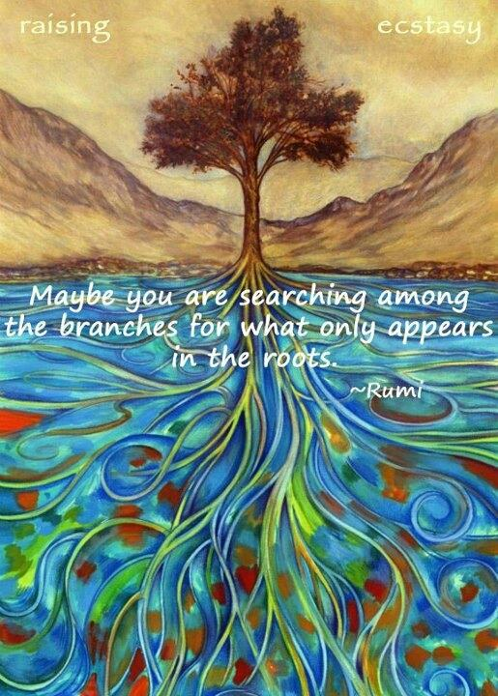
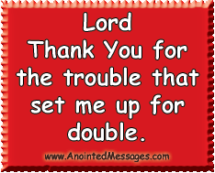

Slide 16
Commitment Test
It’s Not What It Takes For Me To Start…
…It’s What It Takes For Me To Quit

Slide 18
David needed Goliath
The children of Israel needed the giants
The 3 Hebrew children needed the fiery furnace
Sampson needed the philistines
And we need the struggle There is no testimony without a test and no victory without a battle.

Slide 19
God Left Giants in Promised Land On Purpose..to Produce Struggle
Remember :
Grasshoppers Don’t Eat Grapes…
…You Will Never Have Promise Land Faith
…with a Grasshopper Mentality

Slide 20
The Struggle Principle
Has God Given You a Promise…
And Your Facing…?
Loss
Hurt
Health Problems
Remember…

Slide 21
Struggle pt 4
Psalm 119:71 –break down
New Living Translation My suffering was good for me, for it taught me to pay attention to your decrees. It was Good that I was Afflicted
It was for my good that I was humbled; so that I would learn your statutes.

Slide 22
Psalm 119:71 –break down
David Clearly Understood this Principle and Process
Psalms 119:67, 71, “Before I was afflicted I went astray: but now have I kept thy word” 71, “It is good for me that I have been afflicted; that I might learn thy statutes”
Afflicted- weakened, humbled, stressed, struggle
Good- beautiful, faithful, favor

Slide 23
Psalm 119:71
1. Pain forces you to Look…to the Word of God for Answers. 2. Pain forces you to Lean…on the Arm of God instead of man. 3. Pain forces you to Learn...where you went astray. 4. Pain forces you to Long…for His Presence and healing. 5. Pain forces you to Listen…for changes In God’s Instructions

Slide 24
C.S. Lewis said, “God whispers in our pleasure, but shouts in our pain.”
Pain is God’s megaphone to rouse a sleeping world.

Slide 25
Psalm 119:71
Pain Forces You to
Look…
Lean…
Learn...
Long…
Listen…
to the Word of God for Answers
on the Arm of God instead of man
where you went astray
or His Presence and healing
or changes In God’s Instructions

Slide 26
Struggle is a Sign…
#1- There is Still Life in You! - Potential
#2- Satan Does Not Have You Yet – Problem
#3- God Still Has Need of You - Purpose
#4- God is Defending You – Power
#5- Break Thru is On the Way –Promise
Psalms 34:19 (KJV) Many are the afflictions of the righteous: but the
LORD delivereth him out of them all.

Slide 27
The Struggle
God left the giants in the promised land on purpose... 1. Because they needed to learn how to fight their own battles...looking to God for guidance, strength, strategy, and purpose. 2. Because giants distinguish the difference between those who profess and those who possess...those who are all talk and not much action---and those who talk the talk and walk the walk... You know, it is one thing to confess the promises of God, but it is another thing to strap on your sword (The Worde)and go toe to toe with your giants (the enemy and his devices)and possess the land(your Christian inheritance and promises) 3. The Giants expose the grasshoppers in the crowd (When giants show up grasshoppers speak up). Grasshoppers usually blend into their environments but giants uncover them.... grasshoppers don’t eat grapes, You will never have promised land type of faith if you have a grasshopper type mentality. 4. You get to know yourself in the struggle and what you are really made of( the real you comes out under pressure). Christians are like tea bags---you don’t really know what is in them until they are put in hot
5. You get to know God, you realize that God is your only help...you realize what level of faith you are on and this also gives opportunity to grow..

Slide 28
God Left Giants in Promised Land On Purpose..to Produce Struggle
#1- Because They Needed to Learn How to Fight
We are at War!
Eph 6:10-12, ¹⁰ Finally, my brethren, be strong in the Lord, / in
the power of his might.¹¹ Put on the whole armour of God, that
ye may be able to stand against the wiles of the devil. ¹² For we
wrestle not against flesh and blood, but against principalities,
against powers, against the rulers of the darkness of this world,
against spiritual wickedness in high places.
This War is…
Daily -Attacks can come at any hour
Powerful -all your strength not enough
All Inclusive -No One is Excluded

Slide 29
The Struggle
#4 You get to know yourself in the struggle ( the real you comes out under pressure).
#5 You get to know your God, you realize that God is your only help.
#6 You get stronger, you put down roots, you dig into the word and prayer.
#7 You become aware of the excesses and unnecessary things in your life.
#8 The struggle produces thankfulness (example ) someone survives a tornado, their house is gone their car is gone but they are so thankful that they are still alive, the family is together.
When you know you had to fight for what you got: a.You appreciate it more b.You won’t let anyone take it from you
#9 Struggles test your level of commitment
The only way to truly gauge your level of commitment is through the struggle

Slide 30
God Left Giants in Promised Land On Purpose..to Produce Struggle
#1 Because They Needed to Learn How to Fight
He Teaches My Hands to War
2 Samuel 22:35 (KJV) ³⁵ He teacheth my hands to war; so that a bow of steel is broken by mine arms.
Psalms 18:34 (KJV) ³⁴ He teacheth my hands to war, so that a bow of steel is broken by mine arms.
Psalms 144:1 (KJV) ¹ Blessed be the LORD my strength, which teacheth my hands to war, and my fingers to fight:

Slide 31
1- Even if the Healing doesn’t come
2- the Hurt and the Healer Collide
3- Blessings - Laura Story
4- Praise you in this Storm
5- Bring the rain

Slide 33
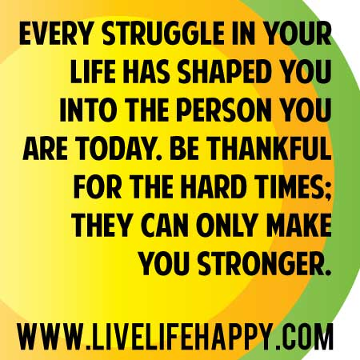

Slide 34
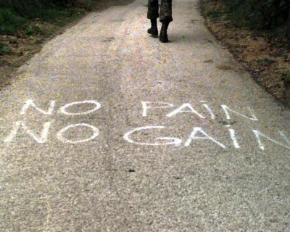
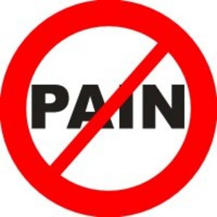

Slide 35
Struggle is a Sign…
Psalms 34:19 (KJV) Many are the afflictions of the righteous: but the
LORD delivereth him out of them all.
Many (abundant and Increasing)
Afflictions (stress- struggles)
Righteous (God’s Children)
Lord (Self-Existent One - Father)
Delivereth (defend, deliver, escape, × without fail, part, pluck, preserve, recover)

Slide 36
The Struggle Principle
Whenever God Gives Us a Promise…
He Also…
…Gives Us a Problem
…Problems Produce Struggle
Abraham
David
Faith Causes Us to Grasp the Promise…
…Problems Cause the Promise to Grab Back

Slide 37
God Left Giants in Promised Land On Purpose..to Produce Struggle
#2- Because Giants Distinguish the Difference …
…Between Professors and Possessors
It’s one thing to confess the promises of God, it’s another thing to strap on your sword /go toe to toe with your giants and possess your promises.
#3- Giants Expose the Grasshoppers in the Crowd
(When giants show up grasshoppers speak up).
Grasshoppers usu Blend into Their Environments … …But Giants Uncover Them

Slide 38
The Struggle
#4- You get to Know Yourself in the Struggle
(the real you comes out under pressure)
#5- You get to Know Your God…
…You Realize that God is Your Only Help
…You Realize that He is More Than Enough!

Slide 39
The Struggle
#6- You Get Stronger, Put Down Roots, Dig Into the Word / Prayer
Col 2:7, "Rooted /built up in him,
strengthened in the faith as you were
taught,/ overflowing w- thankfulness”
When a tree takes root, burrowing deep into the soil, it's not long is mirrored above grown
Even the trunk grows sturdier, more storm-resistant.
The Deeper You Root Your Life In Christ, The Stronger You'll Become

Slide 40
#9- The Struggle Produces Thankfulness
When you know you had to fight for what you got:
You Appreciate It More
You Won’t Let Anyone Take It from You

Slide 41
Faith Without Struggle is…
Weak
Puny
Ineffective
Wishful thinking

Slide 42
#8- You Become Aware of the Excesses and
Unnecessary Things in Your Life
Acts 27:18-20 (KJV) ¹⁸ And we being exceedingly tossed with a tempest, the next day they lightened the ship; ¹⁹ And the third day we cast out with our own hands the tackling of the ship. ²⁰ And when neither sun nor stars in many days appeared, and no small tempest lay on us, all hope that we should be saved was then taken away.

