Slide 1
Little Emily was at her first wedding and gaped at the entire ceremony. When it was over, she asked her mother, "Why did the lady change her mind?"
Her mother asked, "What do you mean?"
"Well, she went down the aisle with one man and came back with another one."

Slide 3
Five Important Truths
Valentines Day 2020
Edward Church

Slide 4
Just in case you've forgotten these important truths (or have never heard them before!), I wanted to share them with you today.
It’s Nice to Get and Give Valentine’s Cards…
But No Matter How Hard We Look…
…They Can Still Seem Generic
But There is One Who Thinks We Are Special…
He is …
Omnipotent
Omnipresent
Omniscient
When He Sends Us His Valentine to Us…
…It is NOT GENERIC!
…It is POWERFUL!

Slide 5
You are AWESOME
Awesomeness is Not Related to What You…
Do
Achieve
Own
It is About Your Inherent Unique Self.
You are Awesome!
Psalms 139:14 - I will praise thee; for I am fearfully [and]
wonderfully made: marvelous [are] thy works; and [that] my
soul knoweth right well. Psalms 139:13 - 127:14 - For thou hast
possessed my reins: thou hast covered me in my mother's womb.

Slide 6
You were Born with EVERYTHING you Need… …to Rock this Life
You Have It All Inside of You. All The…
Talent You Need
Uniqueness You Need
Personal Power You Need.
It's All In You.
You might not be tapping into it all the time, but it's there!
Psalm 139:13-18 13- For you created my inmost being; you knit me together in
my mother’s womb. 14 I praise you because I am fearfully and wonderfully made;
your works are wonderful; I know that full well. 15 My frame was not hidden
From you when I was made in the secret place, when I was woven
together in the depths of the earth.

Slide 7
You are DESTINED to… …Live Your Highest Potential
God Will Guide You...
There Will Be Mountains To Climb
Those Challenges Will Be The Making Of You.
God Will Send Helping Hands
Psalm 139:16 (MSG) ¹⁶ Like an open book, you watched me grow from conception to birth; all the stages of my life were spread out before you, The days of my life all prepared before I'd even lived one day.

Slide 8
You are ENOUGH
No Matter What You Currently Believe And Think, Or
What Anyone Else Says, You Are…
Enough.
Good Enough.
Child Of God.
Complete.
Not Missing One Single Thing.
You are Enough Because He is More than Enough
Philippians 4:13 (AMP) ¹³ I have strength for all things in Christ Who empowers me [I am ready for
anything and equal to anything through Him Who infuses inner strength into me; I am self-sufficient in Christ's sufficiency].

Slide 9
Jeremiah 29:11 (KJV) ¹¹ For I know the thoughts that I think toward you, saith the LORD, thoughts of peace, and not of evil, to give you an expected end.
Jeremiah 29:11 (MSG) ¹¹ I know what I'm doing. I have it all planned out—plans to take care of you, not abandon you, plans to give you the future you hope for.

Slide 10
You are LOVED
God has So Much Love For You…
Even If You Don't Always See Evidence of It
Other People Around You Don't Show It
God Loves You So Much
God Wants You Here.
God Needs You Here.
You are Cherished and…
…You Fill A Very Important Part in this Life

Slide 13
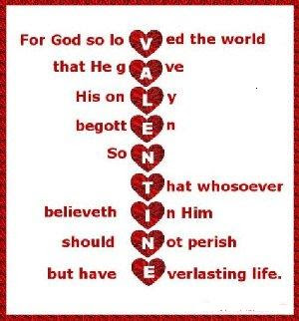
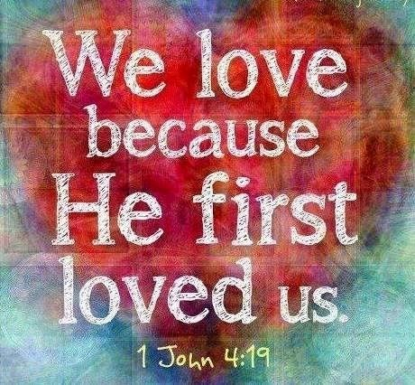
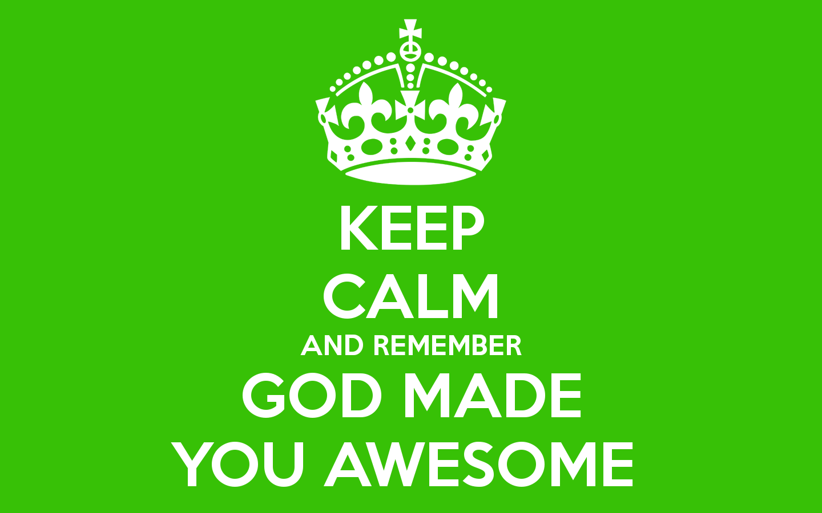
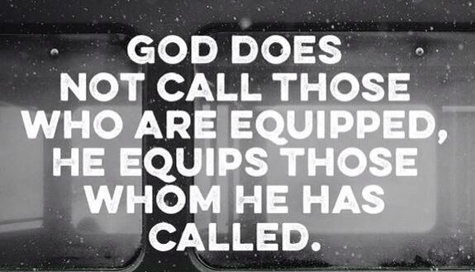
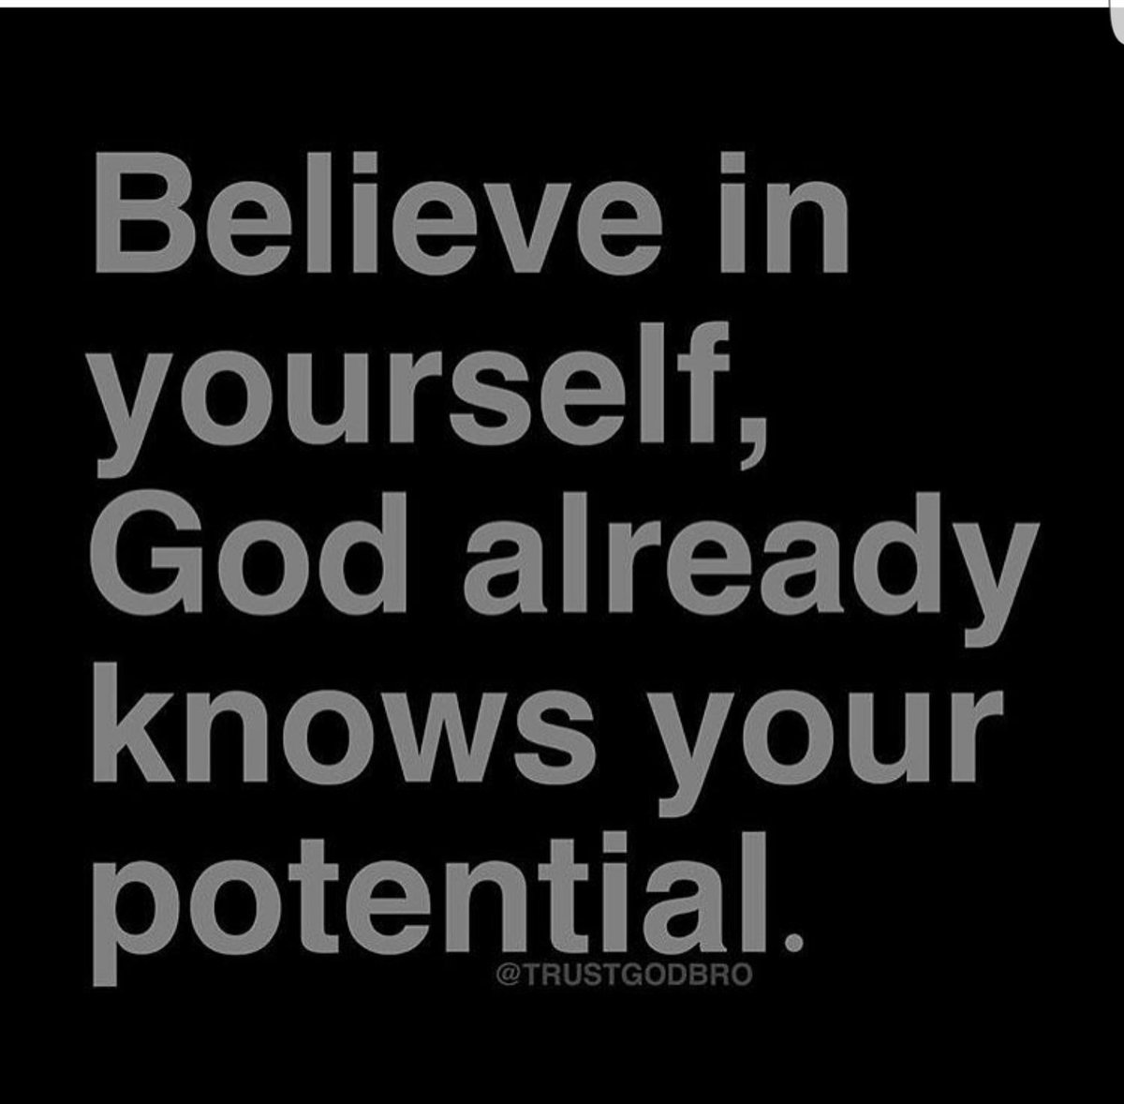
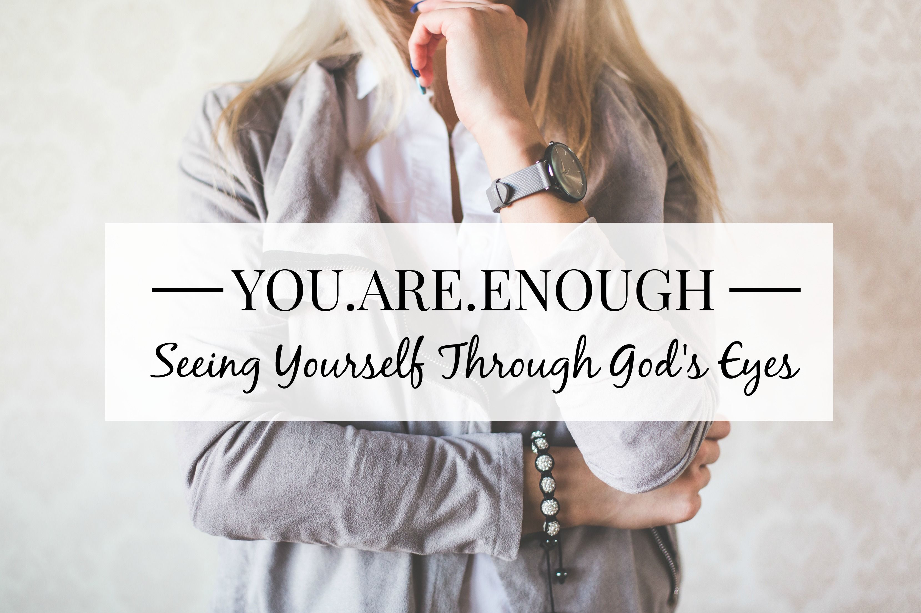
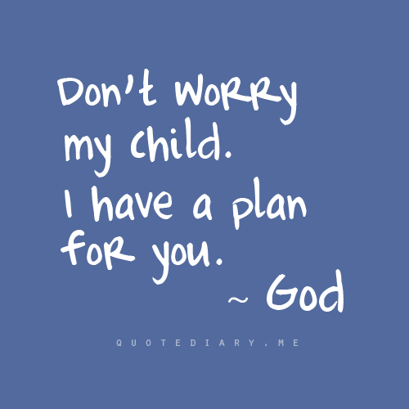

Slide 14
Just in case you've forgotten these important truths (or have never heard them before!), I wanted to share them with you today.
It’s Nice to Get and Give Valentine’s Cards…
But No Matter How Hard We Look…
…They Can Still Seem Generic
But There is One Who Thinks We Are Special…
He is …
Omnipotent
Omnipresent
Omniscient
When He Sends Us His Valentine to Us…
…It is NOT GENERIC!
…It is POWERFUL!

