Slide 1
A DEA officer stopped at our farm yesterday and said, "I need to inspect your farm for illegal growing drugs."
I said, "Okay, but don't go in that field over there."
The DEA officer verbally exploded saying, "Mister, I have the authority of the federal government with me!"
Reaching into his rear pants pocket, the arrogant officer removed his badge and shoved it in my face. "See this badge?! This badge means I am allowed to go wherever I wish - on ANY land! No questions asked or answers given! Have I made myself clear?"
I nodded politely, apologized, and went about my chores. A short time later, I heard loud screams, looked up, and saw the DEA officer running for his life, being chased by my big old mean bull in the field. With every step the bull was gaining ground on the officer. The officer was clearly terrified."
I threw down my tools, ran to the fence and yelled at the top of my lungs, "Your badge, show him your BADGE!!"
Some people aren't shaking hands because of Coronavirus. I'm not shaking hands because everyone is out of toilet paper.

Slide 2
Keeping Cool in a Hot Environment
Part 1
Edward Church
March 29, 2020

Slide 4
In Any Situation Remember
Life is 10% of What Happens to You
And 90% How You Respond
Fear Levels Are at an ALL Time High
Evidenced by the Pandemic

Slide 5
Fonzie video –cool it!

Slide 6
How to Know Your Anxiety is Effecting You- Symptoms…
Poor Concentration
Confusion
Disorientation
Negative Self-Talk
Going Blank
Fixating on one item too long
Careless Mistakes

Slide 8
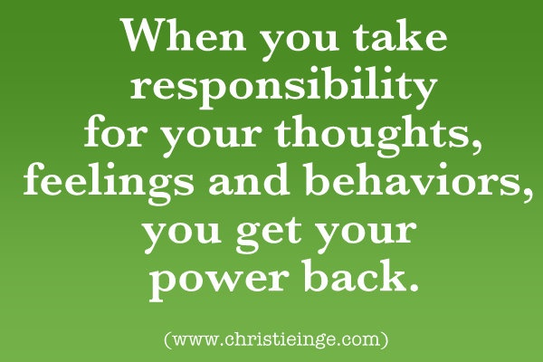
You Don’t Have to..
…Feel this Way
Its Time to take Back..
…Your Power

Slide 9
Slow Down!
Don’t React Immediately
Be patient and collect as much information as possible.
Ask yourself, Is this really going to matter a year from now?
If yes, step back to remove yourself from the situation.
This perspective will help you remain less emotional…
…and improve your ability to make decisions.

Slide 10
Stay Positive
When stressful situations occur…
…your mind wanders
…your thoughts may be negative.
…it will be difficult for you to remain calm
Let go of negative thoughts…
…refocus your mind on something positive
…no matter how small

Slide 11
Never Ask “what if?”
The worst question you could ask in middle of a crisis begins
"What If"
induces panic and forces you to process situations that have not occurred and may never happen.
“What if” questions compound the fear and escalate the problem.
Leads to Only More Anxiety

Slide 12
Take Care of Your Body
If you make your personal health a priority…
…you’ll be better equipped to handle a crisis.
Eat a balanced diet, exercise regularly and get plenty of sleep.
Exercise lowers the level of stress hormones…
…helps the body function at its highest level.
By improving your health, you’ll increase your self-control, memory and emotional intelligence…
…important characteristics that will help you
…respond well to an emergency.

Slide 13
And Be Thankful…
…God’s Got This!

Slide 15
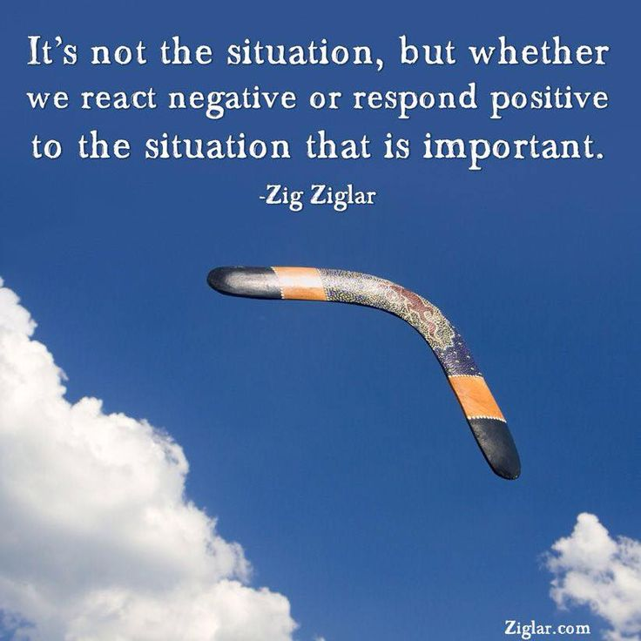
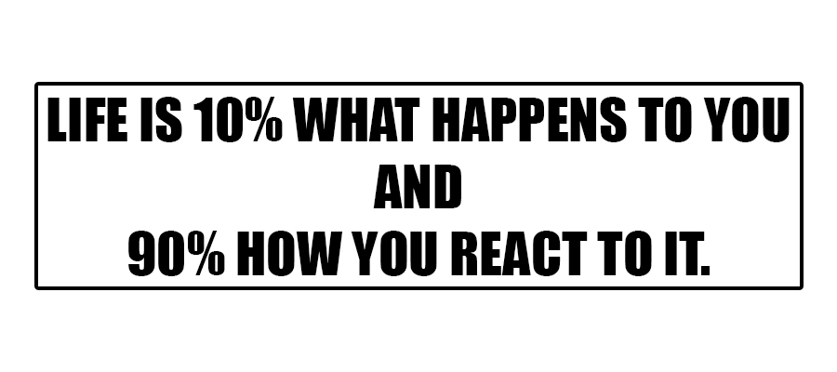
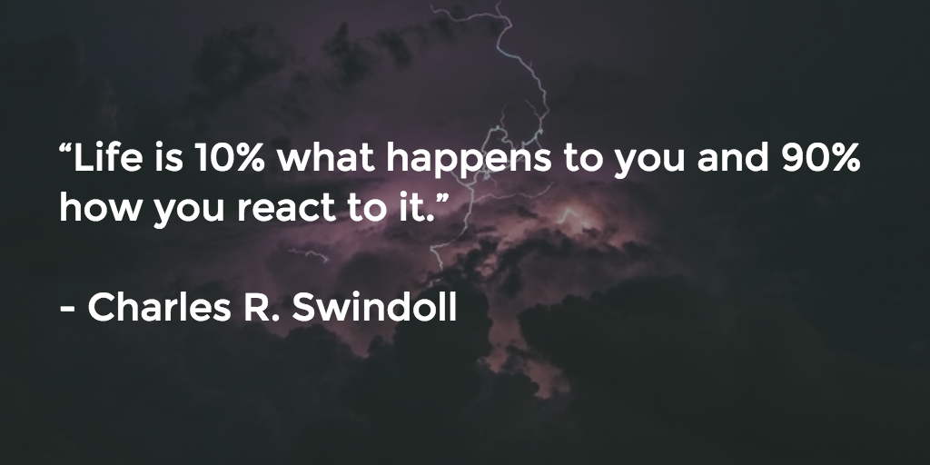
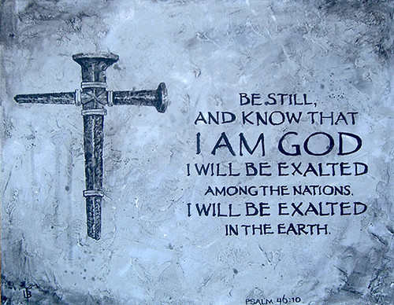

Slide 17
Pt2
5. Limit caffeine.
When you’re in the middle of a dire situation, you might be tempted to run to the break room to grab a cup of coffee. Caffeine may trigger a release of adrenaline, giving you a quick burst of energy and physical strength, only to be followed by a crash marked by fatigue and irritability in some cases. Instead of reaching for that cup of coffee, soda or an energy drink, hydrate yourself with water.
6. Call a trusted friend or mentor.
Use your support system and don’t be afraid to ask for advice with a stressful situation. Someone who isn’t emotionally invested in the situation will be able to see the dilemma from a different perspective and can help you arrive at potential solutions. When you reach out to people you trust and respect, you’ll feel more grounded. That security will help you control your stress and anxiety. As you explain the situation, you may even start to share your thoughts out loud, which might prompt you to discover a new approach or solution.
7. Disconnect.
Pull away from the situation for a while, even if only for an hour or two. When you give yourself time to process a dilemma and the surrounding emotions, you’ll be able to approach the situation with a fresh perspective.
8. Develop a coping strategy.
A crisis may require you to put in long hours at the office or spend weekends working at home. If you remain in a prolonged state of stress, you may cause long-term damage to your health and undermine your ability to make rational, informed decisions.
To better cope, develop a ritual you enjoy. Perhaps you'll choose to meditate in the morning. Take regular walks or sign up for an exercise class. Short exercise breaks can increase stamina. These techniques can help you feel more empowered to handle many situations.

Slide 22
I Feel So Powerless!!!

Slide 23
Bad News Bad News What You Gonna Do?
What You Gonna Do When It Comes to You
Bad News

