Slide 2
All Stressed Up and No Place to Blow
March 22, 2020
Edward Church

Slide 3
Catch the Pandemic?
…there is a Slight Chance
Catch the Pandemonium?
…there is a 100% Chance

Slide 4
Anxiety is a normal, adaptive system in the body…
that tells us…
…when we are in danger…
…which means that dealing with your anxiety
…never involves eliminating it
…but rather managing it.

Slide 5
Just because you are experiencing anxiety does not mean you are in a dangerous situation.
Just because you think something, does not mean it is accurate.
Thoughts are random and sometimes insignificant.
Often, our minds can run wild creating situations of “what if” that may not have any factual basis at all.
Suddenly our mind is running in the wrong direction, and our body begins to feel anxious.

Slide 6
Then the “smoke detector” in our Brain…
…assesses Levels of Safety or Threat…
…Initiates a Fight, Flight or Freeze Response.
Fight
Flight
Freeze

Slide 7
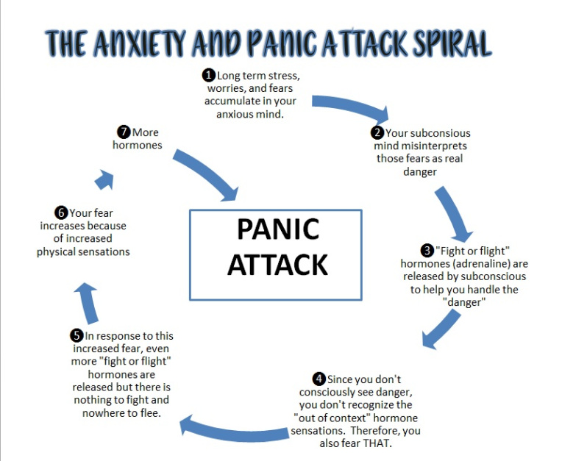

Slide 8
Anxiety/ Panic Attacks
Prompt Catastrophic Thinking…
…most likely Irrational and Out of Proportion to Reality.
Symptoms of a panic attack cannot be ignored
Panic attacks can increase with time and prevent us from functioning
To prevent anxiety from increasing and interfering with daily life, grounding exercises are recommended.
These help us manage the symptoms of anxiety.

Slide 9
A Very Real Threat
Detected by Emotions
Cannot Be Detected by…
Senses
Others
You After Crisis Over
False Reality
Bypasses Senses
Cure
Reconnect to Senses
Brings Back to Reality

Slide 10
How It Works
Start with Breathing Exercises
Breathe In For 5 Seconds
Hold The Breath for 5 Seconds
Breathe Out for 5+ Seconds.
Continue this Pattern Until…
…You Find Your Thoughts Slowing Down.

Slide 12
Acknowledge 5 THINGS around you can SEE
Clock on the wall, carpet on the floor, a table or chair, clouds moving past, or a nearby tree.
Big or small, recognize 5 items you can see with your eyes

Slide 13
Acknowledge 4 THINGS you can TOUCH
The chair you are sitting on, your legs or hair, or your wallet or purse.
Recognize 4 items you can feel with your hands or body

Slide 14
Acknowledge 3 THINGS that you can HEAR.
The sound of people talking or walking, the laughter of children, birds chirping, clocks ticking, cars going by.
Name 3 things that are audible to you

Slide 15
Acknowledge 2 THINGS that you can SMELL
Walk to a bathroom to smell soap, outside to smell something in nature, lean over and smell a pillow on the couch, a pencil on the desk, or check to see how your deodorant is working today.
Whatever it may be, take in the smells around you.

Slide 16
Acknowledge 1 THING that you can TASTE.
It might be the aftertaste of coffee, gum or your last meal.
Take an additional deep breath when done

Slide 17
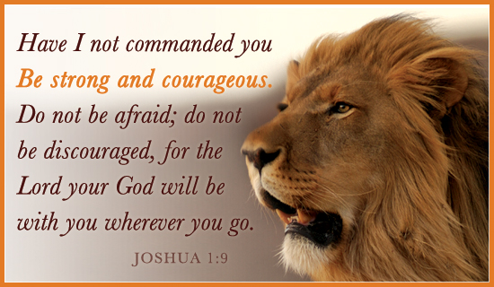
C
O
V
I
D
19
-Christ
-Overpowers
-Viral
-Infectious
-Disease
-Joshua 1:9

