Slide 1
I was in a long line at 7:45 am at the grocery store that opened at 8:00 for seniors only. A young man came from the parking lot and tried to cut in at the front of the line, but an old lady beat him back into the parking lot with her cane.
He returned and tried to cut in again, but an old man punched him in the gut, then kicked him to the ground and rolled him away.
As he approached the line for the 3rd time he said, "If you people don't let me unlock the door, none of you will ever get in to shop."

Slide 3
How to Assist Three Different Groups Back to Edward Church “Who is Coming Back to Church and When?”
Where is Everybody?

Slide 4
Know This …
Most of your congregation never left, they are online.
The church is not about a building, but about impact of the Gospel
The return of the church to physical buildings post COVID is very much in uncharted waters.
People will come back…
What we do not know is who, how many, and when.
There is more we do not know than we do.
So much has changed, our World has changed, Social norms, the Economy, the Way we do Business.
People disagree on what/ why it is happening/ what is safe and not safe.

Slide 5
Three Different Groups to Expect:
None of these Three Groups Indicate…
level of spiritual maturity
is better than another

Slide 6
Biblical Ex- David -ran to Goliath (beheader)-
original terrorist/ psyche warfare
Very effective – biggest man in Israel afraid- whole nation shut down –
sound familiar?

Slide 7
“I’m Running Back”
This is the group that cannot wait. They have their running shoes on and are ready to sprint.
They would have never left had you not closed the doors.
They do not need or want masks, and some would hug you if you let them.
They are excited the doors will reopen, / frustrated that you have not opened already.
Let us estimate that this group comprises about 25% of your congregation.

Slide 8
Keyword = PACE
Help those who want to run back to pace their zeal…
…engage others who feel / think differently with honor / respect.
They need to embrace that while they are comfortable…
…many in your church are not yet ready.
We must be careful to not even unknowingly pressure anyone to come back to a physical church building before they are ready.

Slide 9
“I’m Walking Back”

Slide 10
“I’m Walking Back”
The “I’m walking back” group wants to carefully process what they see / experience before they return.
This is the largest group, let us estimate this group is about 60%.
Remember, this will be the largest of the three groups

Slide 11
Keyword =PEACE
Those who “walk back” will be listening/ watching carefully…
what you say
how you open
connecting to own personal perceptions new normal.
Those will return when they have an internal peace.
First, how you prepare / communicate will help elevate their level of peace. If they sense a thoughtful, well prepared, / clearly communicated process that will enhance their level of trust / co
Second, take “I’m walking back” group seriously. Treat their concerns w- respect /keep the tone light.

Slide 12
“I Might Not Come Back”
Do not panic about this group.
Their delay, even indefinite delay, is not necessarily a bad thing.
They may feel comfortable with online ministry (safe)
If you communicate the freedom to attend online as a regular place of worship rather than subtly pressuring someone to come back, they are much more likely to return in time.
Keep in mind that some may have some degree of compromised health conditions or a combination of age and health issues that suggest they hold back for a season.
This group might represent about 15%.

Slide 13
Keyword =PAUSE
Many are fully with you in heart / spirit, they have simply pushed the pause button for their church attendance in a physical building.
Here are a couple of thoughts on how you can encourage this group.
Intentionally design ways for those who have “pushed pause” on coming back to church to stay connected beyond online.
Reach out, making personal connections focused on engagement.
Assist with genuine love, concern, / sincere guidance.
Communicate how your church can serve those who have pushed pause on physical attendance to continue to move forward in their faith by connecting / serving with others.

Slide 14
Just Remember That…
…We May Have to
…Accept Some New Norms!
God’s Got This!
Either Way We Win!

Slide 16
We Can and Will Make It Through This ☺

Slide 17
1 Samuel 17:50-52 (KJV) ⁵⁰ So David prevailed over the Philistine with a sling and with a stone, and smote the Philistine, and slew him; but there was no sword in the hand of David. ⁵¹ Therefore David ran, and stood upon the Philistine, and took his sword, and drew it out of the sheath thereof, and slew him, and cut off his head therewith. And when the Philistines saw their champion was dead, they fled. ⁵² And the men of Israel and of Judah arose, and shouted, and pursued the Philistines, until thou come to the valley, and to the gates of Ekron. And the wounded of the Philistines fell down by the way to Shaaraim, even unto Gath, and unto Ekron.

Slide 18
1 Corinthians 15:3-6 (NKJV)
³ For I delivered to you first of all that which I also received: that Christ died for our sins according to the Scriptures, ⁴ and that He was buried, and that He rose again the third day according to the Scriptures, ⁵ and that He was seen by Cephas, then by the twelve. ⁶ After that He was seen by over five hundred brethren at once, of whom the greater part remain to the present, but some have fallen asleep.
Acts 1:15 (KJV)
¹⁵ And in those days Peter stood up
in the midst of the disciples, and
said, (the number of names together were about an hundred and twenty,)

Slide 19
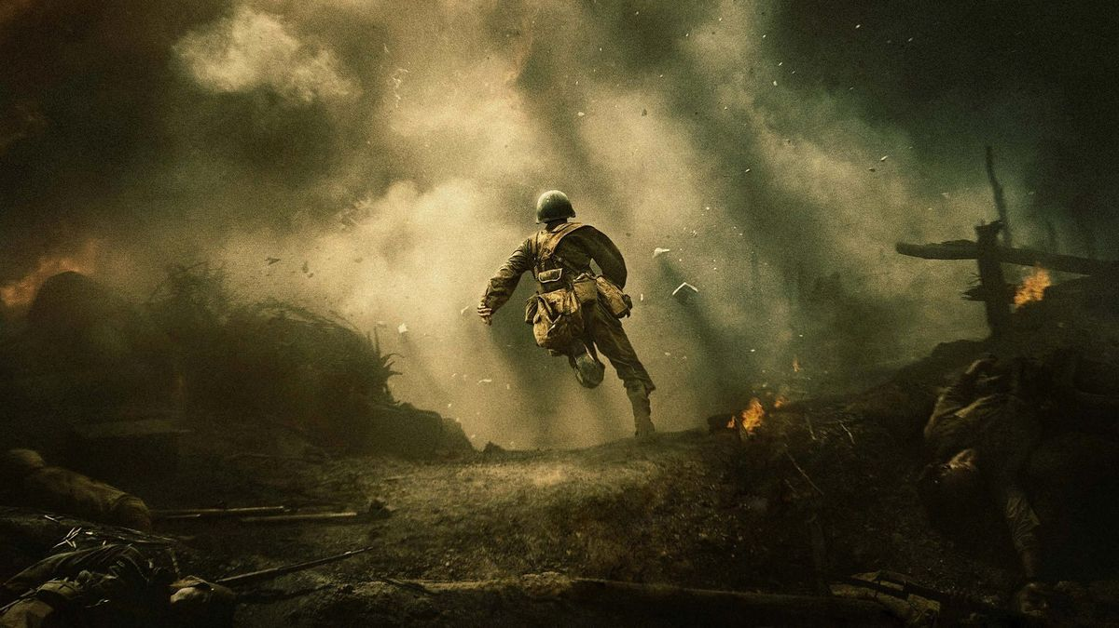
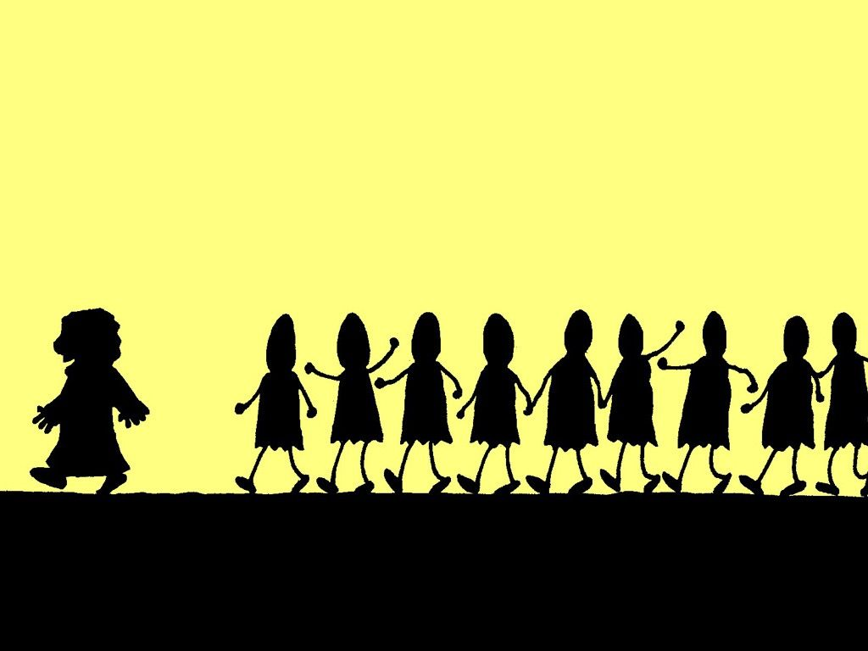
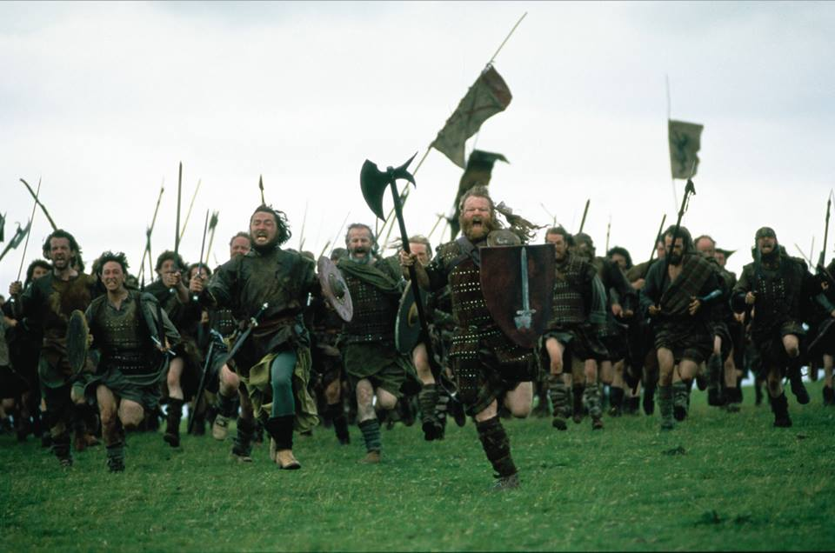

Slide 20
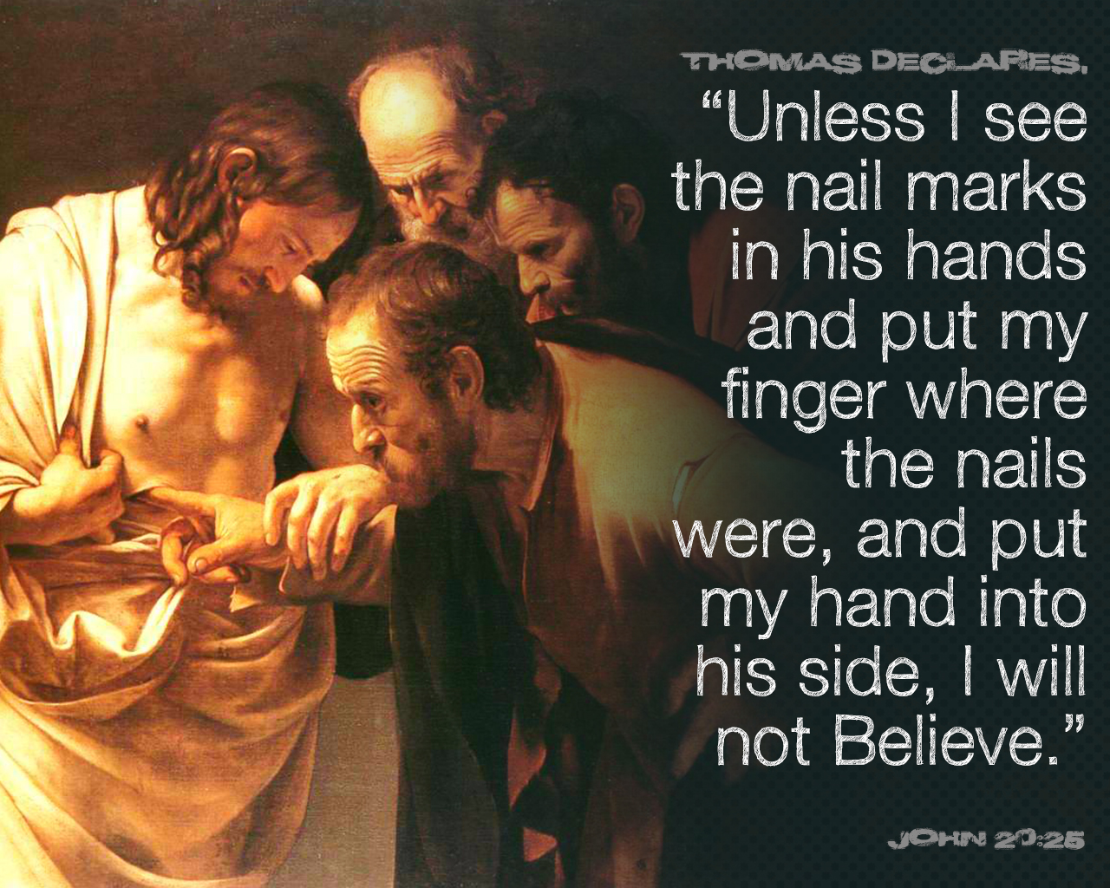
1 Corinthians 15:3-6 (NKJV) ³ For I delivered to you first of all that which I also received: that Christ died for our sins according to the Scriptures, ⁴ and that He was buried, and that He rose again the third day according to the Scriptures, ⁵ and that He was seen by Cephas, then by the twelve. ⁶ After that He was seen by over five hundred brethren at once, of whom the greater part remain to the present, but some have fallen asleep.
Acts 1:15 (KJV) ¹⁵ And in those days Peter stood up in the midst of the disciples, and said, (the number of names together were about an hundred and twenty,)

