Slide 1
A Sunday School teacher challenged her children to take some time on Sunday afternoon to write a letter to God. They were to bring their letter back the following Sunday.
One little boy wrote, "Dear God, we had a good time at church today. Wish you could have been there”

Slide 3
Becoming a “Can DO” Christian
Edward Church
Phil 4:13
June 28. 2020

Slide 4
Philippians 4:13

Slide 5
Philippians 4:13 (AMP) ¹³ I have strength for all things in Christ Who empowers me [I am ready for anything and equal to anything through Him Who infuses inner strength into me; I am self-sufficient in Christ's sufficiency].
Philippians 4:13 (MSG) ¹³ Whatever I have, wherever I am, I can make it through anything in the One who makes me who I am.

Slide 6
Too Many Christians are Living in the
“Land of Can Nots”
Can Nots
What If’s
Wish I Could
Time to Turn the Page
Change the Recording

Slide 7
“I”
not just for them, those, her or him ..It’s For ME!
not for the super saint- struggling saint …It’s For ME! …this is my verse it belongs to me
encourages me when I feel defeated
comforts me when I am sad
emboldens me when I am afraid
empowers me when I am weak
…this is my verse it belongs to me!

Slide 8
“Can”
No Room For Maybes or Might’s- Possibly or Perhaps
…Word of Certainty
Psalms 18:32 It is God that girds me with strength, and makes my way perfect.
Isaiah 41:10 Fear you not; for I am with you: be not dismayed; for I am your God: I will strengthen you; yea, I will help you; yea, I will uphold you with the right hand of my righteousness.

Slide 9
“Do”
Not Gripe About or Think About – DO!!
Verb – word of action; …Christianity is not sitting it is striving
Eph 6:12, ‘ For we wrestle not - against flesh and blood, but against principalities, against powers, against the rulers of the darkness of this world, against spiritual wickedness in high places.

Slide 10
“All”
Not Some or Most – ALL!!
Genesis 18:14 Is any thing too hard for the LORD?
Jeremiah 32:17 Ah Lord GOD! behold, You have made the heaven and the earth by Your great power and stretched out arm, and there is nothing too hard for You:

Slide 11
“Things”
Every Situation – Every Relationship – Every “Thing”
whatever you face put its name in place of “things”
Romans 8:28 And we know that all things work together for good to them that love God, to them who are the called according to his purpose.

Slide 12
“Through”
Small Word –en = fixed position & instrumentality
only through a “certain path and instrument”

Slide 13
“Christ”
John 15:5 I am the vine, you are the branches: He that abides in me, and I in him, the same brings forth much fruit: for without me you can do nothing.

Slide 14
“Which”
Because of this person and the path laid out
This will always be the results…
…if we stay w/ person & on His path

Slide 15
“Strengthens”
Dynamis = power that produces more power
To Infuse inner strength and ability (unstoppable)
“Dynamo”

Slide 16
“Me”
Ends where we started –
if you don’t personalize it… it doesn’t means a thing!!
If you do then “I can do all things through Christ which strengthens me”
is your Battle Cry

Slide 17
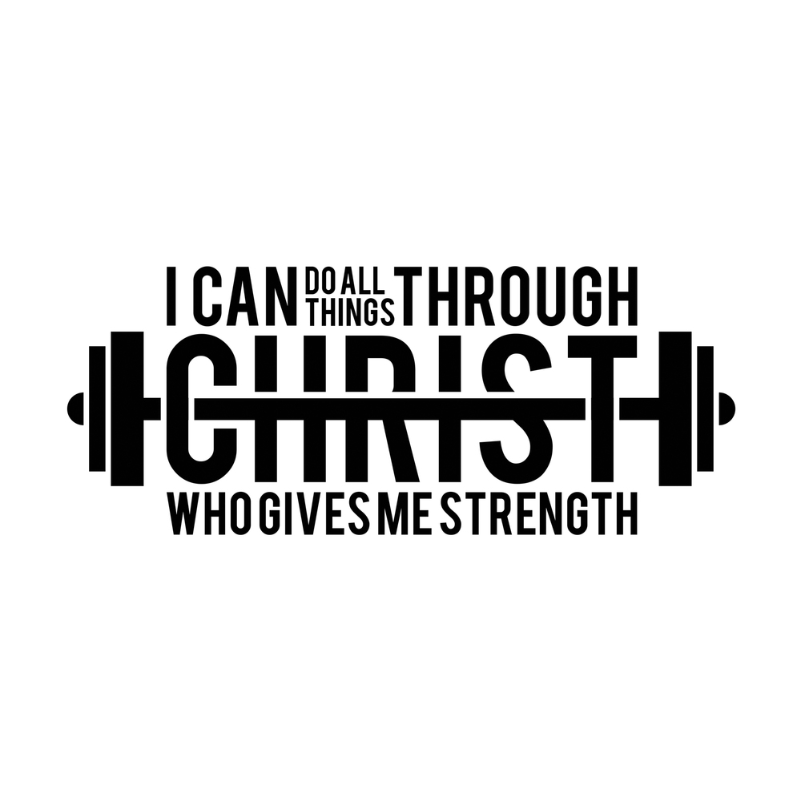

Slide 19
