Slide 1
A gorilla walked into a drugstore and ordered a $1.50 chocolate sundae. He put a ten-dollar bill on the counter to pay for it.
The clerk thought, what could a gorilla know about money? So he gave the gorilla a single dollar bill in change. As he did, the clerk said, "You know, we don't get too many gorillas in here."
"No wonder," the gorilla replied, "at nine dollars a sundae."

Slide 3
How Can I Apologize? Let Me Count the Ways
Edward Church
July 5, 2020
Freedom from Myself
Pt 1

Slide 4
God is About Relationship
God in His Power and Wisdom…
Ordained
Designed
Although Adam had Relationship
God
Animals
Still Alone
“Now the Lord God said, It is not good (sufficient, satisfactory) that the man should be alone; I will make him a helper (suitable, adapted, complementary) for him.” Genesis 2:18 (AMP)

Slide 5
Even Healthy Relationships Have Problems
Relationships
Individuals Need to Feel Loved and Appreciated Relationships Provide This
But they can also Promote Misunderstanding
Actions Run Contrary
Emotions Get Stirred
Feelings Get Hurt
To Guard This,
We Need To Deal Effectively…

Slide 6
Even Healthy Relationships Have Problems
Relationships
Individuals Need to Feel Loved and Appreciated Relationships Provide This
To Guard this, they Need to Deal Effectively…
The Reality
No One Is Perfect.
If People Do Not Deal With the Failures…
…Resulting In An Emotional Barrier of Hurt
The Revelation
• Apologizing
• Forgiving

Slide 7
Five Relational Languages…
Love Languages…
…Help Us Connect
Languages of Apology
…Help Us Re-Correct

Slide 8
Apologizing
The Bible is Very Positive Regarding the Issue of Apologizing
“He who conceals his transgressions will not prosper, but he who confesses and forsakes them will find compassion.” Prov 28:13
“But your iniquities have made a separation between you and your God, and your sins have hidden His face from you so that He does not hear.” Isaiah 59:2
“Therefore if you are presenting your offering at the altar, and there remember that your brother has something against you, leave your offering there before the altar and go; first be reconciled to your brother, and then come and present your offering.” Matt 5:23-24

Slide 9
Learning to Apologize
People learn different styles of apology/non-apology from parents.
• Research shows that about 10% of the population…
…almost never apologizes,
…most of these are men
…they learned this from their fathers

Slide 10
Guidelines for Real Apologies
Number One Rule
NEVER say “I’m sorry…but”
…even if there was wrongdoing on other side
The “but” nullifies the whole apology
It’s an attempt to excuse your own bad behavior based on their bad behavior
It takes strength/ humility but you ALWAYS have a choice over your actions
Be responsible for owning up on your end
God will deal with your spouse separately

Slide 11
What Apologies Are Not… “Missed it by that much”
Common Formats For Apology that Are “Counterfeit”
“Sorry-excuse”
Example:
“I’m sorry I didn’t call-I’ve been really busy.”
Translation:
“Please be understanding about the fact that other things were more important than you.”

Slide 12
What Apologies Are Not… “Missed it by that much”
• “Sorry-excuse” “I’m sorry I didn’t call-I’ve been really busy.”
“Sorry-Denial of Intent”
Ex-“I’m sorry you took it that way. It wasn’t what I meant.”
Tr-“I think it’s too bad that you had difficulty understanding me correctly.”
Ex-“I’m sorry if I offended you.”
Tr-“I can’t think of anything I did wrong, but if you think so, I’d be happy to apologize so I can get back in your good graces.”

Slide 13
What Apologies Are Not… “Missed it by that much”
• “Sorry-excuse” “I’m sorry I didn’t call-I’ve been really busy.”
• “Sorry-denial of intent” “I’m sorry you took it that way. Not what I meant.”
“Sorry-Blame”
Example:
“I’m sorry I didn’t call sooner. Have you been feeling insecure about our relationship lately?”
Translation:
“If you are upset about my not calling, the real cause is your own insecurity, not anything I did.”

Slide 14
Guidelines For Real Apologies
Only say “I’m sorry,” when …
you mean it
can specify what you are apologizing for
A “healthy” or authentic apology can be stated clearly what we did that was disrespectful or inconsiderate without:
• immediately explaining why we did it,
• telling the person that however it looked or sounded, it wasn’t our real intention
• bringing up some other issue that suggests that the other person contributed to or caused the problem.

Slide 15
Guidelines For Real Apologies
Decline to accept an apology that is not given sincerely.
When you accept an apology, knowing it wasn’t real, you pretend an issue is resolved while harboring resentments.
Gently, firmly, without anger.
refuse to accept an insincere apology,
You will feel greater confidence
You Won’t Feel manipulated or pacified
you hold the other person more accountable
without having to argue or try to force an apology.

Slide 18
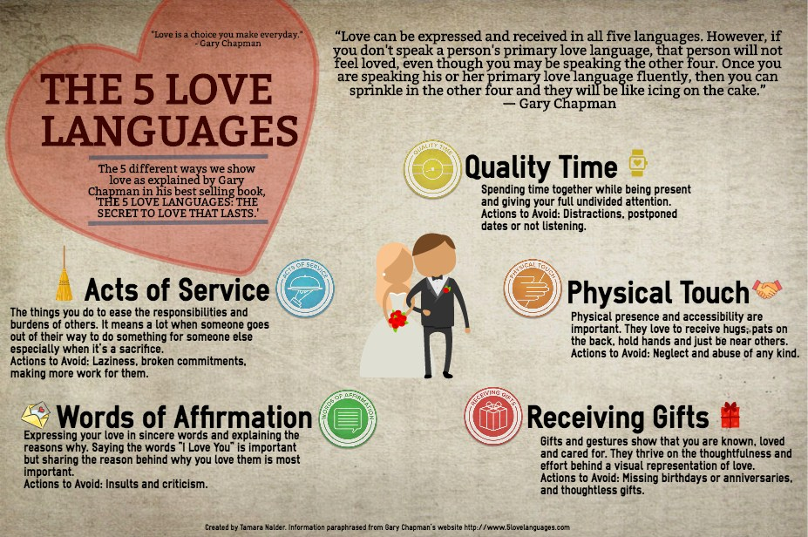
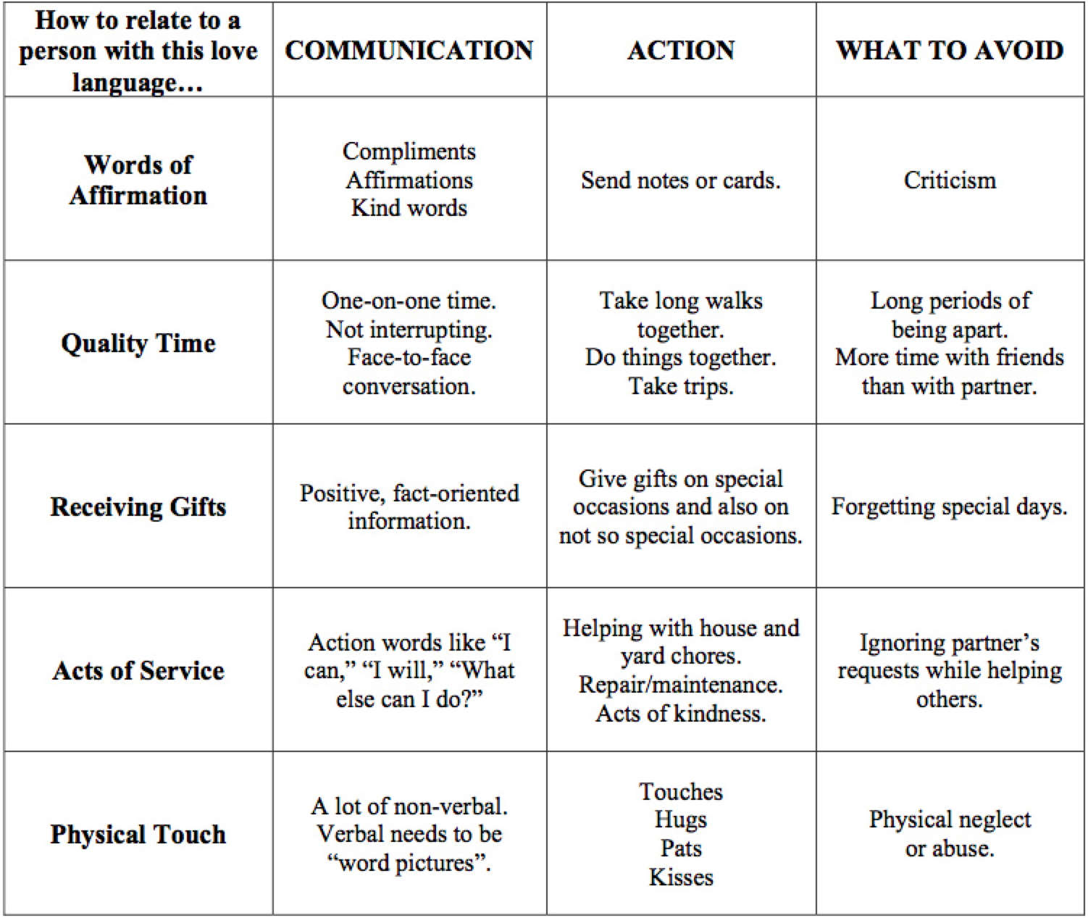

Slide 19
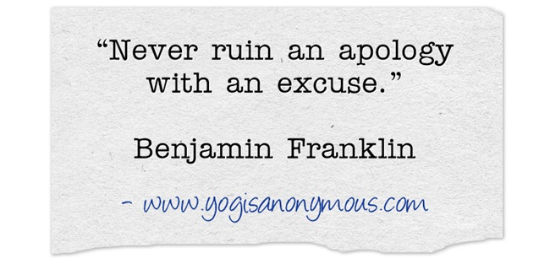
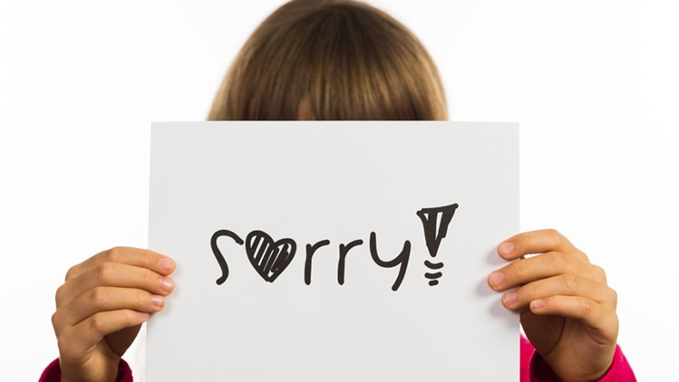
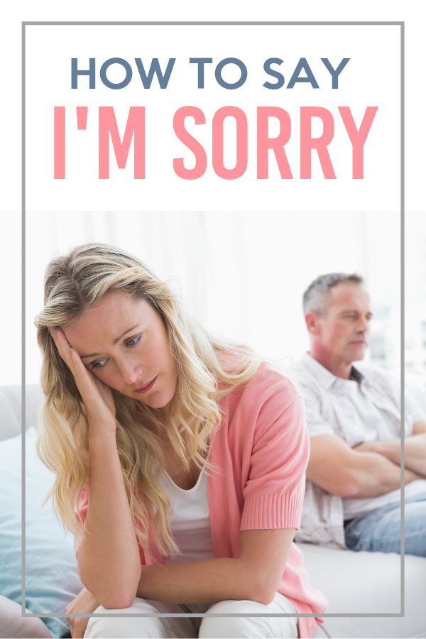

Slide 20
